Slide 1
Data Warehousing Concepts
Lesson 5: Online Analytical Processing (OLAP)

Slide 2
Lesson Objectives
In this lesson, you will learn about:
The concept of Online Analytical Processing
Need for Separate Operational and Informational Systems
Nature of OLAP analysis
Types Of OLAP
OLAP Service Tools
OLTP and OLAP
Operational versus Informational Systems

Slide 3
5.1: Online Analytical Processing (OLAP) Concept of OLAP
OLAP is a functionality available in Data Warehouse applications.
It enables client applications to efficiently access data in a Data Warehouse or Data Mart.
It is a multi-dimensional data model.
It contains a variety of possible views of information.
It simplifies evaluation of ad hoc complex queries.
It provides a very fast response time to ad hoc queries.
Notes:
Online Analytical Processing (OLAP):
OLAP is a category of software technology. It enables the users to gain insight into data through fast, consistent, interactive access to a wide variety of possible views of information, which has been transformed from raw data, to reflect the real dimensionality of the business.
It provides benefits like pre-aggregation of frequently required data, enabling a very fast response time to ad hoc queries. It gives a multi-dimensional data model that makes it easy to select, navigate, and explore the data.
OLAP systems enable managers and analysts to rapidly and easily examine key performance data. OLAP systems allow comparison and trend analysis even on very large volumes. OLAP allows users to view data from various perspectives. It is fast and easy because some aggregations are computed in advance.

Slide 4
5.2: Nature of OLAP Analysis Use of OLAP
OLAP analysis is used for:
Aggregation
Comparison
Ranking
Access to data
Complex criteria specification
Notes:
Nature of OLAP Analysis:
The nature of OLAP analysis varies with the multiple ways of using it.
It is used as the aggregation for summing up the data.
It provides the easy way of comparison.
It allows us to rank the data such that you will be able to find the top most and lower most values in the analysis.
It also helps in accessing the data in detailed way.
It allows to perform complex specification on the criteria.
It represents the data in a more simpler way such that it is easily visualized in terms of graphical presentation.
OLAP Analysis is used for:
Aggregation: (total sales, percent-to-total)
Comparison: Budget versus Expenses
Ranking: Top 10, quartile analysis
Access to detailed and aggregate data
Complex criteria specification

Slide 5
Where does OLAP fit in?
OLAP
Operational Data
Extraction
Transformation
Loading
Business Users



Data Warehouse Storage
Notes:
Nature of OLAP Analysis:
Where does OLAP fit in?
Data from various sources goes through the ETL process and is integrated into a Data Warehouse. Subsequently, OLAP is used to analyze the data in the Data Warehouse. OLAP focuses on meeting end-user’s analytical requirements.
Operational Data: It is the Customer Database, for example, Sales Database and Product Database.
End User: High performance is achieved by pre-planning the requirement for joins, summations and periodic reports by end users.
Extract Transform and Load (ETL):
Extract: It extracts data from data source and keeps it in staging.
Transform: It converts data into format required by Data Warehouse.
Load: It loads data to Data Warehouse.
DWH: Data Warehouse integrates and aggregates data from various operational and external data bases maintained by different Business Units.
OLAP: It has been in use to process and record transactions that create new data and update existing information in databases.
Business User: High performance is achieved by pre-planning the requirement and putting business rules by business users.

Slide 6
OLAP Models
OLAP models are of different types
The processing in all these different types is the same:
Online Analytical processing
The storage methods are different in different models
Different OLAP Models are
ROLAP
MOLAP
HOLAP

Slide 7
5.3: Types of OLAP ROLAP
Relational Online Analytical Processing (ROLAP):
It stores in a Relational form.
It stores Data Mart (Star schema).
Advantages:
It has no data size limitation.
It can leverage functions of RDB.
Disadvantages:
Each request must query the RDB.
ROLAP itself is limited to RDB functionality.
Notes:
Types of OLAP:
Relational Online Analytical Processing (ROLAP):
The data stored in the relational database gives the appearance of traditional OLAP’s slicing and dicing functionality.
In Relational OLAP (ROLAP), Relational DBMS stores Data Mart (Star schema).
Advantage:
ROLAP itself places no limitation on data amount.
Relational database already comes with a host of functionalities. ROLAP technologies, can leverage these functionalities since they sit on top of the relational database.
Disadvantage:
Each ROLAP report is essentially a SQL query (or multiple SQL queries) in the relational database. The query time can be long if the underlying data size is large.
ROLAP itself is limited to RDB functionality.

Slide 8
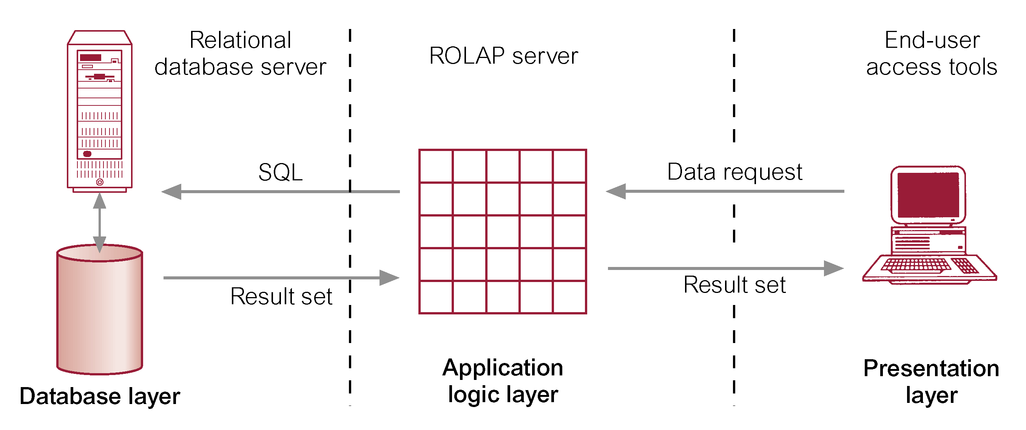
Architecture for ROLAP

Slide 9
5.3: Types of OLAP MOLAP
Multidimensional Online Analytical Processing (MOLAP):
Data is stored multi-dimensionally by using Multidimensional Databases (MDDB)
MDDB’s store data in the form of Multi dimensional cubes
MOLAP cubes are built for fast data retrieval and are optimal for slicing and dicing operations.
Advantages:
It has excellent performance.
It can return complex calculations.
Disadvantages:
It is limited in scope as definition of cube creates boundaries.
Limited volume of data is churned.
Notes:
Types of OLAP:
Multidimensional Online Analytical Processing (MOLAP):
In MOLAP, the data is stored in a multi-dimensional cube. The storage is not in the relational database, but in proprietary formats.
MOLAP storage structure is Array-based.
Advantage:
MOLAP cubes are built for fast data retrieval, and is optimal for slicing and dicing operations.
All calculations have been pre-generated when the cube is created. Hence, complex calculations are not only doable, they return quickly, as well.
Disadvantage:
In case of MOLAP, scope is limited as definition of cube creates boundaries.
It is not possible to include a large amount of data in the cube itself. This is because all calculations are performed when the cube is built. Only summary-level information will be included in the cube itself.

Slide 10
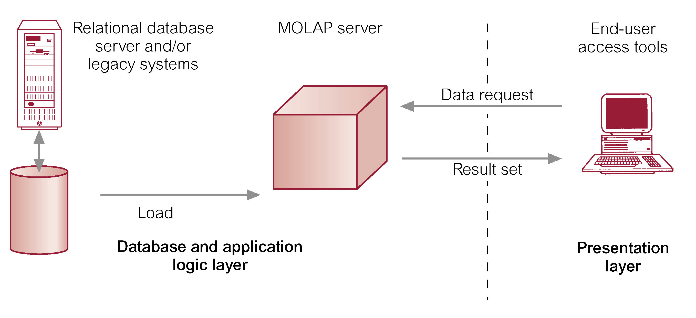
Architecture for MOLAP

Slide 11
HOLAP
HOLAP is the product of the attempt to incorporate the best features of MOLAP and ROLAP into a single architecture.
HOLAP systems stores larger quantities of detailed data in the relational tables while the aggregations are stored in the pre-calculated cubes.
HOLAP also has the capacity to “drill through” from the cube down to the relational tables for delineated data.
Notes:
This tool tried to bridge the technology gap of both products by enabling access or use to both multidimensional database (MDDB) and Relational Database Management System (RDBMS) data stores.

Slide 12
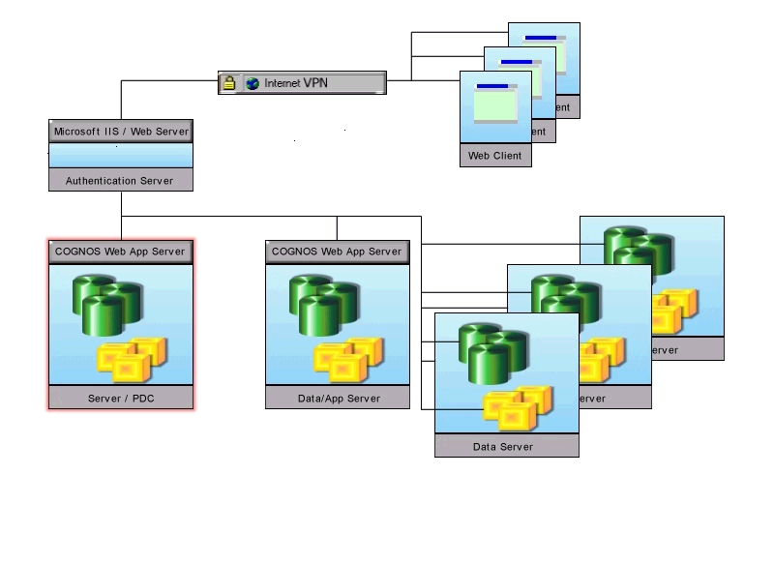
WOLAP Architecture
Web Based Online Analytical Processing: WOLAP, or Web-enabled OLAP, which uses a browser to deliver OLAP. The combination is powerful, say many business managers. The delivery capability of the Web, coupled with the business intelligence tool of OLAP, will allow a broader number of business analysts to benefit from the software.
Example :

Slide 13
Other OLAP tools
DOLAP – Desktop OLAP
MOLAP – Mobile OLAP
SOLAP – Spatial OLAP

Slide 14
Functional ROLAP Vs MOLAP
Tactical Strategic
Detailed Data
Simple Calculations
Analyze past trends
Summary Data
Complex Calculations
Predict future trends

Slide 15
Types of OLAP Operations
Different OLAP operations are:
Roll up (drill-up)
Drill down (roll down)
Slice and dice
Pivot (rotate)
Other operations:
Drill across
Drill through
DrillDown
RollUp
Europe
Asia
Africa
Region
Region
Country
Country
Country
Customer
Customer
Notes:
Types Of OLAP Operations:
Aggregation / Consolidation / Roll up (drill-up): Roll Up operation is used to summarize data by climbing up hierarchy or by dimension reduction. This allows you to aggregate data from lower level details to the parent level. For example, the total revenue generated by a particular product type will be the rolled up value of the revenue generated by descendants, that is, products that belong to that particular product type.
Drill down (roll down): Roll down operation is the reverse of roll-up, that is, a drill down from higher level summary to lower level summary or detailed data, or introducing new dimensions. It allows you to view data from a top-level to a detailed view by going down the hierarchy. For example, we can view the Sales data for the Year and drill down from the year level to a quarterly view and further down to a monthly view.
Slice and dice: It is a general term for viewing data from any angle.
Pivot (rotate): Rotate operation is used for reorienting the cube, visualization, 3D to series of 2D planes.
Other operations:
Drill Across: It involves (across) more than one fact table.
Drill Through: It involves drilling through the bottom level of the cube to its back-end relational.

Slide 16
5.5: OLTP and OLAP Concepts of OLTP and OLAP
OLTP: Online Transaction Processing:
OLTP is used to process and record transactions that create new data.
It updates existing information in databases.
OLAP: Online Analytical Processing:
Data is aggregated, warehoused, and then analyzed.
Users query and generate reports without modifying any data.
Notes:
OLTP and OLAP:
OLTP is basically operational data, wherein data is frequently changing.
For example, you can consider an online Railway Reservation system. A passenger books a ticket for two people. This becomes an operational data. S/He can also change the number of passengers travelling online since OLTP data is frequently updated.
On the other hand, OLAP data is non-operational data, wherein data is read-only data. It used for analytical purpose.
For example, suppose one wants to see, the number of trains running on the previous day. This becomes analysis of data that is not updatable.

Slide 17
OLAP Functional Requirements
Fast Access and Calculations
Speed is critical to maintain an analyst’s train of thought.
An analyst needs to navigate throughout the data which requires aggregations, or roll-ups.
Powerful Analytical Capabilities
There is more complicated calculations to OLAP than simple aggregations, or roll-ups.
Flexibility
Viewing: graphs, charts, row or columns
Definitions: format of numbers, name changes
Analysis: Sales analyze data differently than marketing
Interfaces: section wise, report looks

Slide 18
OLAP- Fast and Selective Access to Summarized Data
Department
PROD
A
c
c
o
u
n
t
i
n
g
Dept. Mgr. View
Actuals
Accounting Dir. View
Time
Budget Dir. View
Ad Hoc View

Slide 19
5.6: Operational versus Informational system Points of Difference
 | Operational (OLTP) | Informational (DW)
Typical User | Clerical | Management
System usage | Regular business | Analysis
Workload | Read/Write | Read only
Types of queries | Predefined | Ad-hoc
Unit of interaction | Transaction | Query
Level of isolation required | High | Low
No of records accessed | <100 | >1,000
No of concurrent users | Thousands | Hundred
Focus | Data in and out | Information out
Notes:
Note: The above table shows the comparison between OLTP and Data Warehouse.

Slide 20
Points of Difference
 | Operational (OLTP) | Analytical Systems
User | Clerk, IT Professional | Knowledge Worker
Function | Day to day operations | Decision support
DB Design | Application-oriented (E-R based) | Subject Oriented (Star, Snow flake)
Data | Current, Isolated | Historical, Consolidated
View | Detailed, Flat relational | Summarized, Multidimensional
Usage | Structured, Repetitive | Ad hoc
Unit of Work | Short, Simple transaction | Complex Query
Access | Read/Write | Read Mostly
Operation | Index/hash on prim. Key | Lots of scan
# Records accessed | Tens | Millions
#Users | Thousands | Hundreds
Db size | 100 MB-GB | 100GB-TB
Metric | Transaction throughput | Query throughput response
Notes:
Note: Above table depicts the comparison between Operational and Analytical systems.

Slide 21
Summary
In this lesson, you have learnt:
OLAP allows users to view data from various perspectives.
The nature of OLAP analysis varies in multiple ways of using it.
Aggregation
Comparison
Ranking
Access to data
Complex criteria specification

Slide 22
Summary
OLAP is used to analyze the data in the Data Warehouse.
Different types of OLAP are:
MOALP
HOLAP
ROLAP

Slide 23
Review Question
Question 1: OLAP analysis is used for:
Option 1: Retrieving data
Option 2: Updating data
Option 3: Summarizing data
Question 2: OLAP makes use of multidimensional data model.
True/ False
Question 3: ___ OLAP operation helps for viewing data from any angle.

