Slide 1
Automated Insight Report

Slide 2
📊 Executive Summary
Date Range: 2025-01-01 to 2025-01-05
Total Impressions: 68000
Total Clicks: 835
Total Spend: $1240

Slide 3
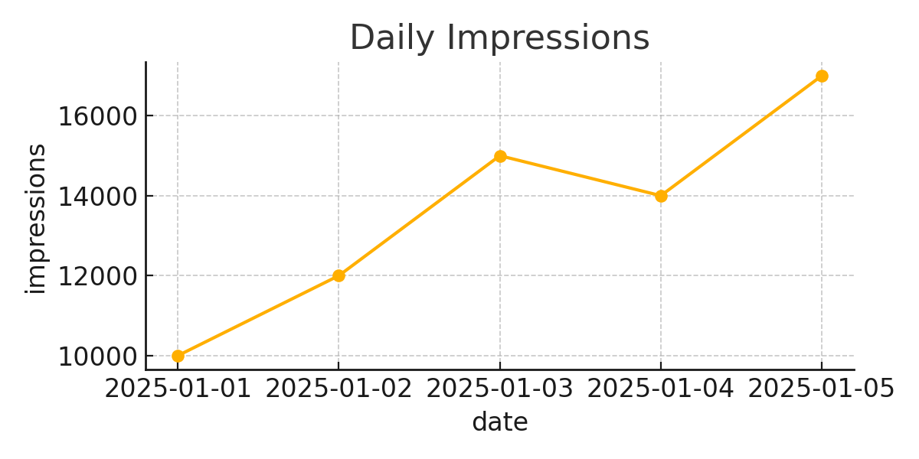
Chart1

Slide 4
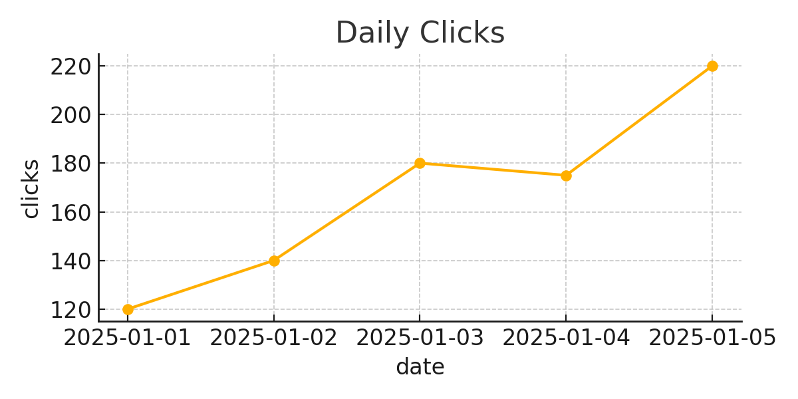
Chart2

Slide 5
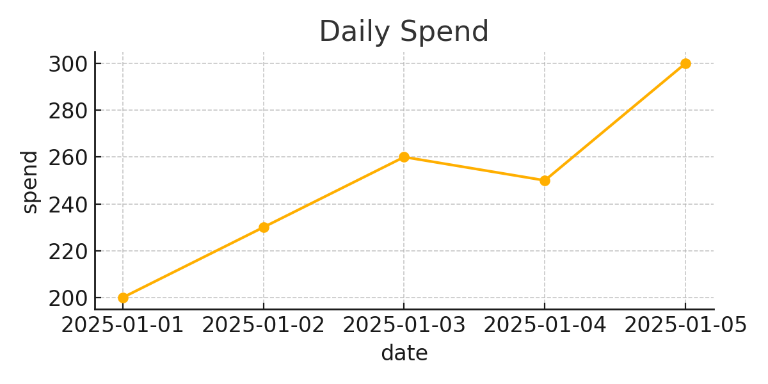
Chart3

