Slide 1
Automated Insight Report
Automated Insight Engine

Slide 2
Executive Summary
Rows: 4, Columns: 5.
Found 3 numeric columns.
Impressions: sum=37000.0, mean=9250.0, max=15000.0
Clicks: sum=170.0, mean=42.5, max=70.0
Spend: sum=430.5, mean=107.625, max=200.0

Slide 3
Dataset Summary
Rows: 4

Slide 4
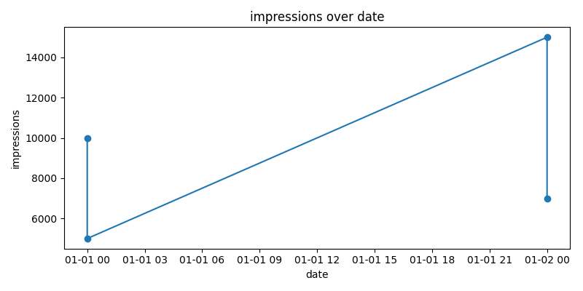
Impressions Over Time

Slide 5
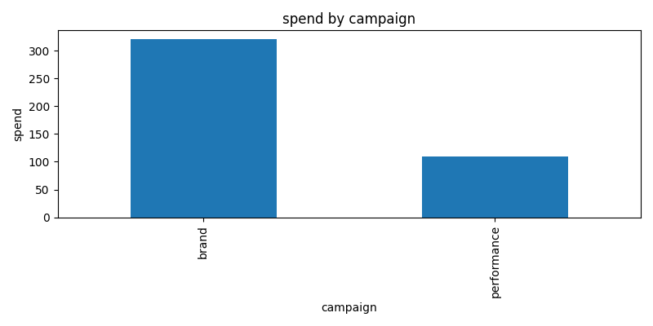
Spend by Campaign

