Slide 1
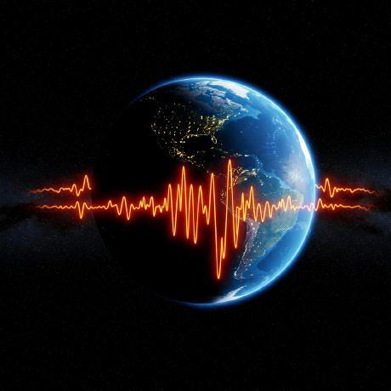
Global Seismic Trends
Priya Jeyakishore
DSGA_V2-S-WD-T-B14
2026
Data-Driven Earthquake Insights

Slide 2
Project Overview
🎯 Objective — Analyze global earthquake patterns using reliable USGS seismic data.
📊 Dataset — Explore 137,263 earthquake records across 27 data attributes.
🛠️ Tools & Technologies — Python • Pandas • MySQL • Streamlit • Plotly
🔎 Key Goal — Discover seismic trends, identify outliers, and highlight potential risk zones.
💡 Outcome — Transform raw earthquake data into meaningful, interactive, data-driven insights.

Slide 3
Data Loading & Collection
🌐 Data Source: U.S. Geological Survey (USGS)
🔗 Source: USGS Earthquake API
📅 Period: September 2021 – August 2026
📊 Records: ~137K earthquake events
📁 Format: JSON → Pandas DataFrame
🗄️ Storage: MySQL
🔄 Process: API → Python → Pandas → MySQL

Slide 4
Data Verification & Validation
✅ Source Verified: U.S. Geological Survey (USGS)
📊 Records Verified: ~137K earthquake events
📅 Date Range: September 2021 – August 2026
🌍 Geographic Validation: Latitude & longitude checked
🔢 Data Type Validation: Numeric, categorical & datetime columns verified
⚠️ Missing Values: Identified and handled during preprocessing
📈 Outlier Detection: Magnitude and depth checked using IQR method
🔁 Duplicate Check: Event records reviewed using event ID

Slide 5
Data Cleaning & Preprocessing
🗑️ Removed duplicate records using earthquake event ID
🔢 Converted data types for numeric and datetime columns
📅 Extracted time features — Year, Month, Day, Hour, Day of Week
🌍 Standardized location data — Country and geographic region
⚠️ Handled missing values in important numerical and categorical fields
📏 Validated ranges for magnitude, depth, latitude and longitude
📊 Detected outliers using the IQR method
🏷️ Created derived categories such as magnitude and depth categories

Slide 6
MySQL Database & SQL Analysis
🗄️ Database: MySQL
📋 Table: cleaned_earthquake_data
🔗 Connection: Python + SQLAlchemy + PyMySQL
📊 Data Storage: Cleaned earthquake dataset loaded into MySQL
🔍 SQL Analysis: Used SELECT, WHERE, GROUP BY, ORDER BY, CASE, and aggregate functions
📈 Insights Generated: Magnitude, depth, country, tsunami, alert level, temporal and geographic analysis
⚡ Purpose: Efficient querying and structured analysis of large earthquake data

Slide 7
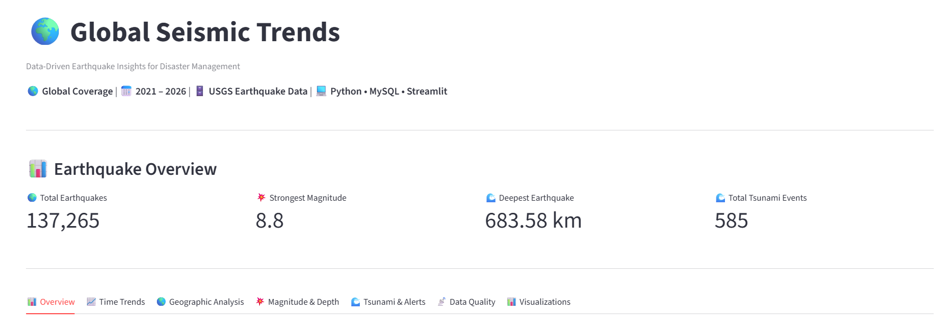
Streamlit Dashboard
🖥️ Built an interactive dashboard using Streamlit.
🔗 Connected MySQL data with Python and displayed analysis results.
📈 Created visualizations for magnitude, depth, trends, tsunami, alerts, and geographic activity.
📑 Organized insights into tabs for easy exploration.

Slide 8
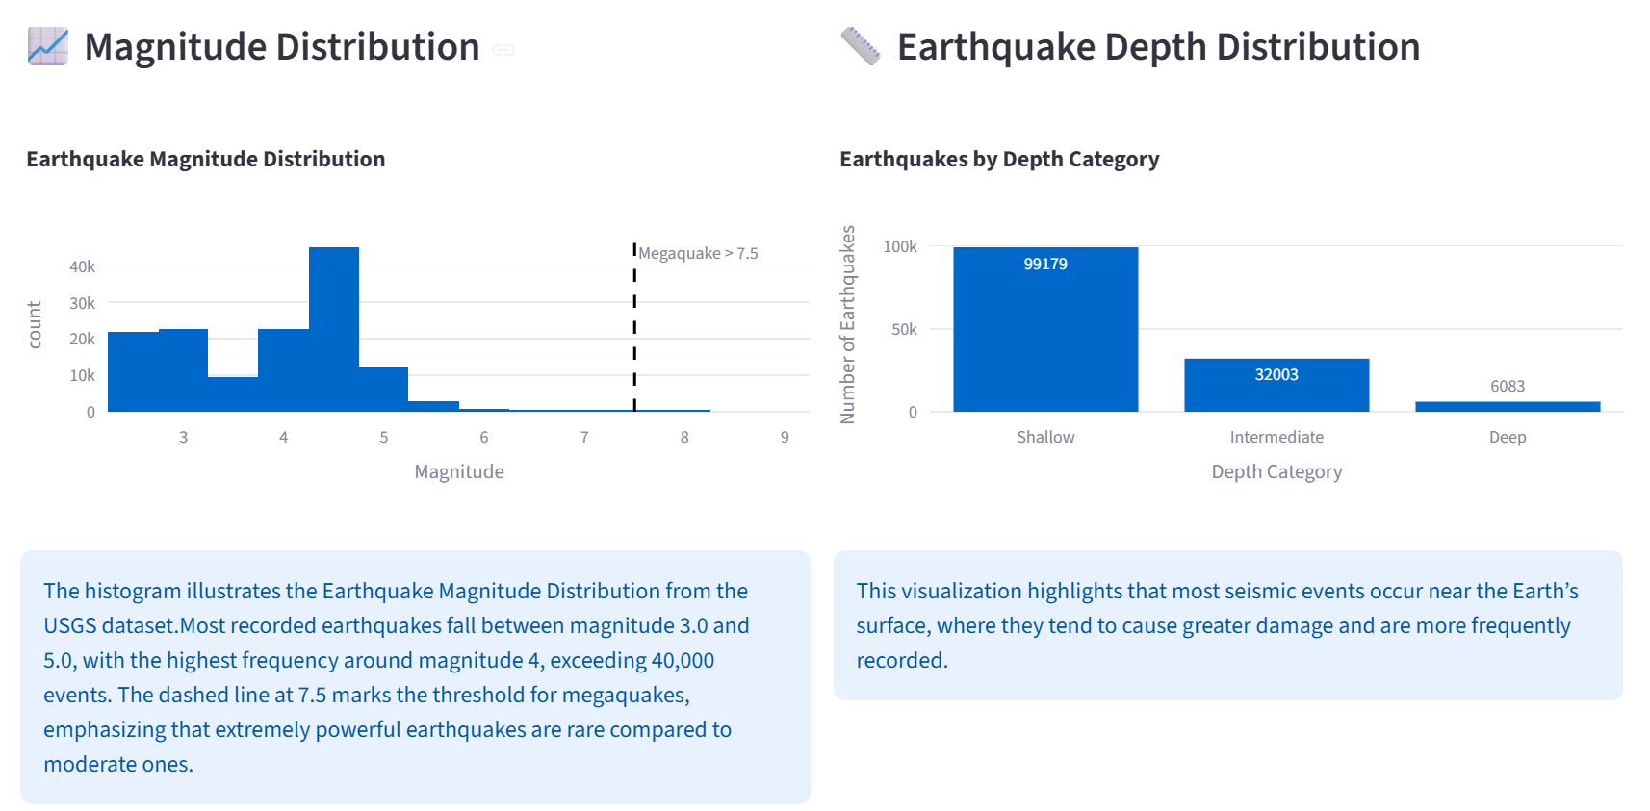
Magnitude & Depth Analysis

Slide 9
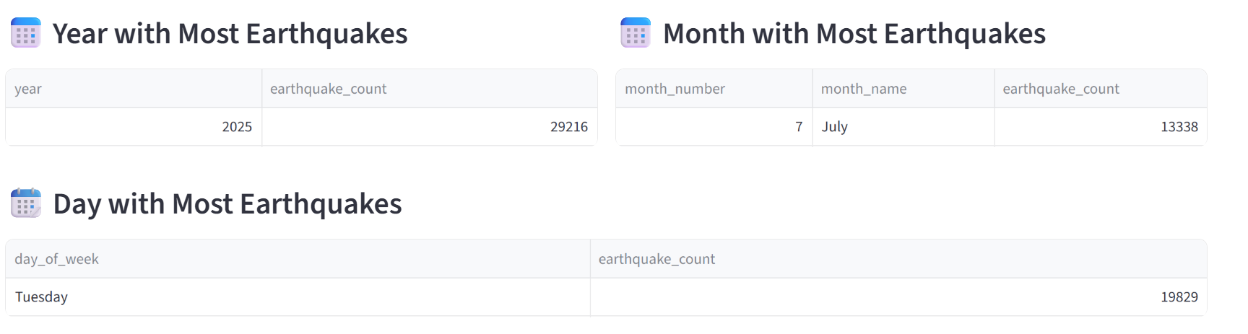
Time Trends
📅 Earthquake activity shows noticeable variation across different time periods. Certain years and months record higher earthquake frequencies, while long-term trends highlight changes in global seismic activity.

Slide 10
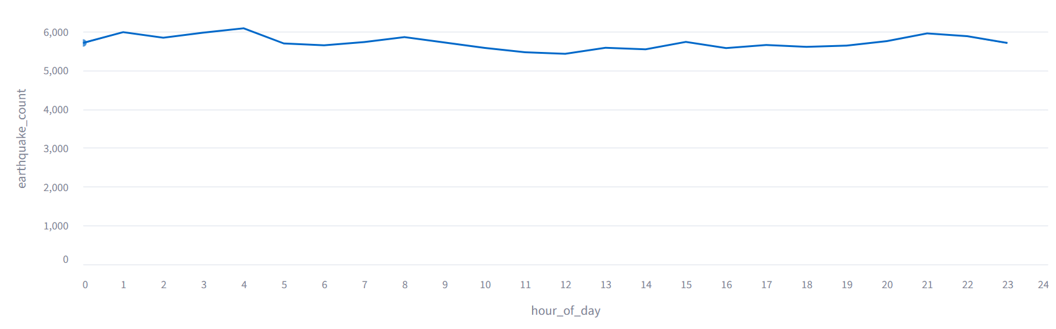
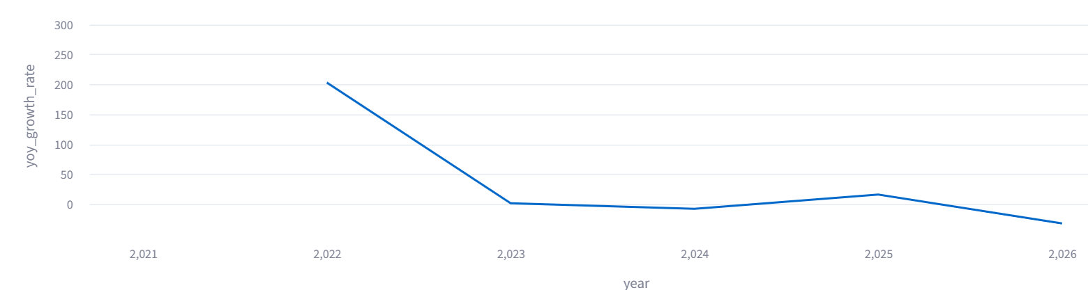
🕐 Earthquakes by Hour
📈 Year-over-Year Growth Rate

Slide 11
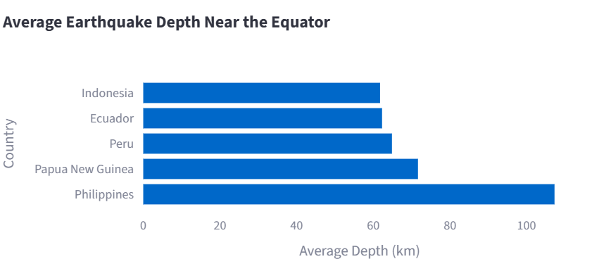
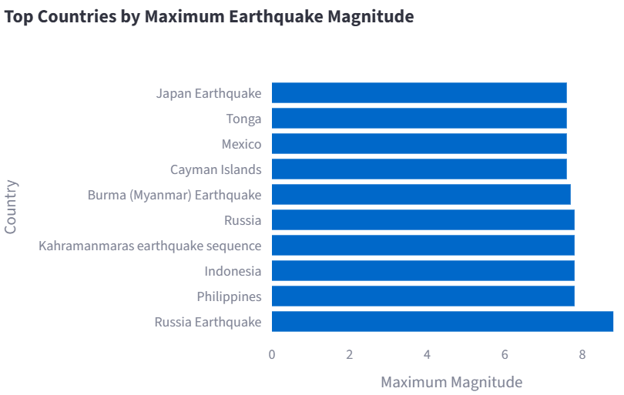
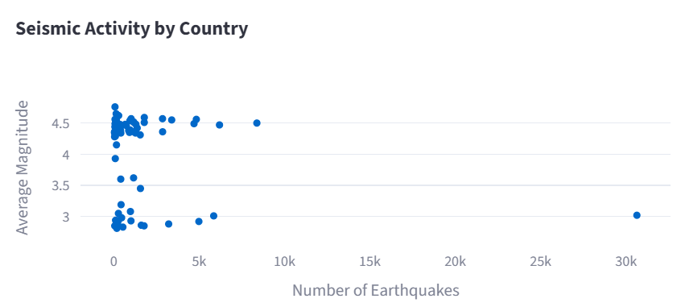
Geographic Insights
🌐 Earthquake activity is concentrated in specific tectonically active regions. Countries around the Pacific Ring of Fire generally show high earthquake frequency and significant magnitudes. Equatorial regions also display distinct depth patterns.

Slide 12
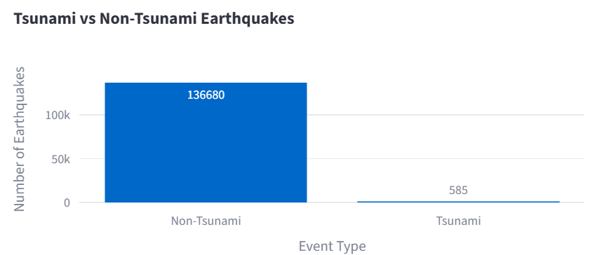
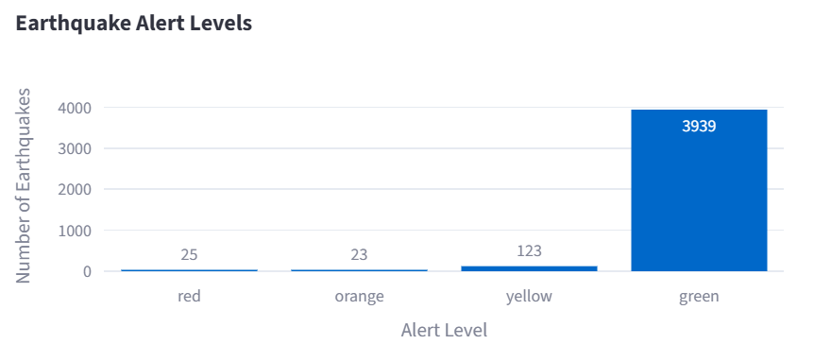
Tsunami and Alerts
🌊 Tsunami Insight: Only a small proportion of recorded earthquakes are associated with tsunami indicators. Alert levels are concentrated in the lower categories, while higher alert levels represent relatively rare and potentially more significant events.

Slide 13
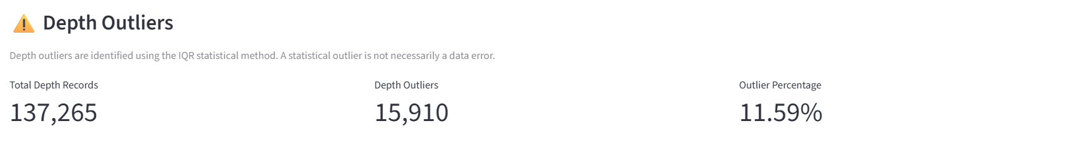
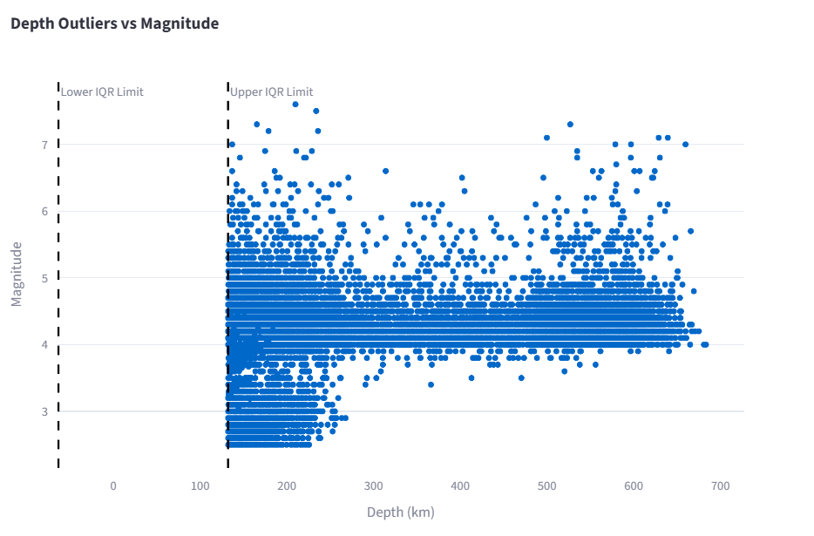
Data quality & Reliability
📌Outlier Insight: 15,910 earthquake depth values (11.59% of valid depth records) are identified as statistical outliers using the IQR method. Many of these values can represent legitimate deep-focus earthquakes rather than incorrect measurements.

Slide 14
Key Findings
🌍 Regional Hotspots — Earthquake activity is strongly concentrated in tectonically active regions, especially around the Pacific Ring of Fire.
📊 Magnitude Patterns — The majority of recorded earthquakes are moderate in magnitude, while high-magnitude events are relatively rare.
🌊 Depth & Impact — Shallow, high-magnitude earthquakes represent important events due to their greater potential surface impact.
⏳ Temporal Trends — Earthquake occurrence varies across years and time periods, revealing noticeable fluctuations in seismic activity.
🌊 Tsunami Potential — Although tsunami-associated earthquakes form a smaller share of total events, they are significant for disaster-risk assessment.
🚨 High-Risk Events — Combining magnitude, depth, location, and tsunami indicators helps identify earthquakes requiring greater attention.

Slide 15
Future Scope
🤖 Machine Learning Prediction — Develop ML models to identify seismic patterns and predict potential high-risk events.
⚡ Real-Time Monitoring — Integrate live USGS data to continuously track earthquakes and update the dashboard.
🗺️ Advanced Risk Mapping — Build interactive GIS-based hazard maps to identify earthquake hotspots and vulnerable regions.

Slide 16
Thanks!

