Slide 1

XYZ-COMPANY SALES ANALYSIS
DATA CLEANING
DATA PROCESSING
DATA ANALYSIS
DATA INSIGHTS

Slide 2
OBJECTIVE
XYZ is a new company and built a startup in year 2022. The company wants to create a sales report and
Compare monthly total bill amount on the bases of zones , states and years.
Compare sampling qty year wise.
Compare the total percentage of items on the basis of RDS Type.
*The data has been taken for year 2022 ie (Nov , Dec ) and year 2023 ie (Jan , Feb , Mar , Apr , May , Jun ).

Slide 3
Compare monthly total bill amount on the bases of zones , states and years.

Slide 4
Compare sampling quantity year wise.

Slide 5
Compare the total percentage of items on the basis of RDS Type.

Slide 6
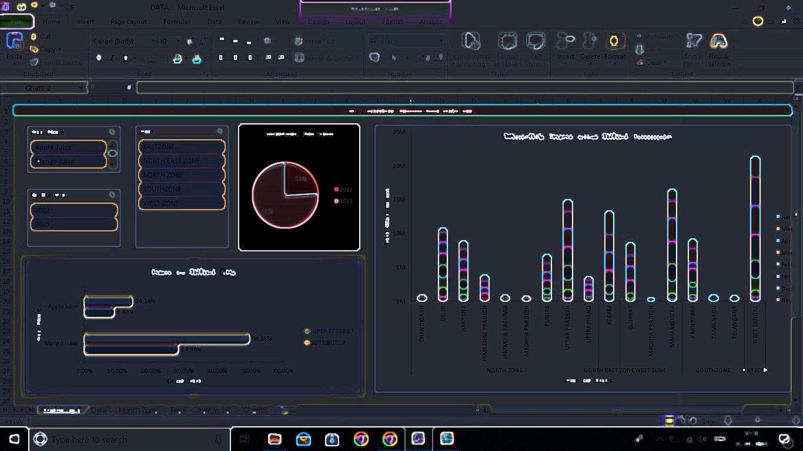
Dashboard
Click on DASHBOARD

Slide 7
Observations
In 2022, there has been highest sales in North region specially Delhi.
In 2023,there has been highest sales in West Bengal (East Zone).
Sampling has been done more in 2023 ie.(Jan,Feb,March,April,May,June)
Mango Juice billed qty under duper stocklist is more.
Recent Sales growth in Madhya Pradesh(in June).

Slide 8
Thank You For Watching

