Slide 1


Social Buzz Company Analysis

Slide 2


Today's agenda
Project recap
Problem
The Analytics team
Process
Insights
Summary

Slide 3

Social Buzz, founded in 2008 by two former engineers from a major social media conglomerate, has rapidly grown to over 500 million monthly active users. Focused on content, the platform emphasizes user reactions, with over 100 ways to engage beyond traditional likes and comments.
Project Recap

Slide 4

Problem
Operates with anonymity, emphasizing user reactions on content
Faces challenges in handling vast amounts of unstructured data from 100,000 daily posts
Employs 200 technical staff out of a total of 250 employees
Seeks external expertise for:
Preparation for an upcoming IPO
Efficient management of the current scale
Learning data best practices from experienced firms

Slide 5



Andrew Fleming
Chief Technical Architect
The Analytics team
Marcus Rompton
Senior Principle
Priya Kundu
Data Analyst

Slide 6
Process
1
Data Understanding
2
Data Cleaning
3
Data Modeling
4
Data Analysis
5
Drawing Insights

Slide 7

Insights
How many unique categories are there?
How many reactions are there to the most popular category?
What was the month with the most posts?

Slide 8
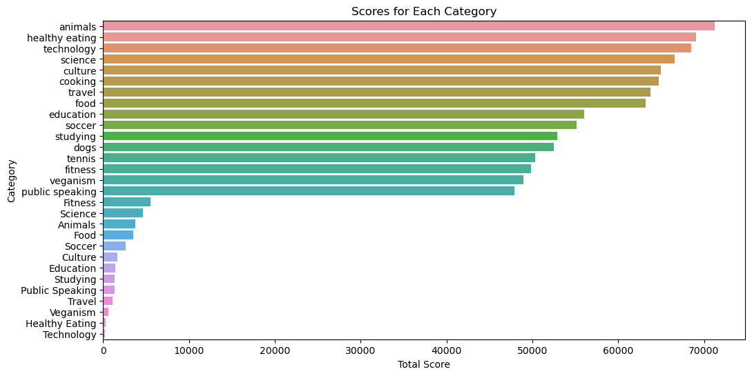
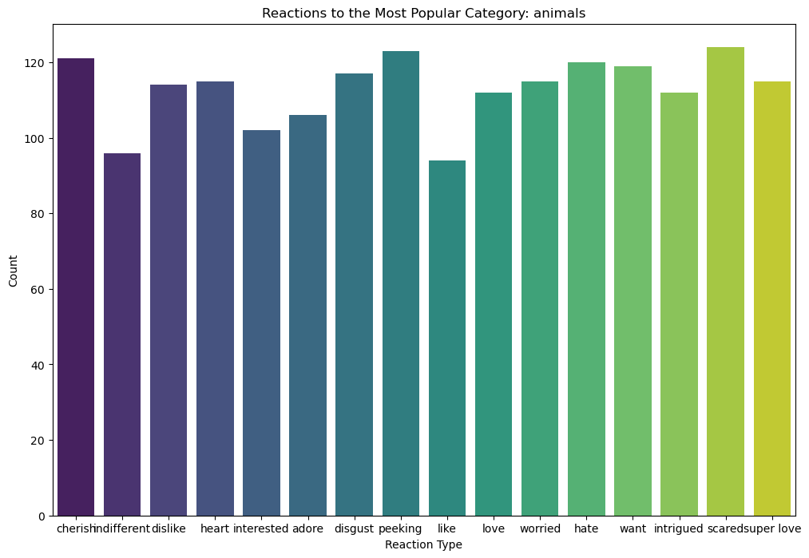
Most Reactions to Animal Category:
The "Animal" category has the most reactions.
This could indicate that content related to animals is more engaging or elicits stronger emotional responses from the audience compared to other categories.
Frequent Reactions to Animal Category:
The reactions "Scared," "Disgusted," and "Cherished" are the most frequent in response to content in the "Animal" category.
This suggests a diverse range of emotional responses to animal-related content, including fear, disgust, and positive emotions like cherishing. It could be that the "Animal" category includes a variety of content, some of which might be thrilling or scary, while others may be heartwarming.

Slide 9
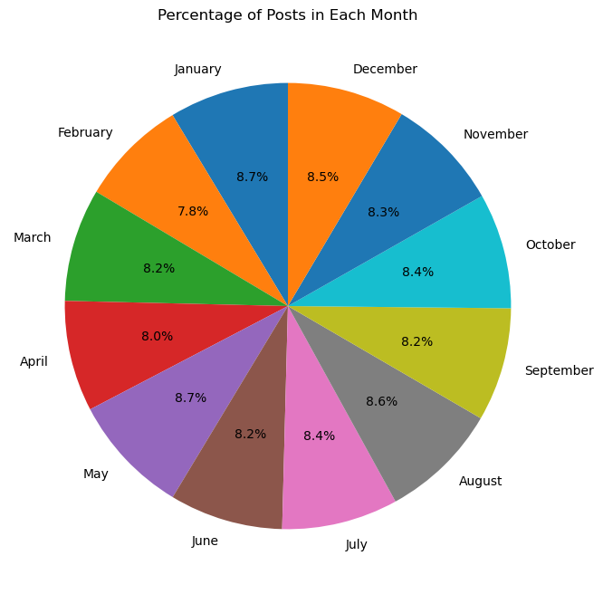
Posts in January and May:
There is a higher frequency of posts in January and May.
This might suggest that there are certain events, seasons, or trends that are more prominent in these months, leading to an increased level of content creation.

Slide 10
The previously mentioned insights can inform content creators and analysts about the trends and preferences of the audience. It may be valuable to explore and create more content related to animals, considering the varying emotional responses observed, and to pay attention to the specific characteristics of content that receive high engagement in January and May.
Summary

Slide 11

Thank you!
ANY QUESTIONS?

