Slide 1

Micro-Credit Defaulter
Submitted by:
PRIYAL AGARWAL

Slide 2
Project Introduction : Micro Finance Services
This project is based on Microfinance services (MFS). A Microfinance Institution (MFI) is an organization that offers financial services to low-income populations.
Microfinance allows people to take on reasonable small business loans safely, and in a manner that is consistent with ethical lending practices.
We are working with one such client that is in Telecom Industry from Indonesia. They have launched various products and have developed its business and organization based on the budget operator model, offering better products at Lower Prices to all value conscious customers through a strategy of disruptive innovation that focuses on the subscriber.
So before launched various products Microfinance services (MFS) becomes very useful when targeting especially the unbanked poor families living in remote areas with not much sources of income.

Slide 3

Problem Statement
Build a Classifier model which can be used to predict in terms of a probability for each loan transaction, whether the customer will be paying back the loaned amount within 5 days of issuance of loan.
The Consumer is believed to be defaulter if he deviates from the path of paying back the loaned amount within the time duration of 5 days. For the loan amount of 5 (in Indonesian Rupiah), payback amount should be 6 (in Indonesian Rupiah), while, for the loan amount of 10 (in Indonesian Rupiah), the payback amount should be 12 (in Indonesian Rupiah).

Slide 4


Mathematical/ Analytical Modelling of the Problem
In the provided dataset, our target variable "label" is a categorical with two categories: " defaulter " and " Non- defaulter ". Therefore, we will be handling this modelling problem as classification.
Non- Defaulter : Label ‘1’ indicates that the loan has been payed
Defaulter : Label ‘0’ indicates that the loan has not been payed.
Data Source :The sample data is provided from FlipRobo’s client database.

Slide 5




Exploratory Data Analysis Steps
Data Features Check
Null Value Check
Correlation Check
Statistics Check
Extract feature information about dataset such as number of rows ,columns and data types of the different features.
In this dataset, we have 209593 rows with 36 features.
Check for the null values present in our dataset via heatmap.
No null values are present in our dataset.
Then using visualization checked the correlation of features with each other and output features.
Few columns were highly correlated with each other ~90%.
part tells about the statistics i.e. mean, median, max value ,min values ,75% and it also gives some sort of outliers’ analysis .
Few outliers were present n the data.

Slide 6



Data Preprocessing Steps
Data Cleaning/Dropping
Checking Data-Skewness
Removing Outliers
Now we dropped some features which are less important or not affecting the outcome variable
For further processing, also dropped some less important features that has values which might not be realistic.
Now, we checked for the distribution of data with the help of hist plot ,whether it is left skewed or right skewed
Observed that many features are right skewed , so further treated it via sqrt method.
Checking for outliers using z-score by considering threshold value=3.
Observed that we cannot remove all the outliers because more than 20% of data is removed using this method.

Slide 7
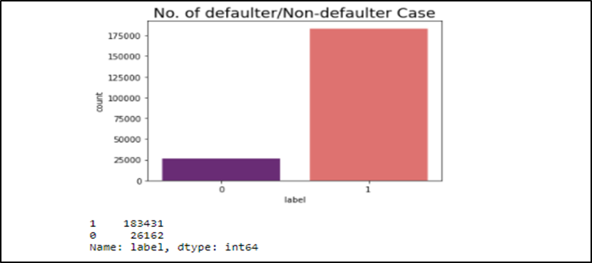
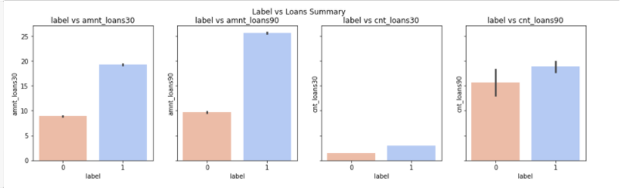
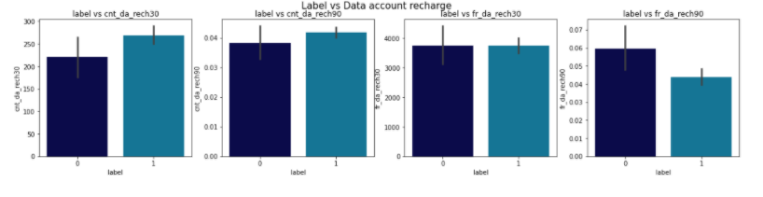
Visualization
Count Plot
We see the number of defaulter and non defaulter cases with the help of count plot.
Then we visualize by plotting different variables with our target variable(Labels) to understand the relationship between different features.
Bi-Variate Loan Summary
Bi-Variate Data Account Recharge Summary

Slide 8
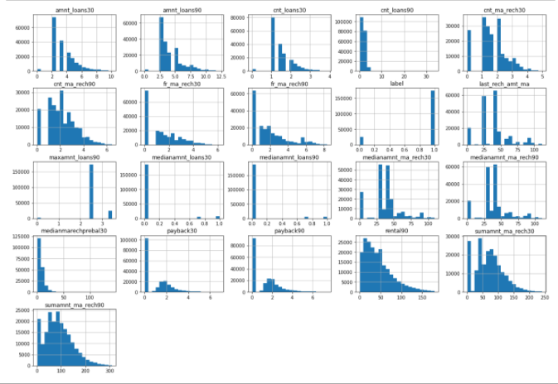
Visualization
HIST PLOT For Data Distribution
We plotted histogram for more information regarding to all numerical features.

Slide 9
Modeling Parts
We know that this is Classification Problem so we use accuracy score, classification report and confusion matrix as our evaluation matrix.
We will also see the AUC score and also plot the AUC_ROC curve for our final model.
Imbalanced dataset is normalized for final modeling.
After splitting the data for input and output Standard-Scalar is applied to standardize the input data.
After train test split applied all the classification algorithms with hyper tuning to find the best scoring one.

Slide 10
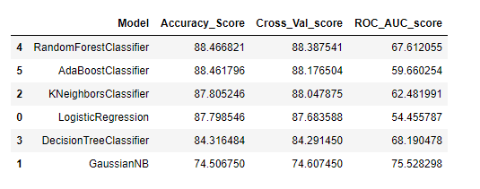
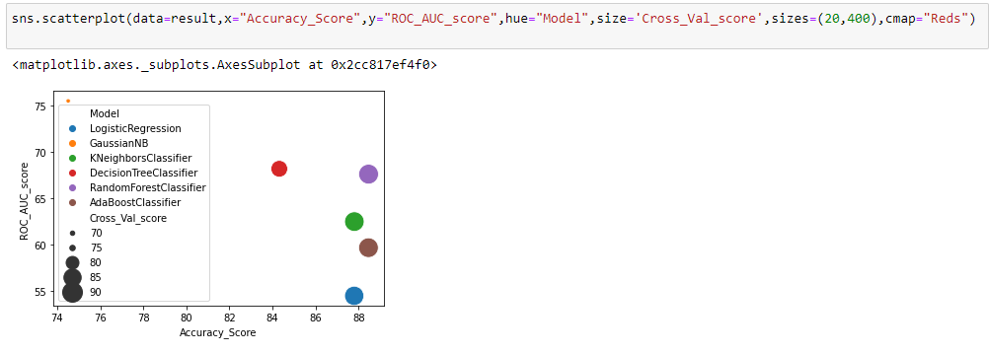
Finalized Model
After applying all the above classification algorithms on the dataset, we see that Random Forest Classifier has highest score for Accuracy, precision , recall and ROC_AUC_Score as compared to other models.
Before selecting final model, cross validation done to avoid under fitting and over fitting of the model.
The finalize model has not much difference between cross validation score and accuracy score.
Plotted AUC_ROC Curve for the final model.
We save our final model as a pickle file with the help of Joblib.
Model Summary
Accuracy vs AUC Score

Slide 11
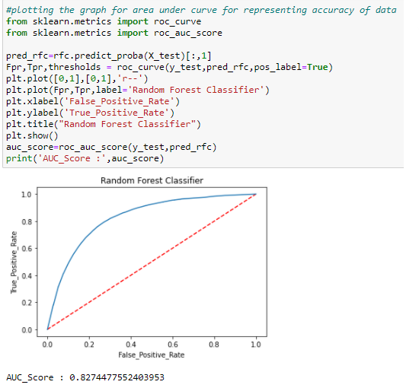
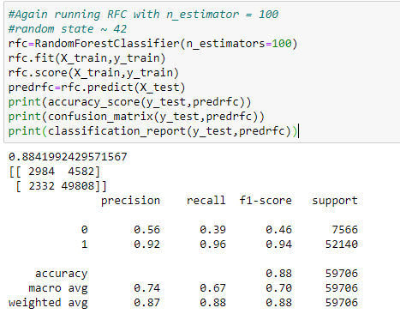
Finalized Model
ROC AUC Curve
Final Model - Classification Report

Slide 12
Conclusion
Taken output variable as 'label'(it has 0 - defaulter and 1- non defaulter)
Found best model as Random Forest Classifier which provides max accuracy score of 0.88.
Fine tuning done on the model and found best estimators (n_estimator=100) for the prediction.
Plotted AOC/ROC line that shows close match between test and predicted values.
Overall model fit is good.
By removing some more outliers, present in dataset the results might improve.
With the help of this project deserved people will get loan more easily & quickly. Being a part of this project and reducing poverty is a proud feeling & motivation.

