Slide 1
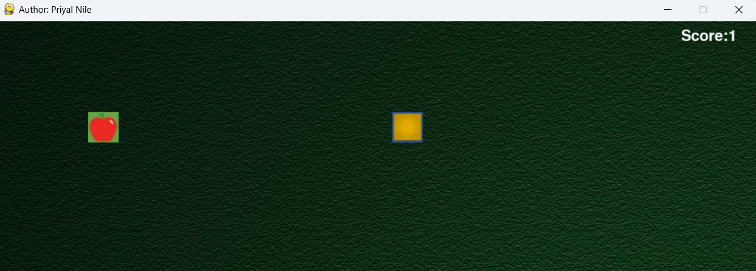




Pygame module
Game.exe
Python
OOP
Git & GitHub
(version control)
Visual Studio
Code
auto-py-to-exe

Slide 2



Game
Pygame module initialization
Pygame mixer music initialization
Display for window game size
Class Objects:
Snake Object
Apple Object
Functions:
Collision Detection Function
Display Score Function
Background music play function (throughout the session is on)
Play sound function (when apple is eaten by snake)
Render Background image function
Game Over function:
Pause Music
Display game over message
Give option to continue when Entered and Escape to exit
Snake & Apple Object re-initialize/reset
Run function logic:
Event Handling from UI
Mouse Exit (close the game)
Keyboard Key options:
Escape(Quit)
Up,
Down,
Left
Right
Enter(Return)
Play function:
Snake.Walk
Apple.Draw
Self.Display_Score
Collisions:
When Snake colliding/eating Apple,
When Snake Colliding with itself,
When Snake Colliding with boundaries of window
Apple
Drawing Screen to put it upon
Apple Image load
Apple X,Y Co-ordinates for placement/creation
Drawing Apple
Moving Apple (randomly)
Snake
Drawing Screen to put it upon
Snake Image load
Snake X,Y coordinates for creation/placement
Initial direction to move
Function:
Draw (To draw all blocks as per length)
Increase Length
Move Functions: Left, Right, Up, Down
Walk (head position and entire body blocks position)

Slide 3
