Slide 1
HACK4PASHUDHAN · VERDANT IMPACT · TEAM ID H4P-VC587GBK
Spillover Radar
One Health surveillance that links animal signals, climate and human health, explains every alert, and tracks the 48-hour response.
VetTech Trio
Parth Kantharia (4th Year B.V.Sc Student Mumbai Veterinary College) · Priyal Kantharia (ML Engineer) · Rahul Bhojkar (Data & ML)
Notes:
Open with the one-line promise: animals often show trouble first; we connect that signal to climate and human data, explain it, and track the response clock.

Slide 2
THE CHALLENGE
Animal warning signs and human cases live in different systems
India has 535M+ livestock; zoonotic spillover is a district-level problem with no district-level shared view.
Fatal data silos
Late cross-sector awareness
Alerts without reasons
Animal cases sit in NADRES, human fever in IDSP/IHIP, weather in IMD. No shared district view.
Unusual livestock deaths or abortions can precede human cases, but no system links them early.
Officers receive a flag without knowing what drove it, which slows verification.
60%+
of emerging infectious diseases are zoonotic
535M+
livestock in India
100M+
rural households depend on livestock
Sources: WHO/WOAH/UNEP/FAO One Health Joint Plan of Action 2022-2026; 20th Livestock Census.
Notes:
Three gaps. Keep the stats short; cite the One Health Joint Plan of Action and the 20th Livestock Census.

Slide 3
CHALLENGE ALIGNMENT
One platform covering all three deliverables
Every item below is implemented in the working prototype (run.py).
D.01
D.02
D.03
Geospatial heatmaps & corridors
Multi-sector data pipeline
Early anomaly detection
Risk-scored map markers + heatmap
Livestock corridors, width = volume
Corridor exposure index, 5 km buffers
Week replay and case replay
Animal + human + climate per district-week
Live weather (Open-Meteo), CSV adapter
Completeness tracking, missing is not zero
Lag correlation animal vs human
Weighted 0-100 risk score
Isolation Forest + CUSUM change-points
Two explanation views per district
2-week trend projection
Notes:
Map each card to the challenge text. D.01 map, D.02 pipeline, D.03 detection.

Slide 4
SYSTEM ARCHITECTURE
From raw feeds to an explained, tracked alert
Five stages, one Python file, runs on a laptop.
1 DATA
2 FUSION
3 DETECTION
4 SERVER
5 DASHBOARD
Animal: abortions, deaths, PPR/FMD, vaccination
Human: febrile illness
Climate: temp, rainfall
Simulated / CSV / case replay / Open-Meteo live
District-week table
Completeness check
Missing is not zero
Lag correlation
Weighted risk 0-100
Isolation Forest
CUSUM change-point
Attribution
Python http.server
GET /api/districts.json
POST report, ack, refresh
Alerts + webhook
Map + corridors
Explainability
Alert Center, 48 h clock
English / Hindi / Marathi
›
›
›
›
Planned, not yet built: NDVI and flood/drought indices, cattle-density normalisation, live NADRES/IDSP connectors, district polygons.
Notes:
Walk left to right. Emphasise that every data source is labelled live, CSV, scenario or simulated.

Slide 5
D.03 METHOD
Transparent score, plus two independent detectors
The 0-100 score is a readable composite; machine learning is a second opinion, not a black box.
RISK SCORE (weekly, per district)
Isolation Forest
VetDistress = 2.5×Abortions + 4.0×Deaths
+ 1.5×PPR/FMD
ClimateStress = 1.8×TempSpike
+ RainDeficit% / 15
VaccineGap = (1 − coverage) × 10
Risk = 100 × ( 0.50·Vet + 0.25·Clim
+ 0.25·Gap )
300 trees on all district-weeks. Flags unusual combinations; counted only if risk is above the cohort mean.
CUSUM change-point
Detects when weekly animal distress shifts. Run on human fever too, to measure how early animals warned.
CRITICAL ≥70
WATCH 40–69
NORMAL <40
Each term capped at its reference level (60 / 10 / 10)
Weights are heuristic; vets can retune them live in the dashboard.
Notes:
Be upfront: the score is a heuristic composite; Isolation Forest and CUSUM confirm it. Weights need veterinary calibration.

Slide 6
EXPLAINABILITY
Every alert says why it is red
Example: Barmer, Rajasthan (simulated data). Two views, so officers can cross-check.
A. Score composition
B. Isolation Forest attribution
BARMER, RAJASTHAN
88.6
Livestock deaths, abortions & PPR
56%
Livestock deaths, abortions & PPR
56%
Thermal shock & rainfall deficit
24%
Thermal shock & rainfall deficit
33%
CRITICAL
Vaccination coverage deficit
19%
Vaccination coverage deficit
11%
Isolation Forest: 100/100
CUSUM change-point: Wk 4
Human fever: 14 cases/wk
Data completeness: 100%
Targeted field action Dispatch the veterinary rapid response team within 48 h, verify reports, sample herds, restrict movement along exposed corridors, alert the District Health Officer.
Notes:
Two views: weighted share of the score, and Isolation Forest occlusion attribution. Say association, not causation. Do not call it SHAP.

Slide 7
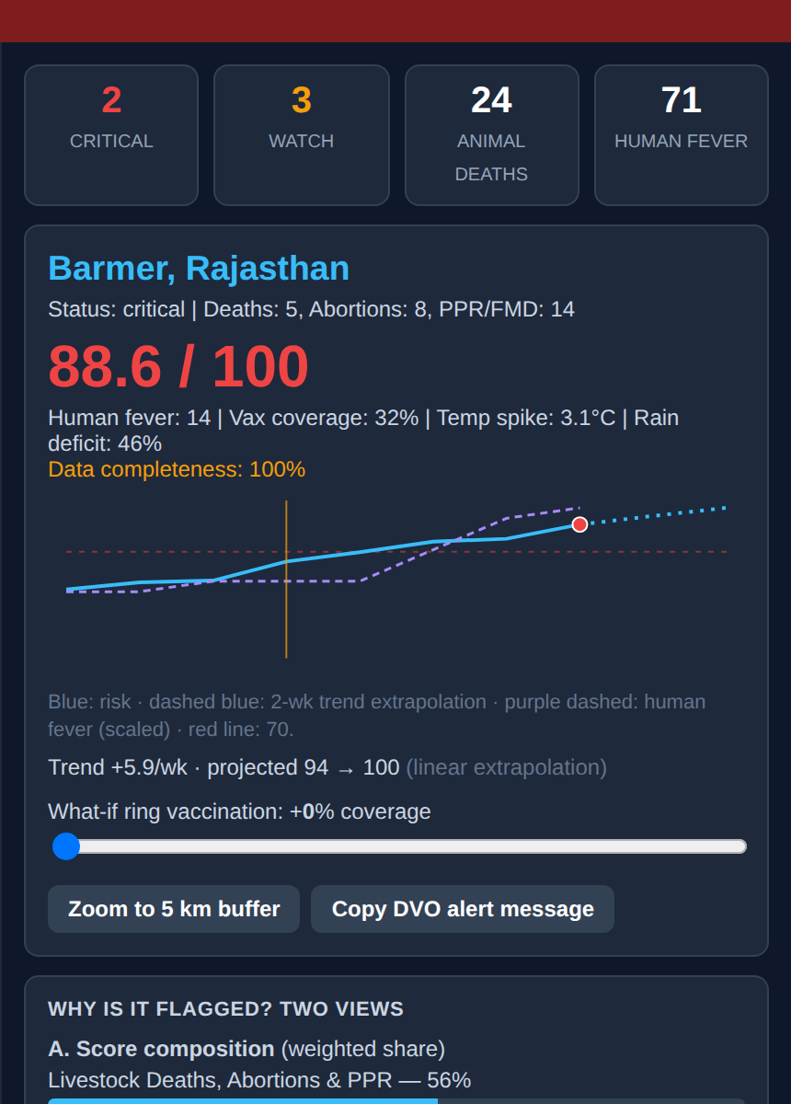
COMMAND DASHBOARD
One screen from signal to decision
Real screenshot of the working dashboard (simulated data).
Score, trend and what-if
Two-week projection, and a ring-vaccination slider showing the score drop.
Two explanation views
Score composition and Isolation Forest attribution side by side.
Expert calibration
Sliders and presets (vector-borne, vaccine-preventable) re-weight the score live.
Field-ready
English, Hindi and Marathi; copy-ready alert message for the District Veterinary Officer.
Exports
Situation report (.txt) and scores (.csv) in one click.
Notes:
Walk the screenshot top to bottom: score, trend and what-if, two explanation views, protocol.

Slide 8
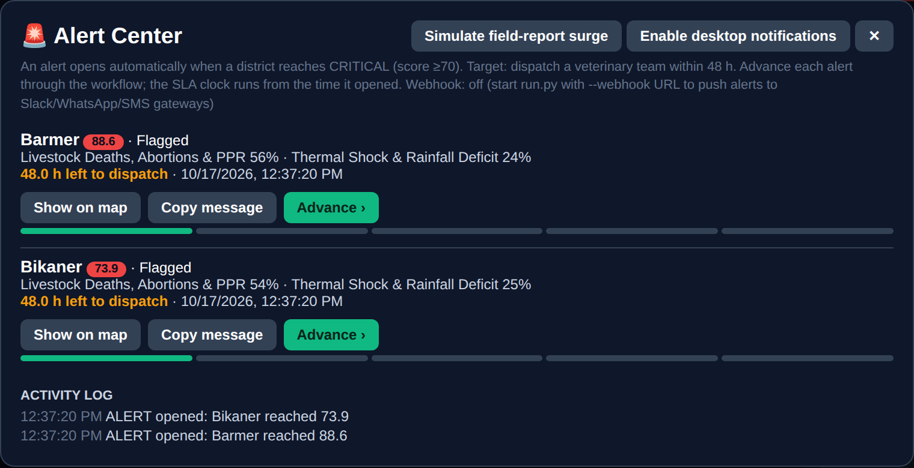
RESPONSE WORKFLOW
Alerts that run against a 48-hour clock
Target: veterinary team dispatched within 48 hours of a CRITICAL flag.
Alert Center
Bell, red banner, pop-up with SLA countdown.
Field-report intake
A vet submits counts; the model re-scores and the map updates.
Webhook
Push new alerts to Slack, WhatsApp or SMS gateways.
Flagged
›
Verified
›
Team dispatched
›
Samples sent
›
Closed
48 h SLA clock runs from alert open to team dispatched (first two steps)
Notes:
This is the differentiator: detection is not enough, we track the response. Show the Simulate surge button live.

Slide 9
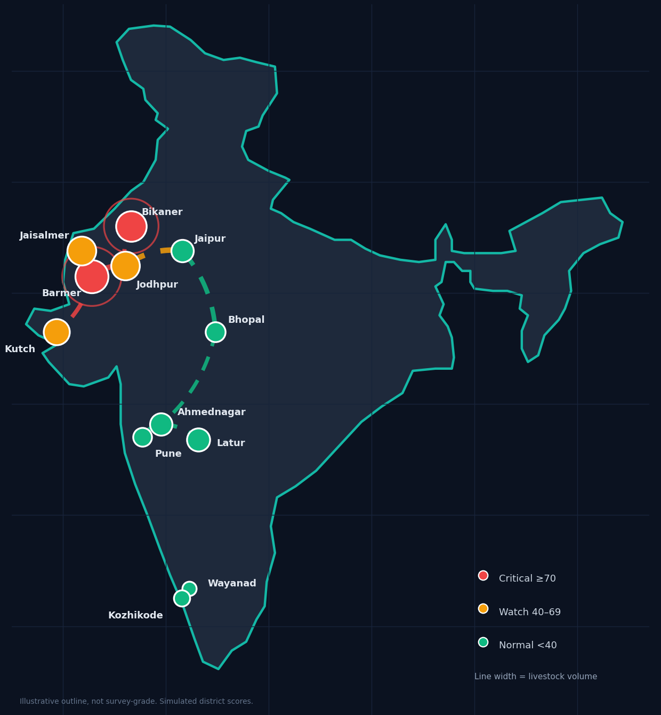
D.01 SPATIAL INTELLIGENCE
Risk map, corridors and downstream exposure
Where risk is, and where it may travel next.
Risk markers and heatmap
Score on every district; critical ones pulse.
Livestock corridors
Line width = movement volume, colour = risk.
Corridor exposure index
Origin risk x volume x unvaccinated share; flags where to pre-position teams.
5 km buffers
A configurable search radius, not a validated containment perimeter.
Replay
Week-by-week playback and documented case replay.
Illustrative outline with district scores from the demo data. Live dashboard uses a real Leaflet basemap.
Notes:
Map image is a prototype rendering; the live dashboard uses Leaflet with Esri or OpenStreetMap basemaps.

Slide 10
TRUST, EVIDENCE & ROADMAP
Built to be checked, with its limits stated
Judges and officers should be able to see what is real and what is simulated.
Data trust
Evidence we can show
Limits and next steps
Completeness per district; missing report is not zero disease
Header chips: Live / CSV / Scenario / Simulated
Field reports fill gaps and re-score instantly
Case replay: lead time against official confirmation week
Animal vs human change-point lead: median 3.0 wk (synthetic, n=4)
Lag correlation across 0-4 weeks
Demo data is synthetic; validate on documented anthrax / HPAI outbreaks
Weights are heuristic; needs veterinary calibration
Next: NADRES/IDSP connectors, NDVI, district polygons
Notes:
Be candid. The honesty is a strength. Lead time numbers here are on synthetic data and say so.

Slide 11
THE TEAM
VetTech Trio: clinic meets code
The interdisciplinary mix One Health needs.
Parth Kantharia
Priyal Kantharia
Rahul Bhojkar
TEAM LEAD & VETERINARY LEAD
ML ENGINEER
DATA & ML ENGINEER
4th Year B.V.Sc. & A.H., Mumbai Veterinary College (MAFSU)
Computer Engineering
Electronics & Telecommunication Engineering
Syndromic classification, triage rules, One Health validation
Pipeline, server, GIS dashboard, alert workflow
Isolation Forest, change-point detection, attribution
github.com/priyalk16/spillover-radar · Prototype for decision support; confirm alerts via lab and field investigation.
Notes:
Close with the team and the repository.

