Slide 1
Screens for Retailer

Slide 2

HoofPrint
Select Logistic Partner
Hello Mr. Order Manager
DASHBOARD
22
75
51
ORDER
SHIPMENT
All Orders
All Shipments
Shipments Delivered
PARTNERS
Select no of days
Select no of days
Order Summary
Shipment Summary

Slide 3
HoofPrint
Select Logistic Partner
Hello Mr. Order Manager
DASHBOARD
5
Pending for Transfer
ORDER
View Orders
5
Add Orders
Transferred
To LP
SHIPMENT
PARTNERS
Order Code | Date | No of Shipment | Logistics Partner | Status
123456 | 30/12/2018 | 2 | ABC
123456 | 30/12/2018 | 2 | ABC
123456 | 30/12/2018 | 2 | ABC
123456 | 30/12/2018 | 2 | ABC
123456 | 30/12/2018 | 2 | ABC
123456 | 30/12/2018 | 2 | ABC
123456 | 30/12/2018 | 2 | ABC
123456 | 30/12/2018 | 2 | ABC
In progress
5
Ready to Ship
Ready to Ship
In Progress
5
Fulfilled
Exception
Transferred
Transferred
5
Exception
Transferred
Fufilled

Slide 4
HoofPrint
Select Logistic Partner
Hello Mr. Order Manager
DASHBOARD
ORDER SUMMARY
OTHER DETAILS
ORDER
Code :
Rejection Reasons:
Description :
Rejection Date :
View Orders
Status :
Add Orders
Date:
SHIPMENT
Comments :
PARTNERS
SHIPMENT DETAILS
No | Code | Type | Quantity | Weight | Special Condition | Source Address | Destination Address | Pick Up Date | Deliver Date | Status
1 | aaa | Fragile | 3 | 2 | RT | Aaa | Vvv | 1111 | Wwww | Delivered
2
3
4
5
The text of this button will change depending on order status
TRANSFER ORDER
BACK

Slide 5
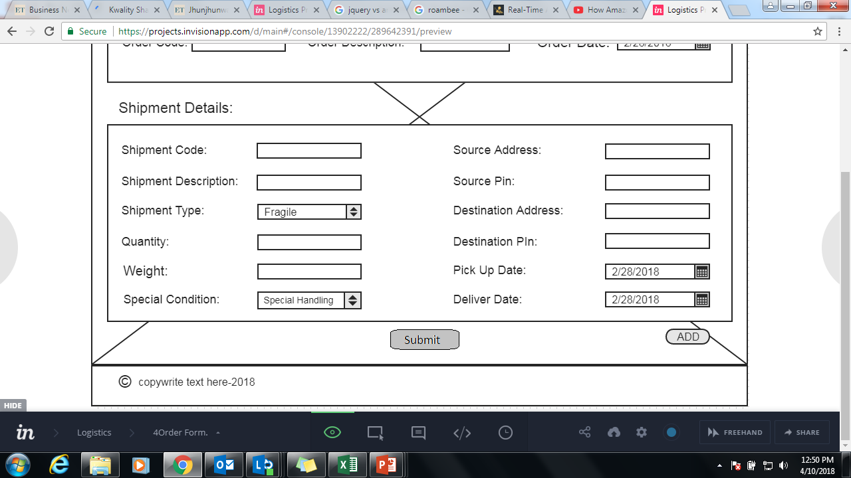
HoofPrint
Hello Mr. Order Manager
ADD ORDER SUMMARY
DASHBOARD
Code :
ORDER
Description :
View Orders
Date:
Add Orders
Comments :
SHIPMENT
Merchant :
Select Logistic Partner
PARTNERS
ADD SHIPMENT DETAILS
SAVE
BACK

