Slide 1
Jira Agile and Portfolio plugin
Presented by : Priya Lohakare

Slide 2
Agenda
Introduction to JIRA
Jira Agile
Agile Boards
Introduction to Portfolio Plugin
Making a Portfolio Plan
Planning Estimates
Demo

Slide 3
Introduction to JIRA
JIRA is a commercial software product developed by Atlassian to be used for bug/issue tracking and project management.
Three Key components in JIRA are:
Project
Workflow
Issue

Slide 4
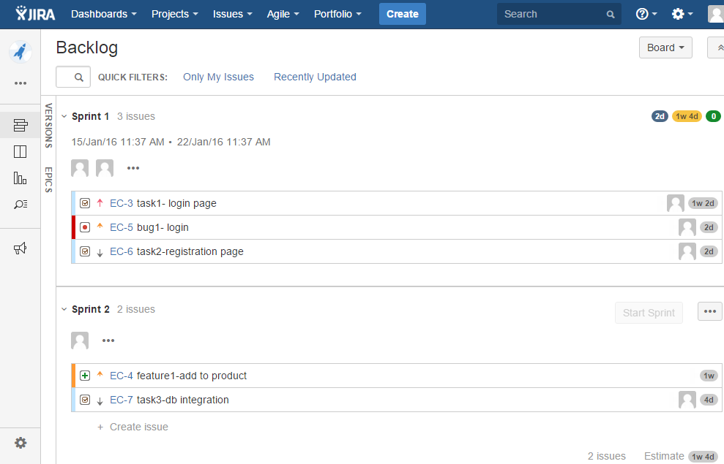

Slide 5
Agile Boards
Provides visibility
View the status of all the issues at glance and transition issues through workflow system
Scrum Board – To plan our work in sprints
Kanban Board – To manage and constraining our work in progress

Slide 6
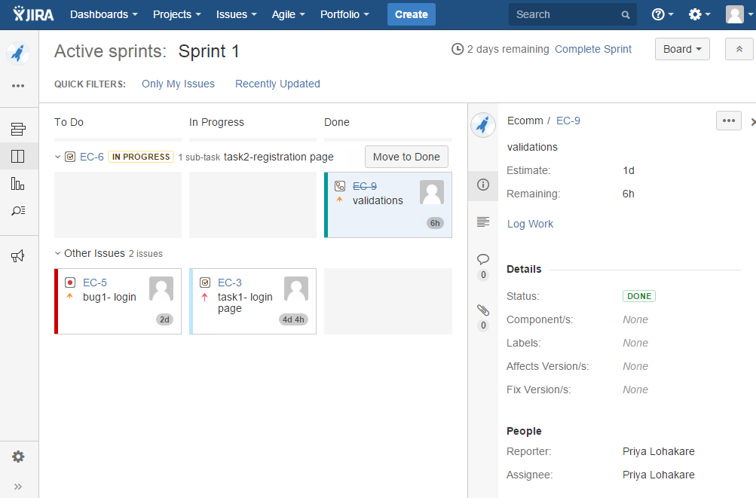
Scrum Board

Slide 7
Portfolio Plugin
Plan and Manage across software teams and projects
Get clear visibility across all team projects
Portfolio makes planning faster
Manages team availability and skills
Optimizes your schedule and forecast release dates
Clear visibility of status & progress of any initiative
Plan “what-if” scenarios on ever changing project priorities

Slide 8
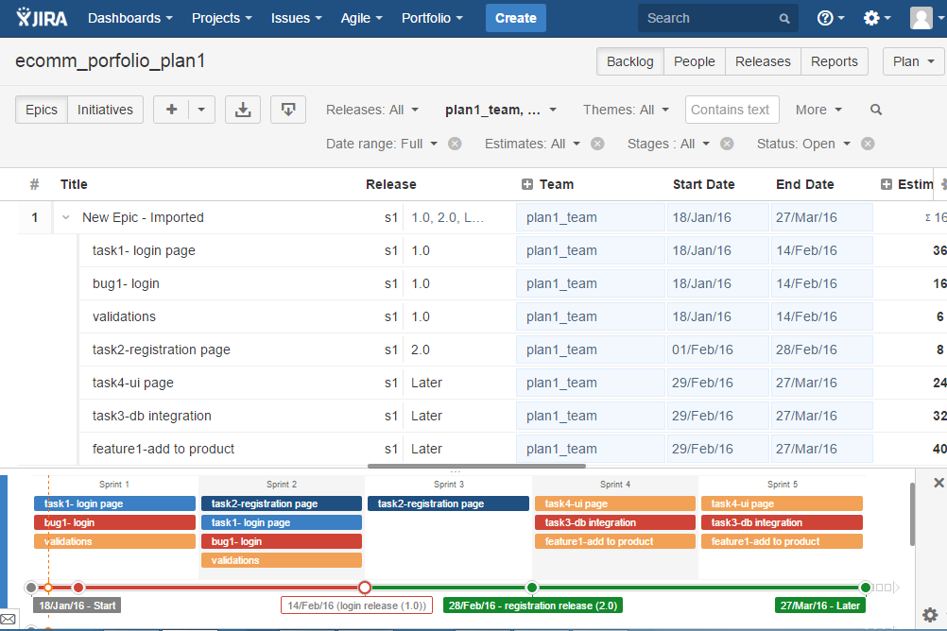

Slide 9
Any Questions?

Slide 10
Thank you!

