Slide 1


FISHEYE-CRUCIBLE
Presented by : Priya Lohakare

Slide 2
Agenda
Overview
Why FishEye-Crucible
Getting started
FieshEye Features
Crucible Features
Crucible workflow
Jira integration
When FishEye is integrated with Crucible
Demo

Slide 3
Overview
FishEye is a revision-control browser and search engine owned by Atlassian, Inc.
Crucible is a collaborative code review application by Australian software company Atlassian.
Used for browsing any repositories e.g. Svn, mercurial, perforce ,git

Slide 4
Why FishEye-Crucible
FishEye allows you to extract information from your source code repository and display it in sophisticated manner
Crucible allows you to request , perform and manage code reviews
It can be integrated with all Atlassian Products
Less maintenance
Link source with JIRA issues, crucible code review and Bamboo builds

Slide 5
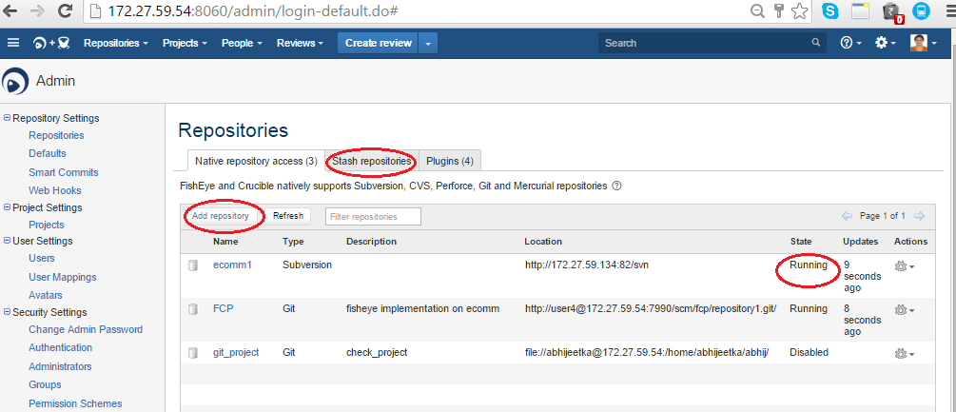
FishEye
Search, track, and visualize code changes
Add a repository
Administration->Repositories->Add repository
Can directly add with STASH repositories

Slide 6
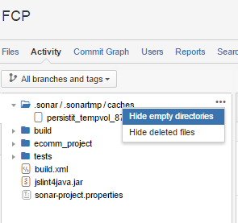
Fisheye Features
Hide empty directories and deleted files
Watch a repository
Tools->Watch

Slide 7
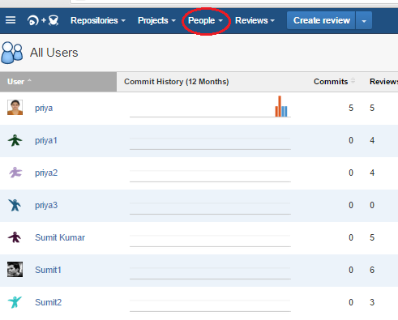
Viewing People’s Statics
Viewing people’s statics

Slide 8
Smart Commits
Using smart commits:
Smart commits allow repository committers to perform actions such as transitioning JIRA issues or creating Crucible code reviews by embedding specific commands into their commit messages
Basic command line syntax
The command line syntax for a commit comment is:
<ISSUE_KEY> #<COMMAND> <optional COMMAND_PARAMETERS>
Eg. <DEMO-22>#comment commit1
JRA-123 #time 2d 5h
Fix a bug +review CR-TEST @jcage @skhan

Slide 9
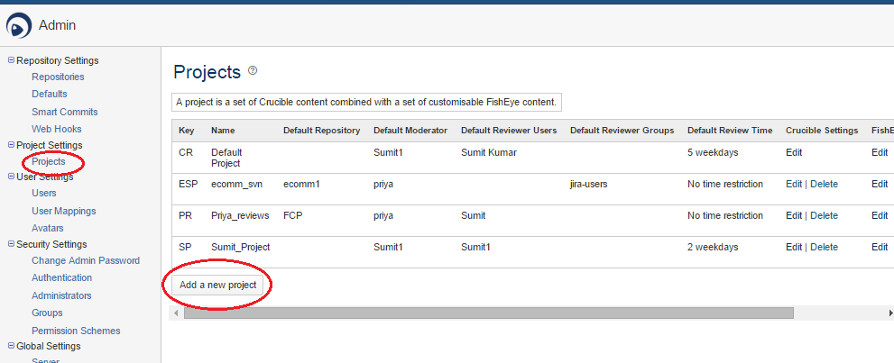
CRUCIBLE
Collaborative peer code review
Create a project in Crucible

Slide 10
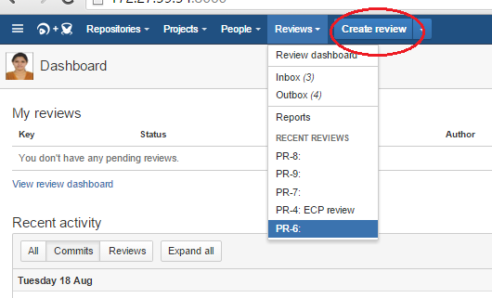
Crucible Features
Creating a review

Slide 11
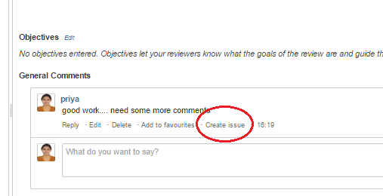
Creating issue in JIRA
Creating issue in JIRA
.

Slide 12
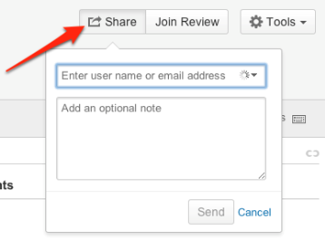
Review Reminders
Review Reminders(SMTP Configuration required)
When a review has a deadline (due date), you can have Crucible send a preset

Slide 13
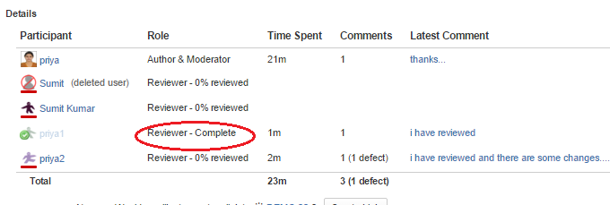
Progress Tracking
Progress Tracking
Crucible tracks the ones you have viewed.

Slide 14
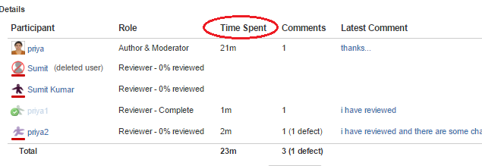
Time Tracking
Time Tracking
Crucible will automatically track the time you spend in a Crucible review.

Slide 15
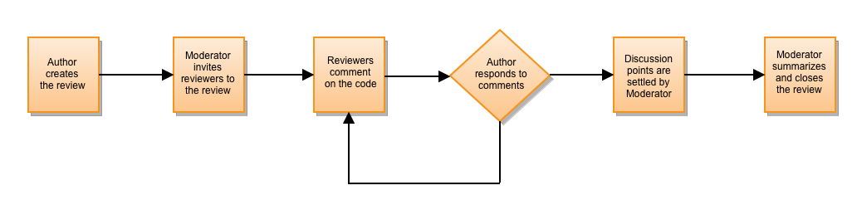
Crucible Workflow
Authors: Usually the creator of the code; the person who will act on the review's outcome.
Reviewer: A participant that will comment on the source files in the review, raising points and discussion on the work that was done.
Moderator: Usually the person who starts the review and is responsible for deciding the outcomes and closing it.

Slide 16
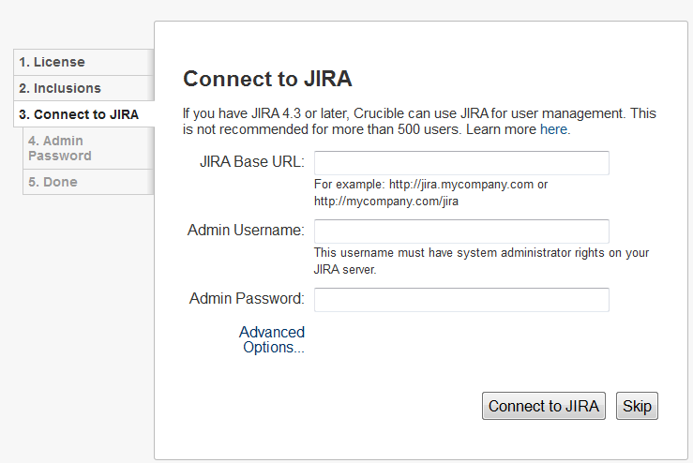
JIRA Integration
The setup wizard allows you to configure the JIRA connection automatically.

Slide 17
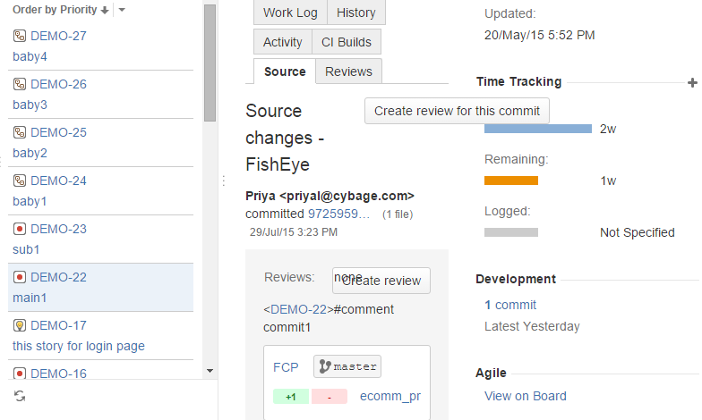
FishEye is integrated with JIRA
When FishEye is integrated with JIRA you can:
Use smart commits to transition JIRA issues
Delegate user and group management to JIRA
View an issue's FishEye changesets

Slide 18
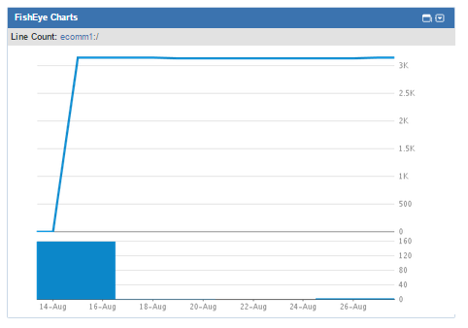
FishEye Charts Gadget
4. Add the FishEye Charts Gadget to your JIRA dashboard
Use smart commits to create Crucible reviews, add reviews to new reviews and update an existing review.

Slide 19
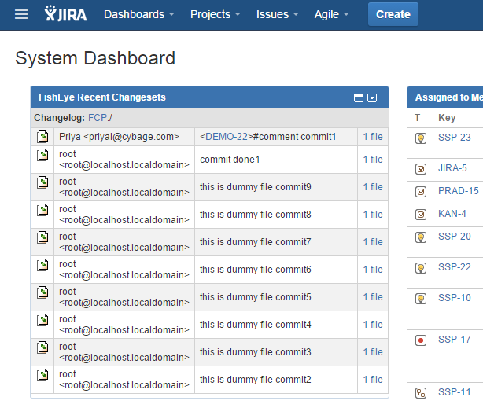
FishEye Recent Changesets Gadget
5. Add the FishEye Recent Changesets Gadget to your JIRA dashboard

Slide 20
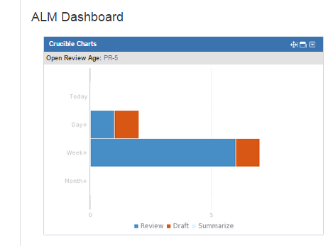
Crucible is integrated with JIRA
When Crucible is integrated with JIRA, you can:
Transition JIRA issues
View an issue's Crucible reviews
Add the Crucible Charts Gadget

Slide 21
When FishEye is integrated with Crucible
Use smart commits to create Crucible reviews, add reviews to new reviews and update an existing review
Files and changesets displayed in activity streams (e.g. the dashboard activity stream) render as links to the relevant files/changesets
See your content roots and repositories associated with projects.
See repository lists and browse repositories using the Files tab.
View charts or code metrics.

Slide 22
Any Questions?

Slide 23
Thank you!

