Slide 1



E-BOOK DICTIONARY
Information Technology (Semester - 4)
Guided by:
-Prof. Phenil Buch
-Prof. Michele Mistry
Prepared By:
Krupali Dobariya (18DIT014)
Priyal Ramani (D19DIT082)

Slide 2
Contents
Problem Statement
Current System and its limitations
Scope
Consolidated list of Requirements.
Hardware and Software Requirement
Project Definition
Snapshots
Limitations
Future Scope
Conclusion
References.

Slide 3

Problem Statement
To find meaning of difficult words from the document, we have to copy that word and paste it in Google.
It is time consuming task so instead of that we are developing this system.
To find meaning of selected word from any e-document or any other desktop applications without active internet connection.

Slide 4
Current System and its limitations
Copy & search on internet
Time consuming & tedious
Internet is mandatory.

Slide 5
Scope
Easy to access
Less time
Accurate

Slide 6
Consolidated list of Requirements:
Python
NLTK
Pyperclip
Tkinter

Slide 7
Hardware and Software Requirement
Hardware
Software
Intel(R)core(TM) i3-3200
2.00 GB RAM
Operating System:
Windows 7, Linux
Development language: Python

Slide 8
Project Definition
When you read some document and to know meaning of difficult word just copy that word and it will display the meanings of that word in pop-up window.
This is an offline software which does not need internet connectivity. You can know the meaning of words without internet connection.
Lots of similar suggestion is also provided in pop-up window where you can know the meaning of some more similar words.

Slide 9
Project Definition
Just copy the word (Ctrl + c).
It shows lots of meanings and synonyms.
NLTK(Natural Language ToolKit) – Searching of meaning and synonyms.
Pyperclip – Use the functionality of clipboard (i.e Copy).
Tkinter – Displaying result in pop up box.

Slide 10
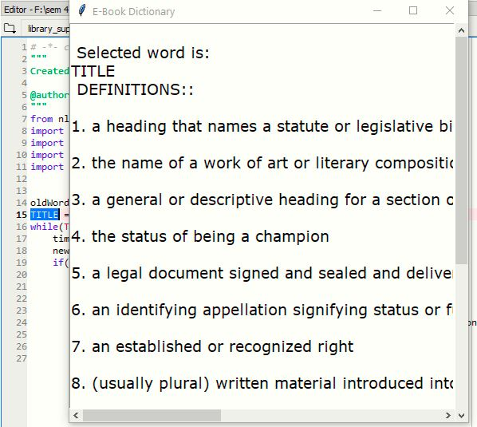
Snapshots

Slide 11
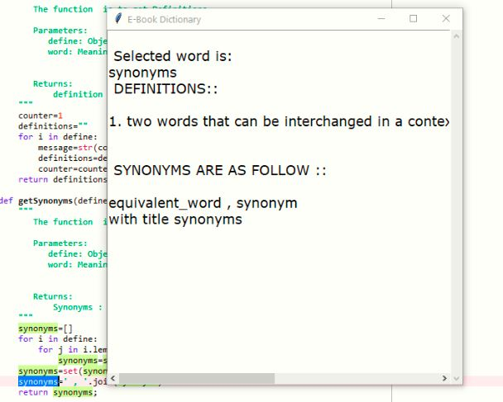

Slide 12
Limitations
Limited meanings and synonyms are display according to NLTK library.
Installation of python is required.
All libraries are mandatory to install.
It shows meanings in English language only.
It is mandatory to keep the project file in user’s pc or computer.

Slide 13
Future Scope
Currently in this project, synonyms are showing in English language only but in future we will update it such that they will be shown in other languages also.
Currently in this project, it is mandatory to keep the project file in the system to search for synonyms. In future the software will work without the project file.
Currently in this project, we have to install the libraries manually to run the software. In future, all the libraries will be installed automatically.

Slide 14
Conclusion
When you read some document and wish to know meaning of difficult word just copy that word and it will display the meanings of that word in pop-up window.

Slide 15
References:
https://www.programiz.com/python-programming
https://medium.com/@pranavbhatia_26901/create-your-own-e-book-dictionary-using-python-and-nltk-library-f70b4031310e

Slide 16
Thank you!

