Slide 1


Resume Builder
Guided By:
Prof. Atufaali Saiyed
Prof. Radhika Patel
Prepared by:
Krupali Dobariya(18DIT014)
Priyal Ramani(D19DIT082)

Slide 2

Contents
Introduction
Problem Statment Scope
Tools and Technology
Hardware and Software requirement
Project Defination Snapshots Flowchart References

Slide 3
Introduction
A resume builder is a software developed to simplify the task of creating a resume for individuals.
The application provides an effective means of designing desired resume in fact a professional looking resume.
The system is flexible to be used and reduces the need of thinking and designing an appropriate resume according to qualifications.

Slide 4
Problem Statment
Daily thousands of people create profiles and upload their resume.
Most of the companies have online job portal sites on which people need to upload their resumes.
Different people create resumes in different patterns which creates difficulty in creating the automated profile. So, people have to manually spend time creating the profile.

Slide 5

Scope
Reusability
Understandability Accurate
Easy to access

Slide 6
Tools and Technology
Flutter
Dart
VS code Firebase

Slide 7
Hardware and Software Requirement
Hardware
Processor – i3
Hard Disk – 5 GB
Memory – 1GB RAM
Software
Windows 7 and above
Microsoft SQL Server
Visual Studio

Slide 8
Project Definition
This project is user-friendly and requires minimum human effort.
Just have to fill up a form that specifies questions such as personal questions, educational, interest, skills and so on.
The answers provided by the users are stored and the system automatically generates a well-structured resume in pdf format.

Slide 9
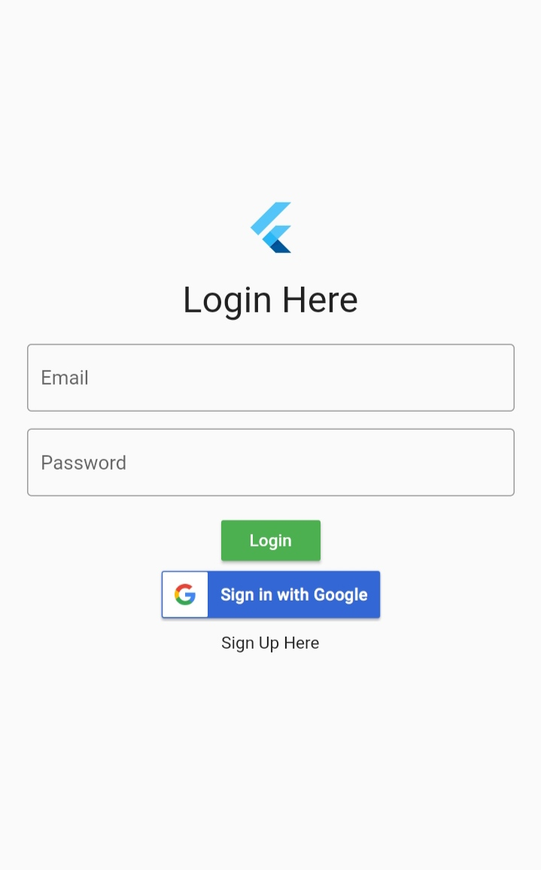
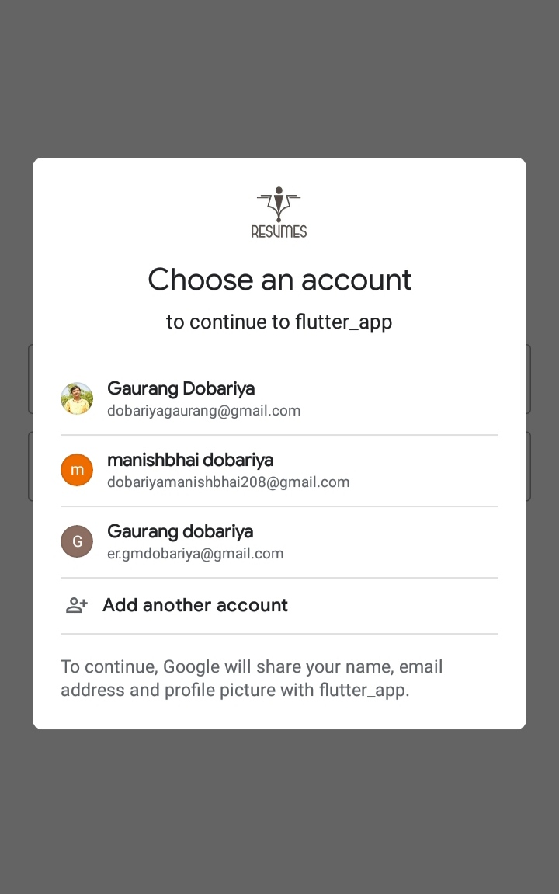
Snapshot
Login page
Sign in with Google

Slide 10
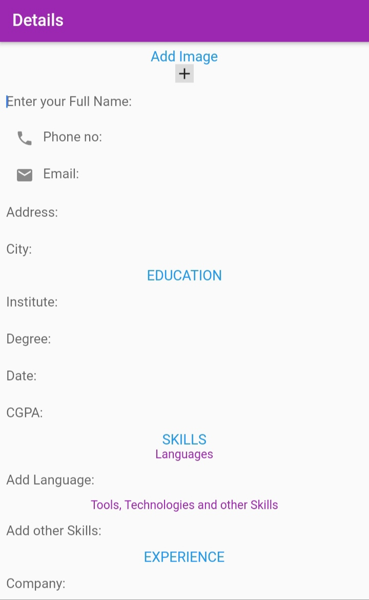
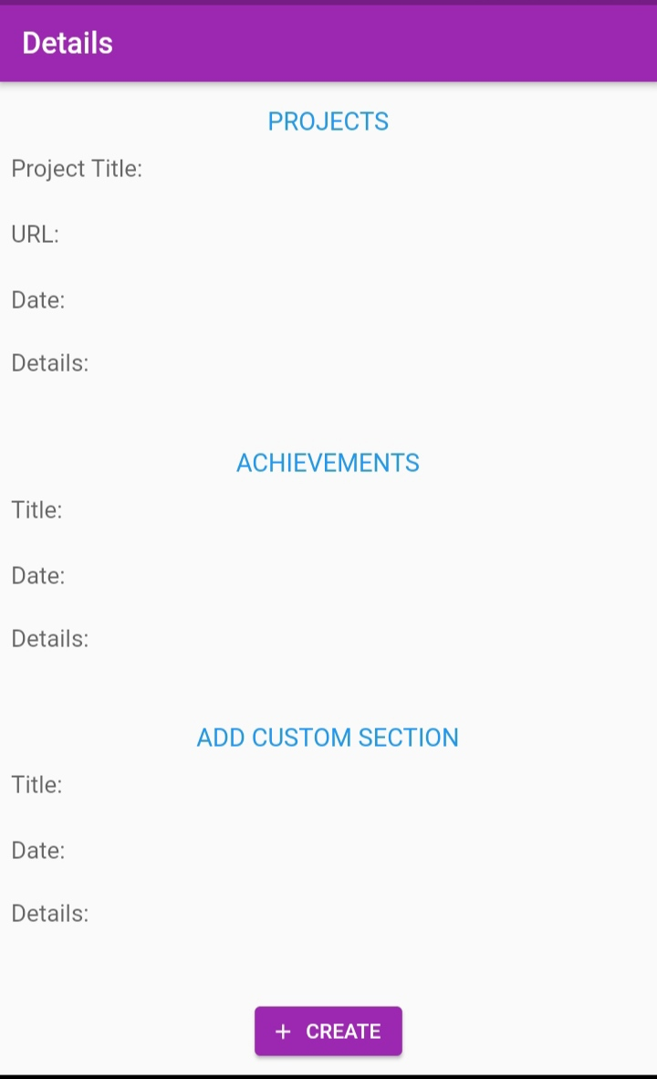
Snapshot
Enter Details

Slide 11
Snapshot
Templets

Slide 12
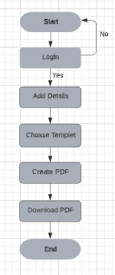
Flow chart

Slide 13
Future Scope
We can also create admin side application for employee search.
Resume can also be classified according to different branches and for specific companies.
We can also suggest an accuracy of generated resume.

Slide 14
References
https://flutter.dev/
https://firebase.google.com/docs/flutter/setup
https://medium.com/flutterdevs/google-sign-in-with-flutter-8960580dec96
https://concordia.udemy.com/course/learn-flutter-dart-to-build-ios-android-apps/learn/lecture/10459784?start=75#content
https://stackoverflow.com/questions/57841080/how-to-fix-a-value-of-type-authresult-cant-be-assigned-to-a-variable-of-type

Slide 15

Thank you!

