Slide 1

ANSWER SHEET MAPPER
One upload.
Every answer, found and mapped.
Question extraction · handwritten answer extraction · label-based mapping · exact-region highlighting · AI grading
Priyal Rathore
answer-sheet-mapper.vercel.app

Slide 2

THE GOAL
A teacher should upload a paper and instantly know three things.
Which question
Where the answer is
How it was graded
was answered — and which weren't, shown as its own visible state, not silently missing.
highlighted as the exact region of the handwritten page, not the whole sheet.
a score, a verdict, and one line of feedback per question — optional, and honest about what it is.

Slide 3





APPROACH
One pipeline, six stages
→
→
→
→
→
Rasterize
Extract questions
Extract answers
Map by label
Grade
Highlight
PDF or images → PNG pages
(mupdf.js, WASM)
Printed order preserved,
sub-parts split
Text + bounding box
per handwritten region
Normalized label match,
not position
Optional: score, verdict,
feedback per question
Click a question →
exact region lights up
Pages within each document extract concurrently, not one-at-a-time — required once a real multi-page upload started exceeding a serverless time limit.

Slide 4
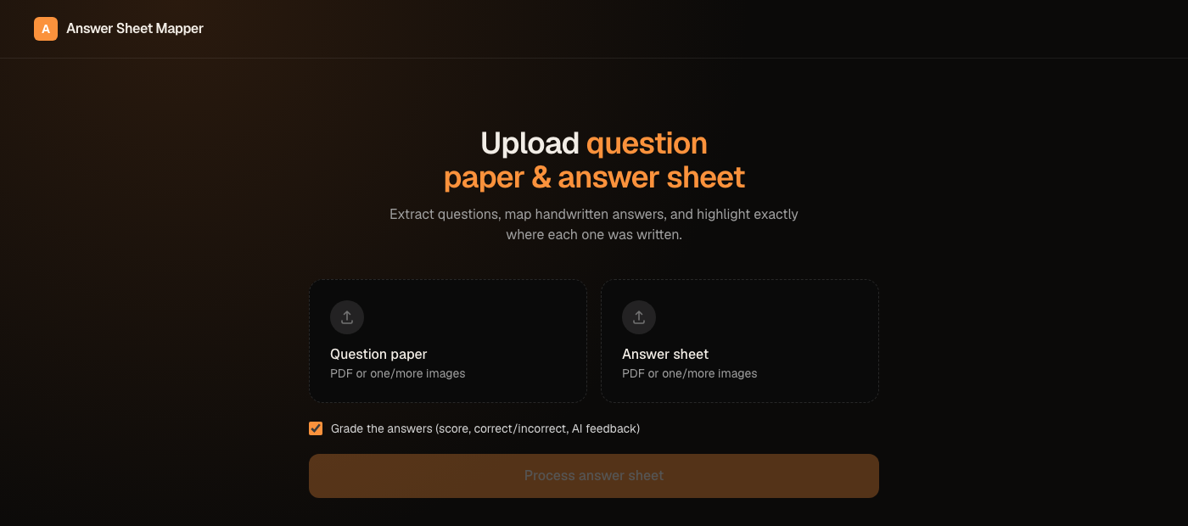
DEMO
Two files in, everything else automatic
PDF or images — either works, for both files
Live step-by-step progress while it runs, not a bare spinner
Grading is opt-in, checked by default

Slide 5
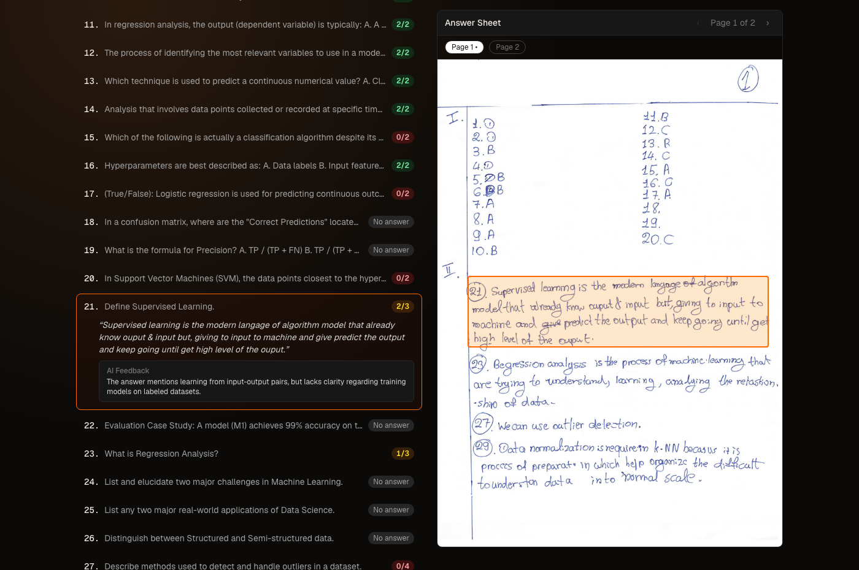
DEMO
Click a question. See exactly where it was answered.

Slide 6
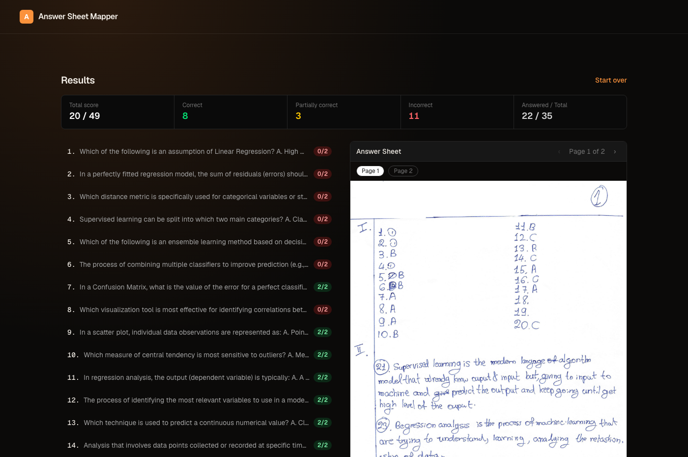
DEMO
Grading, summarized and per-question
Correct
full marks awarded
Partially correct
some marks, feedback on what's missing
Incorrect
zero marks, one line on why
Max marks per question are inferred from its own complexity — a one-line recall question and a multi-part "explain/compare" don't get the same denominator.

Slide 7



HANDLING EDGE CASES
Every case falls out of one design decision
Matching answers to questions by normalized label — not position — means none of these need special-case code.
Out of order
Unanswered
No matching question
Answered 21, 23, 27, 29 — label lookup doesn't care about sequence.
Zero matches at that label → shown as its own grey state, not omitted.
Collected separately as unmatched answers, never silently dropped.
Spans multiple pages
Split across a table
Sub-parts
Same label across pages → flagged, both fragments listed with page numbers.
One answer in two columns, one label — fixed with a geometric row-adjacency check.
"11(a)" and "11(b)" become separate entries, each keeping the parent number.

Slide 8

BUILT WITH VERIFICATION, NOT ASSUMPTION
Three real bugs, caught before they shipped
The boxes that looked wrong but weren't
Debug render made every box on a 20-row answer list look shifted up one row. Cropped the raw image at the claimed pixel coordinates before trusting that theory — the boxes were pixel-accurate. The label chip in my own visualization was the bug, not the extraction.
"11(a)" losing its parent number
Sub-part questions extracted as bare "(a)" / "(b)" — a student writes "11(a)", never bare "(a)", so matching would have silently failed for every sub-parted question. Caught on a synthetic test built specifically to exercise that one requirement line.
A student's table answer split in two
One question answered as a two-column table, number written once. The unlabeled half fell through as an orphan and graded as if the student never wrote it. Fixed with a geometric row-adjacency rule, not just a hopeful prompt tweak.

Slide 9
UNDER THE HOOD
Stack & reliability
STACK
RELIABILITY
Frontend + API
Disk-cached Gemini calls
Next.js App Router, one repo (monorepo by construction)
keyed on model+prompt+schema+image hash — re-runs during dev cost zero quota
AI model
Quota fallback
Gemini gemini-3.6-flash — structured JSON output, temperature 0
one automatic retry on a secondary model — never the default, since A/B testing found it measurably less accurate
PDF rendering
Parallel page extraction
mupdf.js (WASM) — no native dependency, survives Vercel's serverless runtime
concurrent, not sequential — fixes a real timeout that hung the client with no error
Deploy
Client stall watchdog
Vercel, streamed NDJSON progress over a plain Response
45s timeout on every stream read — a hang is now always a visible error

Slide 10

KNOWN LIMITATIONS
Said plainly, not discovered later
No answer key is uploaded, so grading is the model's own subject-matter judgment — not a comparison to ground truth.
Verified against one real scanned handwriting sample in depth, not a broad handwriting-style benchmark.
Label matching handles notation variants ("11(a)" vs "Ans. 11a"), not free-form paraphrasing of a label in words.
Free-tier Gemini quota and Vercel's request-body ceiling are real, external constraints — documented, with a fallback path for the first.

Slide 11


ANSWER SHEET MAPPER
Thank you.
Live app
answer-sheet-mapper.vercel.app
Repository
github.com/priyalrathore003/answer-sheet-mapper
Design doc
LLD.md — architecture, sequence, and the two core algorithms

