Slide 1
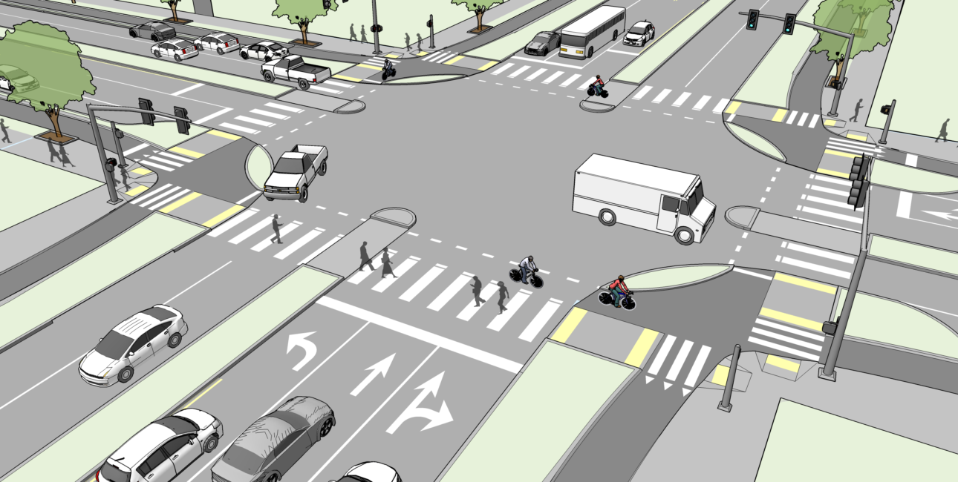
Multi-Agent System for Smart Traffic Management

Slide 2
AI Agents
Traffic Signal Agent
Toll Pricing Agent
Vehicle Agent

Slide 3

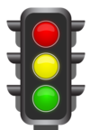
Traffic Signal Agents (TSA)
Queue length using cameras
Change signal phase
Vehicle intent data using V2I
(Straight, turning left or right)
Duration of each phase
Sends congestion info to VA and TPA
Time of day + Weather
Emergency vehicle alerts
Reinforcement learning:
Reward = Minimized wait time + queue length

Slide 4
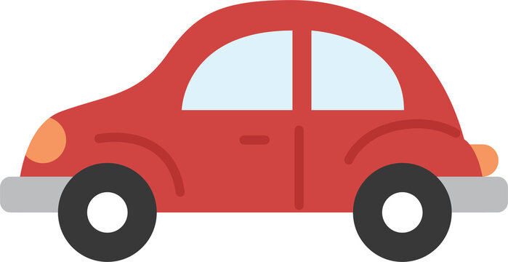
Vehicle Agents (VA)
GPS- Current Location, Speed, Destination
Intent to Cross, Arrival Time, Current Position
TSA- Signal Phase, ETA to Green, Congestion Info
Routing Updates
Dynamic Toll Rates
Speed Optimization
Embedded in smart cars

Slide 5

Toll Pricing Agents (TPA)
Time of day, demand forecast
Congestion levels (from TSA)
Toll prices to VA
Historical traffic
Adjusts road toll prices in real-time to influence traffic behavior.
Predicts expected congestion and adjusts prices to balance load

Slide 6
Simplified System Flow (1)
1. Initialization Phase
Vehicle Agent (VA) initializes with:
GPS location, destination, vehicle profile
Requests toll rates for possible routes from TPA
TPA receives location and destination from VA, estimates:
Toll prices for various path segments
Congestion level as a factor in pricing
Sends back toll rates to VA

Slide 7
Simplified System Flow (2)
2. Route Planning (VA + TPA)
VA computes optimal route using:
Live toll data from TPA
Estimated signal delays (historical or predicted)
Congestion awareness
Selected route is stored and broadcasted to TSA along intersections

Slide 8
Simplified System Flow (3)
3. Traffic Signal Coordination (TSA + VA)
VA periodically sends:
Approach time, intent to cross, and estimated arrival time to the nearest TSA
TSA processes:
Real-time queue lengths from nearby sensors
VA approach data (from many VAs)
Historical traffic patterns for that intersection
TSA uses RL-based decision logic to:
Decide optimal signal phase and duration
Maximize throughput and minimize waiting time
Adjust signals dynamically
TSA sends:
Signal status and green wave timing to VA

Slide 9
Simplified System Flow (4)
4. Real-Time Toll Adjustment (TPA + TSA)
TPA continuously receives:
Traffic density data from TSA
Flow patterns from VA routing requests
TPA runs dynamic pricing model to:
Adjust tolls to reduce congestion in hotspots
Encourage alternate routes
TPA publishes updated tolls to all VAs

Slide 10
Simplified System Flow (5)
5. Vehicle Adjustment and Movement (VA)
VA uses signal timing and toll updates to:
Adjust speed to match green lights (minimizing stops)
Reroute in case toll costs increase significantly
Movement is updated in real-time to TSA and TPA

Slide 11
Simplified System Flow (6)
6. System Feedback and Learning
All three agents log:
Their decisions, inputs, and outcomes
These logs are used to retrain models, evaluate performance, and predict future patterns

Slide 12
Appendix

Slide 13
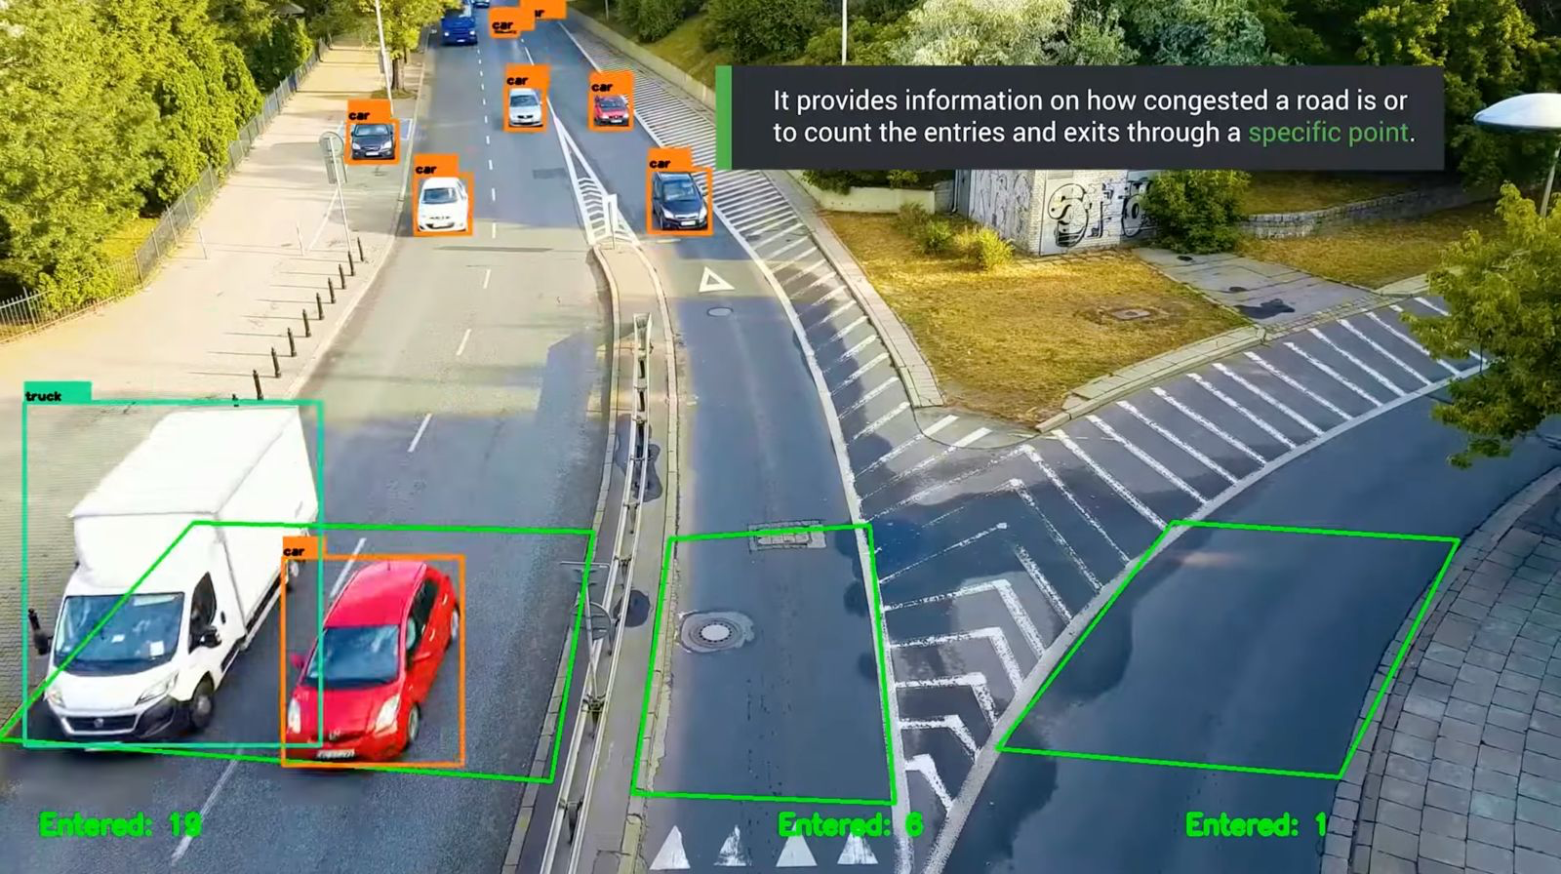
Traffic lane monitoring camera

