Slide 1


Wellness Tourism Package : Descriptive Analysis And New Segment Prediction & Optimization
GROUP 4:
Arghya Misra
Prerana Das
Priyal Vora
Shih-hua wang

Slide 2
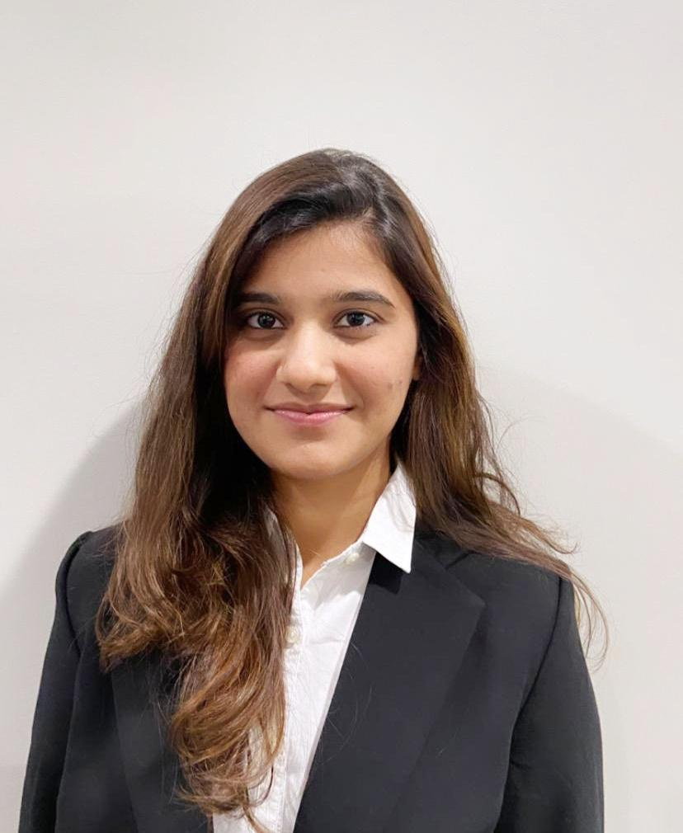



Team Brief
Prerana Das
Priyal
Vora
Shih-Hua Wang
Arghya Misra
MS BAIM
MS Marketing
MS Marketing
MS Supply Chain
*BAIM: Business Analytics and Information Management

Slide 3

Agenda
Team Brief
Case Overview & Objective
Problem Statement
Objective
Dataset
Approach
Business Questions
Key Takeaways

Slide 4

Case Overview & Objective
Problem Statement
Analysis of customers’ data for "Trips & Travel.Com" company to provide consulting on segmentation.
OBJECTIVE
DATASET
APPROACH
Factors that influence purchase decisions
Build a sophisticated shiny application to glean effective data insights
It consists of 4888 records and provides customer information
Conduct descriptive analysis of the customer data and the variation in the variables based on the tourism package segments

Slide 5


Business Questions
BUSINESS QUESTIONS:
How does the overall trend of customer segmentation look like?
What are the trends observed in product preference and demographics within the 5-user segments?
What is the story of the users a.k.a. product buyers who are willing to take a product based on product pitched?
What kind of clustering models can we create based on the most important parameters? What are their optimized parameter values based on linear programming?
As business consultants, the aim of our study is to understand detailed insights of these business questions and
present the solution to the client “Trips and Travels .com”

Slide 6




TAKEAWAYS
THERE ARE 3 KEY TAKEAWAYS FROM THIS PROJECT
The 5 product packages – chosen by customer groups who are different in their product and pitch preference, and demographics. Their preference is driven by their designation and income.
The current customer segmentation looks like:
age group of 15-30
single/unmarried males,
more willing to adopt a product based off sales pitch,
are contacted by company,
belong to tier 2 and 3 cities.
working as Executive with a $15-30K salary who prefer 5-star hotels.
Along with sophisticated techniques such as K means clustering and Linear optimization, basic exploratory segment analysis also provides the most appropriate picture of real driving factors of the data

Slide 7
REFERENCES
These are the references that we took for the Shiny Application:
Links used for the design part:
https://github.com/thepiratex/AttritionAnalysisRShiny/blob/master/App.R
https://www.youtube.com/watch?v=6F5_jbBmeJU (Image)
Links used for the 5-segment descriptive analysis:
https://github.com/BakerSten/Group5FinalR/blob/main/app.R
https://mogali.shinyapps.io/attritionanalysis/
https://github.com/thepiratex/AttritionAnalysisRShiny/blob/master/App.R

