Slide 1

Google Ads Grant Challenge – Croatan Institute
MGMT 52170 - Digital Marketing Applications

Slide 2








Executive Summary
Organization Goal
Highlights
Spread awareness of their new online research tool, RAISER. Get potential customers to sign up for live demos
What kind of ad messaging works
Increased monthly visibility by 44.7% and achieved a CTR of 3.44%
Actively tracked ad campaign for incremental impressions
Google Ads Goal
Boost visibility with relevant search intent to the RAISER landing page
High Click-through-Rate
Low Cost per Click

Slide 3





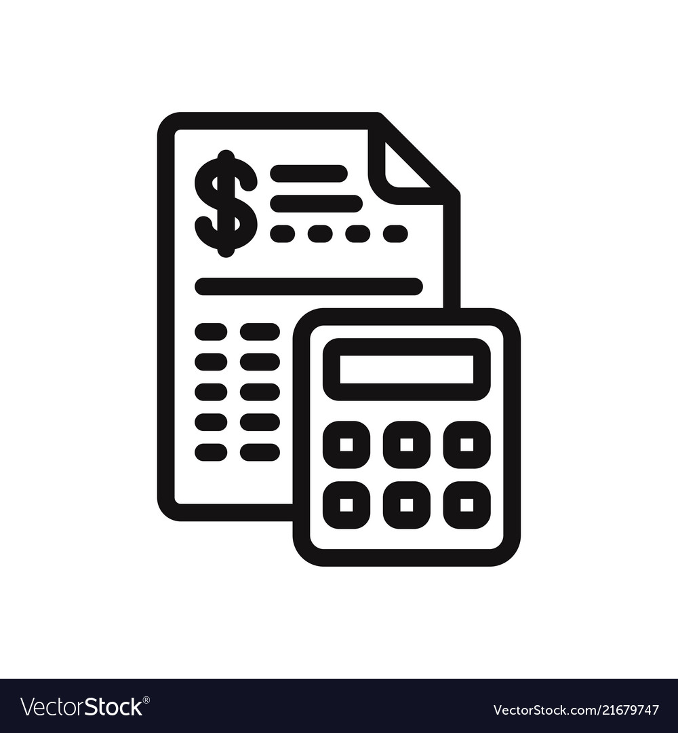
Campaign Overview
1st April 2022 – 29th April 2022
Scheduled: All day
Metric | Value
Impressions | 291
Clicks | 10
CTR | 3.44%
Avg. CPC | $0.31
United States of America
Brand Awareness
Target Impression Share
4 Campaigns
Budget: $329/day

Slide 4

Campaign Structure
Non-Brand
Brand
Generic Non-Brand
DSA Campaign
Same as Non-Brand but with brand terms ‘croatan’ or ‘raiser’
Mutual Funds
Index Funds
https://croataninstitute.org/raiser/
Bonds | Ethical Investing
Conscious Investing | Green Bonds
Consultant/Investor | Impact Capital
Eco Friendly Investing | Impact Funds
Environmental Investing | Impact Investing
ESG Funds | Socially Responsible Investing
ESG Investing | Sri investing
ESG Stocks | Sustainable Investing
ESG Broad | Thematic Investing
ETFs

Slide 5
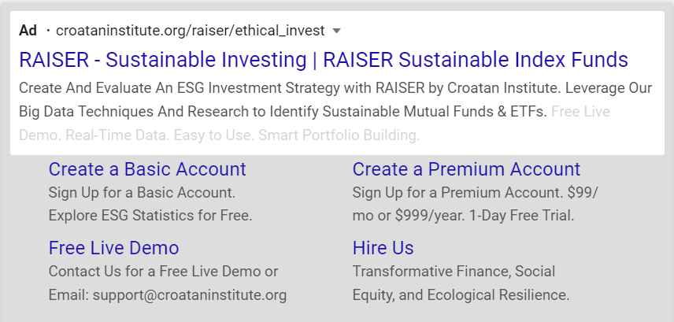
Campaign Design
- Ad Example
Ad Group – Sustainable Investing
Responsive Search Ad
Ad Groups | Keywords | Match Type
Path 1 and 2
Callouts Extension
Sitelink extension

Slide 6
Campaign Evolution
Campaign Level Changes
Changed bid strategy from Maximum Clicks to Target Impression Share
Added Dynamic Search Ads – search ads that showed content based on our NGO’s Raiser page
Impact
44.7% growth in impressions
3.44% click-through-rate
Keyword Level Changes​
Added best performing search terms to campaign
Audited Search Query Report to add/remove
keywords for optimization
Ad Level Changes​​
Added responsive ads
Ad rotation to optimize for best performing ad
Landing page​ optimization to improve Quality Score​

Slide 7
Campaign Performance Metrics
1st April 2022 – 29th April 2022
Metric | Current Campaign (Apr 1st– Apr 29th)
Impressions | 291
Clicks | 10
CTR | 3.44%
Cost per Click | $0.31
Search Impression Share | < 10%
Search Lost IS (Rank) | > 90%
Bid Strategy Type | Target Impression Share
Target Impression Share | 70%
Max CPC Bid Limit for Target IS | $100

Slide 8
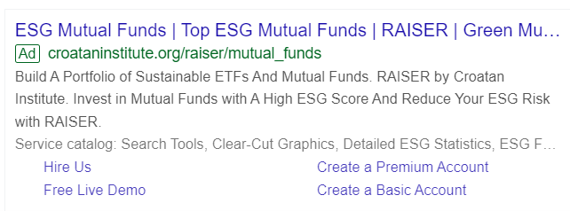
Campaign Highlights
Top Performing Keywords
Device Level Performance
Keyword | Ad group | Match type | Impressions
mutual funds | Mutual Funds_Generic | Broad match | 58
mutual fund investment | Mutual Funds_Generic | Broad match | 29
index investing | Index Fund_Generic | Broad match | 27
esg investing | ESG Investing_Non-brand | Broad match | 20
green bond | Green Bonds_Non-brand | Broad match | 17
Device Type | Impressions | Clicks
Computers | 201 | 10
Mobile Phones | 76 | 0
Tablets | 6 | 0
Most Shown Ad: Ad Group: Mutual Funds_Generic
Impressions | Ad Type | Ad Strength
90 | Responsive Search Ad | Good
Structured Snippet
extension

Slide 9
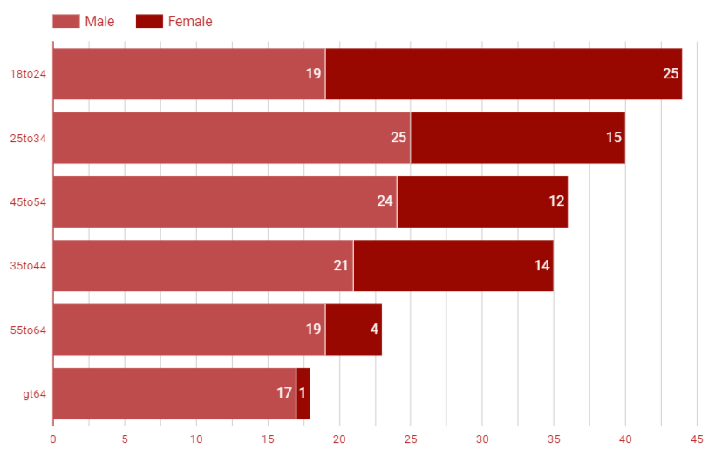
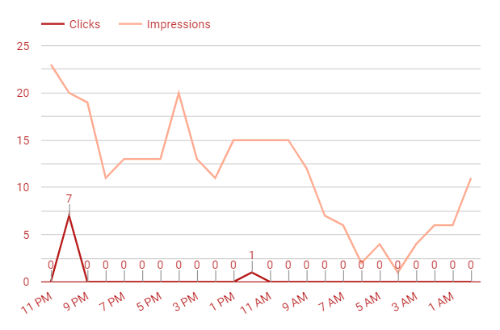
Campaign Highlights
Demographics
Target Audience Active Times
Target Audience Active Times
Most clicks & impressions received at around 10- 11 PM in the night
Age group of 18-24 were shown the ad maximum times and they also clicked the ad most times
Males have more impressions than females

Slide 10



Future Recommendations
Remove broken links and Include CTA to encourage visitors to come on to landing pages & take necessary action
Incorporate and link Google Analytics to Google Ads
Include audiences (website visitors, and affinity audiences)

Slide 11
Future Objectives
Increase further awareness of the Raiser page
Educating about Free Demo and getting people to click on free demos
Increase Raiser Premium Subscriptions

Slide 12
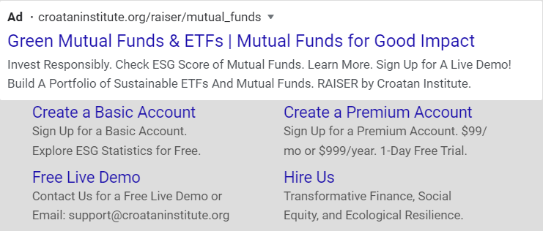
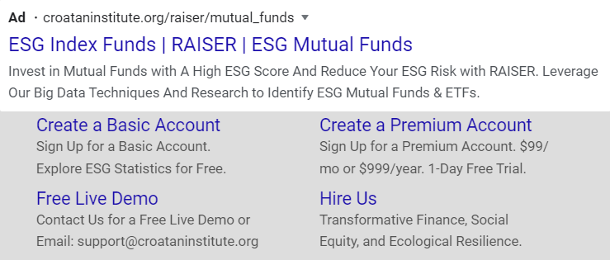
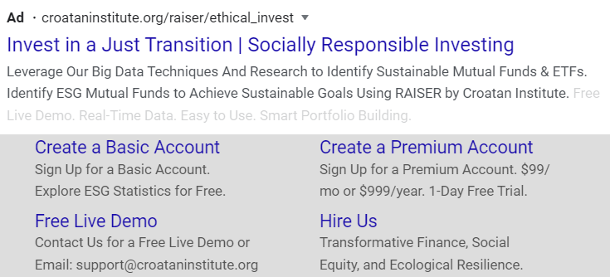
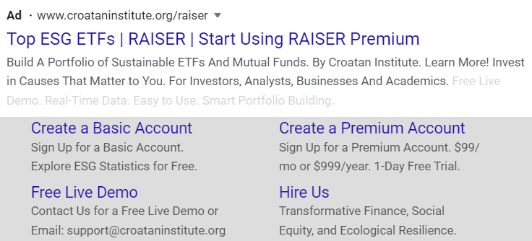
Appendix – Ad Copies

Slide 13
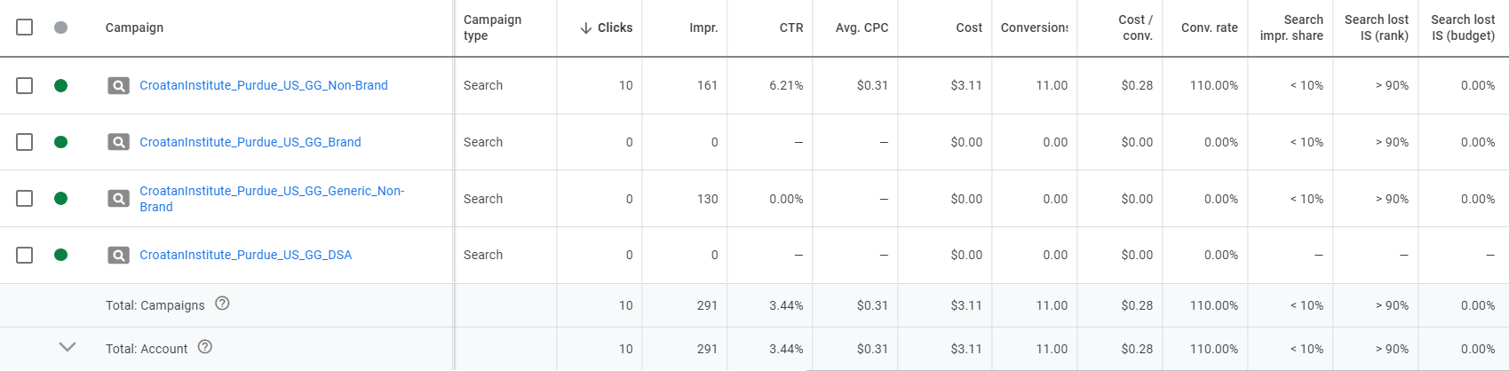
Appendix – Campaign Performance Metrics
Current Campaigns

Slide 14
Search Query Report
Positive Keywords
Negative Keywords
fossil free investing
best mutual funds to invest in
mutual fund calculator
efg investing
esg companies
esp investing
esg stocks
climate change etfs
invest in our planet
what is socially responsible investing
“calvert”
“t rowe”
[india mutual funds]
“manulife”
“marijuana”
“parag parikh”
“pax world”
“vanguard com”
“vanguard website”
“fidelity”

Slide 15

THANK YOU
Do you have any questions?

