Slide 1



Introduction
Jeet N. Jadhav
Enrollment no:170450116008
College: SVMIT, Bharuch
email:(jnj220412@gmail.com )
Yagnesh Limbachiya
Enrollment no:170450116012
College: SVMIT, Bharuch
Email:(yagneshlimbachiya7@gmail.com)
Priyam Patel
Enrollment no:170450116035
College: SVMIT, Bharuch
Email:(priyampatel9911@gmail.com)

Slide 2
News Category Classification
The model trained on this dataset could be used to identify tags for untracked news articles or to identify the type of language used in different news articles.
Updated Approach (2026):
• Replaced base notebook with robust production Python script.
• Implemented full NLP preprocessing (NLTK) & TF-IDF.
• Evaluated 4 Classification Models to find the best F1 Score.

Slide 3
Data Processing
Advanced NLP Pipeline Steps:
1. Missing Value Handling: Filled missing authors with 'Unknown'
2. Feature Merging: Combined Headline + Short Description
3. Text Cleaning: Lowercasing, URL removal, special character removal
4. NLTK Processing: Stopword removal and WordNet Lemmatization
5. Vectorization: TF-IDF (Unigrams & Bigrams, Max 5000 features)

Slide 4
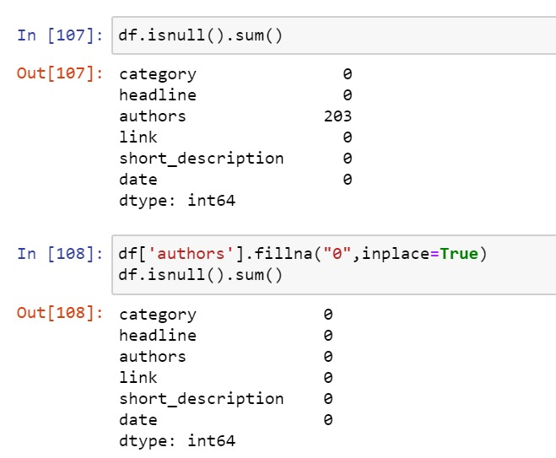

Slide 5
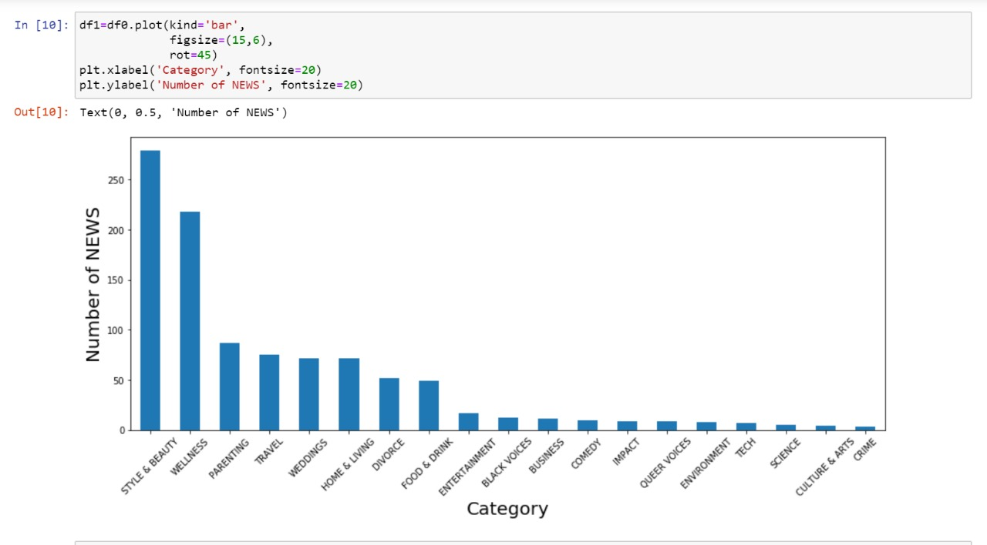
Data understanding

Slide 6
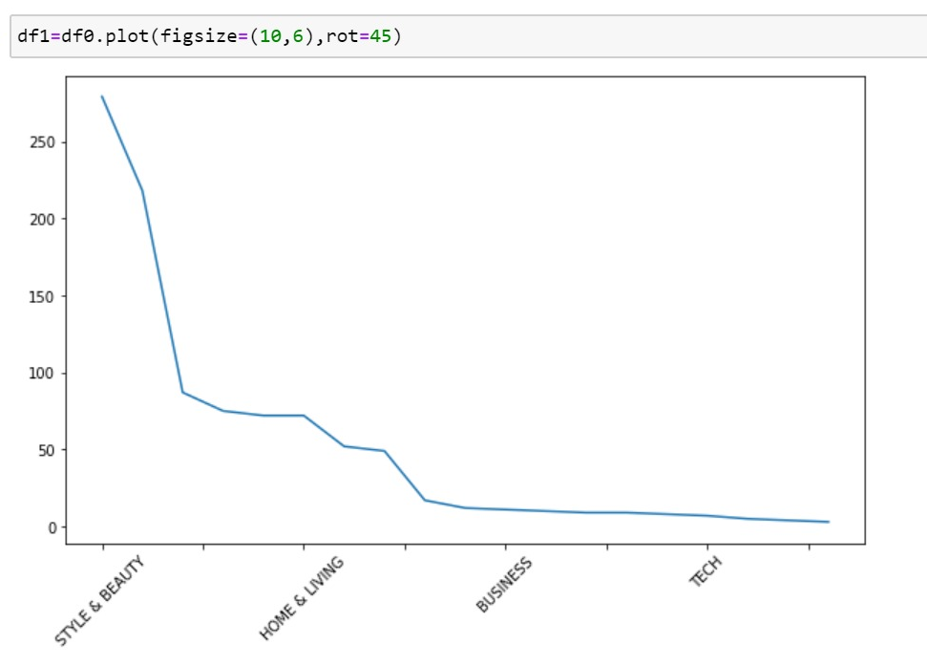
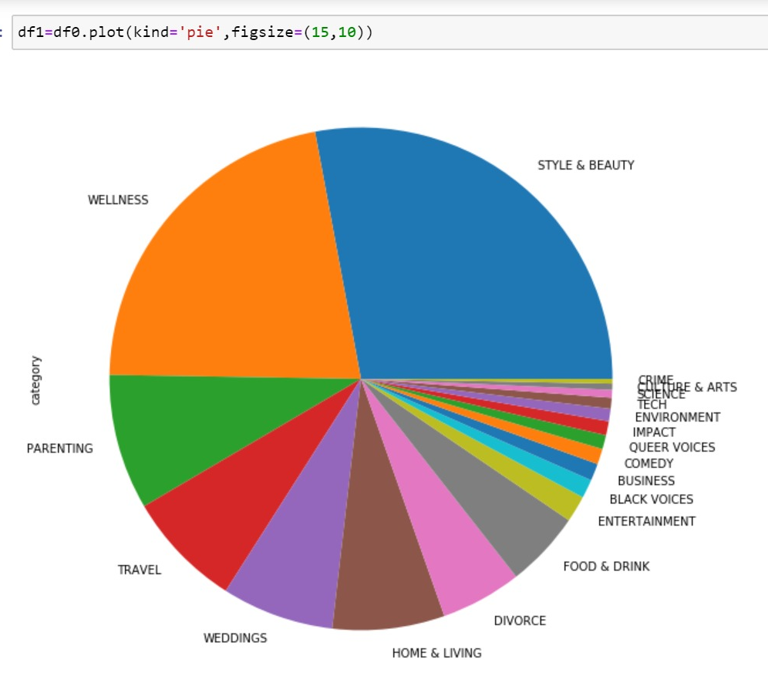

Slide 7
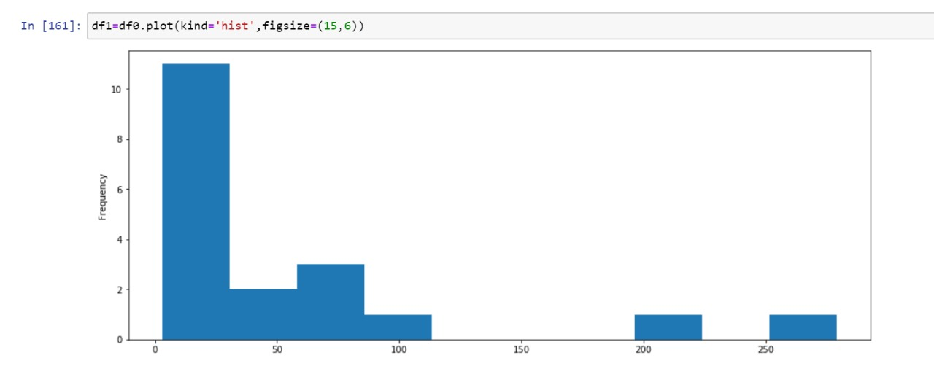

Slide 8
Machine Learning
Models Evaluated (with class weighting for imbalance):
• Logistic Regression
• Multinomial Naive Bayes
• Random Forest Classifier
• Linear Support Vector Machine (SVM) - *Best Performer*

Slide 9
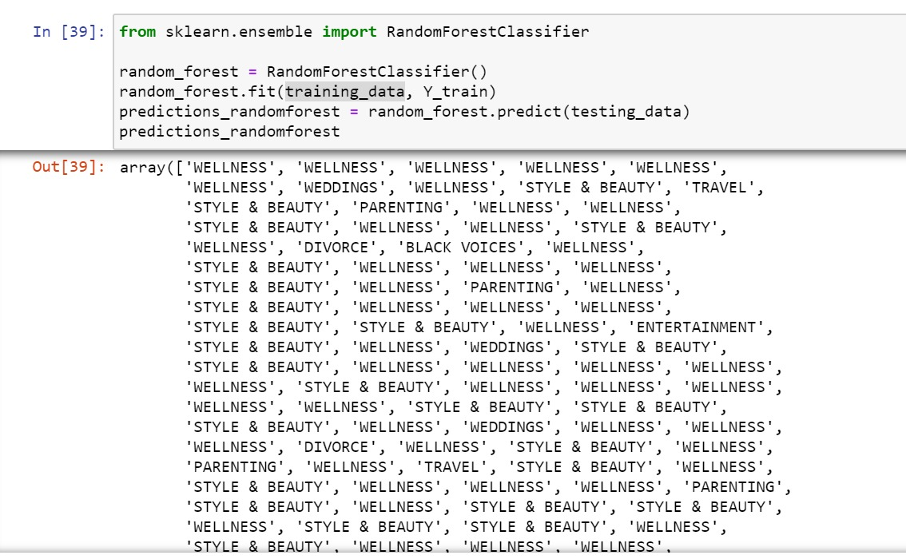
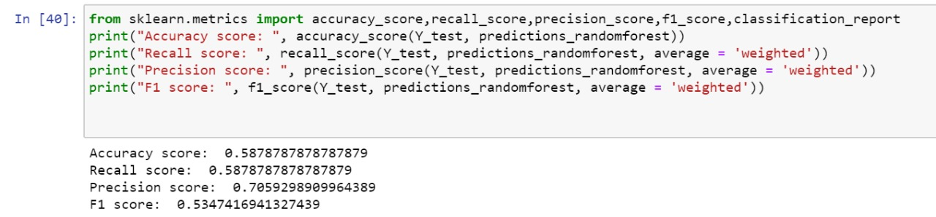

Slide 10
Model Evaluation Results
Model | Accuracy | Precision | Recall | F1 Score
Logistic Regression | 0.6350 | 0.6432 | 0.6350 | 0.6257
Multinomial NB | 0.6250 | 0.6305 | 0.6250 | 0.5800
Random Forest | 0.6450 | 0.6776 | 0.6450 | 0.6107
Linear SVM (Winner) | 0.6850 | 0.6729 | 0.6850 | 0.6734

Slide 11
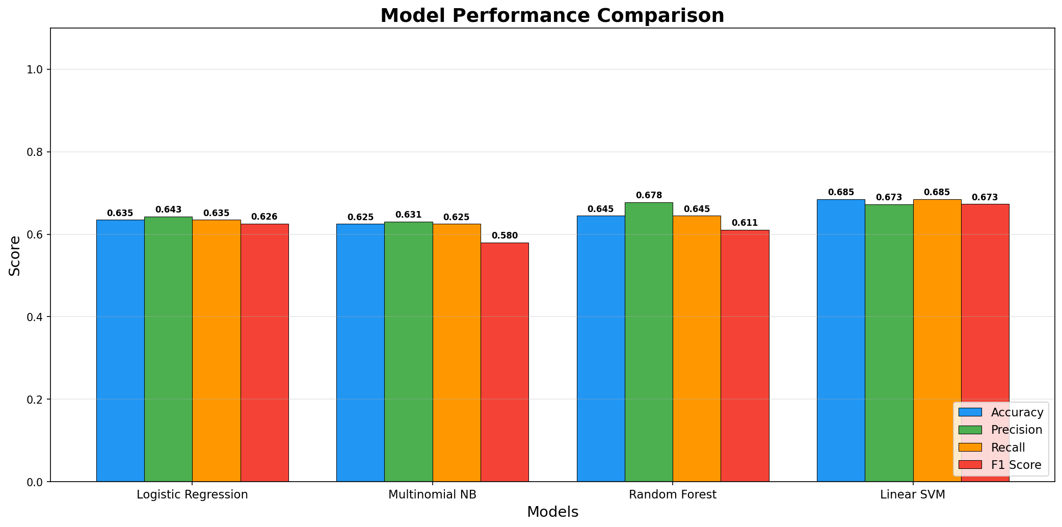
Performance Comparison

Slide 12
Thank You!

