Slide 1
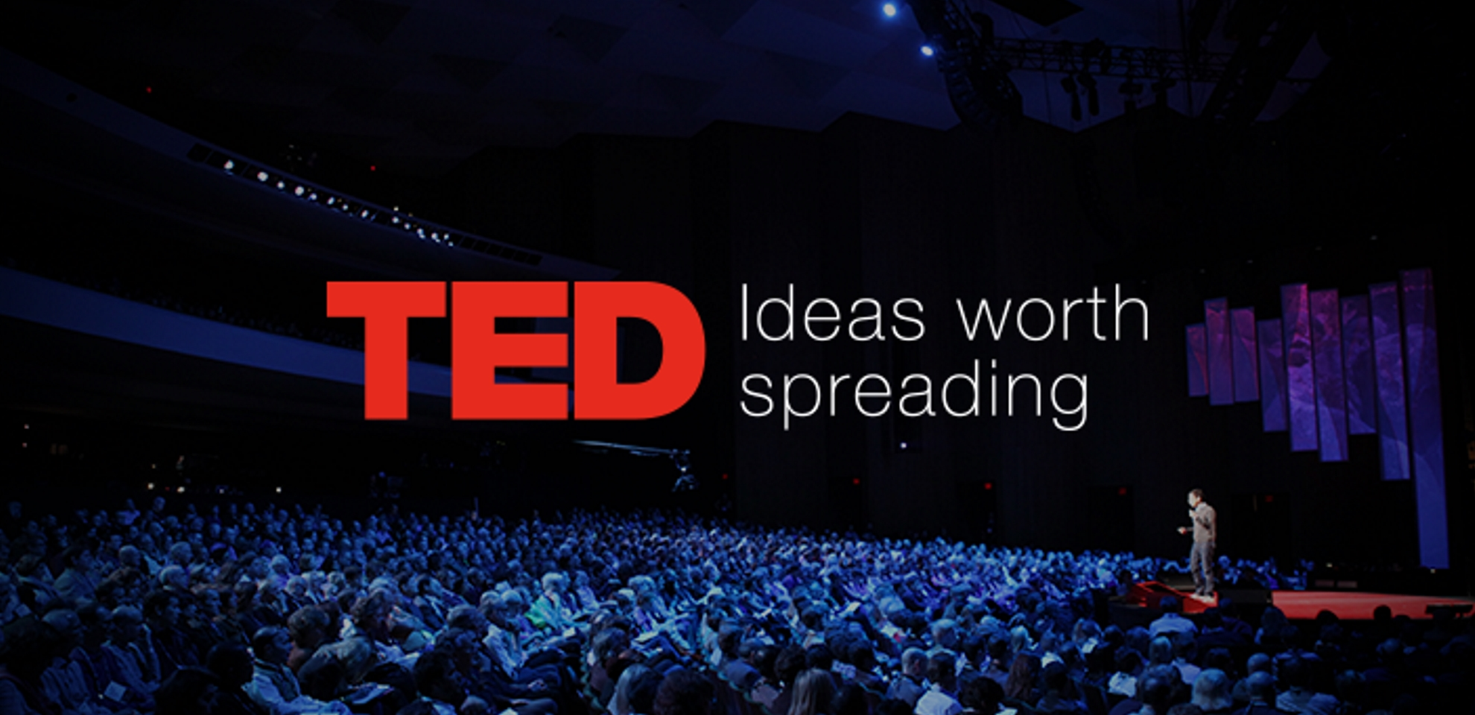
Analysis on TED Talks
HARSH PATEL
PARTH HINGU
PRIYAM SAXENA
SANJANA ATHREYA
VISHV BRAHMBHATT

Slide 2
Audience
Problem Statement
Analyzing ted talks and identifying the various factors that are affecting the popularity of a video
Predicting the number of views based on significant factors.
Audience for our analysis is the speaker who is planning to present a talk which will help him to see how duration and other factors affect the views and popularity of a video

Slide 3
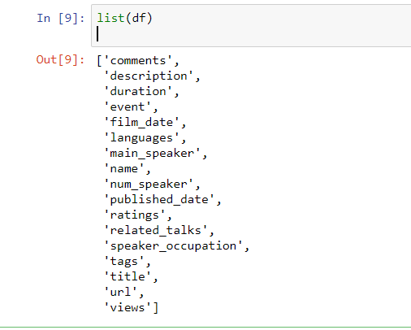
Dataset and Data dictionary
The dataset that has been used for performing exploratory and predictive data analysis has been web scrapped from the official TED Talks website, www.ted.com
The analysis has been performed using two data sets. The main dataset contains all the details of the TED Talks along with its speakers.
The other data set will contain the content of the speech in textual format.

Slide 4
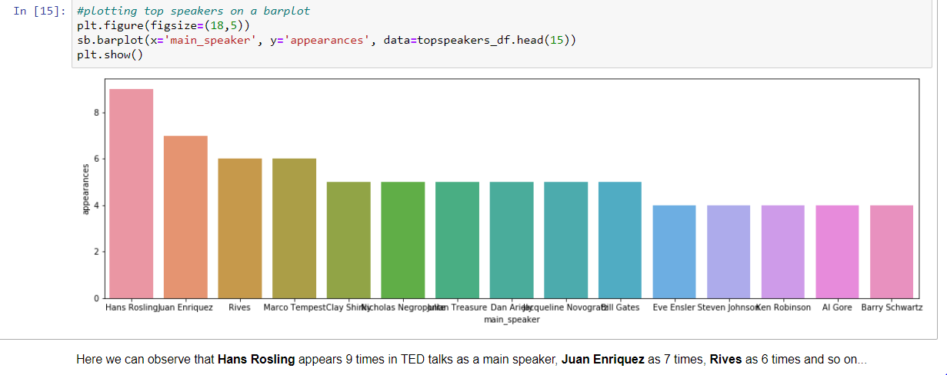
Data Cleaning and EDA
checking missing values and proper date time format conversion were done as part of cleaning
For EDA, we have found out relationship among various variables and also highlighted various factors that have high TED talk. Lets look below some of them:
Which speaker has maximum talks?

Slide 5
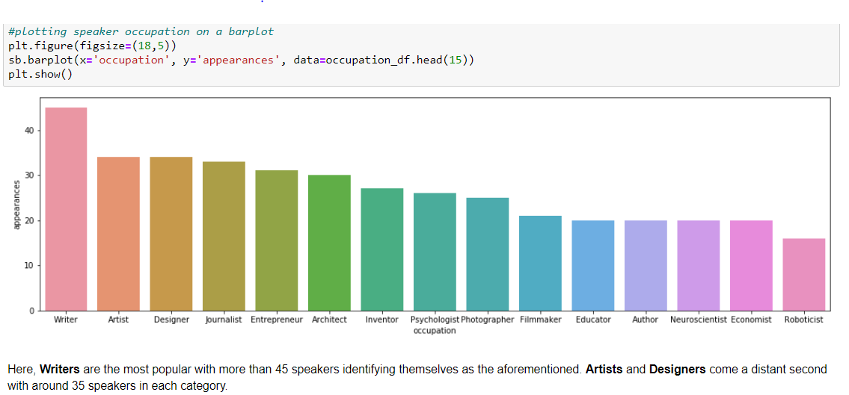
2) Speaker of which occupation is most popular among TED talks?

Slide 6
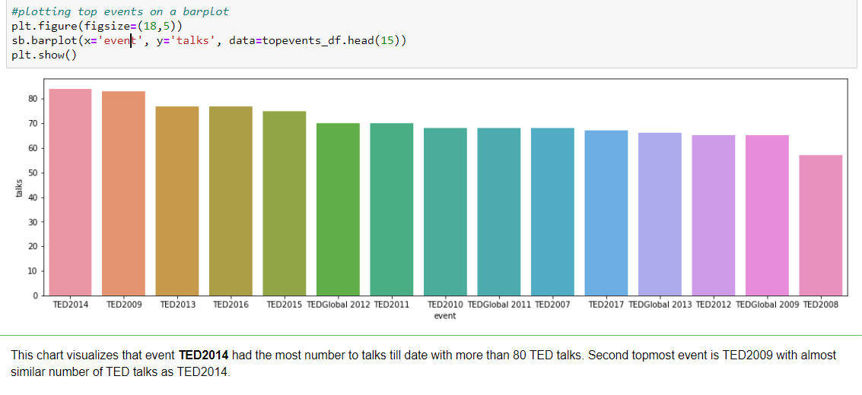
3) Which are most worthy event of TED talks?

Slide 7
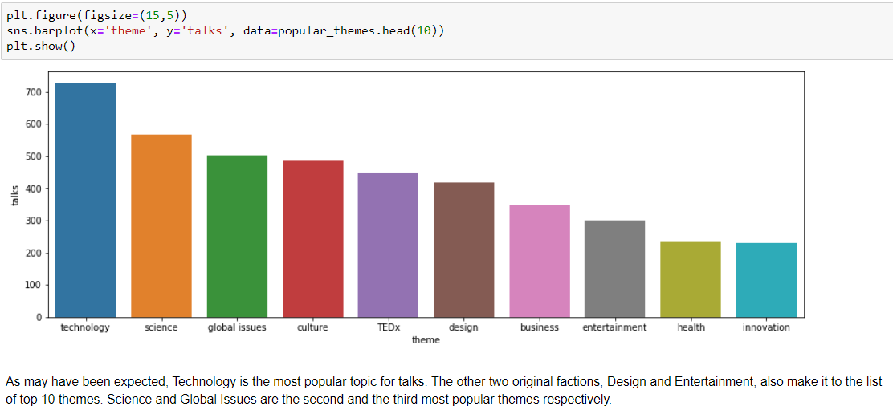
4) Which is the most popular theme of TED talks?

Slide 8
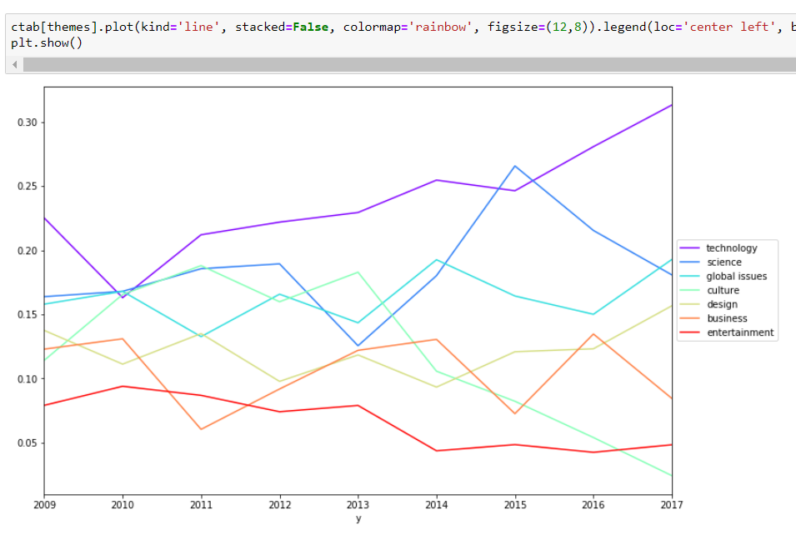
5) Which talks tend to attract the largest amount of discussion?

Slide 9
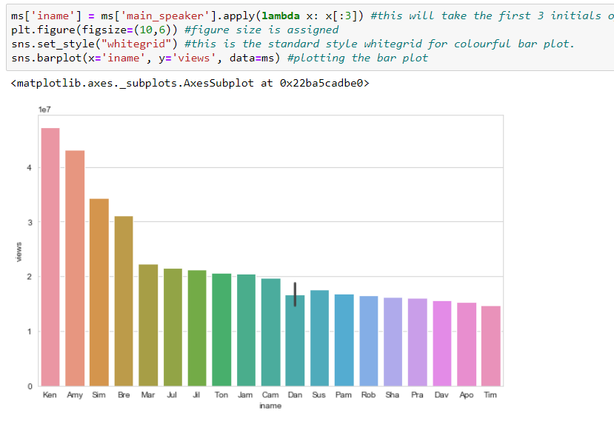
6) Which speaker has the most number of views?

Slide 10
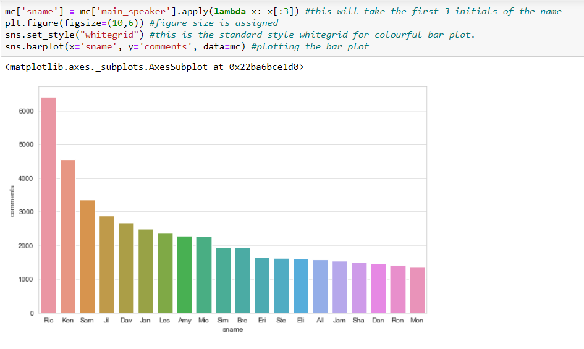
7) Which speaker has the most number of comments?

Slide 11
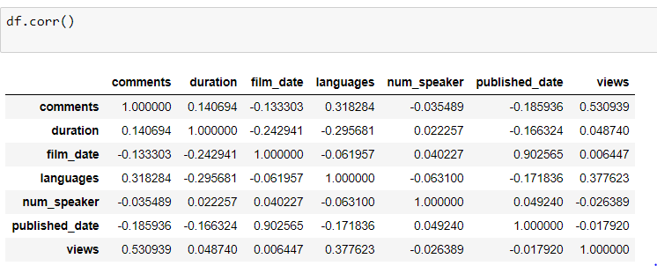
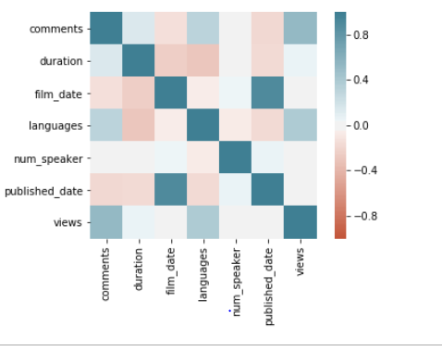
Statistical Analysis
Finding correlation among various factors

Slide 12
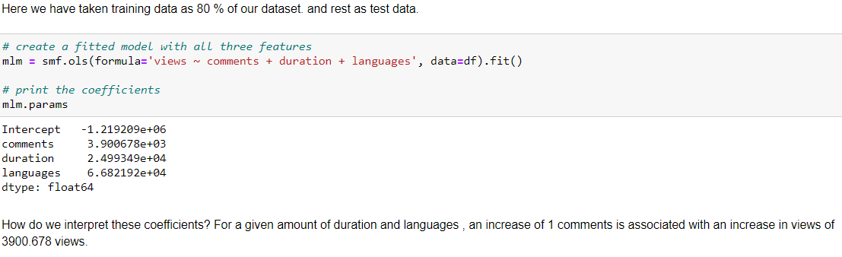
Multiple Linear Regression Model

Slide 13
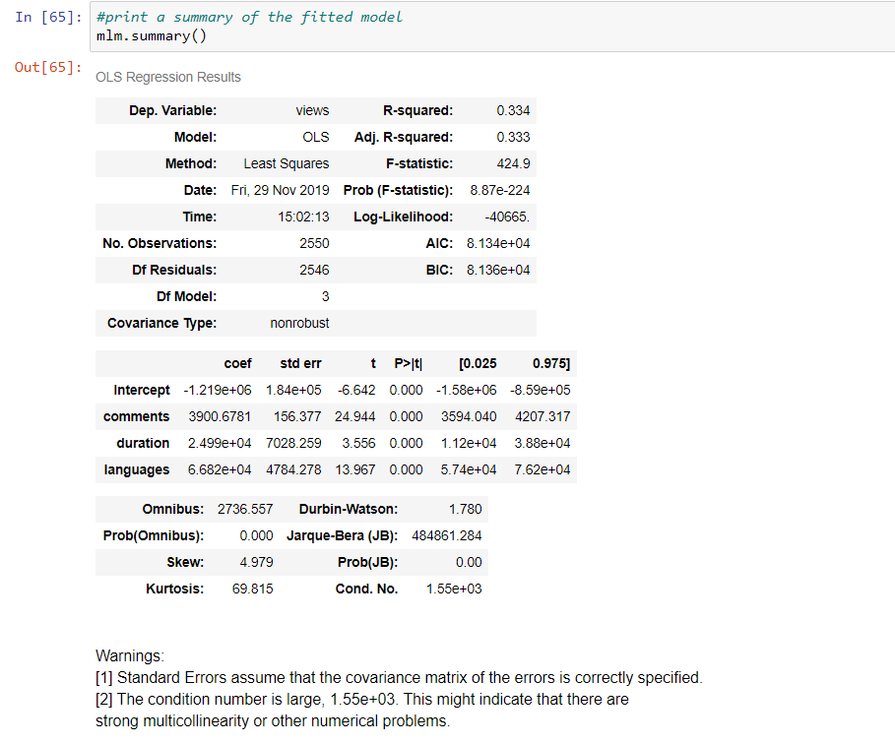

Slide 14
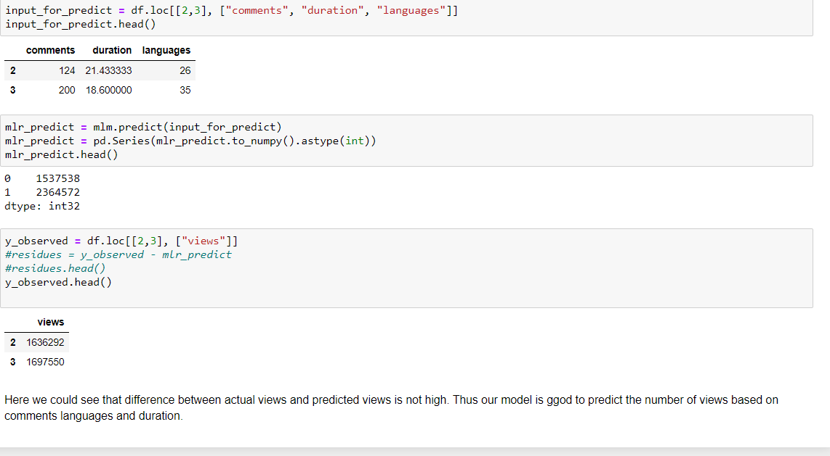
Conclusion:
We could see from our linear regression model that comments, languages and duration are the factors affecting number of views a video will get.

