Slide 1

Ayurveda Medicine Order App

Slide 2





Technologies Utilized
Oracle
Spring Boot
Git/GitHub
Postman
Swagger ui

Slide 3
Abstract
Our project focuses on developing a robust backend system for managing Ayurveda medicines through a microservice architecture. By leveraging Spring Boot and Oracle technologies, we aim to streamline the process of ordering, managing, and validating Ayurveda medicines, thereby enhancing efficiency and productivity in the healthcare sector.

Slide 4
Architecture Diagram
Medicine
Service
API
Gateway
Client
User
Service
Order
Service

Slide 5
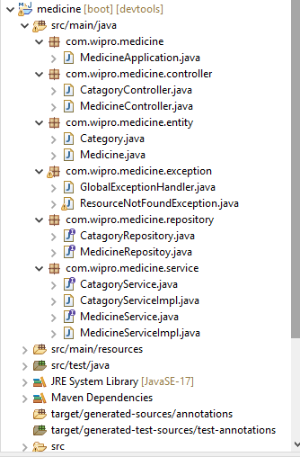
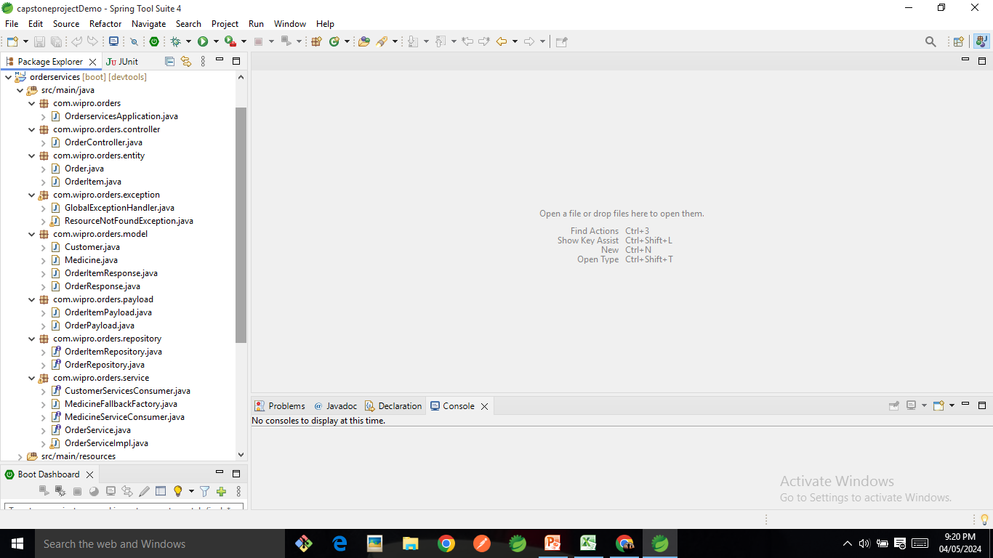
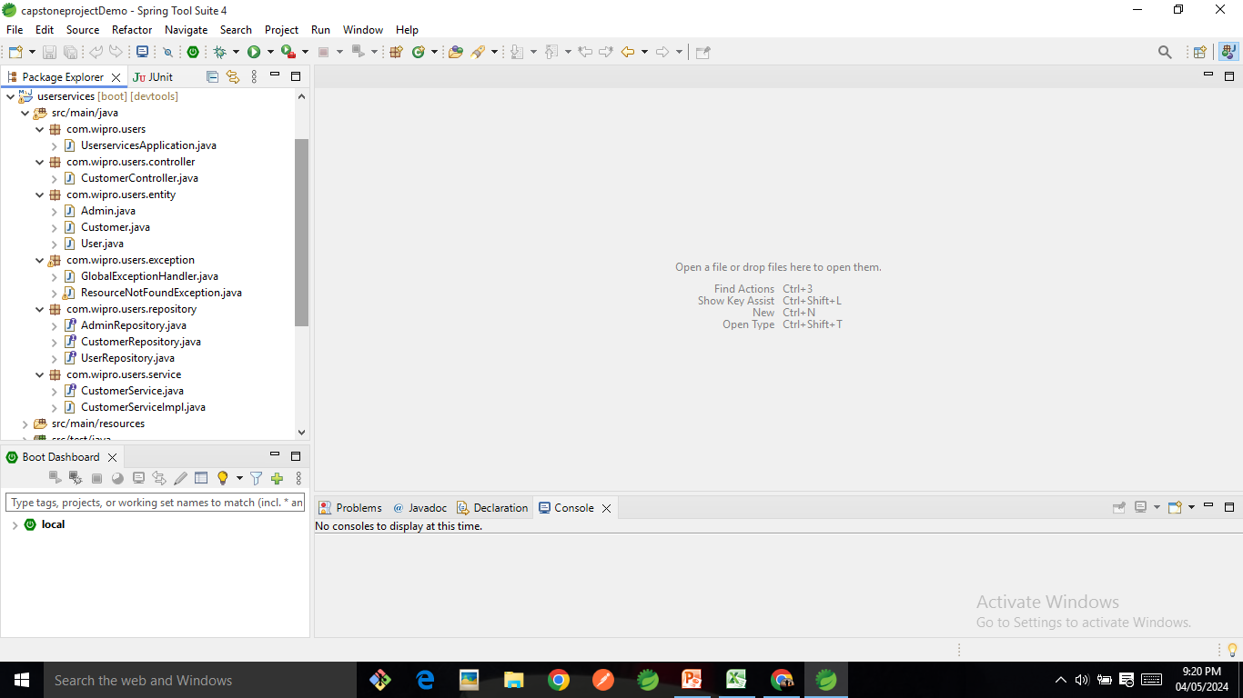
Java Backend Class Hierarchy

Slide 6
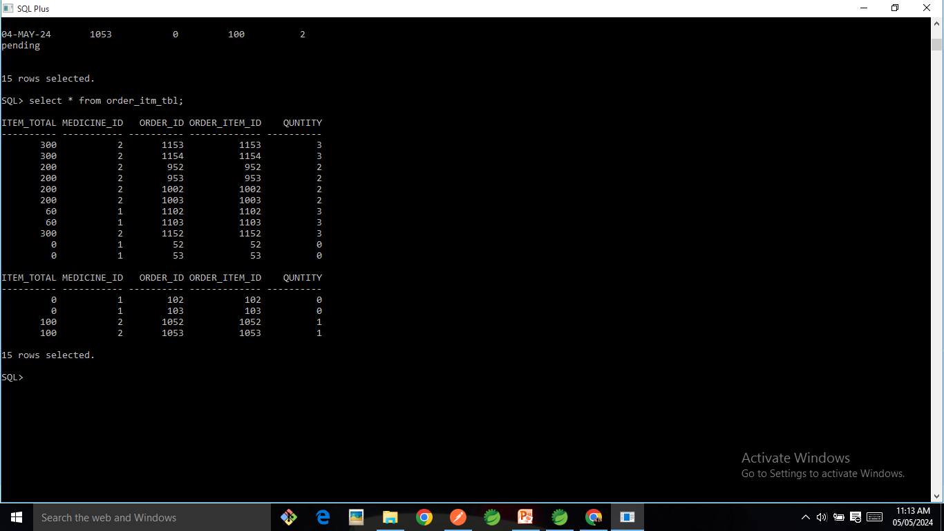
Oracle Database:

Slide 7
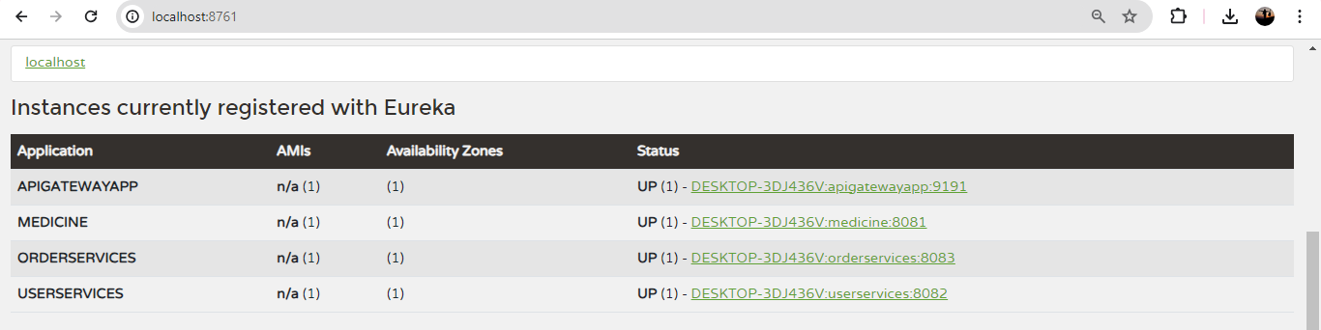
Main Page

Slide 8
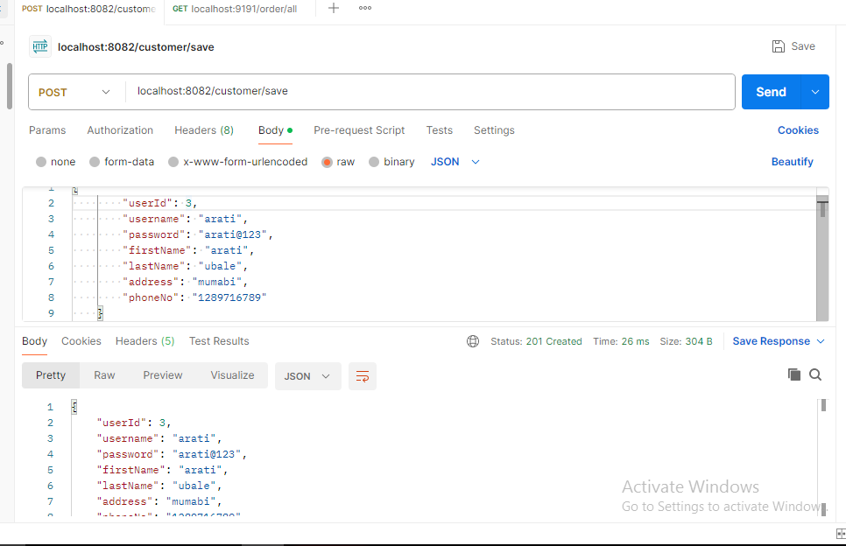
Add Customer

Slide 9
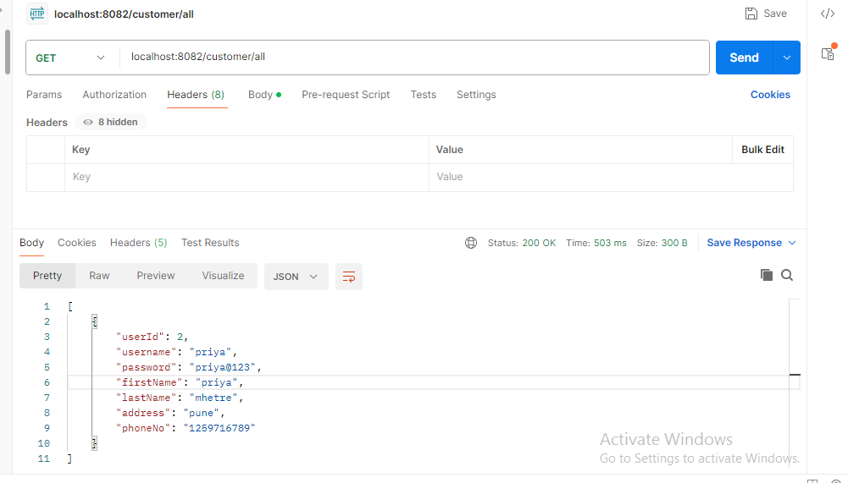
All Customer

Slide 10
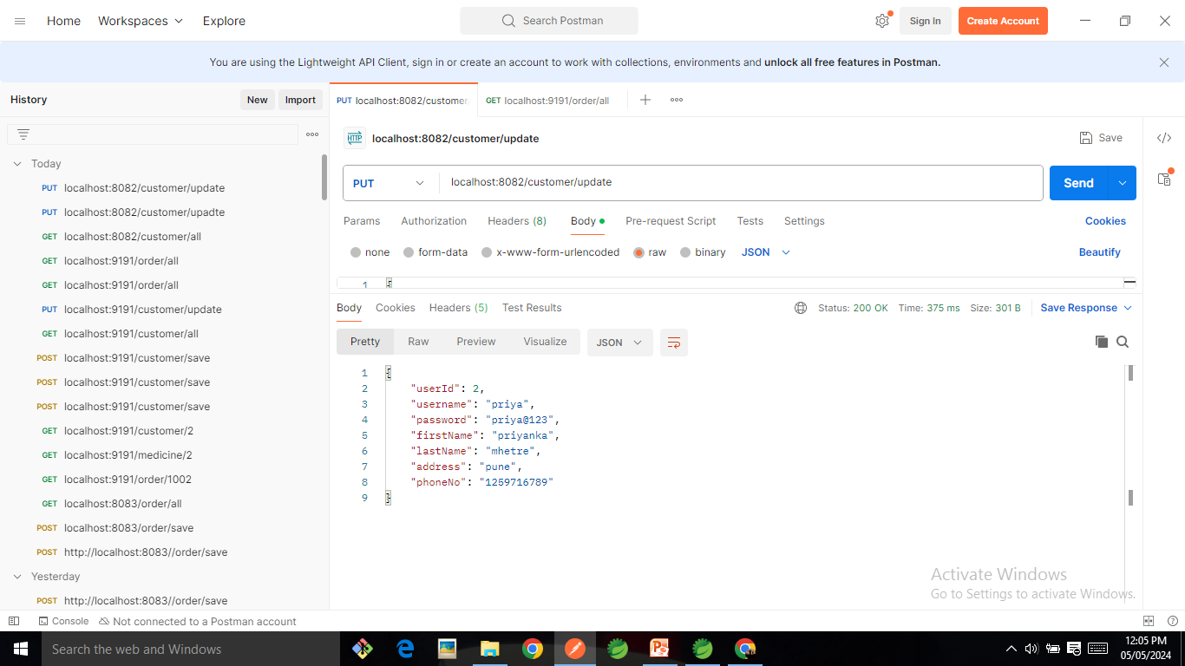
Update Customer

Slide 11
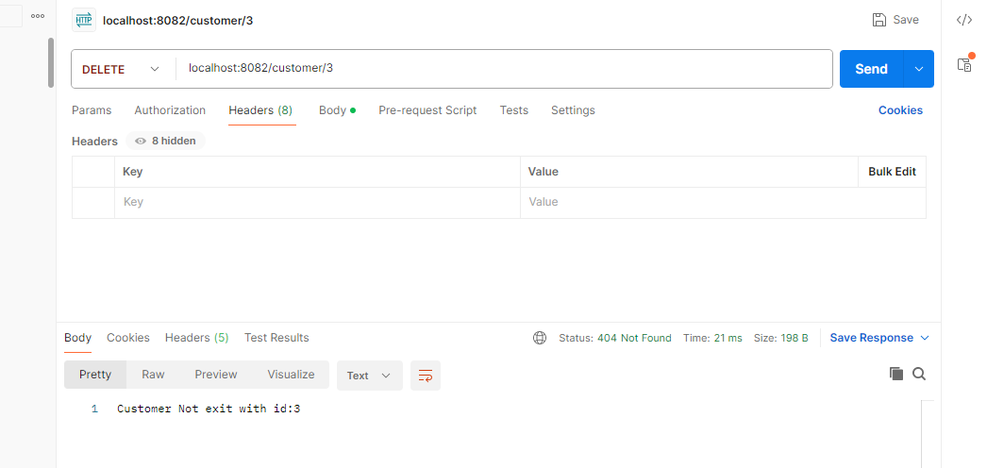
Delete Customer

Slide 12
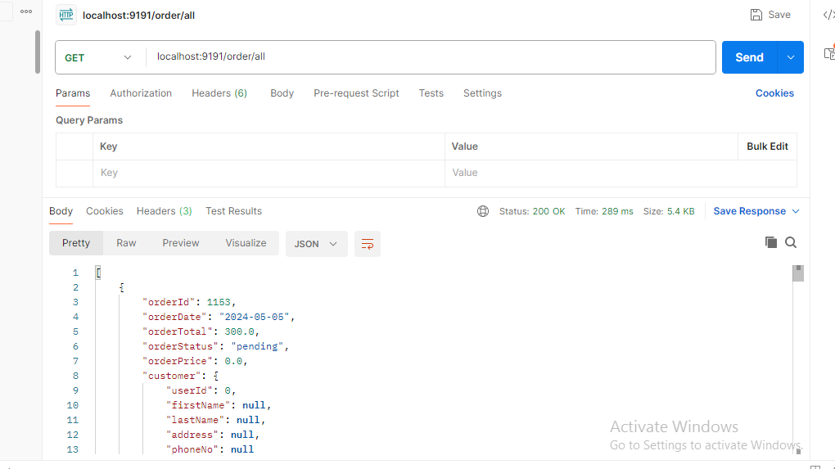
Circuit Breaker- resilience4j

Slide 13
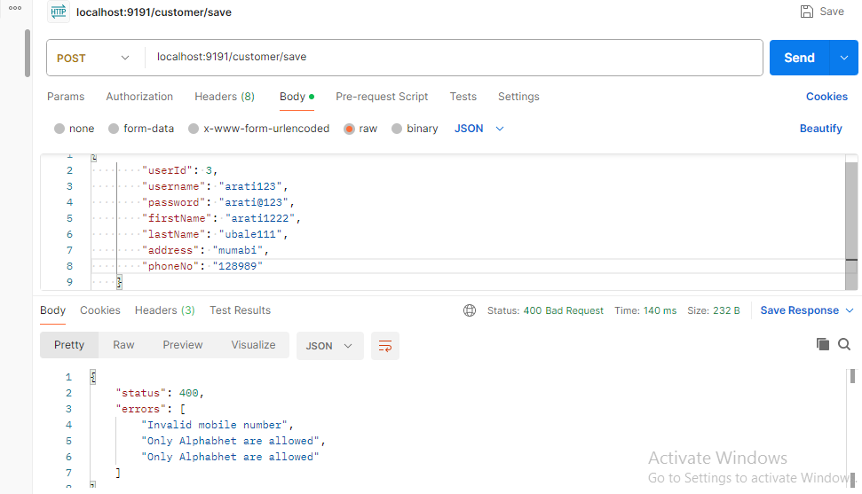
Basic Validation :

Slide 14
Conclusion
In conclusion, our microservices-based Ayurveda medicine application offers a streamlined solution for medicine management. Through Spring Boot, Oracle, and a modular approach, we've created a scalable, efficient system that simplifies ordering, management, and validation processes..

Slide 15

Thank you for listening !

