Slide 1
Credit Card Fraud Detection under Class Imbalance:
Is Balancing the Training Data Necessary?
MSc Data Science and Artificial Intelligence: Research Project Presentation
Student Name
Priyam Patel Vikasbhai
Student Email
[Insert SHU student email]
School
School of Computing and Digital Technologies
College
College of Business, Technology and Engineering (BTE)
University
Sheffield Hallam University
Supervisor
Gregor Milligan
Date
[Insert submission date]
P. Patel Vikasbhai (SHU)
Credit Card Fraud Detection — MSc DS&AI
[Insert submission date] 1 / 37

Slide 2
Acknowledgements
Project Support Recognition
I thank my supervisor, Gregor Milligan, for steady guidance throughout this project — particularly for encouraging me to treat evaluation metrics and performance analysis as a topic in their own right, which led directly to the train-versus-test diagnostic that became this project's main contribution.
I also thank the academic and technical staff of the department for the resources that made this project possible, and my fellow students for the discussions that helped me correct an early misreading of my own results. Finally, I thank my family for their patience while this project was completed.
P. Patel Vikasbhai (SHU)
Credit Card Fraud Detection — MSc DS&AI
[Insert submission date] 2 / 37

Slide 3
Presentation Agenda I
1
Introduction
2
Literature Review
3
Research Methodology
4
Ethics
5
Implementation
P. Patel Vikasbhai (SHU)
Credit Card Fraud Detection — MSc DS&AI
[Insert submission date] 3 / 37

Slide 4
Presentation Agenda II
6
Results
7
Evaluation
8
Conclusion
9
References
10
AI Declaration
P. Patel Vikasbhai (SHU)
Credit Card Fraud Detection — MSc DS&AI
[Insert submission date] 4 / 37

Slide 5
1. Introduction
P. Patel Vikasbhai (SHU)
Credit Card Fraud Detection — MSc DS&AI
[Insert submission date] 5 / 37

Slide 6
Introduction: Framework, Aims & Research Questions I
Situation: Card payments are authorised in milliseconds — the first line of defence against fraud is an automated model, not a human analyst. Fraud is a tiny minority of traffic: 0.58% of training transactions and 0.39% of test transactions, across 1,852,394 records in total.
Complication: Applied practice defaults to resampling the training data before fitting a model, yet a growing body of literature (Baisholan et al., 2025; Sakho et al., 2024) argues resampling inflates published performance and hides a threshold problem. No controlled, prevalence-preserving experiment has settled this disagreement.
Resolution: This project runs a controlled experiment — identical features, algorithms, hyperparameters and test set — changing only the training class ratio, then evaluates every model on one untouched, realistically imbalanced test partition.
Research Questions
RQ1: Is it necessary or beneficial to balance the training data, or is training on the original imbalanced distribution preferable?
RQ2: When fraud labels are available, do supervised classifiers outperform classic unsupervised anomaly detectors, and by what margin?
P. Patel Vikasbhai (SHU)
Credit Card Fraud Detection — MSc DS&AI
[Insert submission date] 6 / 37

Slide 7
Introduction: Aims, Objectives & Course Alignment II
Aim: Determine, through a controlled experiment, whether balancing the training distribution improves fraud detection at realistic fraud rates, and how supervised classification compares with unsupervised anomaly detection when labels are available.
1
Review the literature on class imbalance in fraud detection.
2
Build a leakage-aware feature engineering pipeline from raw transactions.
3
Train Logistic Regression and Random Forest under original and Random-Under-Sampled regimes.
4
Evaluate all models on one untouched test partition using a six-metric suite.
5
Use train-versus-test gaps to separate overfitting from prior mismatch.
6
Benchmark unsupervised anomaly detectors against the supervised classifiers.
Benefits & Beneficiaries
Deliverable & Course Alignment
Card issuers gain lower fraud losses and a lighter review workload; merchants gain fewer chargebacks and fewer wrongly declined sales; cardholders gain less fraud exposure and less friction.
A reproducible pipeline across four Python notebooks — data loading and feature engineering, exploratory analysis, model training, and evaluation — where each stage saves its outputs for the next stage to read. An applied, quantitative project built entirely in Python, matching the MSc Data Science and AI course pathway.
P. Patel Vikasbhai (SHU)
Credit Card Fraud Detection — MSc DS&AI
[Insert submission date] 7 / 37

Slide 8
2. Literature Review
P. Patel Vikasbhai (SHU)
Credit Card Fraud Detection — MSc DS&AI
[Insert submission date] 8 / 37

Slide 9
Literature Review: The Balancing Controversy I
Balance the Training Data
Preserve the Original Imbalance
Oztemel & Isik (2025) — oversampling is the most-reported treatment for imbalance, 2020–2024.
Chawla et al. (2002) — SMOTE reliably raises minority-class recall.
Muaz et al. (2020) — RUS and SMOTE-family methods are competitive across classifiers.
Baisholan et al. (2025) — resampling inflates published scores relative to deployment.
Sakho et al. (2024) — the benefit of rebalancing is largely a threshold effect, not a modelling one.
Carvalho et al. (2025) — resampling amplifies class overlap rather than resolving it.
Strengths & weaknesses: both camps rely on comparisons that change training and test data together, or draw on different datasets, which makes it hard to isolate the real effect of resampling from the effect of dataset choice.
Well-rounded contrast: this project tests both positions directly, under controlled conditions, on the same realistically imbalanced test set.
P. Patel Vikasbhai (SHU)
Credit Card Fraud Detection — MSc DS&AI
[Insert submission date] 9 / 37

Slide 10
Literature Review: Metric Debate & Gaps II
PR-AUC vs. ROC-AUC: convention favours PR-AUC under severe imbalance (Davis & Goadrich, 2006; Saito & Rehmsmeier, 2015). Richardson et al. (2024) argue the opposite — ROC-AUC is stable as class prevalence changes, while PR-AUC confuses prevalence with classifier quality. Both metrics are reported here, and neither is allowed to stand alone.
Six Gaps This Project Addresses
1
Evaluation sets are often balanced along with training, contaminating the test.
2
Class-prior mismatch is routinely misdiagnosed as overfitting.
3
Statistical metrics are rarely translated into operational review workload.
4
Supervised and unsupervised approaches are compared across incompatible studies.
5
Simple baselines are under-reported relative to complex methods.
6
Feature engineering choices are under-documented and leakage is under-checked.
P. Patel Vikasbhai (SHU)
Credit Card Fraud Detection — MSc DS&AI
[Insert submission date] 10 / 37

Slide 11
3. Research Methodology
P. Patel Vikasbhai (SHU)
Credit Card Fraud Detection — MSc DS&AI
[Insert submission date] 11 / 37

Slide 12
Research Methodology: The Research Onion Integration I
Layer | Choice | Justification
Philosophy | Positivist | with a pragmatist strand in design choices — the question is measurable and testable
Approach | Deductive | tests two propositions drawn directly from the literature
Methodology | Quantitative & experimental | every construct is a numeric measurement
Strategy | Controlled computational experiment | cross-sectional, archival dataset
Time horizon | Single forward-looking split | official temporal train/test partition, not a random shuffle
Alternatives Considered and Rejected
Qualitative interviews: would add context but cannot answer a measurable-behaviour question.
Practitioner survey: establishes belief, not correctness.
Mixed methods: excluded on time and ethics grounds — would require human participants and a higher ethics category.
Project alignment: each layer traces directly back to the two research questions — a deductive, quantitative, controlled design is the only one that isolates the effect of the training class ratio.
P. Patel Vikasbhai (SHU)
Credit Card Fraud Detection — MSc DS&AI
[Insert submission date] 12 / 37

Slide 13
4. Ethics
P. Patel Vikasbhai (SHU)
Credit Card Fraud Detection — MSc DS&AI
[Insert submission date] 13 / 37

Slide 14
Ethics: Governance & Data Collection I
Data collection strategy: no primary data was collected from people. The dataset is the Credit Card Transactions Fraud Detection Dataset (Kartik2112, 2020, Kaggle), generated by the Sparkov simulator across 1,000 simulated cardholders and 800 simulated merchants.
Data source & storage: downloaded from Kaggle under its public licence, stored locally for the duration of the project, and deleted at the end of assessment.
Data analysis: quantitative — supervised and unsupervised models scored with a six-metric suite (accuracy, precision, recall, F1, ROC-AUC, PR-AUC), compared across training regimes.
Ethics Approval Registration
Approved via Blackboard under category UREC1 (no human participants) prior to any data processing. The dataset contains no personal data under the UK GDPR at any stage.
P. Patel Vikasbhai (SHU)
Credit Card Fraud Detection — MSc DS&AI
[Insert submission date] 14 / 37

Slide 15
Ethics: Risk Management II
Risk | Mitigation
Data leakage between train/test | Scaler fitted on training data only; transaction-ID overlap verified numerically as zero
Balanced-model failure misread as overfitting | Every model scored on train and test; the train-minus-test gap is reported explicitly
Unsupervised detectors infeasible at full scale | One-Class SVM / LOF fitted on a documented 40,000-record subsample; reported as a limitation
Misreading imbalanced-data metrics | Six metrics reported together rather than accuracy alone
Synthetic-data validity limits | Findings reported as an upper bound, not a deployment guarantee
Reproducibility drift | A single fixed random seed (42) used across every stochastic step
P. Patel Vikasbhai (SHU)
Credit Card Fraud Detection — MSc DS&AI
[Insert submission date] 15 / 37

Slide 16
5. Implementation
P. Patel Vikasbhai (SHU)
Credit Card Fraud Detection — MSc DS&AI
[Insert submission date] 16 / 37

Slide 17
Implementation: Pipeline Architecture & Lifecycle I
1
Data Acquisition
Load official train/test files, preserving temporal order
Deliverable
2
Exploratory Analysis
Quantify prevalence; profile amount, time & category
Four Jupyter notebooks:
01_data_loading.ipynb
02_eda.ipynb
03_model_training.ipynb
04_evaluation.ipynb
3
Feature Engineering
Derive 6 features; one-hot category; drop identifiers
4
Matrix Preparation
Fit scaler on train only; align columns
5
Balanced Subset
Random Under-Sampling 1:1
Tools
6
Model Fitting
5 models, 2 regimes, fixed seed = 42
Python 3, Jupyter Notebook, pandas, NumPy, scikit-learn, matplotlib, seaborn, pyarrow, joblib.
7
Evaluation & Analysis
Score on untouched test; train-vs-test diagnostics
Shared execution sequence for both experiments (Study One — RQ1, Study Two — RQ2), split across the four notebooks
P. Patel Vikasbhai (SHU)
Credit Card Fraud Detection — MSc DS&AI
[Insert submission date] 17 / 37

Slide 18
Implementation: Source Code, Testing & Deployment II
# 01_data_loading.ipynb — stage 1 of 4
def haversine_km(lat1, lon1, lat2, lon2):
lat1, lon1, lat2, lon2 = map(np.radians, [lat1, lon1, lat2, lon2])
dlat, dlon = lat2 - lat1, lon2 - lon1
a = np.sin(dlat/2)**2 + np.cos(lat1)*np.cos(lat2)*np.sin(dlon/2)**2
return 2 * 6371 * np.arcsin(np.sqrt(a))
def engineer_features(df):
out = df.copy()
out['age'] = (out['trans_date_trans_time']
- out['dob']).dt.days / 365.25
out['hour'] = out['trans_date_trans_time'].dt.hour
out['is_night'] = out['hour'].between(0, 5)
out['distance_km'] = haversine_km(
out['lat'], out['long'],
out['merch_lat'], out['merch_long'])
out['log_amt'] = np.log1p(out['amt'])
out = pd.get_dummies(out, columns=['category'],
drop_first=True)
return out
train_fe.to_parquet(OUT / 'data/train_fe.parquet')
Testing & Validation Framework
Eight system-level checks, all passed: no missing values · no duplicate rows · zero transaction-ID overlap · exact 1:1 class parity in the balanced set · scaler fitted on training data only · identical metrics on re-run under the fixed seed · identical columns across train and test · identical metrics after the code was split into four notebooks.
Deployment Model
A reproducible research pipeline, not a hosted service. The same four notebooks run on a local machine or as four chained Kaggle kernels, each stage reading the previous stage's output. Every run is deterministic under the fixed seed.
Identifiers removed explicitly: card number, transaction ID, names, address, merchant name, occupation, raw latitude/longitude and Unix timestamp — each could let a flexible model memorise entities instead of generalising.
P. Patel Vikasbhai (SHU)
Credit Card Fraud Detection — MSc DS&AI
[Insert submission date] 18 / 37

Slide 19
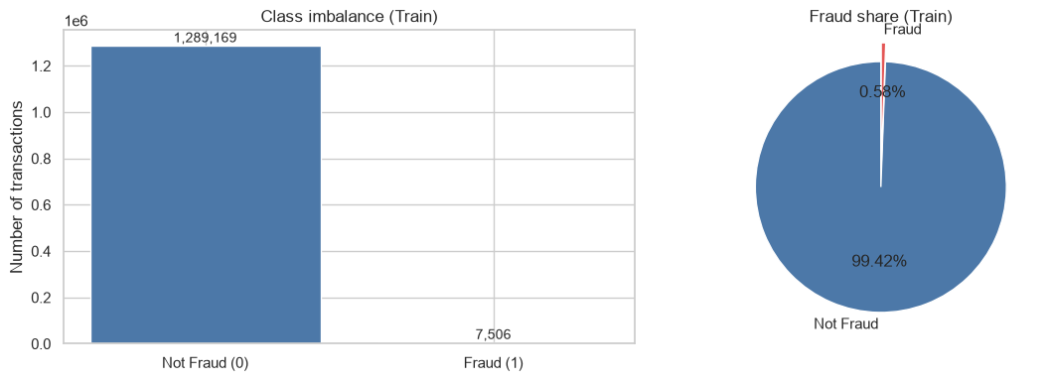
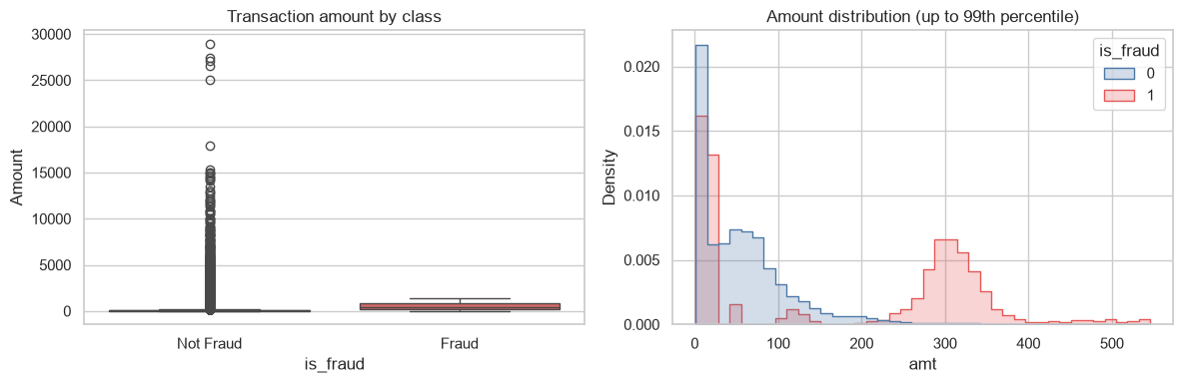
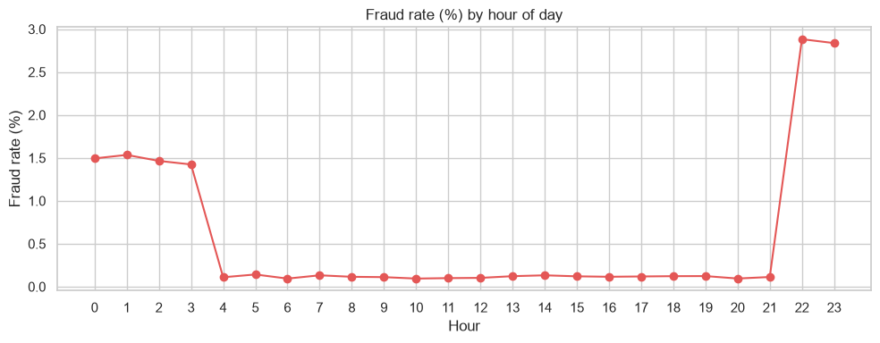
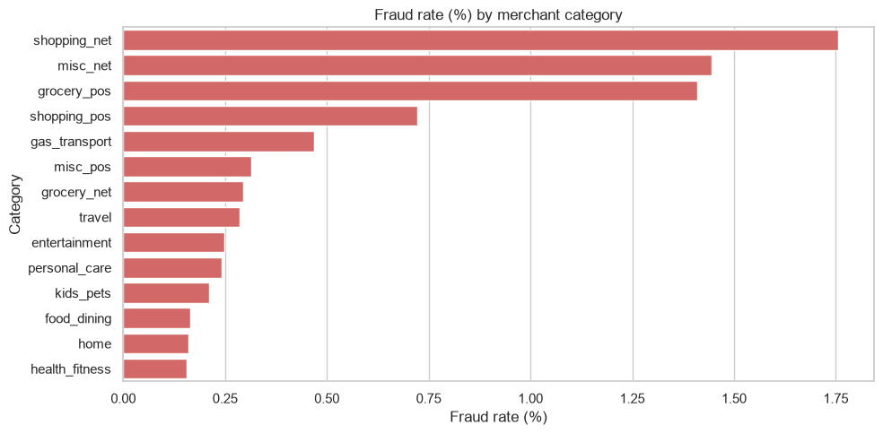
Implementation: Exploratory Evidence Behind the Design III
The exploratory analysis below directly shaped the feature engineering used in Stage 3 of the pipeline.
Class imbalance: training and test partitions
Transaction amount by class
Fraud rate by hour of day
Fraud rate by merchant category
P. Patel Vikasbhai (SHU)
Credit Card Fraud Detection — MSc DS&AI
[Insert submission date] 19 / 37

Slide 20
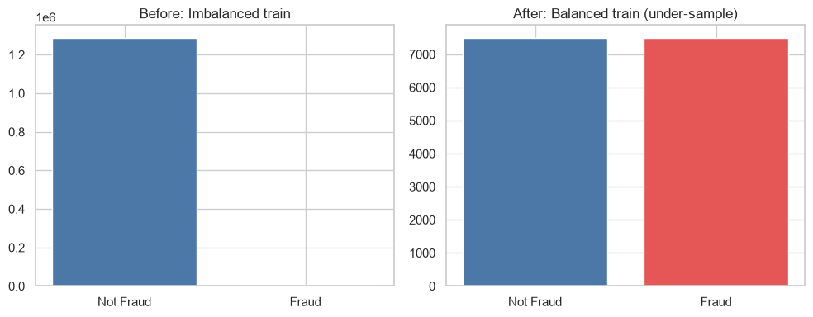
Implementation: Balanced Subset & Model Configuration IV
Model | Type | Key configuration
Logistic Regression | Supervised | max_iter=1000, L2 default
Random Forest | Supervised | n_estimators=100, max_depth=16
Isolation Forest | Unsupervised | n_estimators=100, contamination = train fraud rate
One-Class SVM | Unsupervised | RBF kernel, nu=0.01, 40k legitimate subsample
Local Outlier Factor | Unsupervised | n_neighbors=20, novelty=True, same subsample
Training class distribution before and after Random Under-Sampling
Reproducibility: a single fixed random seed (42) used across every stochastic step.
1,281,663
15,012
legitimate rows discarded (99.42% of majority class)
rows in the balanced 1:1 training set (7,506 = 7,506)
P. Patel Vikasbhai (SHU)
Credit Card Fraud Detection — MSc DS&AI
[Insert submission date] 20 / 37

Slide 21
6. Results
P. Patel Vikasbhai (SHU)
Credit Card Fraud Detection — MSc DS&AI
[Insert submission date] 21 / 37

Slide 22
Results: Headline Findings I
A classifier predicting “legitimate” for every record would score 99.61% accuracy while catching zero fraud — accuracy alone is discarded as a decision criterion.
Model | Accuracy | Precision | Recall | F1 | ROC-AUC | PR-AUC
Imbalanced · Logistic Regression | 0.9967 | 0.7778 | 0.2186 | 0.3413 | 0.8619 | 0.3463
Imbalanced · Random Forest | 0.9989 | 0.9426 | 0.7506 | 0.8357 | 0.9961 | 0.8819
Balanced · Logistic Regression | 0.8977 | 0.0303 | 0.8233 | 0.0585 | 0.9514 | 0.1633
Balanced · Random Forest | 0.9787 | 0.1506 | 0.9716 | 0.2608 | 0.9968 | 0.8014
Highlighted trade-off: the Imbalanced Random Forest gives the best overall balance across the six-metric suite.
P. Patel Vikasbhai (SHU)
Credit Card Fraud Detection — MSc DS&AI
[Insert submission date] 22 / 37

Slide 23
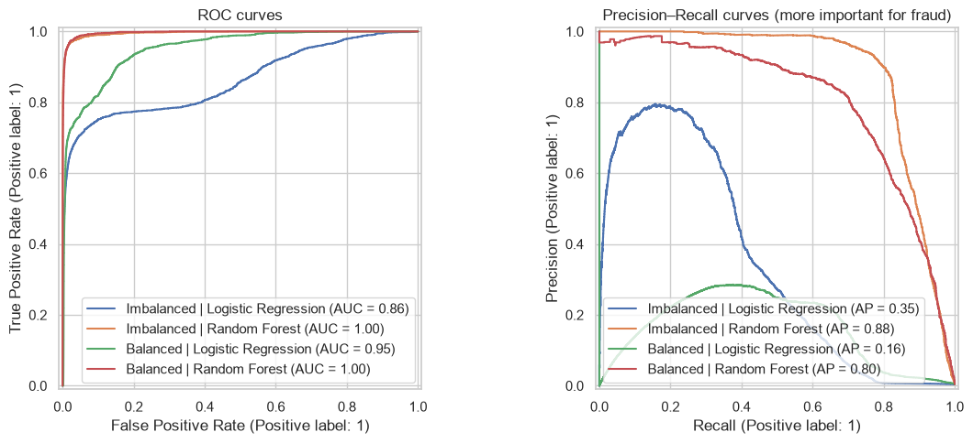
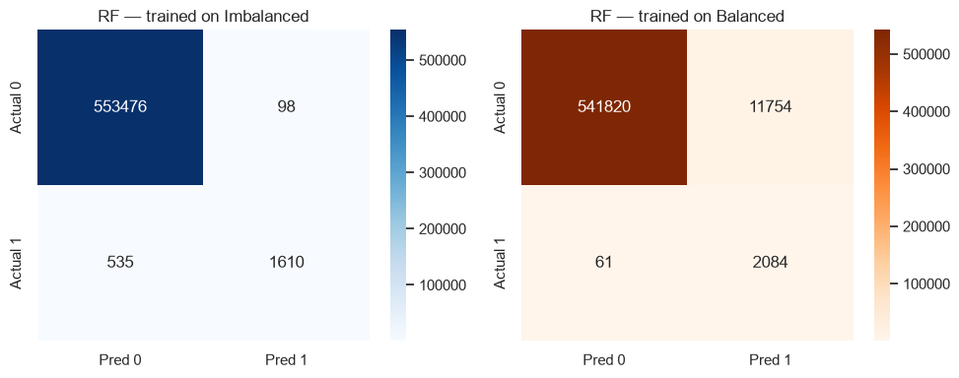
Results: Discrimination & Decision Evidence II
Confusion matrices, Random Forest, imbalanced vs. balanced regime
ROC and precision-recall curves, all four supervised models
 | Imbalanced RF | Balanced RF
Alerts raised | 1,708 | 13,838
Frauds missed | 535 | 61
Reviews per fraud found | 1.1 | 6.6
P. Patel Vikasbhai (SHU)
Credit Card Fraud Detection — MSc DS&AI
[Insert submission date] 23 / 37

Slide 24
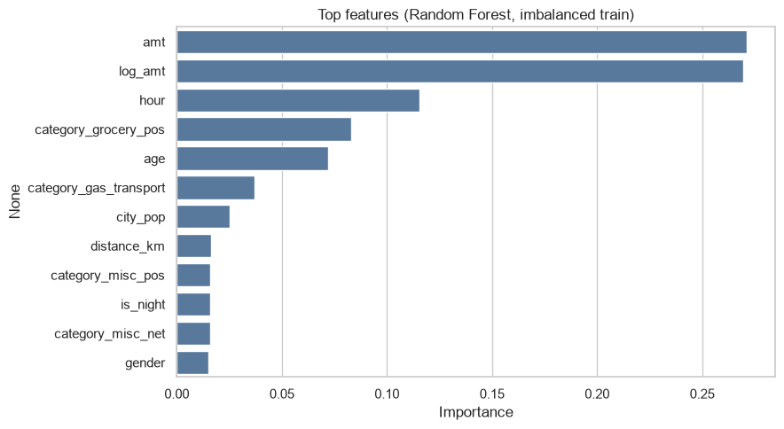
Results: Alignment to the Research Question III
Alignment to RQ1: the Imbalanced Random Forest gives the best precision, F1 and PR-AUC while raising the fewest alerts — directly answering RQ1 that balancing is not required for strong detection on this dataset.
Amount dominates: amount and log-amount lead feature importance, consistent with fraud averaging far higher spend than legitimate transactions.
Temporal signal confirmed: hour and the night indicator carry real weight.
Caveat: impurity-based importance is a plausibility check, not a causal account.
Top twelve features by importance (Random Forest, imbalanced train)
P. Patel Vikasbhai (SHU)
Credit Card Fraud Detection — MSc DS&AI
[Insert submission date] 24 / 37

Slide 25
7. Evaluation
P. Patel Vikasbhai (SHU)
Credit Card Fraud Detection — MSc DS&AI
[Insert submission date] 25 / 37

Slide 26
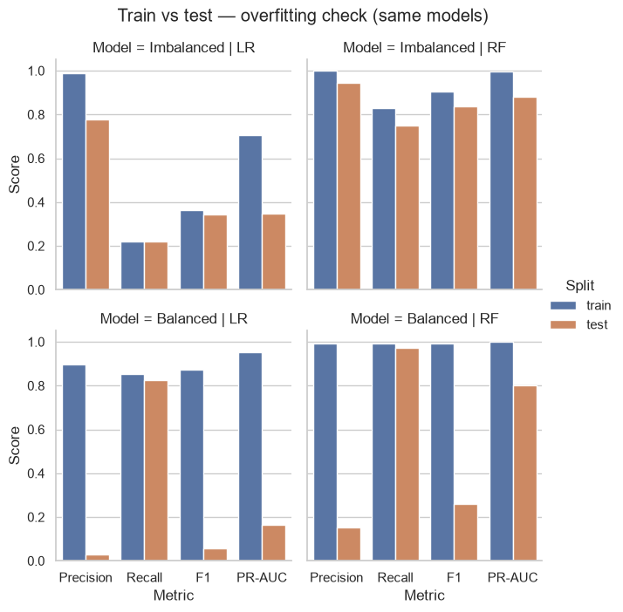
Evaluation: Ranking vs. Decision — Prior Mismatch, Not Overfitting I
Recall barely moves: balanced RF goes from 0.9923 (train) to 0.9716 (test) — an overfitted model would not generalise this well.
Precision collapses instead: 0.9936 → 0.1506, because the false-positive rate stays the same while its denominator grows from 7,506 to 553,574 legitimate test rows.
ROC-AUC is nearly identical: 0.9961 vs. 0.9968 — both Random Forests rank transactions almost equally well.
Diagnosis: this is class-prior mismatch, fixed by adjusting the decision threshold, not by retraining.
Train vs. test performance, all four supervised models
P. Patel Vikasbhai (SHU)
Credit Card Fraud Detection — MSc DS&AI
[Insert submission date] 26 / 37

Slide 27
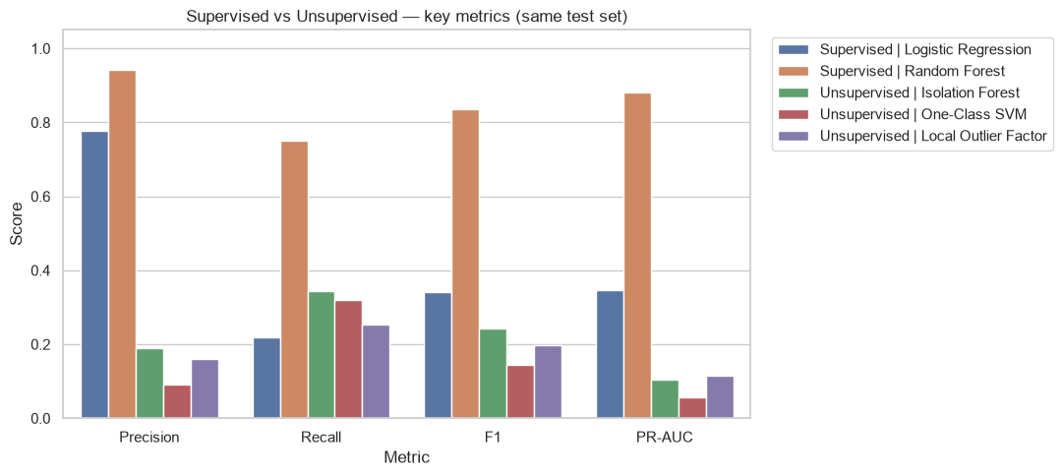
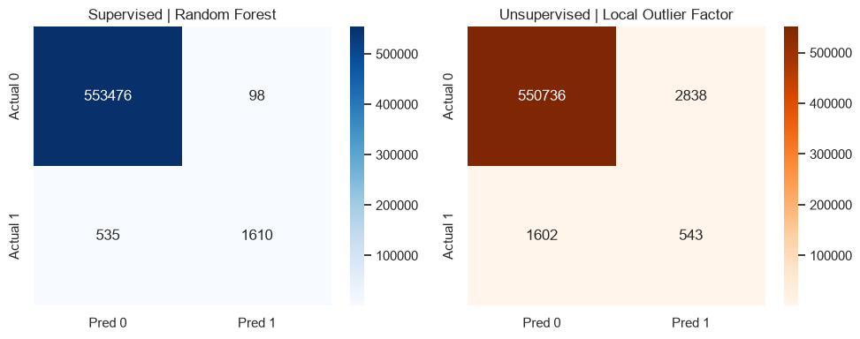
Evaluation: Supervised vs. Unsupervised Detection II
Confusion matrices, best supervised vs. best unsupervised model
Key metrics, supervised classifiers vs. unsupervised detectors
7.6×
1,610 / 1,708
higher PR-AUC for supervised Random Forest (0.8819) vs. best unsupervised detector, LOF (0.1159)
vs. 543 / 3,381 for LOF — RF catches about 3× the fraud from roughly half the alerts
P. Patel Vikasbhai (SHU)
Credit Card Fraud Detection — MSc DS&AI
[Insert submission date] 27 / 37

Slide 28
Evaluation: Validation Route, Strengths & Limitations III
Applied Route
Systematic Route
Not applicable — this project has no human participants or end users (UREC1), so no user acceptance testing or participant feedback was collected.
Supervisor critique through review meetings, reflective self-evaluation against the six-metric suite, and cross-checking every reported number against the notebook outputs before writing.
Strengths: a controlled, realistic answer to an unsettled question; a working diagnostic for prior mismatch versus overfitting.
Weaknesses & limitations: synthetic dataset (figures are an upper bound); only one balancing ratio tested; no formal threshold sweep; two unsupervised detectors subsampled to 40,000 records; a single train/test split, so no confidence interval.
Feedback application: supervisor feedback on the initial, incorrect “overfitting” reading of the balanced model directly led to the train-versus-test diagnostic that is now this project's central contribution.
P. Patel Vikasbhai (SHU)
Credit Card Fraud Detection — MSc DS&AI
[Insert submission date] 28 / 37

Slide 29
8. Conclusion
P. Patel Vikasbhai (SHU)
Credit Card Fraud Detection — MSc DS&AI
[Insert submission date] 29 / 37

Slide 30
Conclusion: Resolution of Gaps and Objectives I
Addressing literature gaps: the controlled design keeps the test set untouched (Gap 1), the train-vs-test diagnostic separates prior mismatch from overfitting (Gap 2), operational costs are reported alongside statistical metrics (Gap 3), supervised and unsupervised methods are compared on the same test set (Gap 4), Logistic Regression is reported as a simple baseline (Gap 5), and every feature engineering decision — including a zero-leakage check — is documented (Gap 6).
Objective Completion Mapping — 6 / 6 Met
✓
Literature reviewed
✓
Leakage-checked pipeline built
✓
Both regimes trained
✓
All models evaluated
✓
Prior mismatch diagnosed
✓
Unsupervised benchmark done
P. Patel Vikasbhai (SHU)
Credit Card Fraud Detection — MSc DS&AI
[Insert submission date] 30 / 37

Slide 31
Conclusion: Answering the Research Questions II
RQ1: balancing is not necessary, and helps only under a narrow, quantifiable condition. Imbalanced RF wins on precision (0.9426), F1 (0.8357) and PR-AUC (0.8819); balancing trades precision for recall at a cost of 25.6 extra reviews per extra fraud caught. The balanced model's failure is prior mismatch, fixed by threshold adjustment, not retraining.
RQ2: where labels exist, supervised classification is clearly better — 7.6× higher PR-AUC than the best unsupervised detector.
Limitations
Future Work
Synthetic corpus — figures are an upper bound, not a deployment guarantee.
Only one balancing ratio tested.
No formal threshold sweep performed.
Single temporal split — no confidence intervals.
Cost-optimal threshold search across the full decision range.
Compare SMOTE and intermediate balancing ratios.
Add gradient-boosted models (XGBoost, LightGBM) with calibration.
Validate the findings on real, non-synthetic transaction data.
P. Patel Vikasbhai (SHU)
Credit Card Fraud Detection — MSc DS&AI
[Insert submission date] 31 / 37

Slide 32
9. References
P. Patel Vikasbhai (SHU)
Credit Card Fraud Detection — MSc DS&AI
[Insert submission date] 32 / 37

Slide 33
References: APA 7th Edition Style Mapping I
Baisholan, N., et al. (2025). A systematic review of ML in credit card fraud detection under original class imbalance. Computers, 14(10), 437.
Carvalho, M., Pinho, A. J., & Brás, S. (2025). Resampling approaches to handle class imbalance: A review from a data perspective. Journal of Big Data, 12(1), 71.
Chawla, N. V., et al. (2002). SMOTE: Synthetic minority over-sampling technique. Journal of AI Research, 16, 321–357.
C-Rella, J., Cao, R., & Vilar, J. M. (2024). Cost-sensitive thresholding over a two-dimensional decision region for fraud detection. Information Sciences, 657, 119956.
Dal Pozzolo, A., et al. (2018). Credit card fraud detection: A realistic modeling and a novel learning strategy. IEEE TNNLS, 29(8), 3784–3797.
Davis, J., & Goadrich, M. (2006). The relationship between Precision-Recall and ROC curves. Proc. 23rd ICML, 233–240.
He, H., & Garcia, E. A. (2009). Learning from imbalanced data. IEEE TKDE, 21(9), 1263–1284.
Kartik2112. (2020). Credit card transactions fraud detection dataset [Data set]. Kaggle.
P. Patel Vikasbhai (SHU)
Credit Card Fraud Detection — MSc DS&AI
[Insert submission date] 33 / 37

Slide 34
References: APA 7th Edition Style Mapping II
Liu, F. T., Ting, K. M., & Zhou, Z.-H. (2008). Isolation forest. Proc. 8th IEEE ICDM, 413–422.
Oztemel, E., & Isik, M. (2025). A systematic review of intelligent systems and analytic applications in credit card fraud detection. Applied Sciences, 15(3), 1356.
Richardson, E., et al. (2024). The receiver operating characteristic curve accurately assesses imbalanced datasets. Patterns, 5(6), 100994.
Saito, T., & Rehmsmeier, M. (2015). The precision-recall plot is more informative than the ROC plot for imbalanced datasets. PLOS ONE, 10(3), e0118432.
Sakho, A., Malherbe, E., & Scornet, E. (2024). Do we need rebalancing strategies? A theoretical and empirical study around SMOTE and its variants [Preprint]. arXiv.
Saunders, M. N. K., Lewis, P., & Thornhill, A. (2023). Research methods for business students (9th ed.). Pearson.
Schölkopf, B., et al. (2001). Estimating the support of a high-dimensional distribution. Neural Computation, 13(7), 1443–1471.
Xuan, S., et al. (2018). Random forest for credit card fraud detection. IEEE 15th ICNSC, 1–6.
P. Patel Vikasbhai (SHU)
Credit Card Fraud Detection — MSc DS&AI
[Insert submission date] 34 / 37

Slide 35
10. AI Declaration
P. Patel Vikasbhai (SHU)
Credit Card Fraud Detection — MSc DS&AI
[Insert submission date] 35 / 37

Slide 36
AI Use Transparency Statement (AITS 2 Alignment) I
AI Transparency Scale (AITS) Declaration
This assessment aligns with AITS Level 2 (AI for Shaping), permitted under university academic conduct policy.
AI tools used: a general-purpose AI writing assistant, used during the preparation of the written report.
Purpose of AI use: preliminary brainstorming, structuring chapter and section outlines, and copy-editing to enhance clarity and consistent terminology.
Human contribution: all design choices, all code used for analysis, all experiments, and all numbers presented were authored independently. Each reference was independently verified against the publisher's listing or the Crossref registry.
Reflection on AI use: AI helped structure the report and refine language, but every technical statement and number was cross-checked manually against the notebook outputs before being written down.
P. Patel Vikasbhai (SHU)
Credit Card Fraud Detection — MSc DS&AI
[Insert submission date] 36 / 37

Slide 37
Thank You!
Questions & Academic Discussion Welcome
Primary Contact Address:
[Insert SHU student email]
P. Patel Vikasbhai (SHU) Credit Card Fraud Detection — MSc DS&AI 37 / 37

