Slide 1
PROJECT TITLE
CAPSTONE PROJECT
Presented By:
1. M Priyadharshini-Yogi Vemana University-ECE

Slide 2
OUTLINE
Problem Statement
Proposed System/Solution
System Development Approach (Technology Used)
Algorithm & Deployment
Result (Output Image)
Conclusion
Future Scope
References

Slide 3
Problem Statement
The Pradhan Mantri Gram Sadak Yojana (PMGSY) is a flagship rural development program in India, initiated to provide all-weather road connectivity to eligible unconnected habitations. Over the years, the program has evolved through different phases or schemes (PMGSY-I, PMGSY-II, RCPLWEA, etc.), each with potentially distinct objectives, funding mechanisms, and project specifications. For government bodies, infrastructure planners, and policy analysts, efficiently categorizing thousands of ongoing and completed projects is crucial for effective monitoring, transparent budget allocation, and assessing the long-term impact of these schemes. Manual classification is time-consuming, prone to errors, and scales poorly. This project addresses the need for an automated system to classify these projects accurately based on PMGSY_SCHEME based on its physical and financial characteristics.

Slide 4
Proposed Solution
Develop a machine learning model to classify rural infrastructure projects under their respective PMGSY schemes (PMGSY-I, II, III) using physical and financial project data.
This model will support faster decision-making for monitoring, budgeting, and impact analysis of government projects.
Data Collection:
Used the official AI Kosh dataset containing details of PMGSY projects from across India.
Data Preprocessing:
Cleaned the dataset by removing nulls and unused columns, and normalized numerical features.
Machine Learning Algorithm:
Trained multiple models using IBM Watson AutoAI; the best-performing model was the Snap Random Forest Classifier.
Deployment:
Best model selected using IBM Watson AutoAI
Deployed as an online service in IBM Watson Studio
Evaluation:
Evaluated using accuracy, with the final model achieving 92.4%. Additional evaluation included prediction confidence and visualization.

Slide 5
System Approach
This section outlines the overall strategy and methodology for building a machine learning model to classify PMGSY rural infrastructure projects using IBM Watson tools.
System requirements
IBM Watson Studio (AutoAI)
IBM Cloud Lite
AI Kosh PMGSY Dataset (CSV Format)

Slide 6
Algorithm & Deployment
This section outlines the machine learning approach used to classify rural infrastructure projects into the correct PMGSY scheme using project-level features.
Algorithm Selection: Snap Random Forest Classifier (chosen based on performance by AutoAI)
Data Input: Project statistics such as road/bridge length, cost, completion status, and expenditure
Training Process: The model was trained using IBM AutoAI, which split the data, applied preprocessing, and optimized model parameters through automated evaluation
Prediction Process: Once deployed, the model predicts the correct PMGSY scheme for new project data via a web-based API hosted on IBM Watson Studio

Slide 7
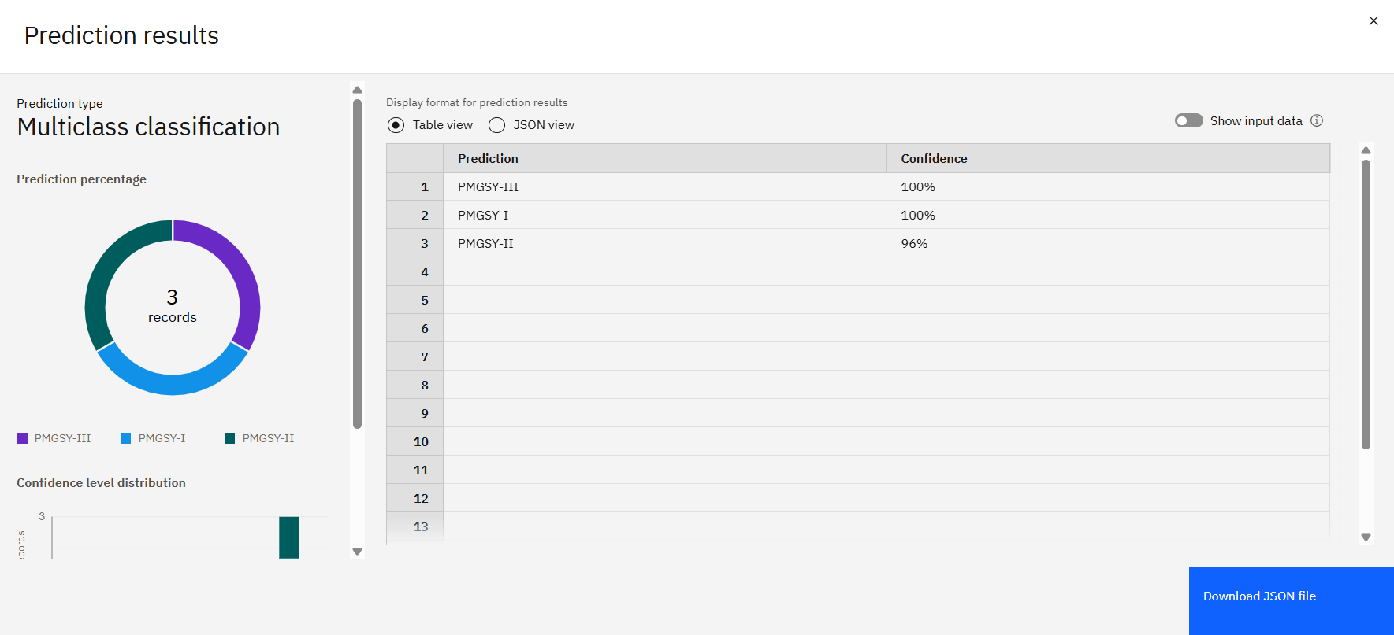
Result

Slide 8
Conclusion
Successfully automated the classification of rural infrastructure projects
High model accuracy (92.4%) achieved using IBM AutoAI
Reduced manual errors and improved scalability for government analysis
Simplifies future project tracking

Slide 9
Future scope
Expand model to include additional states, time factors, and satellite input
Integrate into public dashboard or government portals
Enhance with geolocation & real-time status tracking
Fine-tune models with new data regularly for accuracy

Slide 10
References
AI Kosh Dataset
IBM Watson Studio Documentation
IBM Cloud Lite Services
ML Algorithms used in AutoAI
GitHub Repository link:
https://github.com/priyamaddela26/Project_IBMCloud

Slide 11
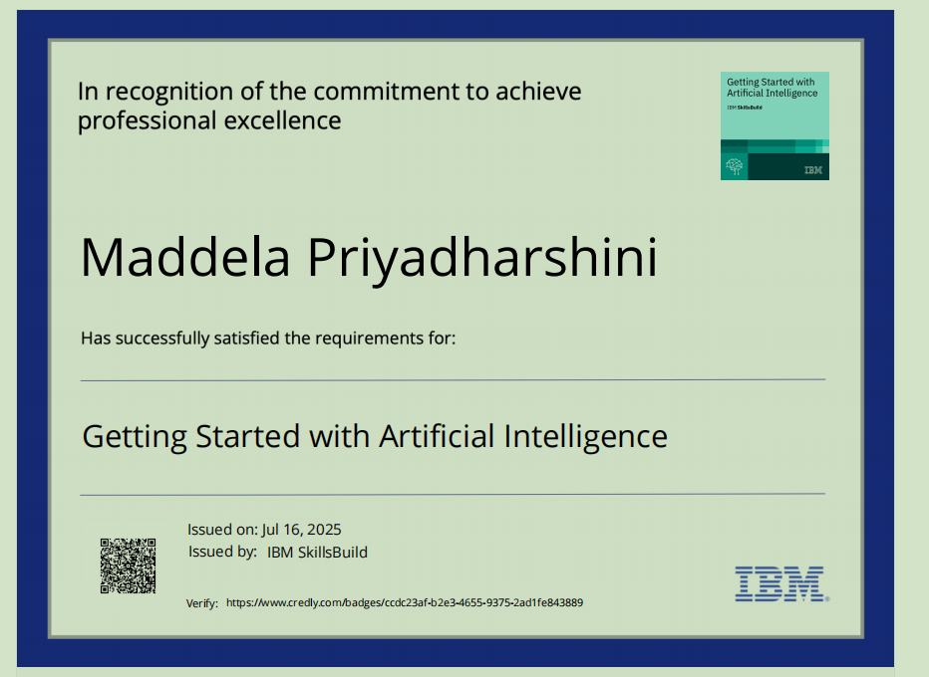
IBM Certifications

Slide 12

IBM Certifications

Slide 13
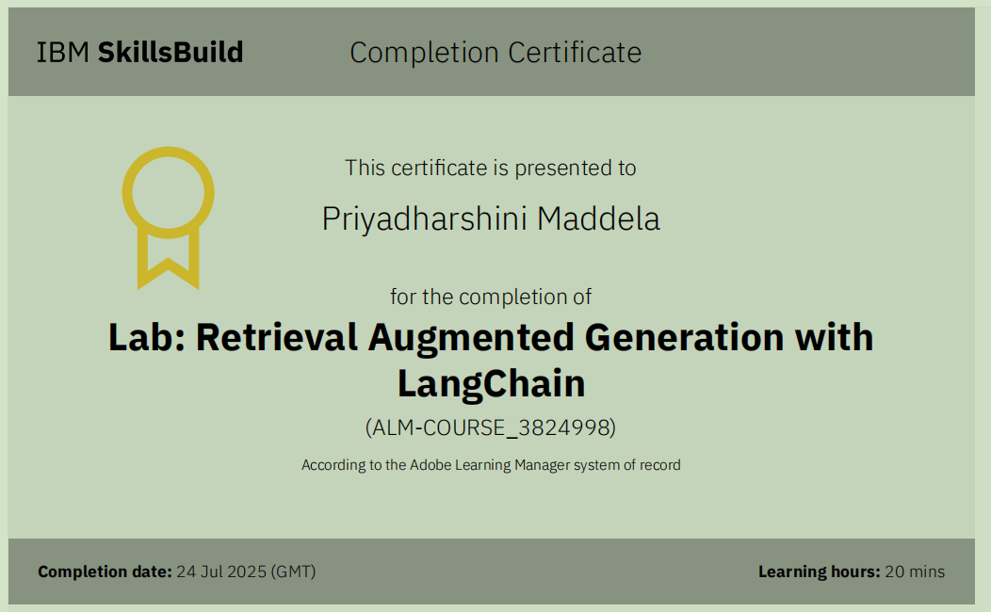
IBM Certifications

Slide 14
THANK YOU

