Slide 1




DIGITAL PORTFOLIO
student information
**Student Name**: Priyadharshini .B
**Registration Number and NMID **:34624U23025 and 556F364CD9E2697B18F4DD507B04898F
**Department**:Bsc Information System And Management
**College/University**:M.M.E.S. WOMEN'S ARTS AND SCIENCE COLLEGE/THIRUVALLUVAR UNIVERSITY

Slide 2
PROJECT TITLE
Digital portfolio

Slide 3

Agenda
1. **Problem Statement**
2. **Project Overview **
3. **End Users**
4. **Tools and Technologies**
5. **Portfolio Design and Layout**
6. **Features and Functionality**
7. **Results and Screenshots**
8. **Conclusion**
9. **GitHub Link**

Slide 4
Problem statement
In today’s digital era, individuals lack a centralized
and accessible platform to showcase their skills,
achievements,and projects in a professional manner.

Slide 5
project overview
This project aims to create a digital portfolio that acts as an online
resume and personal brand platform. It displays educational background,
projects, skills, and achievements in an interactive and appealing format.

Slide 6
Who Are The End Users
“End users are the people who directly use a product, system, or service.
They interact with the final output to fulfill their needs, making them
the ultimate focus of design and development. ”

Slide 7
Tools and Techniques
Frontend: HTML, CSS, JavaScript
Backend: (Optional) Node.js / PHP
Frameworks: React.js / Bootstrap
Other Tools: GitHub, Figma (for design), VS Code

Slide 8
Protfolio Design and Layout
"A creative showcase of personal achievements, skills,
and projects presented through an engaging portfolio design.
Focused on layout, aesthetics, and user-friendly navigation to
leave a lasting impression. "

Slide 9
Features and Functionality
Mobile responsive design
Dynamic project display
Contact form with validation
Integration with GitHub and LinkedIn
Downloadable resume

Slide 10



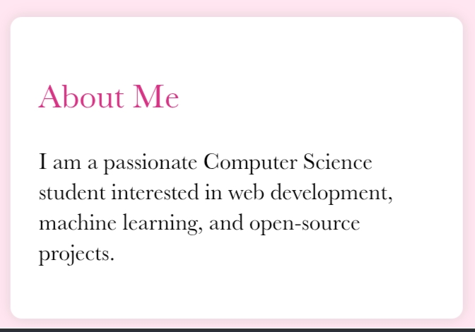
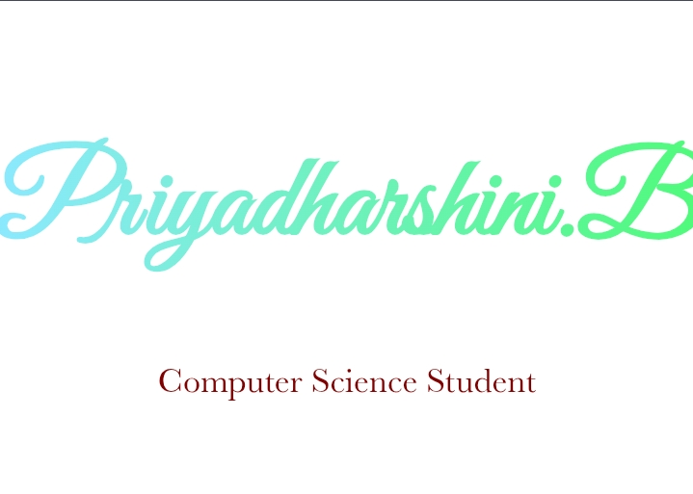
Results and Screenshots
The portfolio website was successfully developed using HTML, CSS, and
JavaScript with interactive design features. Below are screenshots
showcasing the layout, projects, and contact form.

Slide 11
Conclusion
The digital portfolio provides an effective, professional way to present skills and work online.
It improves visibility and opportunities in academic and professional fields.
It’s a scalable project with potential for future enhancements.

Slide 12
GitHub Link
https://github.com/priyamangay195-byte/Priya/tree/main

Slide 13
THANK YOU

