Slide 1
SQL · E-COMMERCE ANALYSIS
E-commerce
Sales Analysis
Turning transaction data into business decisions with PostgreSQL.

Slide 2



PROJECT SCOPE
What the project answers
Three questions connect the transaction table to practical business decisions.
Where growth comes from
Where friction appears
What to do next
Which channels, customers, products, and regions drive revenue?
Where do cancellations, returns, and delivery issues appear?
How can SQL analysis guide marketing, inventory, and retention decisions?

Slide 3
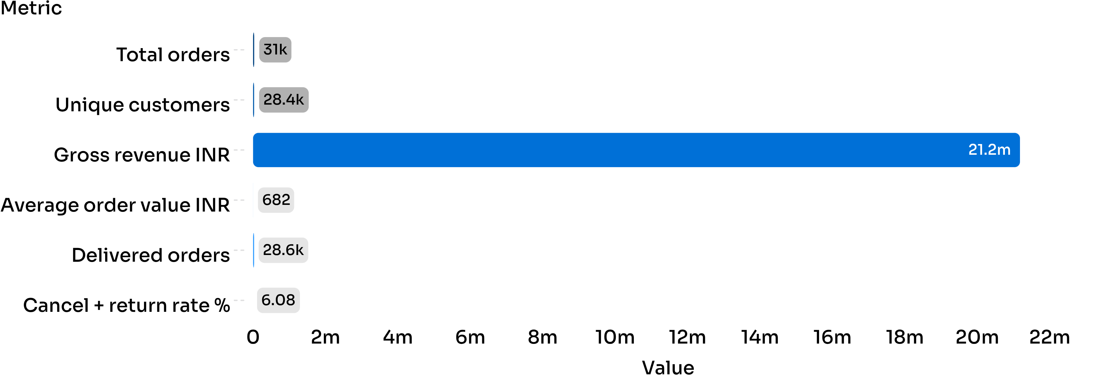
EXECUTIVE SNAPSHOT
The dataset at a glance
31,047 orders create a broad base for customer, channel, category, and regional analysis.
Source: E-Commerce Sales Analysis Report · High delivery completion with a 6.08% combined cancellation and return rate.

Slide 4
METHOD
How the analysis was built
PostgreSQL turns row-level transactions into comparable business views.
Aggregations
CASE expressions
Window functions
Date functions
Conditional aggregation
Revenue, orders, units, and averages.
Monthly performance trends.
Age bands, regions, and order types.
Revenue share and status percentages.
Cancellation, return, and refund analysis.

Slide 5
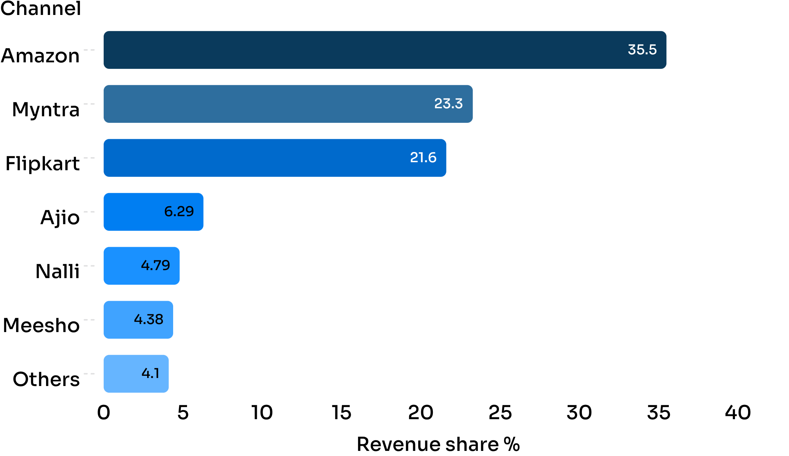
CHANNEL MIX
Amazon leads the channel mix
35.48%
Amazon contributes 35.48% of total revenue.
Amazon and Flipkart together contribute approximately 57.08% of revenue.
Source: E-Commerce Sales Analysis Report · Revenue share by channel.

Slide 6
CUSTOMER ECONOMICS
Women drive volume; men spend more per order
Gender | Orders | Revenue INR | Average order value INR
Women | 21,553 | ₹13,562,773 | ₹629.28
Men | 9,494 | ₹7,613,604 | ₹801.94
Women drive scale
Women generate 64% of revenue through higher order volume.
Men show a higher AOV of ₹801.94 versus ₹629.28.
Source: E-Commerce Sales Analysis Report · Gender sales comparison.

Slide 7
AGE MIX
Customers aged 26–45 are the volume engine
Age group | Orders | Revenue INR | Average order value INR
26–35 | 7,850 | ₹5,352,829 | ₹681.89
36–45 | 7,793 | ₹5,314,130 | ₹681.91
18–25 | 6,206 | ₹4,221,619 | ₹680.25
46–55 | 4,354 | ₹2,983,560 | ₹685.25
66+ | 2,743 | ₹1,886,910 | ₹687.90
26–35 + 36–45
Both groups generate approximately ₹5.3M in revenue.
66+
Highest displayed AOV at ₹687.90.
Source: E-Commerce Sales Analysis Report · Orders by age group.

Slide 8
SEGMENT PRIORITIES
Women aged 26–45 are the strongest value segment
WOMEN · 26–35
WOMEN · 36–45
MEN · 36–45
₹3,475,674
₹3,344,271
₹799.13
Across 5,520 orders.
Across 5,328 orders.
Higher AOV.
Use segment-specific retention for women 26–45 and premium recommendations for men 36–45.
Source: E-Commerce Sales Analysis Report · Segment-specific revenue, orders, and AOV.

Slide 9
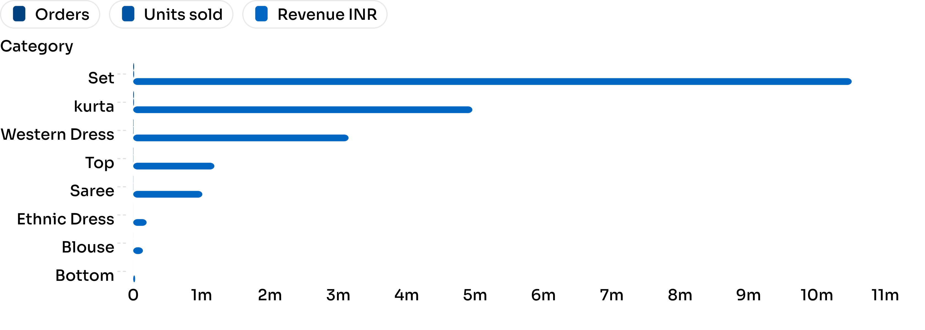
PRODUCT MIX
Sets are the clear category leader
Sets generate more than twice the revenue of Kurta, creating a clear inventory priority.
Source: E-Commerce Sales Analysis Report · Revenue by product category. Bottom has the lowest displayed order volume.

Slide 10
REGIONAL PERFORMANCE
South India leads regional performance
SOUTH INDIA
NORTH INDIA
12,111
9,043
Orders
Orders
₹7,964,480 revenue
₹6,552,921 revenue
Approximately 34% more orders
South India versus North India.
Next move
Protect availability in the South while testing growth plays in North and West India.
Source: E-Commerce Sales Analysis Report · Regional orders and revenue.

