Slide 1

AI staff on WhatsApp that answers your customers — and knows when to call your team
SwarmAI
Customer desk · Knowledge base · Team assistant
Notes:
SwarmAI puts an AI assistant on the channels your customers already use — WhatsApp, Telegram and the web. It answers from your own documents, and the moment it is unsure, or the customer wants a person, it hands the chat to your team. Nothing that matters happens without a human OK.

Slide 2



Your customers message you all day
Same questions, every day
Messages after hours wait
Chats scattered on phones
Timings, prices, “where is my order”, directions — your staff answer them again and again.
A customer who writes at 10 pm hears back the next morning — or goes to a competitor.
Staff reply from personal phones. Nobody sees who answered what, or which chat is still open.
The result: slow replies, tired staff and leads that never come back.
Notes:
Ask the customer how many WhatsApp messages they get a day, how many are repeat questions, and what happens to messages that arrive after hours.

Slide 3







Meet SwarmAI
A team of AI agents that works on the channels your customers already use — and always lets your people take over.
Customer desk
Answers customers 24×7 on WhatsApp and Telegram, and hands the chat to your team when needed.
Knowledge base
Learns from your PDFs, Word files, web pages and FAQs — and quotes them, not the internet.
WhatsApp
Telegram
Team assistant
Web app
Voice notes
Email, calendar, tasks, reminders, expenses and research for your own staff.
Notes:
Three products on one platform. Most customers start with the customer desk plus the knowledge base; the team assistant is an add-on for owners and staff.

Slide 4


How a customer conversation flows
1. Customer writes
2. Bot answers
3. Hands over
4. Team replies
5. Bot resumes
On WhatsApp or Telegram — text or voice note, in their own language.
From your documents, naming the source. If it isn’t there, it says so.
Customer asks for a person, is upset, wants a refund or booking — or the answer isn’t known.
Staff get an alert with a summary and reply from the Inbox, on the customer’s own chat.
One click hands the chat back. The bot knows what your team said.
While a person is handling the chat, the bot stays silent — your customer never gets two answers.
Notes:
This is the core loop. Steps 1–2 handle the repeat questions automatically. Steps 3–5 are what makes it safe: the bot knows its limits and your team stays in charge.

Slide 5
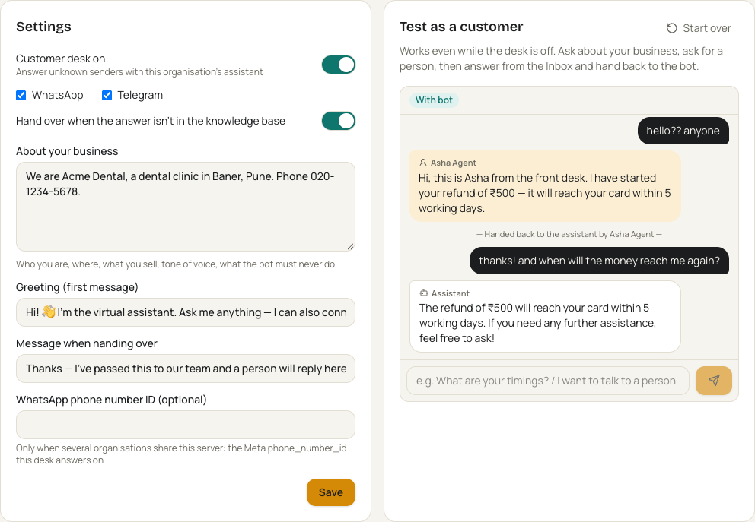
The customer desk in action
Answers in the customer’s language
English, Hindi, Hinglish — text or voice notes.
Hands over with a summary
Your team sees why the customer needs a person.
Quiet while your team replies
Then picks up exactly where they left off.
Test before you go live
“Test as a customer” runs the full flow in the browser.
Notes:
Screenshot from the admin console with a demo dental clinic. On the right, a staff member answered a refund question, handed the chat back, and the bot answered the follow-up using what the staff member said.

Slide 6
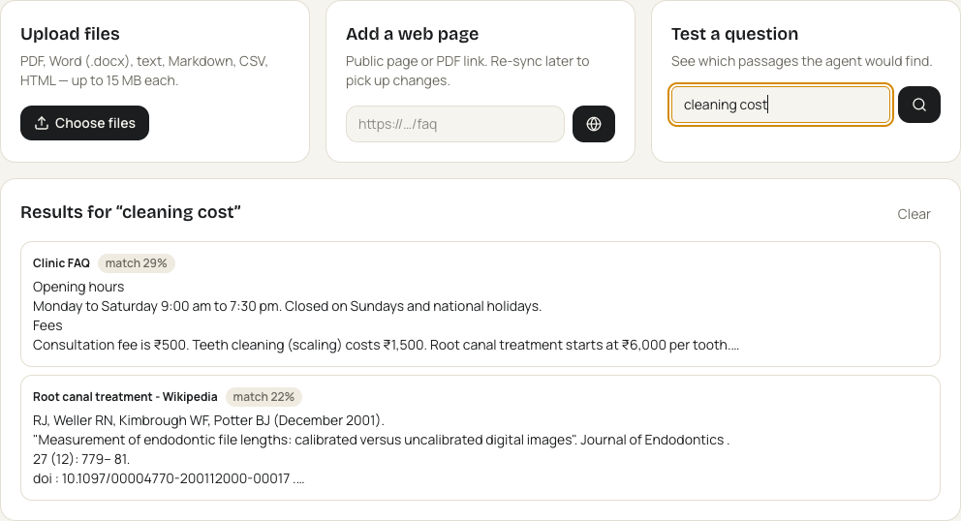




Answers only from your documents
Add your content
PDF, Word, web pages, or paste your FAQs and price list.
Searched by meaning
“kitna lagega cleaning ka” finds “Teeth cleaning: ₹1,500”.
Answer with the source
Every answer names the document and page.
No guessing
Not in your documents? It says so and hands over.
“Test a question” shows exactly which passages the bot will use — before any customer asks.
Notes:
Technically this is retrieval-augmented generation (RAG): documents are split into passages, embedded, stored in a vector index per organisation, and the most relevant passages are given to the model with an instruction to answer only from them and cite them. Scanned image-only PDFs need OCR first.

Slide 7









An assistant for your team, too
Email
Calendar
Knowledge
Research
Read, summarise, draft, reply
Agenda, free slots, invites
Your documents, cited
Web and news, with sources
Tasks & contacts
Expenses
Reminders
Notes & memory
To-dos, Google Sheet sync
Log from a receipt photo
On WhatsApp, Telegram, web
Remembers preferences
Travel
Shopping
Documents
Your own agents
Flights, hotels, trip plans
Price compare, drop alerts
Summarise, extract, translate
Built in the admin console
It works without being asked
Morning brief · urgent-mail alerts · meeting prep · follow-up nudges · price-drop alerts · weekly review — delivered on WhatsApp or Telegram.
Notes:
One message can use several agents at once: “log ₹450 lunch, remind me at 5 to call Ravi, and what’s the weather in Pune tomorrow”. Email and calendar connect per person to their own Google account.

Slide 8





You stay in control
Approval before action
Customers stay in their lane
Roles for your team
Sending email, deleting, or any tool you choose waits for a person to approve.
Customer chats can only use safe tools — never your mailbox, tasks or files.
Owner, admin, agent and member. Invite links that expire after 7 days.
Full audit log
Your data, kept separate
Your own AI account
Every action, take-over and reply is recorded and searchable.
Documents and conversations are isolated per organisation.
Optionally use your own OpenAI key, stored encrypted.
Notes:
The biggest objection is “what if the AI does something wrong?”. Answer: anything with a side effect is a proposal a human approves, customers physically cannot reach internal tools, and every action is logged.

Slide 9


Always on, safely hosted
Customers & team
One secure entrance
SwarmAI
Backups & alerts
WhatsApp, Telegram and the web app — from any phone or browser.
Encrypted HTTPS only. Nothing else on the server is reachable from the internet.
AI agents, workflows and your data on a private network inside the server.
Every night, kept 14 days. Your team is told on Telegram if anything fails.
Runs 24×7
Invite-only access
Or in your own cloud
In the cloud — restarts itself after a crash or reboot. Your laptop can be off.
Only people you invite can create an account on your SwarmAI.
The same setup runs on your server with your own AI account.
Notes:
How it is run: one cloud server with a single encrypted entrance; everything else (AI agents, workflow engine, database) is on a private network inside it. Containers restart automatically, health is checked continuously, the database is backed up every night and the team gets a Telegram message if a backup fails. Sign-up is invite-only on hosted servers. For clients who need it, the same setup runs in their own cloud with their own AI account.

Slide 10
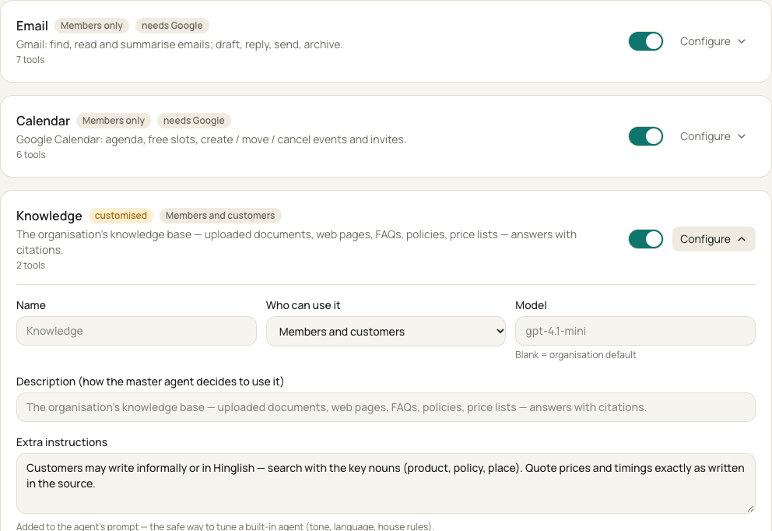

Set up without writing code
Switch agents on or off
Add house rules: tone, language, what never to say
Choose models and which tools need approval
Create your own agents
Apply an industry pack in one click
Invite your team and set roles
See usage, approvals and the audit log
Notes:
Everything a client changes later — greeting, hand-over message, instructions, documents — is done in the admin console. Changes reach the bot within about 30 seconds.

Slide 11







Ready-made industry packs
AVAILABLE NOW
ON THE ROADMAP
Sales & leads
WhatsApp Support Desk
Product, order and policy questions answered from your documents. Complaints, refunds and cancellations go straight to your team with the order details collected.
Collections
HR & hiring
Real estate
Clinic Front Desk
Timings, fees, doctors and test preparation. Never gives medical advice. Appointment requests go to the front desk; emergencies get the 112 message.
Education
D2C commerce
Notes:
A pack is a preset: agents, instructions, greeting and hand-over rules for an industry. We load your documents on top and tune it during the pilot. Roadmap packs are built on request with the first client in that industry.

Slide 12
Live in four weeks
Week 1
Week 2
Week 3
Week 4
Discover & load
Configure & test
Soft launch
Review & go live
Your top questions, hand-over rules and documents go into the knowledge base.
Greeting, tone and pack set up. Your team tests as customers.
Live on your WhatsApp number. Your team handles hand-overs from the Inbox.
We review the numbers together, fill knowledge gaps and switch fully on.
WHAT WE MEASURE
Questions answered by the bot
First-reply time
Chats handed to your team
Customer satisfaction
Notes:
You provide: your FAQs, price list and policies; a WhatsApp Business number verified with Meta; and one or two staff for the Inbox. We agree the target numbers in week 1.

Slide 13
Simple, predictable pricing
Starter
Growth
Enterprise
₹4,999 /month
₹12,999 /month
Custom
1 channel (WhatsApp or Telegram)
3 team seats
500 customer chats / month
50 documents
Email support
WhatsApp + Telegram + web
10 team seats
3,000 customer chats / month
Industry pack + custom agents
Team assistant for staff
Unlimited seats and chats
Your own cloud or server
Your own AI account and keys
Custom integrations
Priority support
All plans are hosted 24×7 with HTTPS and nightly backups. One-time setup from ₹25,000 per pack. WhatsApp charges from Meta are billed at cost. Prices exclude GST and are indicative — the final quote follows the discovery call.
Notes:
Indicative prices — confirm before sending. A pilot can be offered as the setup fee plus the first month at Starter price.

Slide 14
Let’s start with a 4-week pilot
1. A 30-minute call about your customers’ top questions
2. You share your FAQs, price list and policies
3. Within a week, you test SwarmAI on your own data
[Your name] · [email] · [phone]
Notes:
Replace the contact line before sending.

