Slide 1



Integrated Program in Business Analytics
Retail Revenue Forecasting
Group K

Slide 2
Agenda
Retail Revenue Forecasting Overview and Objectives
Retail Data Overview
Data Pre-Processing
Exploratory Data Analysis Results and Outcomes
Forecasting using ARIMA Model
Forecasting using Facebook Prophet Model
Recommendations and Business Impact
Appendix

Slide 3




Retail Revenue Forecasting Overview and Objectives
The main objective is to forecast the sales or Revenue of a retail store in the US based on the historical data
Sales forecasting templates will make it easier to project future sales & adjust the strategy
Depending on the sales forecasting, we might also get access to:
More accurate cash flow projections
Predict expenses
See where to invest marketing dollars
Better allocate hiring budgets
Spot emerging trends early
See potential issues in the sales flow early

Slide 4
Retail Data Overview
The data collected is a daily invoice data for a retail store in the USA
The available is ~ 3 years of daily transaction data Start Date – 20th April 2019 End Date – 04th December 2022
Few additional data insights are as below –
Distinct Products – 40
Distinct Customers – 1979
Distinct Invoices - 32351
Different Available Packaging Sizes of Products – 4
Different Shelf Space Positions - 3

Slide 5
Retail Data Overview
Below is the Schema of the Data and its Explanation
Sl No | Column Nam | Description
1 | Invoice | Individual Invoice Numbers
2 | Product_Code | The code of different 40 products
3 | Quantity | Quantity purchased
4 | InvoiceDate | Invoice Date
5 | InvoiceDate_timeStamp | Invoice Date Timestamp
6 | Price | Price of the product
7 | Customer_ID | Individual Customer ID
8 | Country | Country Name
9 | Pack_Size_Code | Distinct Pack Size Code
10 | In_Store_Promotion_Flag | In store Promotion flag - Promotion done or not
11 | Online_Promotion_Flag | Online Promotion flag - Promotion done or not
12 | Shelf_Space_Code | Shelf Position of the Product kept in store

Slide 6
Data Pre-Processing
As a part of Data Pre-Processing the below steps were performed –
Derive Revenue Data - The Revenue is derived by multiplying Price and Quantity at an Invoice level
Date Format Conversion - Convert the Invoice column in Date format and Sort in ascending data
One Hot Encoding - Perform One Hot Encoding for Columns - Pack_Size_Code and Shelf_Space_Code
Aggregate Data – Aggregate the below columns data at Invoice and Product level so that we get daily product wise revenue – Revenue, Price,Quantity,In_Store_Promotion_Flag,Online_Promotion_Flag,Pack_Size_Code_1,Pack_Size_Code_2,Pack_Size_Code_3,Pack_Size_Code_4,Shelf_Space_Code_1,Shelf_Space_Code_2,Shelf_Space_Code_3

Slide 7
Data Pre-Processing
As a part of Data Pre-Processing the below steps were performed –
Generate Count Measures - Additional Count Measures are generated i.e. Daily count of distinct customers and products.

Slide 8
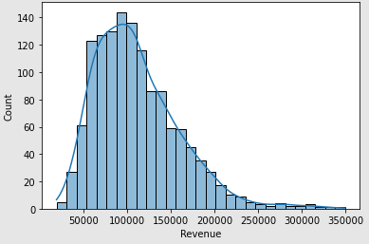
Exploratory Data Analysis Results and Outcomes
Below are the analysis and outcomes of the EDA -
Revenue Distribution Histogram –
The Histograms implies that the data is left skewed

Slide 9
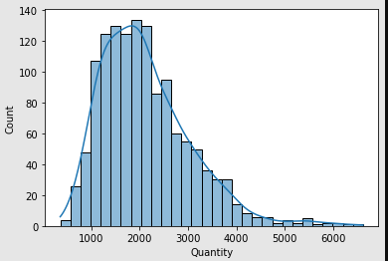
Exploratory Data Analysis Results and Outcomes
Purchase Quantity Distribution Histogram –
The Histograms implies that the data is left skewed

Slide 10
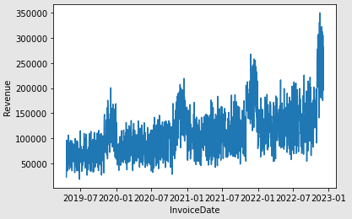
Exploratory Data Analysis Results and Outcomes
Date wise Revenue Distribution –
The distribution implies that there is seasonal peaks at the end of every year

Slide 11
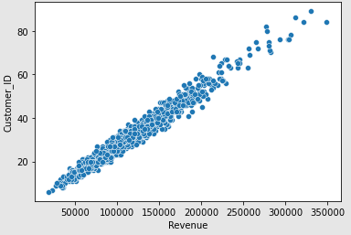
Exploratory Data Analysis Results and Outcomes
Count of Customer wise Revenue
Revenue is directly promotional to Distinct number of Customers

Slide 12
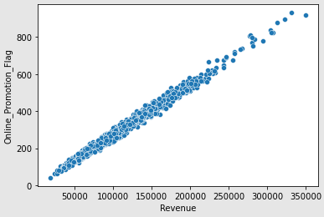
Exploratory Data Analysis Results and Outcomes
Online Promotion wise Revenue
Revenue increases as the online Promotion is increased

Slide 13
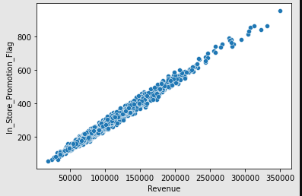
Exploratory Data Analysis Results and Outcomes
In Store Promotion wise Revenue
Revenue increases as the In Store Promotion is increased

Slide 14
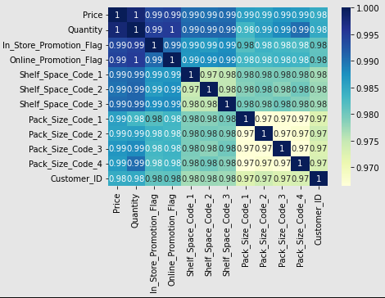
Exploratory Data Analysis Results and Outcomes
Correlation of different attributes
All the variables are highly corelated hence considering all the attributes is not required while modeling. We will proof this further while implementing the ML Modes

Slide 15
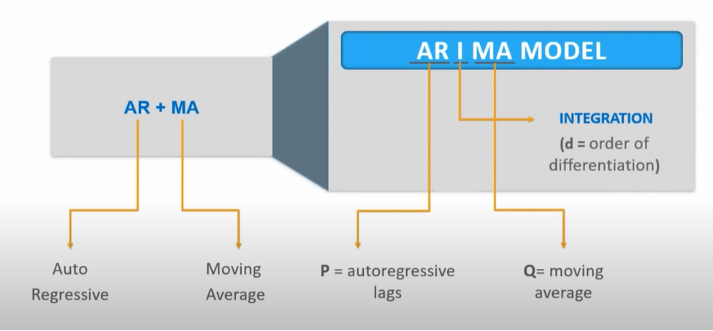
Forecasting using ARIMA Model
ARIMA – Auto Regression Integrated Moving Average
Data is regressed on itself. Lags of the stationarized series are called “autoregressive” (AR) terms
A Time series which needs to be differenced to be made stationary is an “integrated” (I) series
Linear combination of errors are is taken over time. Lags of the forecast errors are called “moving average” (MA) terms
A non-seasonal ARIMA model can be (almost) completely summarized by three numbers:
p = the number of autoregressive terms
d = the number of non-seasonal differences
q = the number of moving-average terms
Steps to follow in ARIMA:-
Make the Time Series Stationary by Differencing.
Build and Select a candidate for ARIMA Model.
Use ACF and PACF plots to determine order of q and p.
Use the chosen candidate ARIMA(p,d,q) model to forecast.
Validate the model .

Slide 16
Forecasting using ARIMA Model
To check Time series data is Stationary or not Stationary, will perform two tests.
1. Rolling Mean and Rolling Standard Deviation – Test
Calculating Rolling Mean and Standard Deviation to check for data is stationary or not stationary.
Rolling Statistics test is more of a visual technique .
In Rolling Statistics test we Plot Mean and Standard Deviation of the time series an see if it varies with time.
2. Augmented Dickey Fuller - Test
Dickey-Fuller test is statistical tests for checking stationarity.
Dickey-Fuller test comprise of a Test Statistic and some Critical Values for different confidence levels(1%, 5%, 10%)
In Dickey-Fuller test we visualize the results and if the “Test Statistic” value is less then the “Critical Value”, we can say that the time series is stationary.

Slide 17
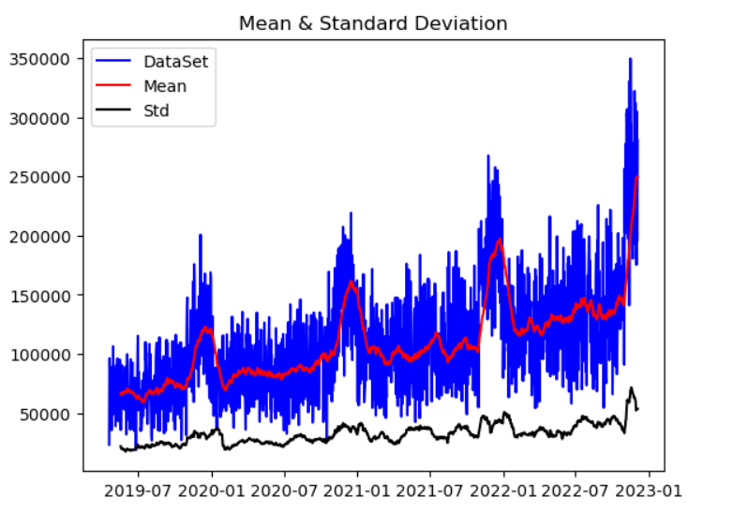
Forecasting using ARIMA Model
Rolling Mean and Rolling Standard Deviation - Test
Calculating Rolling Mean and Standard Deviation to check for data is stationary or not stationary.
Plotted the Rolling Statistics, Here the original Dataset is color blue, Mean is color Red and Std. is color Black.
Mean and Standard Deviation are not constant. Which means the data is not stationary.

Slide 18
Forecasting using ARIMA Model
Augmented Dickey Fuller Test
Results of Dickey Fuller Test Test Statistic -1.787183 P-Value 0.686843 #Lags Used 11.000000 No. Of Observations Used 1313.000000 dtype: float64 Critical Values: 1% : -3.435340198430096 Null Hypothesis Accepted. Time Series is not Stationary 5% : -2.863743768394356 Null Hypothesis Accepted. Time Series is not Stationary 10% : -2.567943297315671 Null Hypothesis Accepted. Time Series is not Stationary
Dickey Fuller Test is used to check the data is stationary or not Stationary.
As , Critical values should be grater then the Test statistics And P Values should value = 0.5
This means it will not reject the Null Hypothesis and Data is Not Stationary.

Slide 19
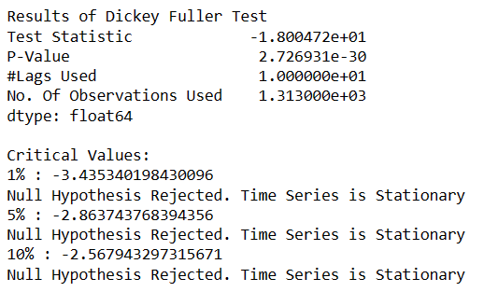
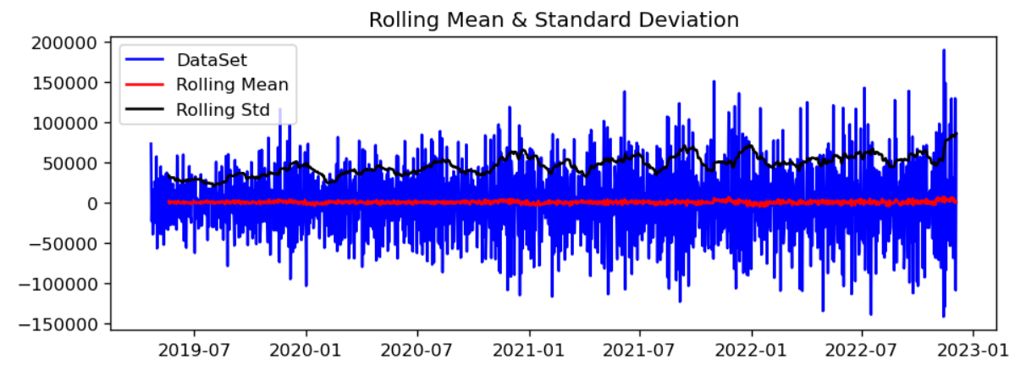
Forecasting using ARIMA Model
After Differencing “Dataset” and “Moving Average” to make the Data Stationary

Slide 20
Forecasting using ARIMA Model
Autocorrelation and Partial Autocorrelation Function
Autocorrelation and partial autocorrelation are measures of association between current and past series values and indicate which past series values are most useful in predicting future values.
With the future values we can determine the order of processes in ARIMA Model. Below is the order of processes.
ARIMA model is classified as an "ARIMA(p , d , q)" model, where:
p is the number of autoregressive,
d is the number of no seasonal differences needed for stationarity, and
q is the number of lagged forecast errors in the prediction equation.
To find out the values of Auto Regressive lag and Moving Average lag, we have to plot the ACF and PCAF graph. In order to find the P value we will plot the PACF graph and to find the Q value we will plot the ACF graph.
Method to Preferred for PACF is Ordinary Least Square.

Slide 21
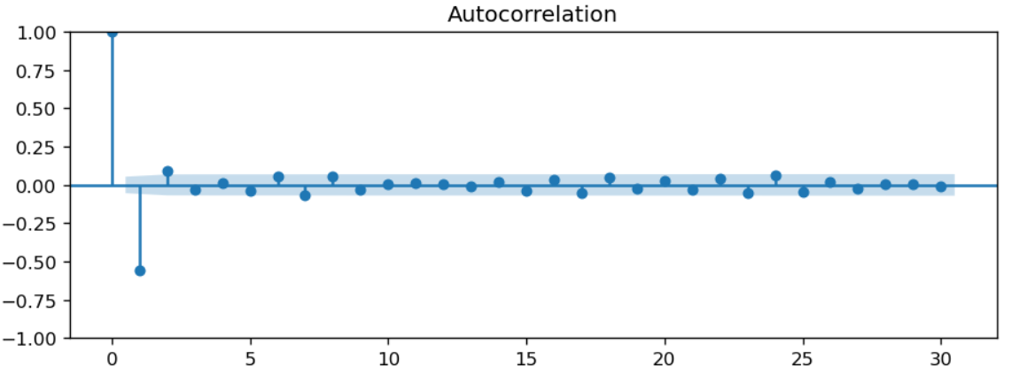
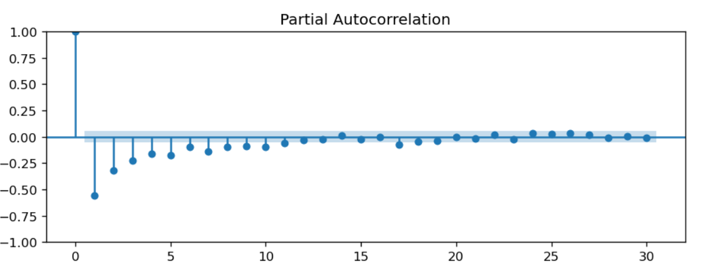
Forecasting using ARIMA Model
Autocorrelation and Partial Autocorrelation Function

Slide 22
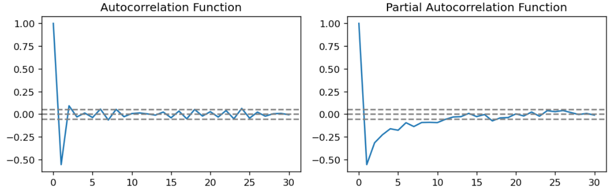
Forecasting using ARIMA Model
Autocorrelation and Partial Autocorrelation Function

Slide 23
Forecasting using ARIMA Model
ARIMA Results
==============================================================================
Dep. Variable: Sales Amount No. Observations: 1325
Model: ARIMA(2, 1, 0) Log Likelihood -547.394
Date: Sun, 22 Jan 2023 AIC 1100.789
Time: 15:38:54 BIC 1116.354
Sample: 04-20-2019 HQIC 1106.624
- 12-04-2022

Slide 24
Forecasting using ARIMA Model
ARIMA Results
Covariance Type: opg
coef std err z P>|z| [0.025 0.975]
ar.L1 -0.7087 0.027 -26.617 0.000 -0.761 -0.657
ar.L2 -0.3390 0.026 -13.285 0.000 -0.389 0.289
sigma2 -0.1338 0.005 -25.196 0.000 -0.123 -0.144
Ljung-Box (L1) (Q): 6.42 Jarque-Bera (JB): 15.01
Prob(Q): 0.01 Prob(JB): 0.00
Heteroskedasticity (H): 0.76 Skew: -0.26
Prob(H) (two-sided): 0.00 Kurtosis: 2.94
Warnings:
[1] Covariance matrix calculated using the outer product of gradients (complex-step).
[2] Covariance matrix is singular or near-singular, with condition number 1.77e+35. Standard errors may be unstable.

Slide 25
Forecasting using ARIMA Model
SARIMAX Results
SARIMAX Results
Dep. Variable: Sales Amount No. Observations: 1325
Model: ARIMA(1, 1, 2) Log Likelihood -15712.260
Date: Tue, 07 Feb 2023 AIC 31432.520
Time: 16:19:46 BIC 31453.274
Sample: 04-20-2019 HQIC 31440.300
- 12-04-2022

Slide 26
Forecasting using ARIMA Model
SARIMAX Results
Covariance Type: opg
coef std err z P>|z| [0.025 0.975]
ar.L1 -0.6596 0.191 -3.462 0.001 -1.033 -0.286
ma.L1 -0.2748 0.203 -1.353 0.176 -0.673 0.123
ma.L2 -0.5086 0.182 -2.789 0.005 -0.866 -0.151
sigma2 1.248e+09 1.15e-10 1.09e+19 0.000 1.25e+09 1.25e+09
Ljung-Box (L1) (Q): 0.07 Jarque-Bera (JB): 9.08
Prob(Q): 0.79 Prob(JB): 0.01
Heteroskedasticity (H): 2.47 Skew: 0.20
Prob(H) (two-sided): 0.00 Kurtosis: 2.89
Warnings:
[1] Covariance matrix calculated using the outer product of gradients (complex-step).
[2] Covariance matrix is singular or near-singular, with condition number 1.77e+35. Standard errors may be unstable.

Slide 27
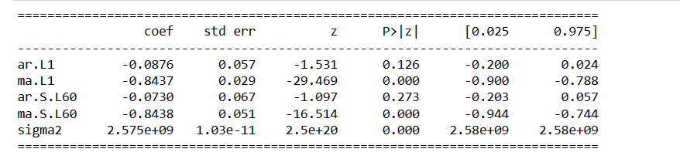
Forecasting using ARIMA Model
SARIMAX Results
Warnings:
[1] Covariance matrix calculated using the outer product of gradients (complex-step).
[2] Covariance matrix is singular or near-singular, with condition number 1.77e+35. Standard errors may be unstable.

Slide 28
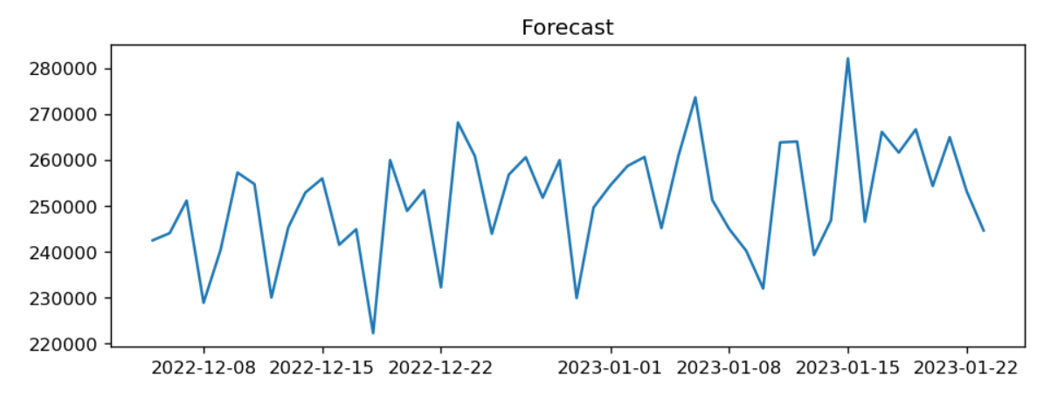
Forecasting using ARIMA Model
Forecast using SARIMAX

Slide 29
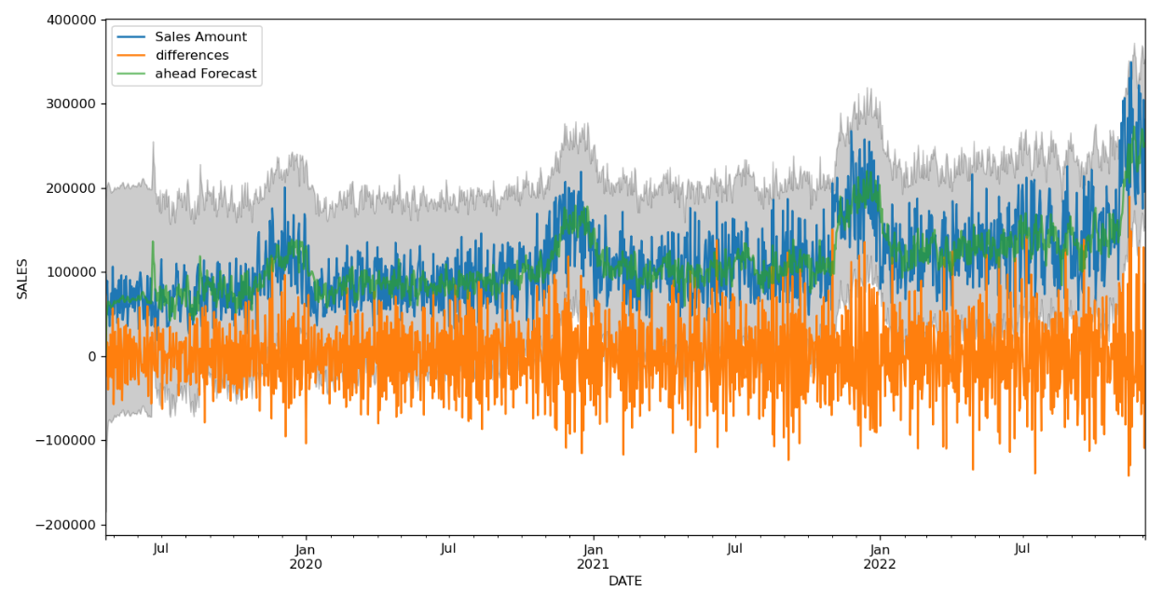
Forecasting using ARIMA Model
Actual vs Prediction using ARIMA
The Actual Sales Amount over the
Months of the years Matches the
With the Prediction of the Sales Amount.

Slide 30
Forecasting using ARIMA Model
RMSE (Square Root Of Mean Squared Error
MSE/RMSE 1st Run With(Window 365 and p,d,q(2,1,1) - 365 days
36018.95192564254
The RMSE of the forecasts is 36018.95
MSE/RMSE 2nd Run
34471.99224657315 With(window 12 and p,d,q(1,1,2) - 12 months
The RMSE of the forecasts is 34471.99
MSE/RMSE 3nd Run
34471.99224657315 With(window 30 and p,d,q(1,1,2) - 30 days
The Mean Squared Error of the forecasts is 34471.99
MSE/RMSE 3nd Run
126473.11761448582 With(window 30 and p,d,q(1,1,2) - 30 days
The Mean Squared Error of the forecasts is 126473.21

Slide 31
Forecasting using Facebook Prophet Model
Prophet also know as seasonality model is very prominently used for Time Series Analysis these days
Prophet has below two advantages :
Prophet makes it much more straightforward to create a reasonable, accurate forecast
Prophet forecasts are customizable in ways that are intuitive to non-experts.
The Prophet procedure is an additive regression model with four main components:
A piecewise linear or logistic growth curve trend. Prophet automatically detects changes in trends by selecting changepoints from the data.
A yearly seasonal component modeled using Fourier series
A weekly seasonal component using dummy variables
A user-provided list of important holidays

Slide 32
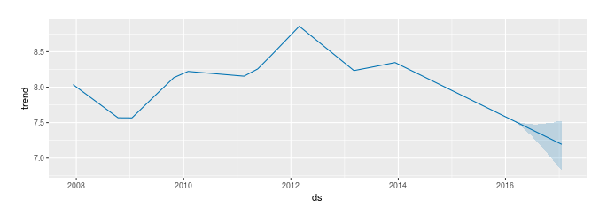
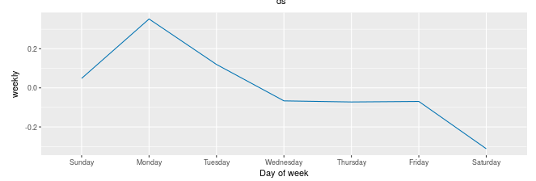
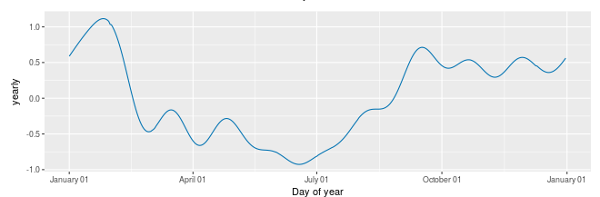
Forecasting using Facebook Prophet Model
Prophet will provide a components plot which graphically describes the model it has fit:

Slide 33
Forecasting using Facebook Prophet Model
For Forecasting purpose, first the model was trained on one product and Pack Size data.
There are three major parameters which is shared in the prophet model while modeling those are –
Additional Holidays – Optional parameter not used in our case as US holidays are added by default by prophet model
Changepoint Prior Scale
Seasonality Prior Scale

Slide 34
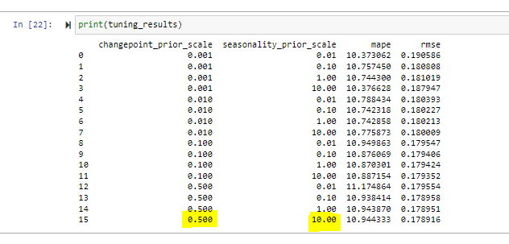
Forecasting using Facebook Prophet Model
The Changepoint prior Scale and Seasonality Prior Scale is tunned as a part of hyper parameter tuning and below is the results
On the basis of the results the Mape and RMSE is minimum for
Changepoint_Prior_Scale = .500
Seasonality Prior Scale = 10.0

Slide 35
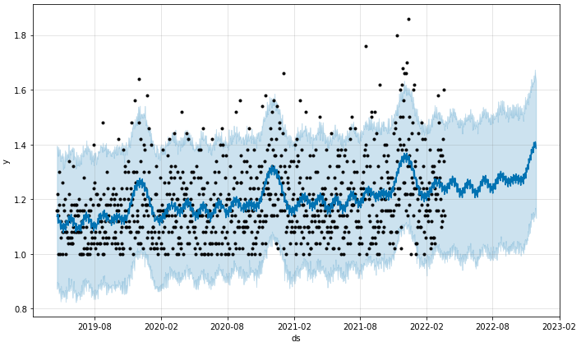
Forecasting using Facebook Prophet Model
After Forecasting using one product and pack Size, below is the result –

Slide 36
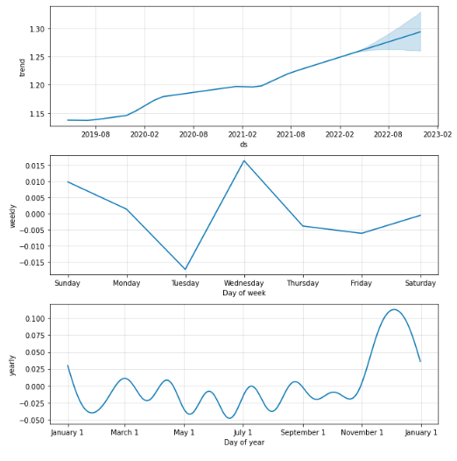
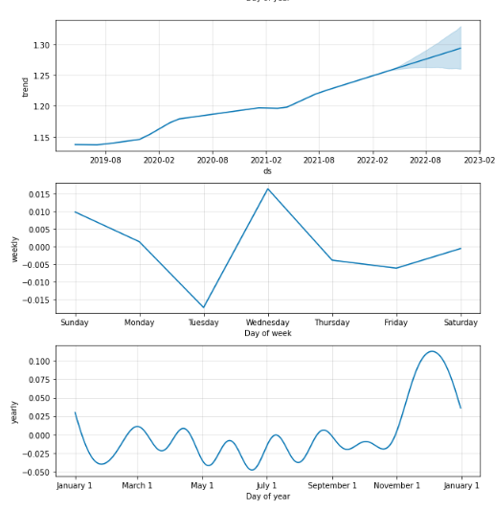
Forecasting using Facebook Prophet Model
Below are the trend Results-

Slide 37
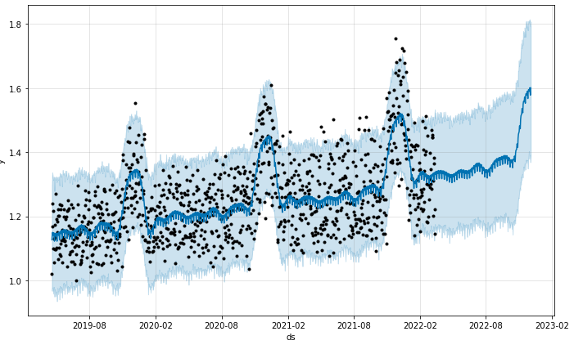
Forecasting using Facebook Prophet Model
Once tested the prophet model is used to forecast data at a store level i.e. Final Output :

Slide 38
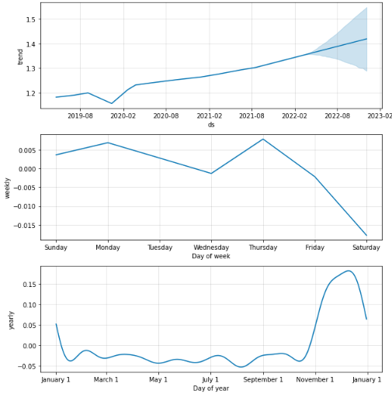
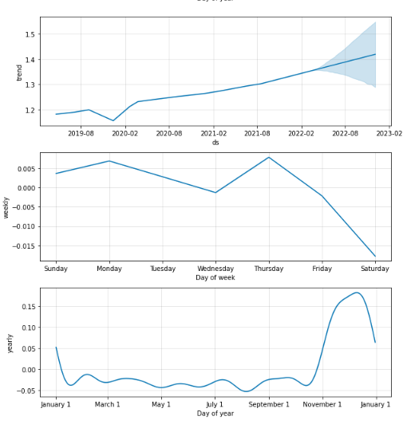
Forecasting using Facebook Prophet Model
Final Output Trends:

Slide 39
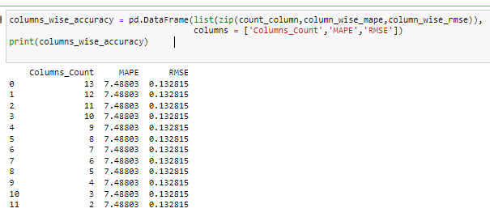
Forecasting using Facebook Prophet Model
Prophet is a smart model, and it considers checks for the correlation of all the variables that is shared as an input.
The model was trained in an iterative manner by reducing the number of variables, and RMSE and MAPE was evaluated :

Slide 40
Recommendations and Business Impact
The retail data is usually very widely distributed hence the exact forecast is very rare
The MAPE ~ 8% and RMSE 0.13 is achieved using the Prophet model
The predictions can be further improved by some below techniques :
LSTM – LSTM is Long Short-Term Memory and is one of a very popular Algorithm for Time series analysis. It is a type of Recurrent Neural Network Model
Dynamic Time Wrapping – This is an alternative of Normalization especially for time series analysis.

Slide 41
Thank You

