Slide 1


Expense Tracker: Your Financial Management Solution
Notes:
1

Slide 2
Meet Our Team
NAME : PANCHANI PANKTI ANKITBHAI.
ROLL NO : 131
ENROLLMENT NO : 23002170110107
BATCH : A-4
BRANCH : CE
NAME : SHARMA SHWETA VIJAYKUMAR.
ROLL NO : 140
ENROLLMENT NO : 23002170110175
BATCH : A-4
BRANCH : CE
NAME : KAPADIYA PRIYAM M.
ROLL NO : 126
ENROLLMENT NO : 23002170110064
BATCH : A-4
BRANCH : CE
NAME : MISTRY JAY RAMESHBHAI.
ROLL NO : 133
ENROLLMENT NO : 23002170110092
BATCH : A-4
BRANCH : CE
NAME :BALESANA HASSANBHAI YUNUSBHAI.
ROLL NO : 122
ENROLLMENT NO : 23002170110003
BATCH : A-4
BRANCH : CE
Notes:
2

Slide 3
Purpose of Expense Tracker
Financial Overview
Financial Planning
  Provide visual insights (like charts or graphs) to show spending patterns and areas where money could be saved.
  Help with future planning by showing trends, identifying unnecessary expenses, and helping users set financial goals.
Notes:
6

Slide 4





Key Features & Technologies
List
Matplotlib
Efficiently manages expenses.
Visualizes data for easy understanding.
yagmail
NumPy
Send expense report through gmail
Performs financial calculations.
Notes:
4

Slide 5

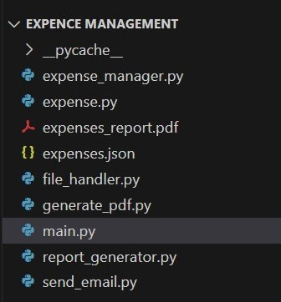
Python Classes
Notes:
5

Slide 6
Merits
  Easy to Use
  Clear Visuals
Merits and Demerits
  Customizable
Demerits
  Limited features
Notes:
7

Slide 7

Future Enhancements
AI-Driven Insights
1
Predictive spending analysis.
Cloud Integration
2
Store user data on the cloud
Integration with Bank Accounts
3
Notes:
8

Slide 8

Thank You
We appreciate your time and interest.
Notes:
10

