Slide 1



JOB
PORTAL
BY : PRIYAM KAPADIYA

Slide 2
INTRODUCTION
Name : kapadiya priyam m.
Roll No : 149
Enrollment No : 23002170110064
Batch : D-5
Branch : CE

Slide 3


TABLE
OF CONTENT
Porpose
ER diagram
use-case diagram
Flow chart
Functionalities
Used Data Structure
SQL table
Merits & Demerits

Slide 4
OBJECTIVES
Create a user-friendly platform.
Help company to find employee.
all employee find suitable job.

Slide 5




MY SERVICE
APPLY FOR JOBS
ANY BUSINESS CAN POST JOB OPENINGS
SHOW JOBS

Slide 6
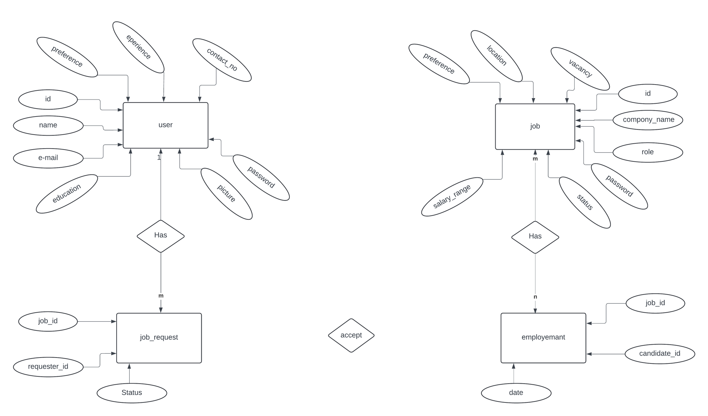
ER DIAGRAM

Slide 7
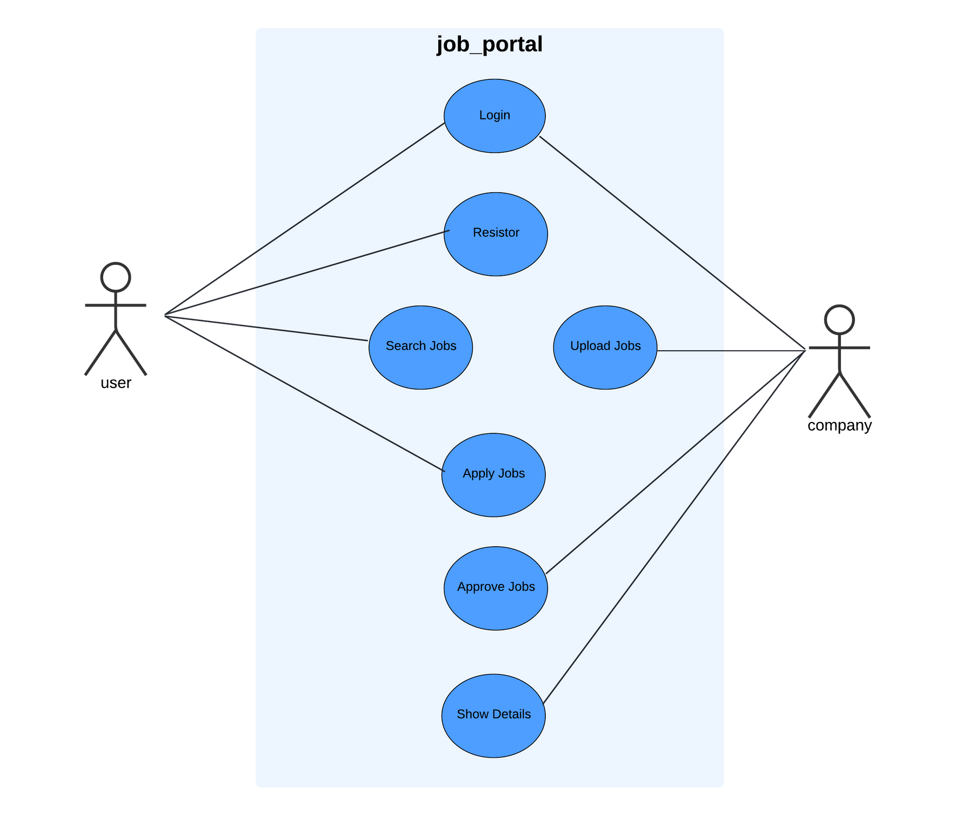
USE-CASE DIAGRAM

Slide 8
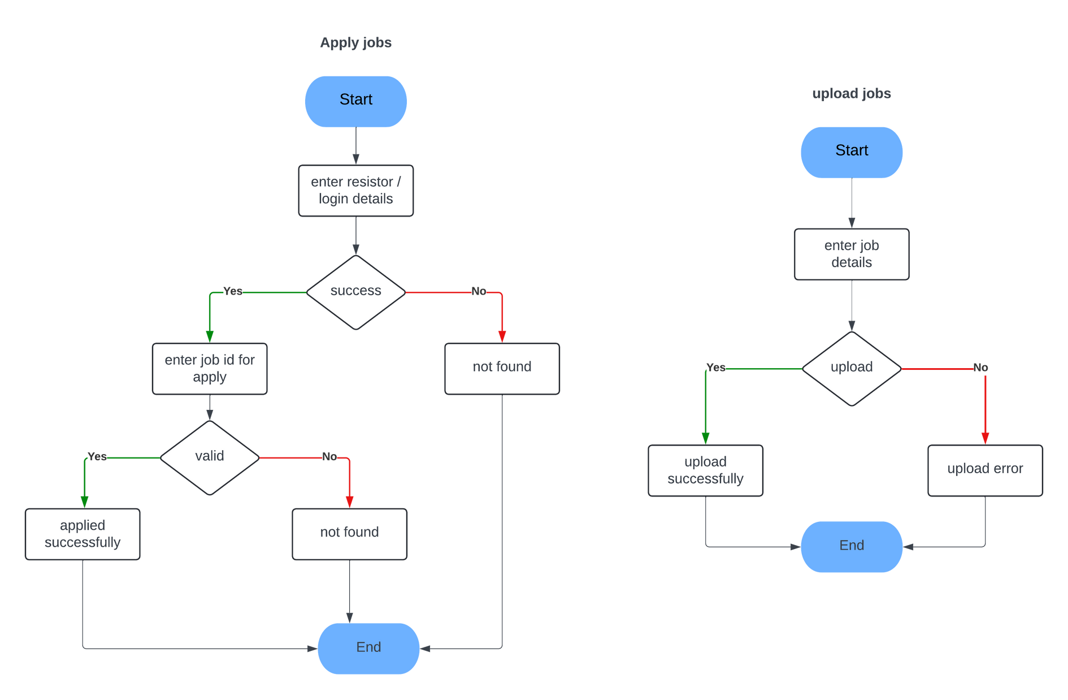
FLOW CHART

Slide 9
FUNCTIONAL SPECIFICATIONS
Data Structures using JAVA | JAVA - II | DATABASE MANAGEMENT
Data structures, such as linked lists, array, facilitate efficient storage and retrieval of job and user information. | 1. Exceptional Handling in job and user Database | 1.DML Queries for job & user details.
2. Update and delete job & user data using LinkedList. | 2. jdbc use for connection | 2.DDL Queries for job & user details.

Slide 10
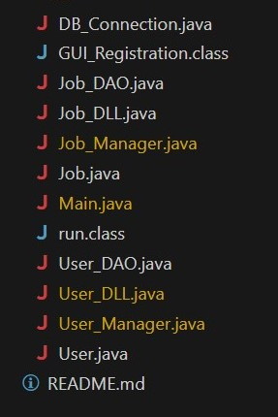

USED DATA STRUCTURES AND CLASS
LinkedList
Array

Slide 11
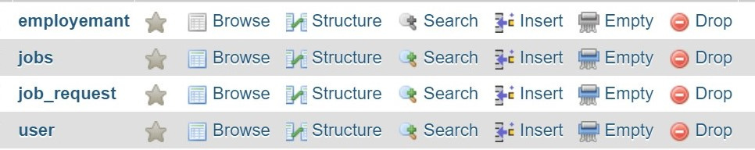
SQL USED
PROCEDURES
TRIGGERS
AddJob
AddUser
UserSelected
Update_Availability

Slide 12



TOOLS DETAILS
Visual Studio
XAMPP Control Panel v3.3.0
Chrome Browser
mysql-connector-j-9.0.0

Slide 13
MERITS
Helps employers hire faster
Helps people find job opportunities that are a good fit for them.
Simple to use
Fast information access
DEMERITS
Data Security Risks

Slide 14
THANK YOU

