Slide 1
Design Assignment Presentation
Group 27
Design Problem 1

Slide 2
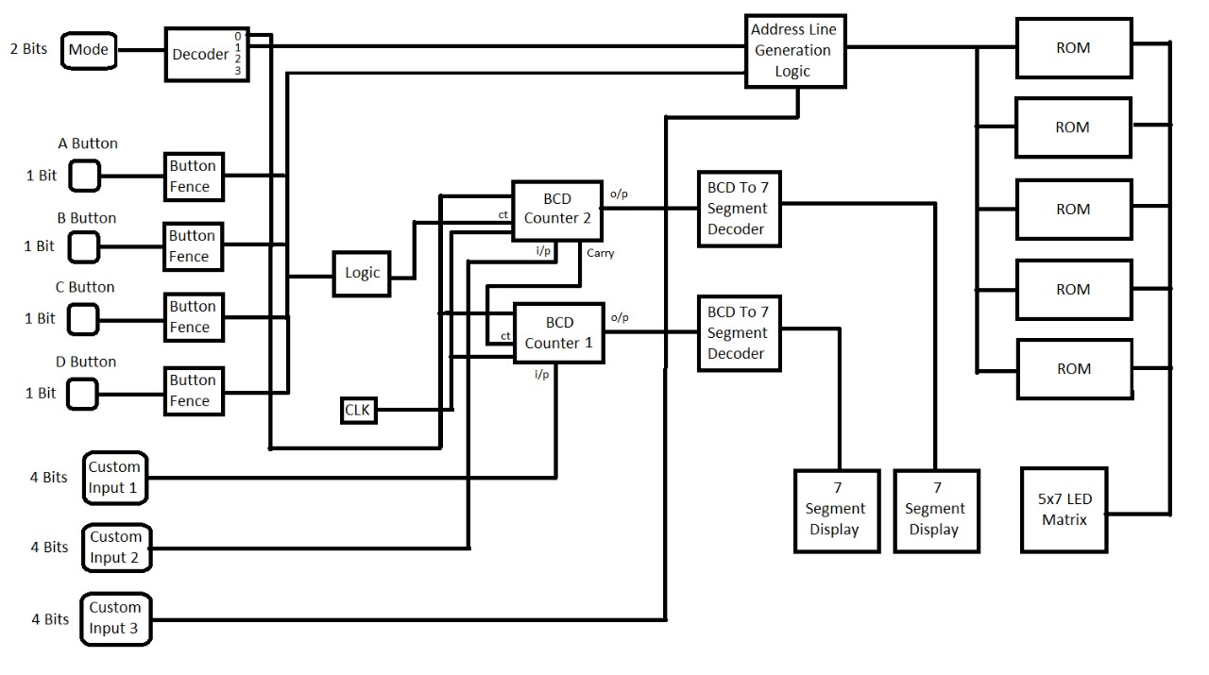
Top Level Block Diagram
INPUT
OUTPUT

Slide 3
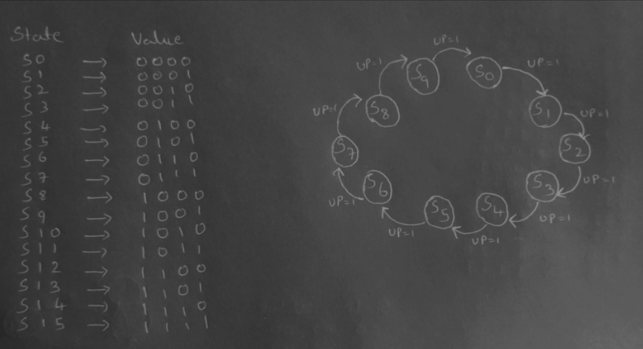
State Diagram 1 (BCD Up Counter)

Slide 4
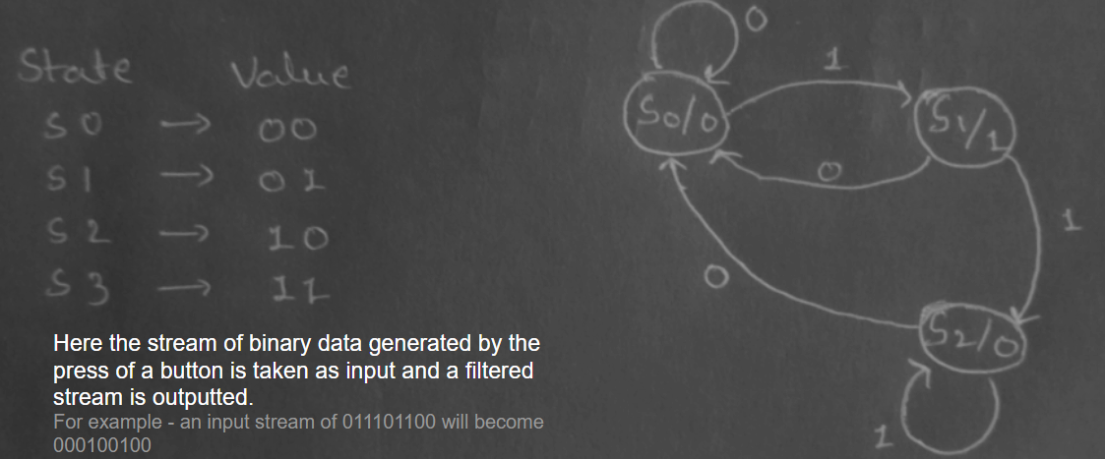
State Diagram 2 (Button Fence)

Slide 5
Additional Functionalities
The device can function in three modes:
Mode 0: As a static display that takes input for all displays
Mode 1: As a counter for a single bank station, with the station id as the input and the token number part as counter
Mode 2: As a counter for parallel bank stations. In this mode, various stations for the same process can simultaneously use the counter. Depending on the station where the request is initiated, the station id is changed while maintaining a common counter for all stations. This is useful in situations where multiple stations are doing the same job and the token issued to customers includes only his position in queue while the station is read from the display
Can start counting from any value by loading it from the parallel input and then using the counter functionality as usual
Can be easily pre programmed to display any desired characters
Invalid inputs to the display are displayed as ‘?’
Extra input rejection: One button press can only give a single count signal by using a fence to detect edges

Slide 6
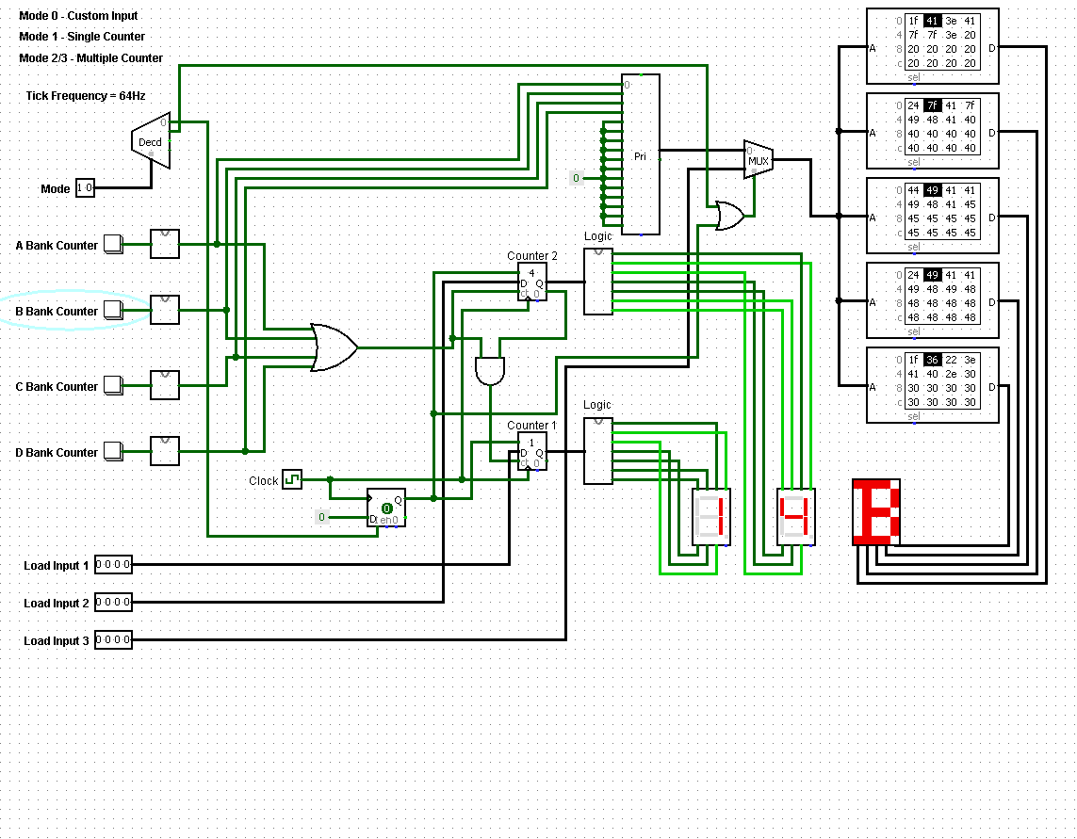
Sample Input/Output
Main Circuit

Slide 7
Thank You!

