Slide 1




INFOSYS SPRINGBOARD · VIRTUAL INTERNSHIP 7.0
Cyber Threat Analytics
Platform & Incident
Visualization System
A team-built Power BI framework that turns 40,000 raw cybersecurity events into seven interactive dashboards of clear, actionable threat intelligence.
TEAM MEMBERS
SECURITY INTELLIGENCE FRAMEWORK
Siddhant Singh | Priyam Sinha | Ponnuru Nithiin
Infosys Springboard Virtual Internship 7.0 · Mentor: Ms. Nithyasri S J
40,000 Incidents
7 Dashboards
28 States

Slide 2


01
01 · PROJECT OBJECTIVE
Goals and modules of the framework
PROJECT OBJECTIVE
PROJECT MODULES
Consolidate 40,000 raw cybersecurity incidents into one Power BI analytical framework
Detect and quantify attack patterns, severity levels and anomaly behaviour
Monitor network traffic, user behaviour and response effectiveness
Communicate complex log data as clear KPIs for technical and non-technical audiences
Cyber Security Attacks Analysis
Threat Detection & Anomaly Analysis
Network Traffic Analysis
User Behaviour Analytics
Threat Profile, Severity & Alert Response

Slide 3
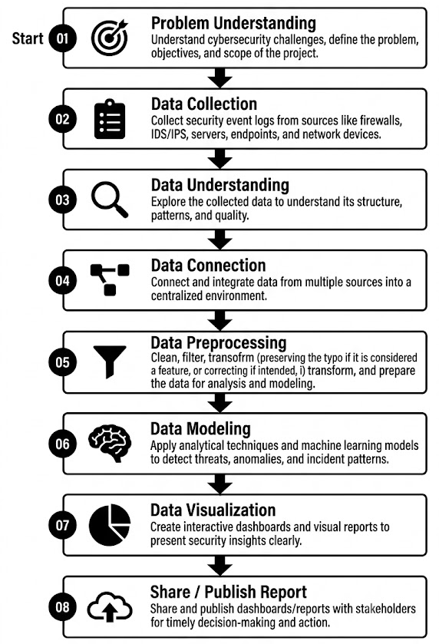
02
02 · PROJECT WORKFLOW
The eight-stage Power BI pipeline

Slide 4
03
03 · PROJECT EXECUTION MILESTONES
How the project was delivered
M1
M2
M3
M4
MILESTONE 1
MILESTONE 2
MILESTONE 3
MILESTONE 4
Data Acquisition & Cleaning
Data Modeling
Development
Review & Optimization
Sourced the 40,000-record Kaggle dataset and shaped it through 19 Power Query steps — types, nulls, date/time split and category standardisation.
Built and marked a Date table, established relationships and authored core DAX measures and the Anomaly Score Band logic.
Designed the seven themed dashboards with slicers, cross-filtering, decomposition tree, ribbon, treemap and Sankey visuals.
Validated figures across visuals, optimised model performance, and consolidated the report, PPT and GitHub repository.

Slide 5



04
04 · CHALLENGES & RESOLUTIONS
Obstacles met and how the team solved them
CHALLENGES
RESOLUTIONS
1
Keeping a 40,000-row model responsive while every visual stayed interactive.
Wrote efficient DAX and disabled unnecessary auto date/time tables to keep the model fast.
2
Designing derived metrics (% High Severity, Block Rate %, Anomaly Bands) that held under every filter.
Iteratively tested and validated each measure across all slicer interactions and filter contexts.
3
Keeping one visual language across seven dashboards built by different team members.
Standardised colours & severity encoding and merged work cleanly via Microsoft Teams and GitHub.

Slide 6

05
05 · FUTURE ENHANCEMENTS & KEY INSIGHTS
Where the framework goes next
KEY INSIGHTS
FUTURE ENHANCEMENTS
33.6%
DDoS marginally leads a broad, multi-vector threat mix (Malware 33.3%, Intrusion 33.2%).
Integrate near-real-time data via scheduled refresh or DirectQuery
Add predictive analytics — anomaly forecasting & risk scoring (Python / R / Azure ML)
Row-level security for role-based dashboards + automated alerting via Power Automate
Drill-through to raw incidents, a true India choropleth, and publish to the Power BI Service
~45%
Windows is the most-targeted OS; malware indicators appear in exactly 50% of events.
33.8%
Only about a third of attacks are actively blocked — a clear, quantified response gap.

Slide 7



06
06 · CONCLUSION
What the team delivered and gained
The Cyber Threat Analytics Platform successfully transformed 40,000 raw cybersecurity incidents into seven interactive Power BI dashboards delivering clear, actionable threat intelligence.
TECHNICAL SKILLS
SOFT SKILLS
Power BI, Power Query ETL & data modeling
DAX measures, calculated columns & KPI logic
Advanced visuals & report interactivity (GitHub version control)
Problem Solving
Communication
Teamwork
Presentation

Slide 8


07
07 · ACKNOWLEDGEMENTS & REFERENCES
With gratitude
ACKNOWLEDGEMENTS
REFERENCES
We would like to express our heartfelt gratitude to:
Kaggle — “Cyber Security Attacks” dataset (40,000 records, 2020–2023)
Microsoft Power BI & DAX official documentation and community resources
Infosys Springboard learning modules and training materials
Infosys Springboard Team — for a structured, industry-aligned internship platform
Ms. Nithyasri S J (Mentor) — for consistent guidance, feedback and encouragement
Team members — Siddhant Singh, Priyam Sinha & Ponnuru Nithiin

Slide 9
Thank You
Cyber Threat Analytics Platform with Incident Visualization System
Siddhant Singh · Priyam Sinha · Ponnuru Nithiin
Infosys Springboard Virtual Internship 7.0 · Mentor: Ms. Nithyasri S J

