Slide 1


Stock Price Prediction using LSTM and News Sentiment Analysis
Divyam Gupta
Rishabh Tiwari
Mentor: Dr. Swati Srivastava

Slide 2
Objective
To predict the closing price of a company based on its previous stock movement and recent news
Creating a Website for the end user to interact with our model
To determine the future value of a company stock or other financial instruments traded on an exchange

Slide 3
Technology
Machine Learning
To build an algorithm for training and prediction.
LSTM
Popular algorithm for time-series forecasting
HTML and CSS
For developing a frontend for user to interact
Django
For connecting the UI with the ML backend

Slide 4
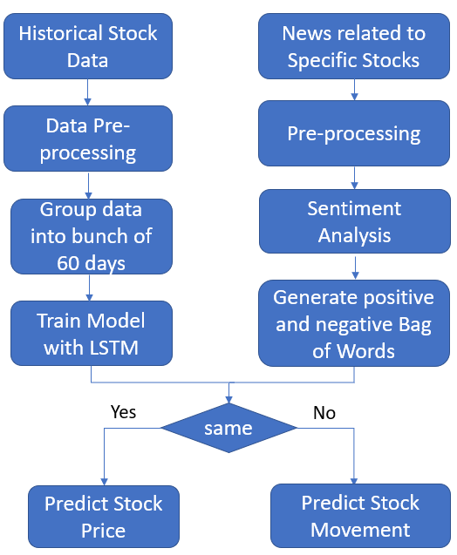
Proposed Model
The model we proposed contains two different parts.
One is a predictive model, which will be trained on historical stock data.
And the other is analyzing the sentiments of news for sudden stock movement

Slide 5
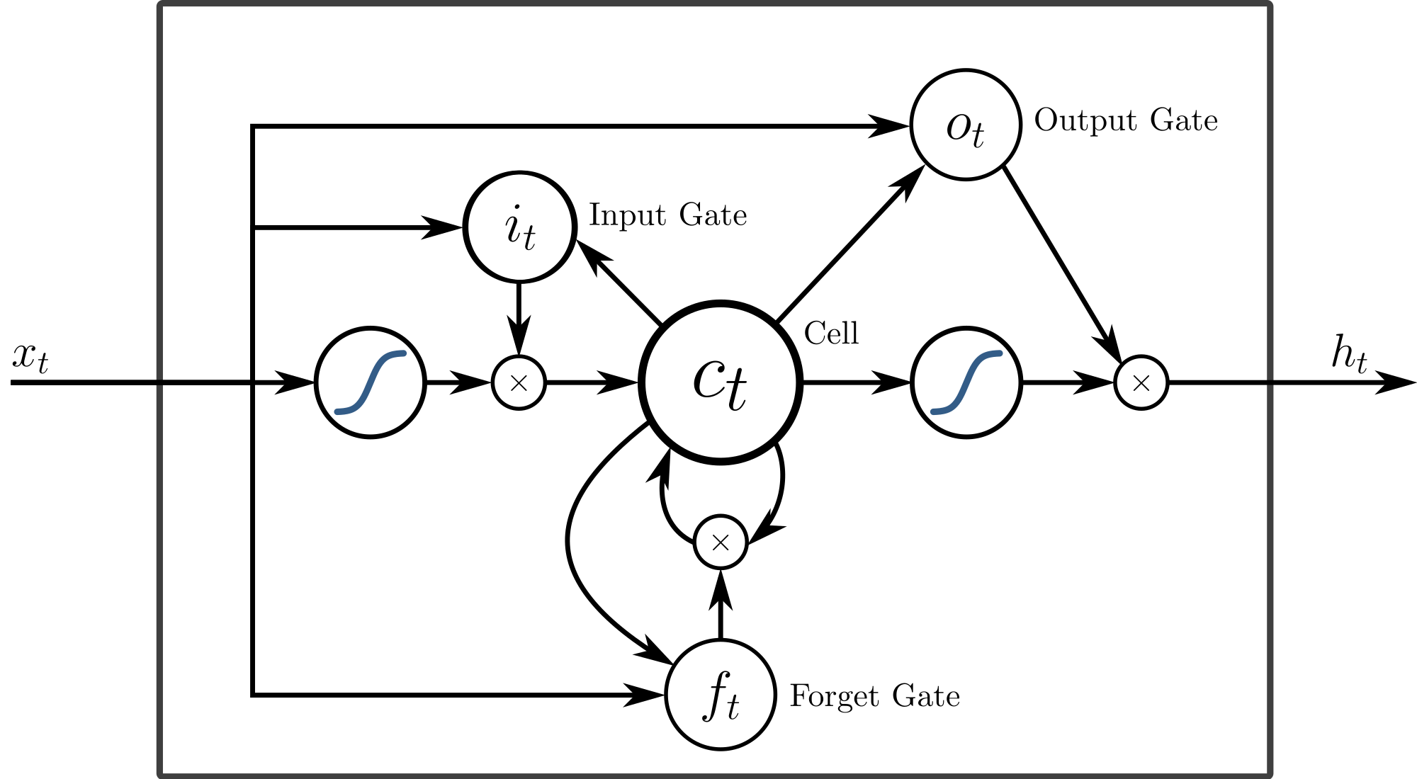
Long Short Term Memory
LSTMs are very powerful in sequence prediction problems because they're able to store past information.
A form of RNN
The same network is trained through sequence of inputs across “time”
Has Feedback Connection
Fixes the vanishing gradient problem of RNN

Slide 6
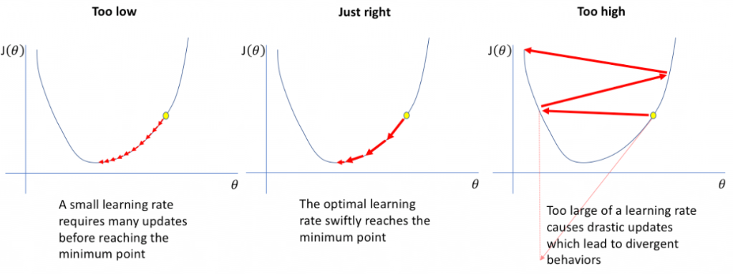
Gradient Problem

Slide 7
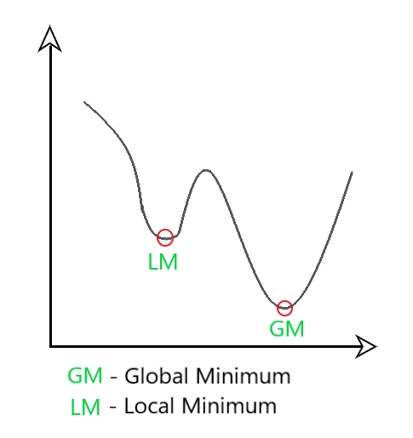
Adam Optimizer
Adaptive Moment Estimation is an algorithm for optimization technique for gradient descent
Adam combines the best properties of the AdaGrad and RMSProp algorithms to provide an optimization algorithm that can handle sparse gradients on noisy problems.
We control the rate of gradient descent in such a way that there is minimum oscillation when it reaches the global minimum while taking big enough steps (step-size) so as to pass the local minima hurdles along the way

Slide 8
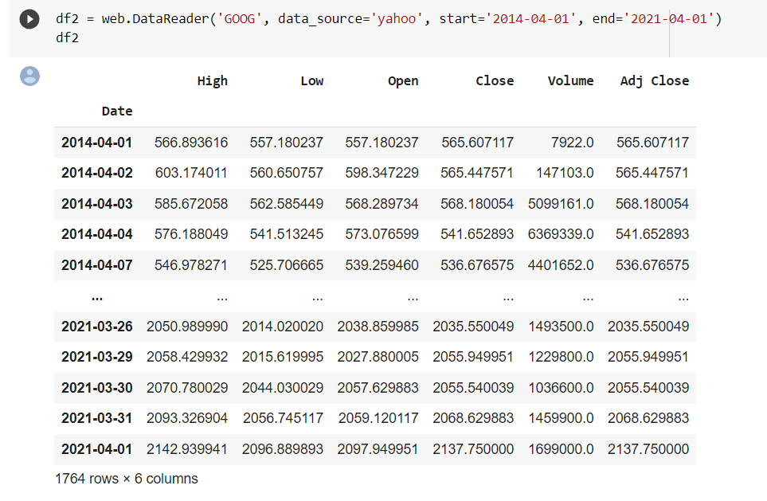
Numeric Dataset

Slide 9
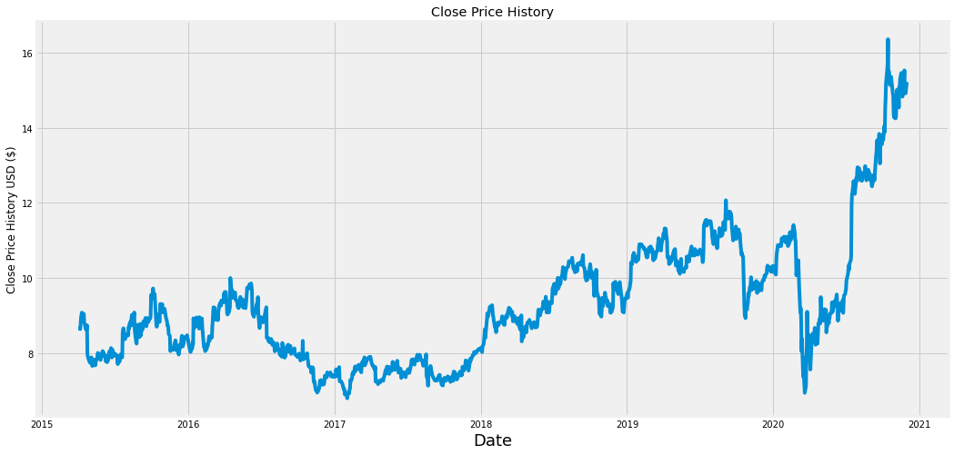
Graphical Representation Of DataSet

Slide 10
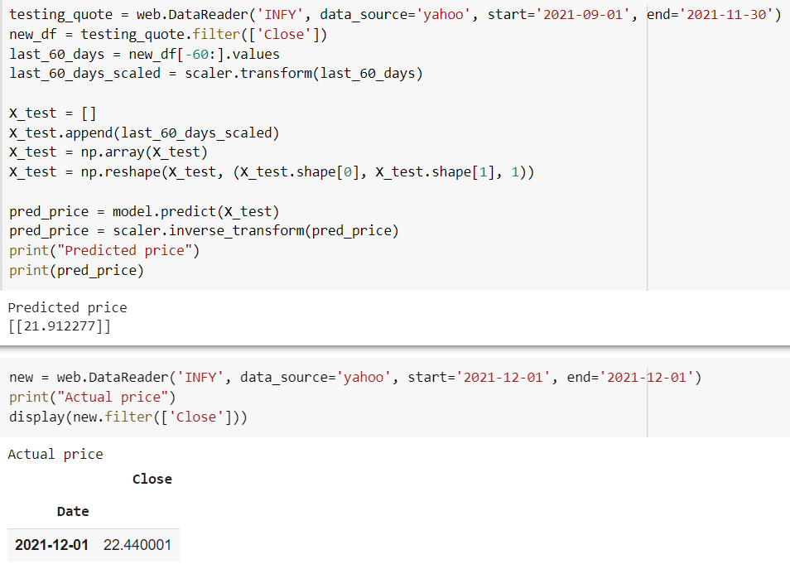
Model Testing On Infosys stocks

Slide 11
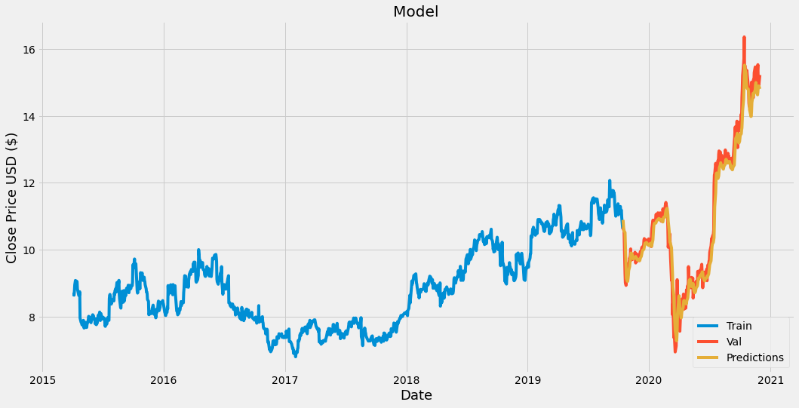
LSTM Prediction

Slide 12
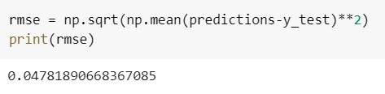
Mean Square Error (MSE)
The MSE of an estimator measures the squares of the errors.
The MSE is a measure of the quality of an estimator. It is a positive value that decreases as the error approaches zero.

Slide 13
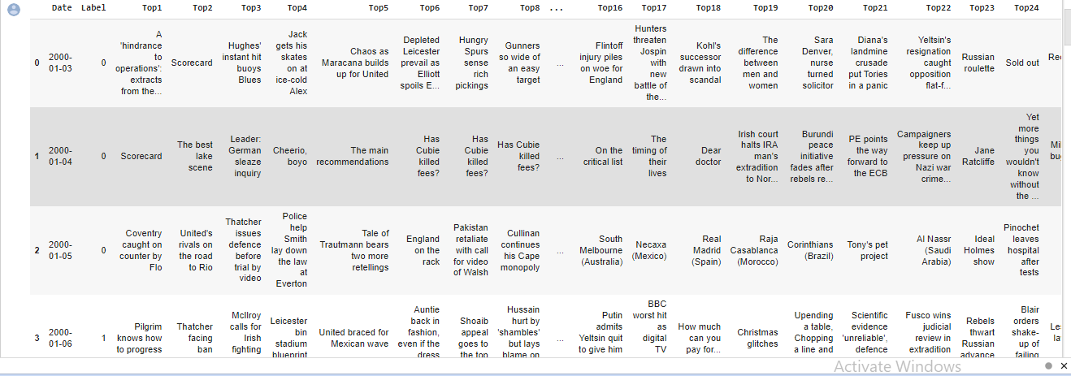
News dataset for Sentiment Analysis ( Source -KAGGLE)

Slide 14
SENTIMENT ANALYSIS
Sentiment Analysis is contextual mining of text which identifies and extracts subjective information in source material, and helping a business to understand the social sentiment.
It is the most common text classification tool that analyses an incoming message and tells whether the underlying sentiment is positive, negative our neutral.

Slide 15
APPLICATION OF SENTIMENT ANALYSIS
For Data cleaning process , firstly we had removed all the punctuation marks , small words and all,as by this there will be no affect on sentiments , it remains same.
Merged top 25 headlines of same day so that it concludes all day report to one sentiment.
Implemented Bag of words through count vectoriser in training the model, with ngram range of 1, so that we have taken all sentiments word by word .

Slide 16
BAG OF WORDS
The evaluation of movie review text is a classification problem often called sentiment analysis. A popular technique for developing sentiment analysis models is to use a bag-of-words model that transforms documents into vectors where each word in the document is assigned a score
The bag-of-words model is a way of representing text data when modeling text with machine learning algorithms. The bag-of-words model is simple to understand and implement and has seen great success in problems such as language modeling and document classification.

Slide 17
RANDOM FOREST CLASSIFIER
Random forest is a Supervised Machine Learning Algorithm that is used widely in Classification and Regression problems. It builds decision trees on different samples and takes their majority vote for classification and average in case of regression.
One of the most important features of the Random Forest Algorithm is that it can handle the data set containing continuous variables as in the case of regression and categorical variables as in the case of classification. It performs better results for classification problems.

Slide 18
Accuracy , F1 Score , Confusion Matrix
Precision- Out of all the positive predicted, what percentage is truly positive.
Recall- Out of the total positive, what percentage are predicted positive. It is the same as TPR (true positive rate).
It is the harmonic mean of precision and recall. It takes both false positive and false negatives into account. Therefore, it performs well on an imbalanced dataset
It is a matrix of size 2×2 for binary classification with actual values on one axis and predicted on another.

Slide 19
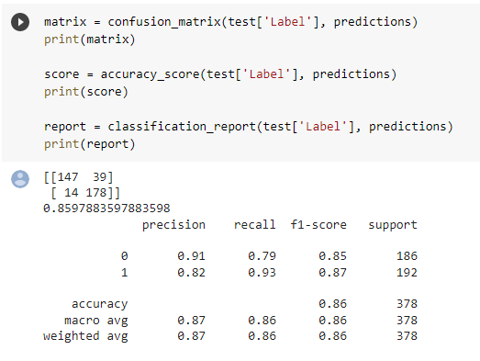

Slide 20
Python News API
The main use of News API is to search through every article published by over 80,000 news sources and blogs in the last 4 years. Think of us as Google News that you can interact with programmatically.
This returns a JSON object with the results in an array we can iterate over.

Slide 21
Prediction From News API
Here we have fetched news headlines from the dataset and our model is trained for news API , this results in predicting the sentiment of headlines resulted in 1 and 0
0 stand for neutral or negative sentiments which which will decrease the stock price or remains same .
1 stands for positive sentiment which will increase the stock price .

Slide 22
Related Work
The prediction of closing prices using financial data using ANN and random forest by Mehar Vijh shows low values of RMSE indicators.
Gong, J., & Sun, S. build a model to predict stock prices using simple logistic regression approach, which shows that logistic regression model outperforms other popular ANN models for prediction.
Hegde, M. S. et. al. have discussed in his paper that Long Short-Term Memory and Recurrent Neural Networks are capable of solving linear problems and can be used to predict the stock prices.

Slide 23
Continue…
The research done by Bollen, J. et.al. shows that mood of individual people also affects the stock market price.
The paper by Pakkala, D., shows that the polarity of each news headline can either be detected by dictionary approach or using semi supervised learning.

Slide 24
Price Prediction
The financial dataset contains high, low, open, close, volume and the close values of stock for each day in USD.
As the data values varied in a wide range of values, so it is first preprocessed with MinMaxScaler to scale the data between 0 and 1 for uniformity and better data capturing.
The training dataset is divided into bunch of 60-days. The model will analyze the pattern of 60-days and will give prediction for the 61st day.

Slide 25
Continue…
The sequential network consists of four layers, first two LSTM layers has 50 neurons each, then two dense layers of 25 and 1 neuron respectively.
For gradient descent, Adam optimizer is used which is a combination of two gradient descent methodologies.

Slide 26
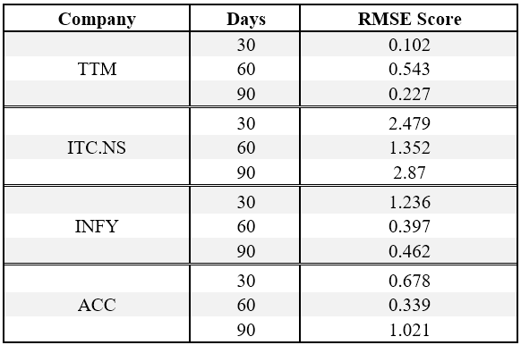
Results and Discussion
The discussed model is trained and tested on four historical price datasets of company including Tata Motors, ITC, Infosys and ACC.
The root mean square error calculated after training and testing on those datasets with bunch of 30-days, 60-days and 90-days.
The analysis shows that 60-day bunches give the better results as compared to other bunch sets.

Slide 27
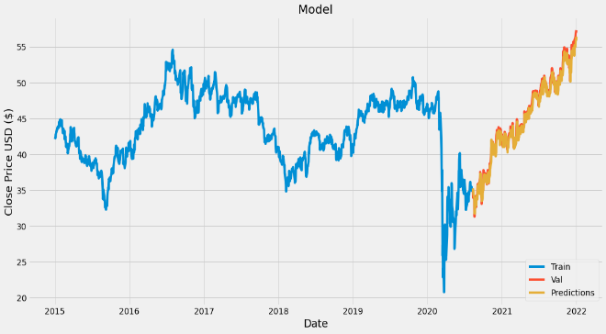
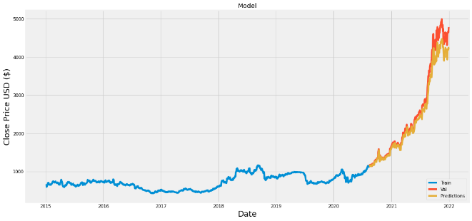
Continue…
Another analysis done considering stocks that change with a large stock price in a short duration of time.
It shows that in spite of the model performing well with stocks that change with a reasonable amount, it gives low performance with sudden changing stocks

Slide 28
Thank YOU ☺

