Slide 1

ScamGuard: AI-Based Online Scam
and Fraud Detection System
Bhavya Goyal
1BM23CS063
Priyam Thakur
1BM23CS252
Samir Chaudhary
1BM23CS294
Sana Subodh
1BM23CS296
Dr. Kayarvizhy N
Professor
Department of Computer Science and Engineering
B.M.S. College of Engineering

Slide 2
Outline
1. Problem Statement
2. High Level Design
3. Detailed Design
4. Implementation
5. Results (Tables, Graphs, Dataset Used) and Snapshots of the Output
6. Conclusion and Future Enhancements
7. Paper Published
8. References

Slide 3
Problem Statement
Scam SMS in India copy genuine service messages: bank KYC updates, electricity disconnection notices, parcel fees, e-challans, job offers and digital-arrest threats, often in Hindi or mixed Hindi-English
Scam and genuine messages share the same words (KYC, OTP, account, block, link), so keyword filters raise false alarms on real bank and operator messages
Public smishing data contains only user reports; reports are unverified and many of them are genuine messages
One scam campaign is sent with small edits to many people, so a random train-test split overstates accuracy
Most tools give a bare label without telling the user which part of the message is the trap
Objective: build an audited Indian SMS dataset and an explainable detector that separates scam from genuine messages with few false alarms, evaluate it without campaign leakage, and deliver it as a deployed web application

Slide 4
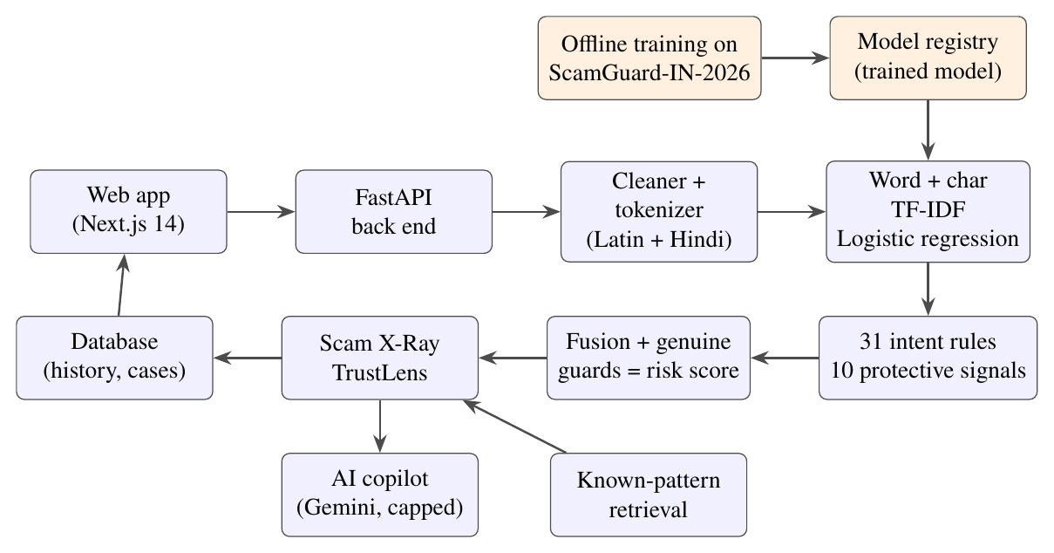
High Level Design
Offline (orange): dataset build and training. Online (blue): every request is cleaned, classified, checked by the rules and explained.

Slide 5
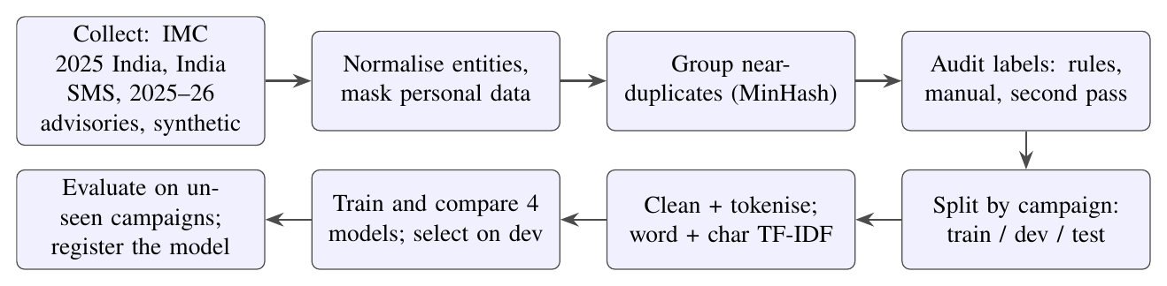
Detailed Design
Dataset and model pipeline: from source collection to the registered model
Collect: IMC 2025 India reports, India SMS collection, 2025-26 advisories, synthetic templates
Audit: every reported-message campaign confirmed by rule or read by hand; second pass on model disagreements
Split: MinHash near-duplicate campaigns; each campaign goes to only one of train, development or test

Slide 6
Detailed Design (contd.)
Preprocessing: replace e-mails, URLs (also bare links like bit.ly/x) and phone numbers with tokens; lowercase; keep Latin and Devanagari words; light stemming
Features: TF-IDF word 1-2-grams (30,000) + character 2-5-grams (60,000); 35,148 features after pruning; handles Hindi and spellings like K.Y.C or bl0cked
Classifier: logistic regression p(x) = σ(w·φ(x) + b), C = 16, balanced class weights
Intent layer: 31 patterns for 26 scam intents (OTP request, pay-to-receive, KYC deadline, remote-access app, legal threat) and 10 protective signals (do-not-share warning, 1909/1930, masked-account alert)
Fusion: s(x) = σ(clip(logit p, ±4) + 5(E⁺ − E⁻)); capped at 0.15 for genuine alerts; decoy rule for "never share your OTP ... share it"
Explanation: matched phrases grouped into hook, pressure, request and cash-out (Scam X-Ray, TrustLens)

Slide 7
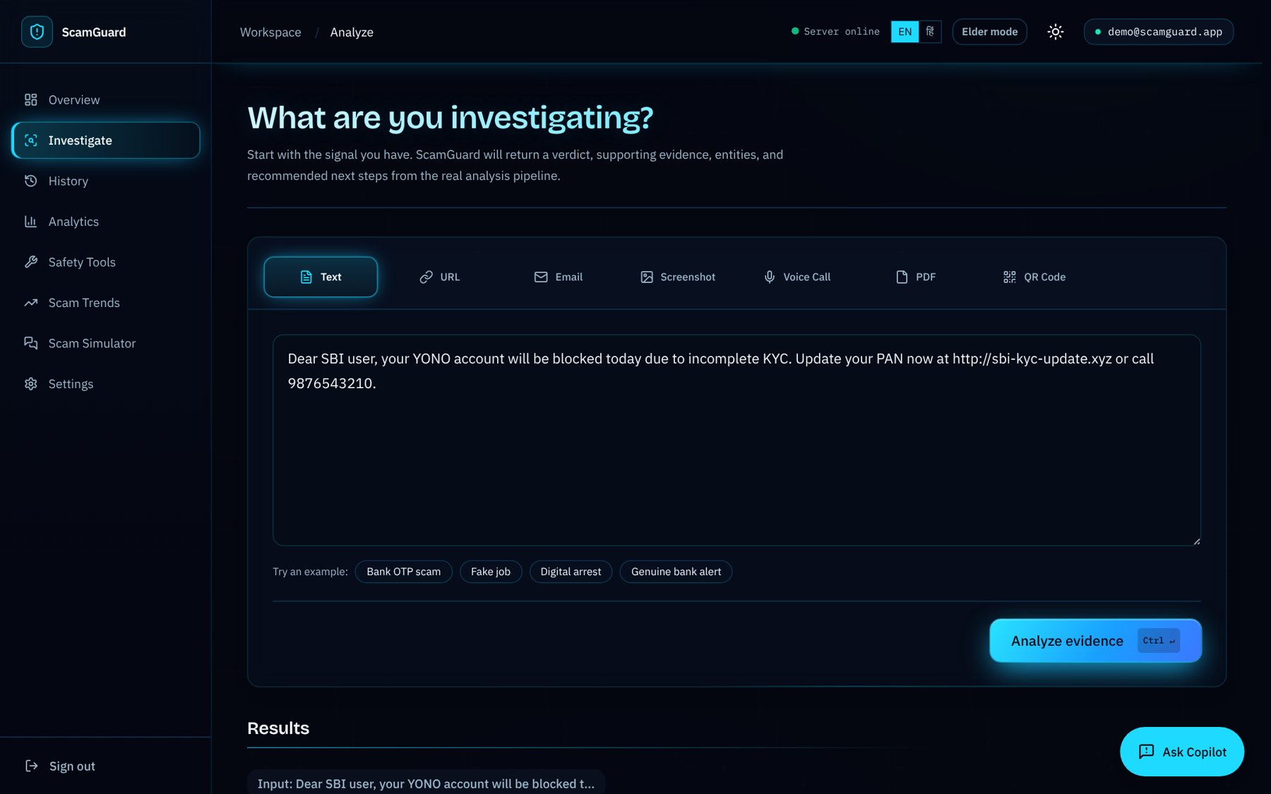
Implementation
Front end: Next.js 14, React 18, Tailwind CSS; English and Hindi
Back end: FastAPI, SQLAlchemy, PostgreSQL, JWT authentication, rate limiting
Machine learning: scikit-learn; versioned model registry; same preprocessing in training and serving
Data tools: datasketch (MinHash), pandas, NumPy, Matplotlib
Deployment: Render (back end and front end), GitHub Actions CI
Quality: 818 automated tests and a daily check of the live site
Full analysis screen

Slide 8
Implementation (contd.)
Module | What it does
Quick check | Verdict and reasons for a pasted message, without sign-in
Full analysis | Text, URL, e-mail, screenshot, PDF or QR input; risk score and evidence
Scam X-Ray and TrustLens | Risky phrases by stage, what a genuine message would do, next steps
AI copilot | Answers follow-up questions about a scan (Gemini, daily cap)
Safety tools | QR check, before-you-pay check, file check, chat timeline
History and analytics | Saved scans, search, export, verdict share and score trend
Scam simulator | Practice messages to learn the common tricks

Slide 9
Results: Dataset Used (ScamGuard-IN-2026)
Source | Genuine | Scam | Use
IMC 2025 reports, India subset (audited) | 963 | 3,987 | train / dev / test
India SMS collection (audited) | 1,694 | 6 | train / dev / test
2025-26 advisories and news | 1 | 11 | test only
Synthetic 2025-26 scam and genuine types | 2,950 | 1,787 | train only
Total | 5,608 | 5,791 | 11,399
Split | Messages
Train | 8,645
Development | 868
Test (real, unseen campaigns) | 1,874
2025-26 advisory test | 12
All 2,922 reported-message campaigns checked: 1,253 by rule, 1,669 by hand; 19.5% of retained reports were genuine
6,662 real messages form 4,085 near-duplicate campaigns (largest 128); test = 665 genuine + 1,209 scam
Attributes: text, label, source, subtype, is_synthetic, campaign, split

Slide 10
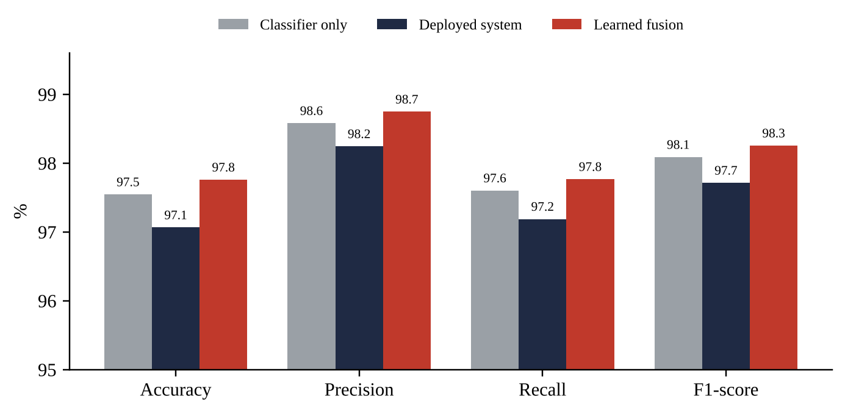
Results: Performance on the Real Test Set
System (1,874 messages) | Accuracy | Precision | Recall | F1 | False alarms
Classifier only | 97.5% | 98.6% | 97.6% | 98.1% | 2.6%
Deployed system | 97.1% | 98.2% | 97.2% | 97.7% | 3.2%
Learned fusion | 97.8% | 98.7% | 97.8% | 98.3% | 2.3%
Deployed system: accuracy 95% CI 96.3-97.8%; false alarms 95% CI 2.0-4.6%
ROC-AUC 0.995, average precision 0.997
Catches 1,175 of 1,209 scams; passes 644 of 665 genuine messages
2025-26 advisories: 10 of 11 scams caught, genuine notice passed

Slide 11
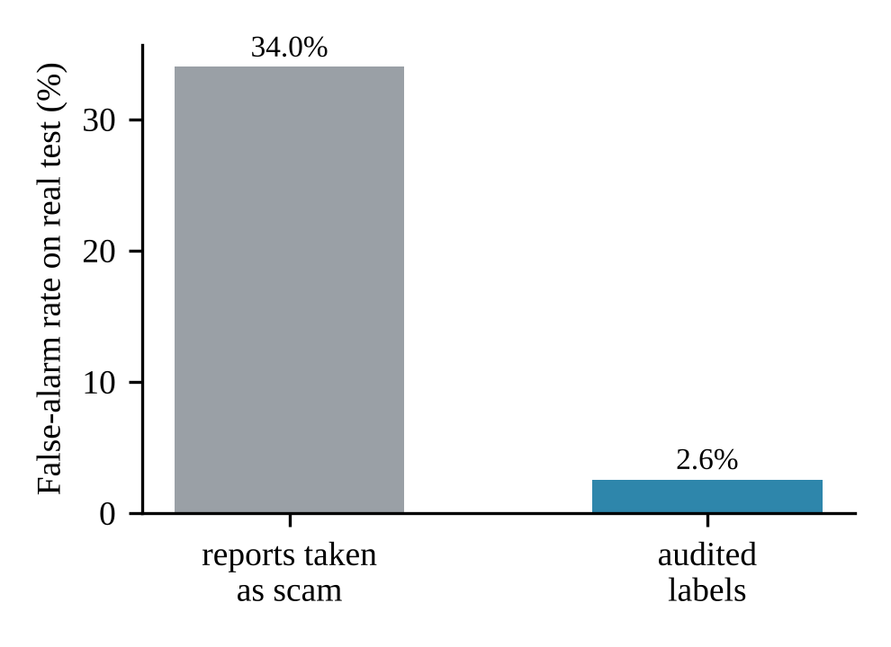
Results: Research Findings
Label audit: training on report labels gives 34.0% false alarms; audited labels give 2.6% (McNemar p < 10⁻³⁰)
Leakage: a random split shows 0.8% false alarms, the campaign split 1.4%; 793 test rows leaked under the random split
Synthetic data: recall on 2025-26 scam types rises from 35.6% to 82.2%; real-data F1 stays at 98.1%
Intent rules: on unseen real data F1 98.1% → 97.7%; kept for phrase-level explanations

Slide 12
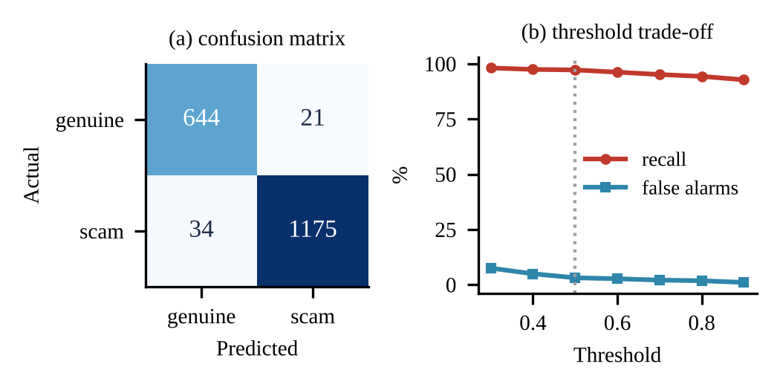
Results: Model Comparison and Errors
Word + char TF-IDF | F1 | False alarms
Naive Bayes | 95.5% | 6.5%
Logistic regression | 98.1% | 2.6%
Linear SVM | 98.2% | 3.9%
Random forest | 97.6% | 3.3%
Logistic regression selected: lowest false-alarm rate among the strong models, readable word weights
Deployed system: 34 scams missed, 21 genuine flagged; 15 of the 21 are reported-but-genuine bank messages
Threshold 0.9: false alarms 0.8% at 92.5% recall
Model 1.6 MB; 3.8 ms per message
Deployed system: confusion matrix and threshold trade-off

Slide 13
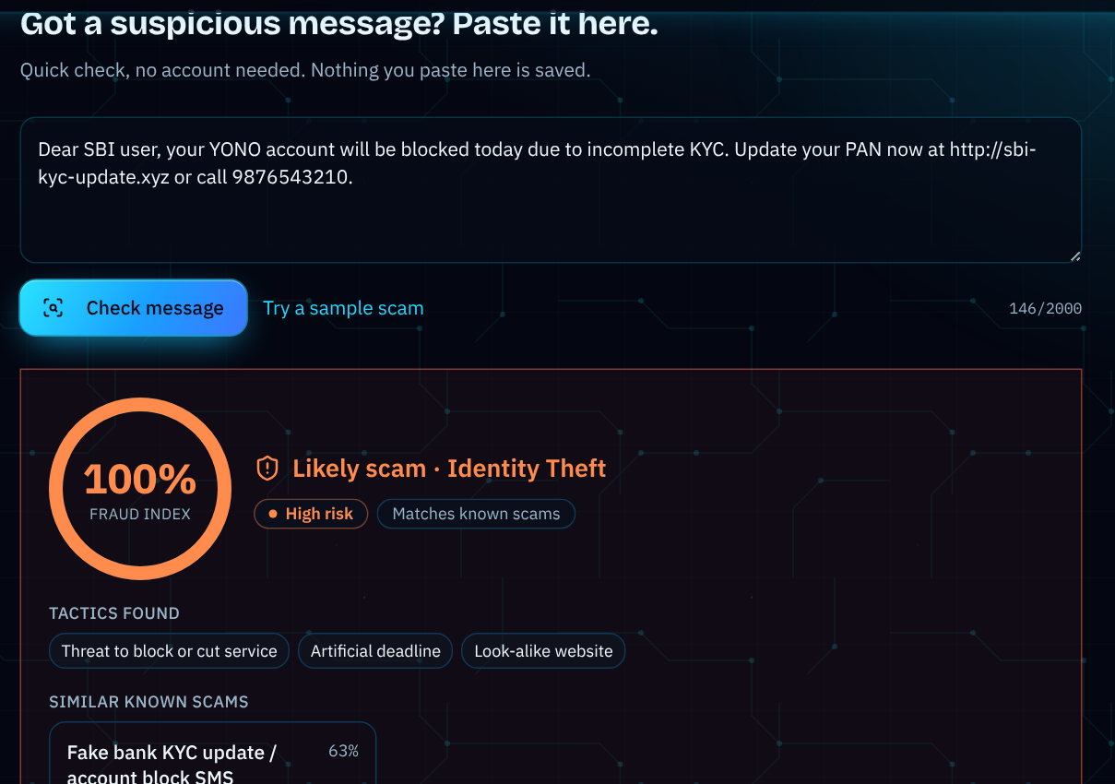
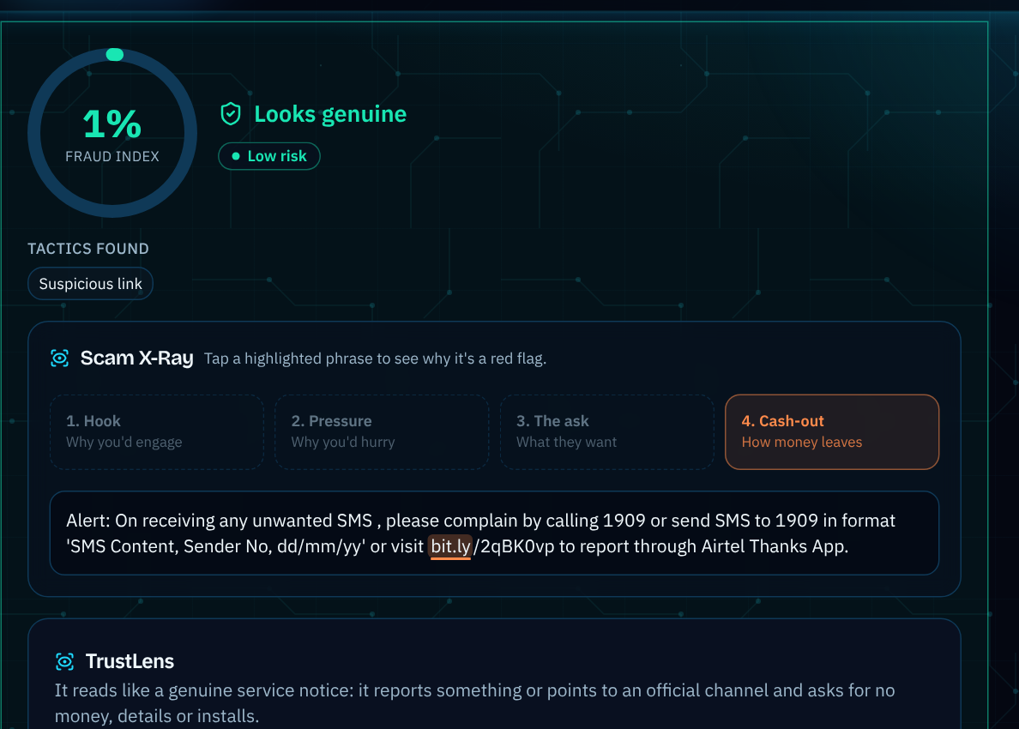
Results: Snapshots of the Output (1/4)
Quick check: fake KYC SMS flagged as scam
Quick check: operator 1909 notice looks genuine

Slide 14
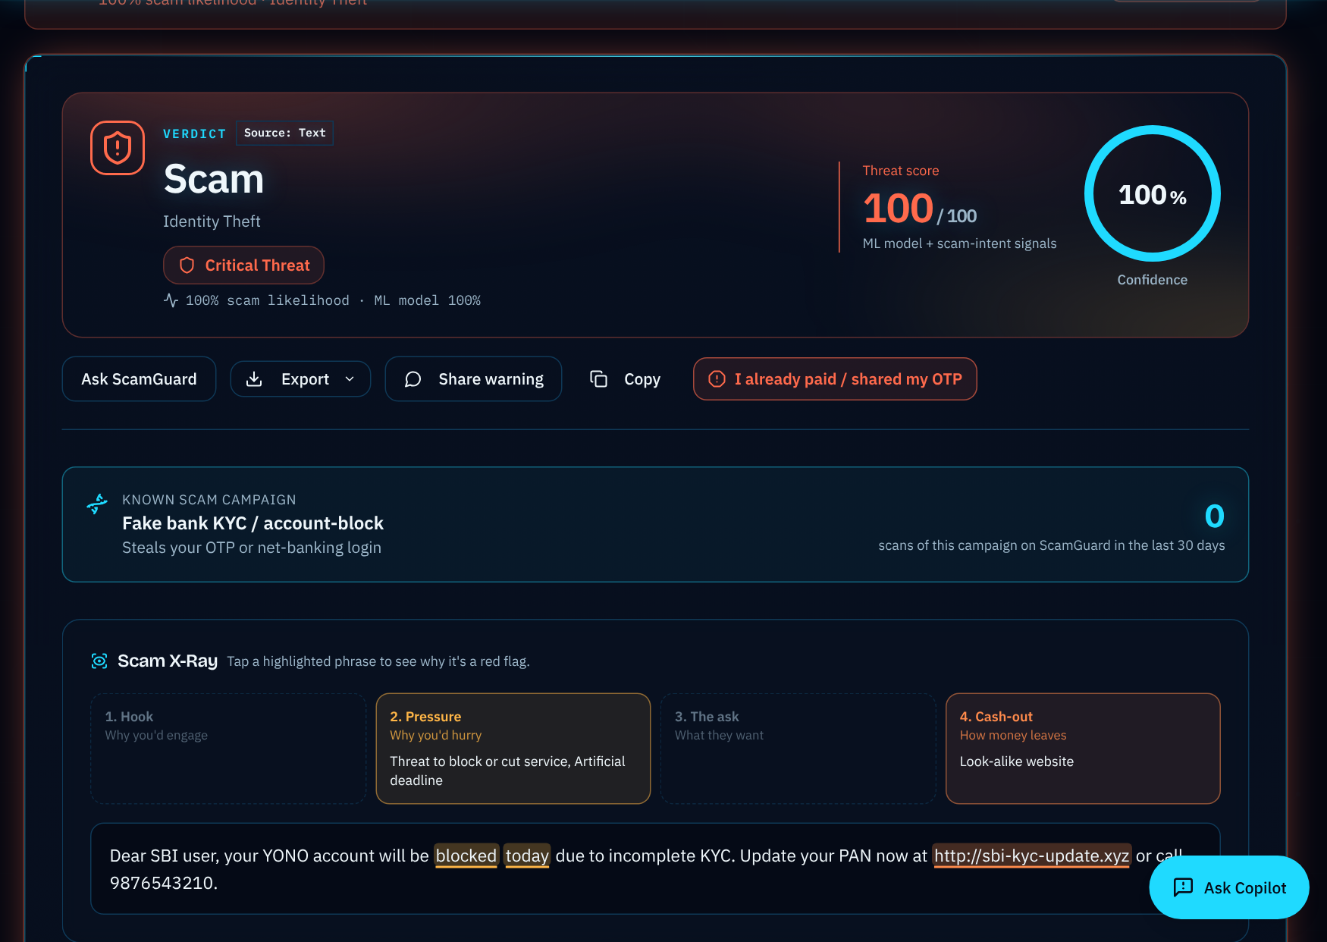
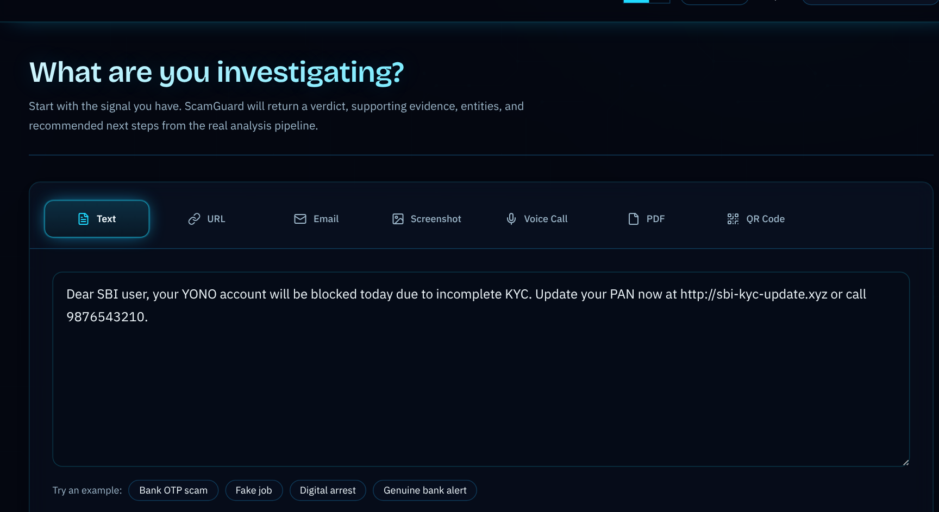
Results: Snapshots of the Output (2/4)
Full analysis of a scam message
Scam X-Ray: risky phrases by scam stage

Slide 15
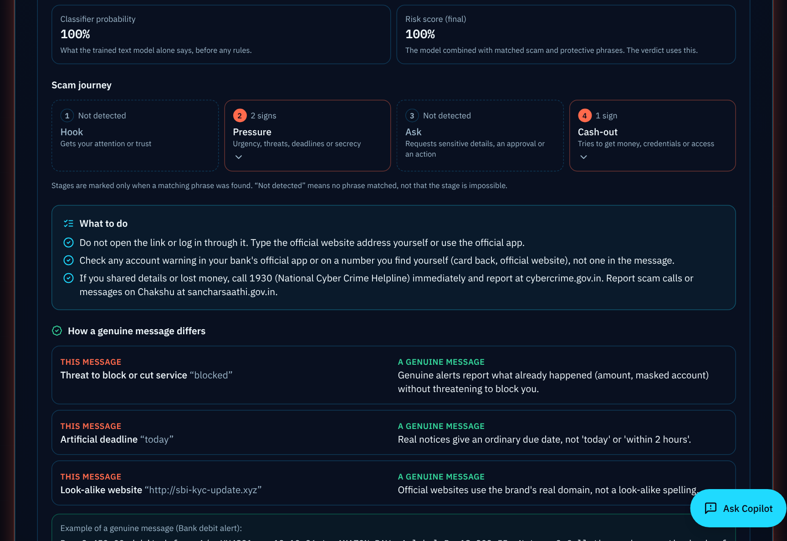
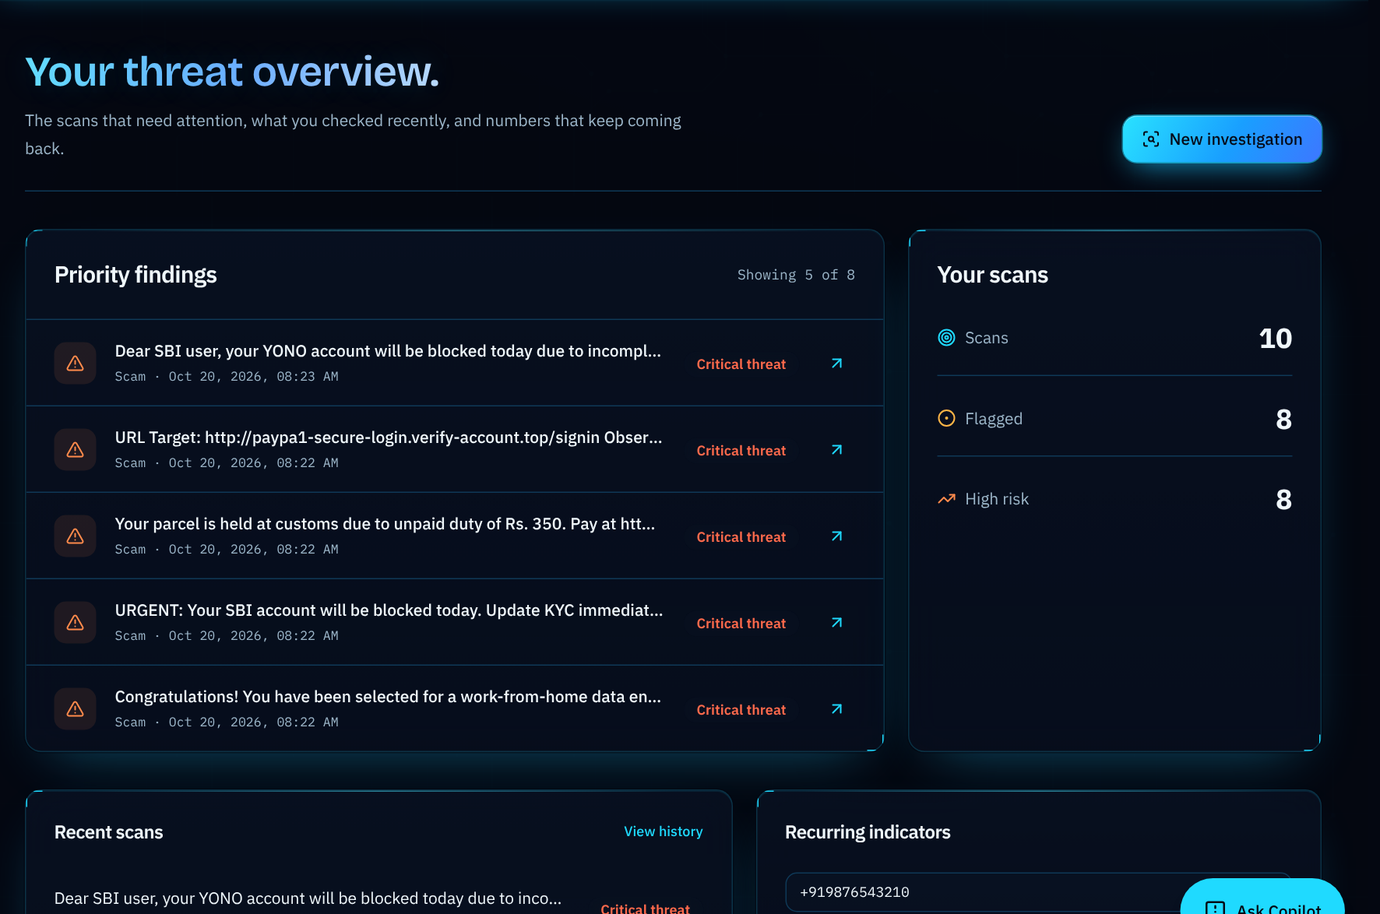
Results: Snapshots of the Output (3/4)
TrustLens: scam journey and next steps
Dashboard: priority findings and recent scans

Slide 16
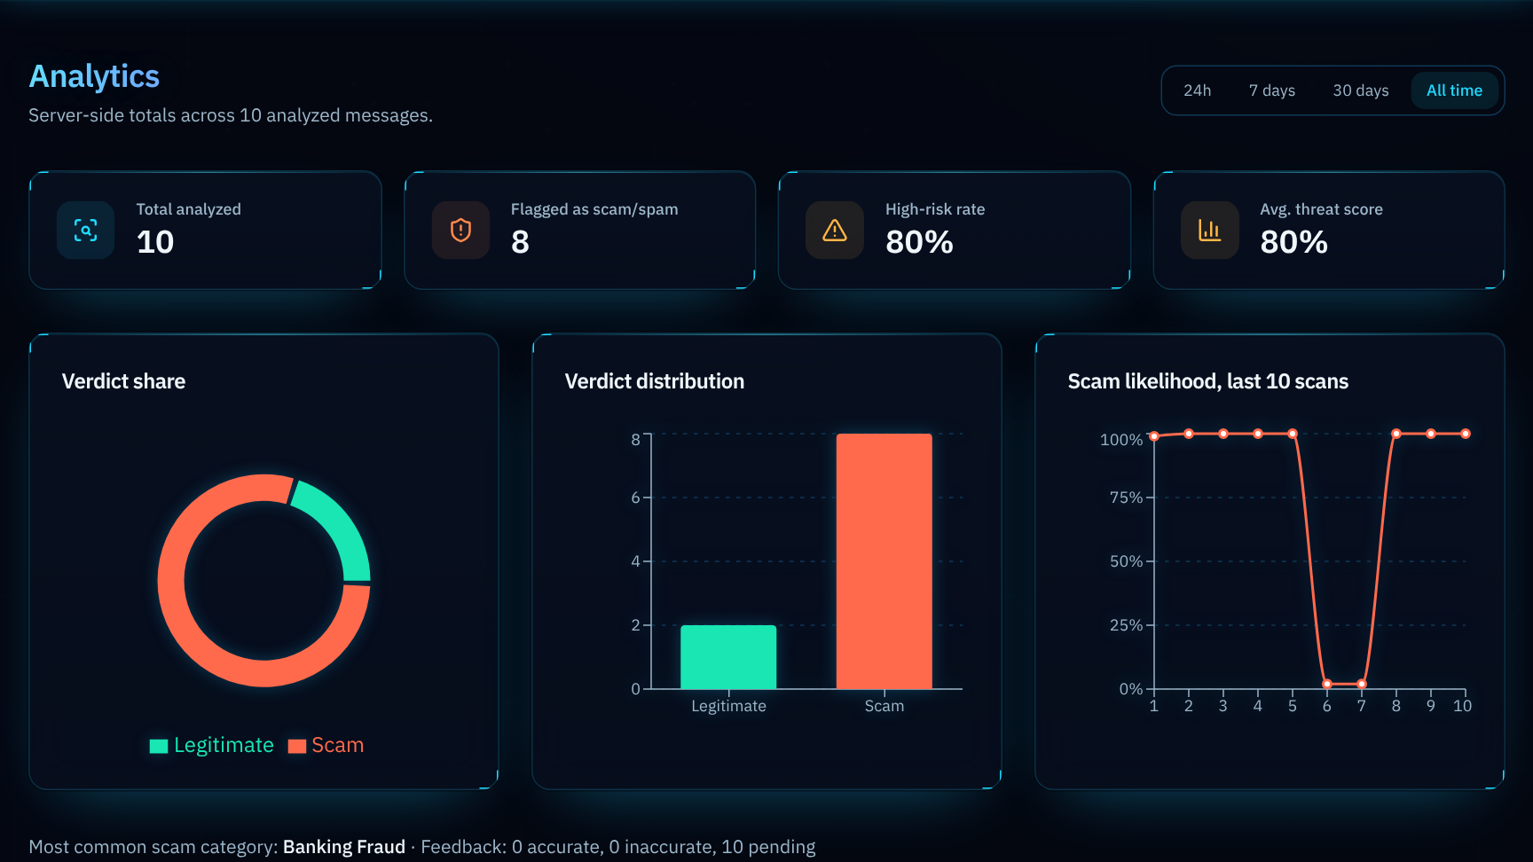
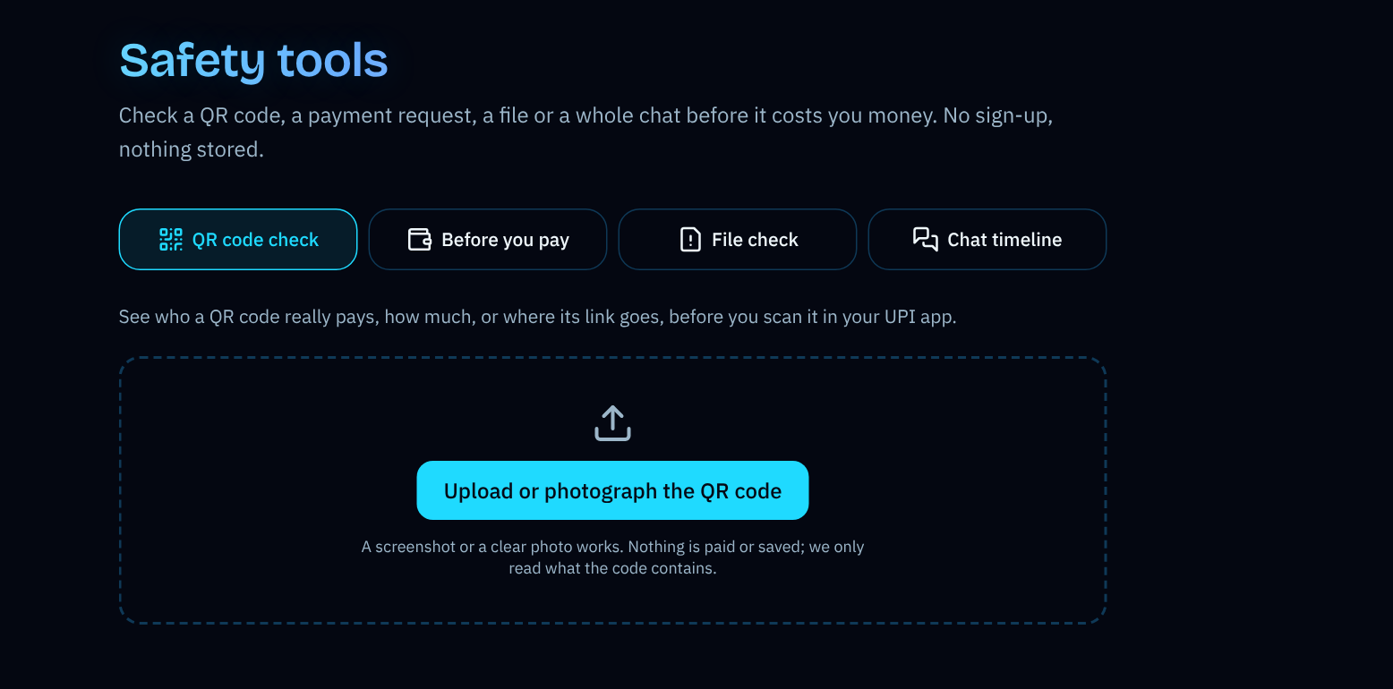
Results: Snapshots of the Output (4/4)
Analytics: verdict share and score trend
Safety tools: QR, before-you-pay, file check, chat

Slide 17
Conclusion and Future Enhancements
Conclusion
Future Enhancements
ScamGuard-IN-2026: 11,399 Indian SMS, audited labels, campaign-aware split
Label quality matters most: report labels 34.0% false alarms, audited labels 2.6%
Deployed system on 1,874 unseen-campaign messages: 97.1% accuracy, 98.2% precision, 97.2% recall, 3.2% false alarms
Explainable web application with Hindi support, under 4 ms per message
Team-contributed 2026 SMS as a larger real test set
Second annotator and inter-annotator agreement
Kannada, Tamil, Telugu and other Indian languages
Tests against adaptive and LLM-paraphrased scams
Small transformer models under the same split
Android share-to-check

Slide 18
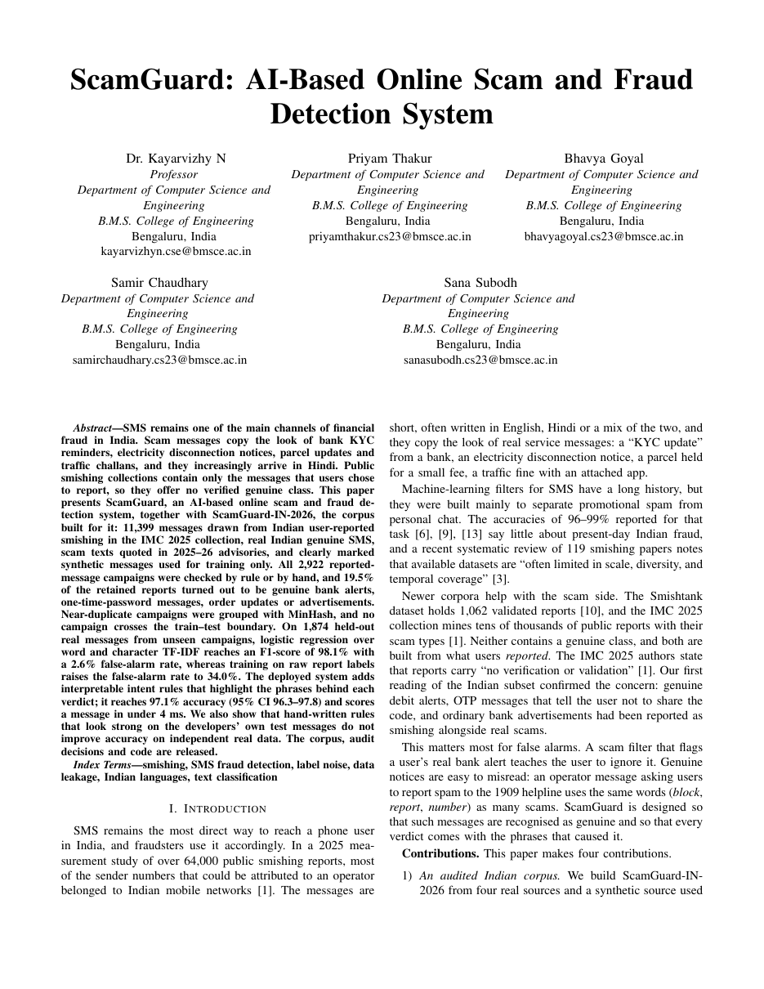
Paper Published
Title: ScamGuard: AI-Based Online Scam and Fraud Detection System
Authors: Dr. Kayarvizhy N, Priyam Thakur, Bhavya Goyal, Samir Chaudhary, Sana Subodh
Format: IEEE conference paper, 8 pages
Status: manuscript complete; to be submitted after the guide's approval
Contributions: audited Indian SMS corpus, measurement of report noise, campaign-aware evaluation, independent test of hybrid rules

Slide 19
References
[1] S. Agarwal, A. Papasavva, G. Suarez-Tangil, and M. Vasek, "Fishing for smishing: Understanding SMS phishing infrastructure and strategies by mining public user reports," in Proc. ACM IMC, 2025, doi: 10.1145/3730567.3764431.
[2] S. Agarwal, G. Suarez-Tangil, and M. Vasek, "An overview of 7726 user reports: Uncovering SMS scams and scammer strategies," in Proc. NDSS Symp., 2026.
[3] M. M. A. Pritom et al., "Short message service (SMS) phishing attacks and defenses: A systematic review," arXiv:2604.11429, 2026.
[4] D. Timko and M. L. Rahman, "Smishing Dataset I: Phishing SMS dataset from Smishtank.com," in Proc. ACM CODASPY, 2024.
[5] D. Goel, H. Ahmad, A. K. Jain, and N. K. Goel, "Machine learning driven smishing detection framework for mobile security," arXiv:2412.09641, 2024.
[6] C. Northcutt, L. Jiang, and I. Chuang, "Confident learning: Estimating uncertainty in dataset labels," J. Artif. Intell. Res., vol. 70, pp. 1373-1411, 2021.
[7] K. Lee et al., "Deduplicating training data makes language models better," in Proc. ACL, 2022, pp. 8424-8445.
[8] S. Kapoor and A. Narayanan, "Leakage and the reproducibility crisis in machine-learning-based science," Patterns, 2023.
[9] A. Z. Broder, "On the resemblance and containment of documents," in Proc. Compression and Complexity of SEQUENCES, 1997.
[10] G. Salton and C. Buckley, "Term-weighting approaches in automatic text retrieval," Inf. Process. Manage., vol. 24, no. 5, pp. 513-523, 1988.

Slide 20
Thank You

