Slide 1

ScamGuard: AI-Based Online Scam
and Fraud Detection System
Bhavya Goyal
1BM23CS063
Priyam Thakur
1BM23CS252
Samir Chaudhary
1BM23CS294
Sana Subodh
1BM23CS296
Dr. Kayarvizhy N
Professor
Department of Computer Science and Engineering
B.M.S. College of Engineering

Slide 2
Outline
1. Problem Statement
2. High Level Design
3. Detailed Design
4. Implementation
5. Results (Tables, Graphs, Dataset Used), Cross-Domain Study and Snapshots
6. Conclusion and Future Enhancements
7. Research Papers
8. References

Slide 3
Problem Statement
Scam SMS in India copy genuine service messages: bank KYC updates, electricity disconnection notices, parcel fees, e-challans, job offers and digital-arrest threats, often in Hindi or mixed Hindi-English
Scam and genuine messages share the same words (KYC, OTP, account, block, link), so keyword filters raise false alarms on real bank and operator messages
Public smishing data contains only user reports; reports are unverified and many of them are genuine messages
One scam campaign is sent with small edits to many people, so a random train-test split overstates accuracy
Most tools give a bare label without telling the user which part of the message is the trap
Objective: build an audited Indian SMS dataset and an explainable detector that separates scam from genuine messages with few false alarms, evaluate it without campaign leakage, and deliver it as a deployed web application

Slide 4
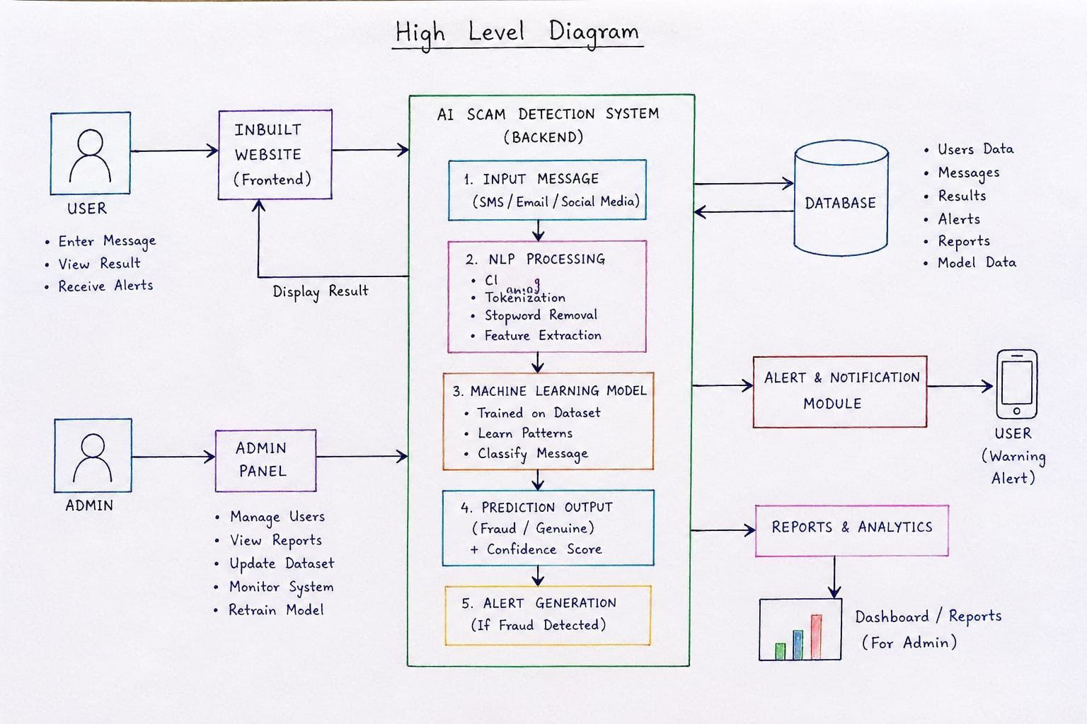
High Level Design
Offline (orange): dataset build and training. Online (blue): every request is cleaned, classified, checked by the rules and explained.

Slide 5
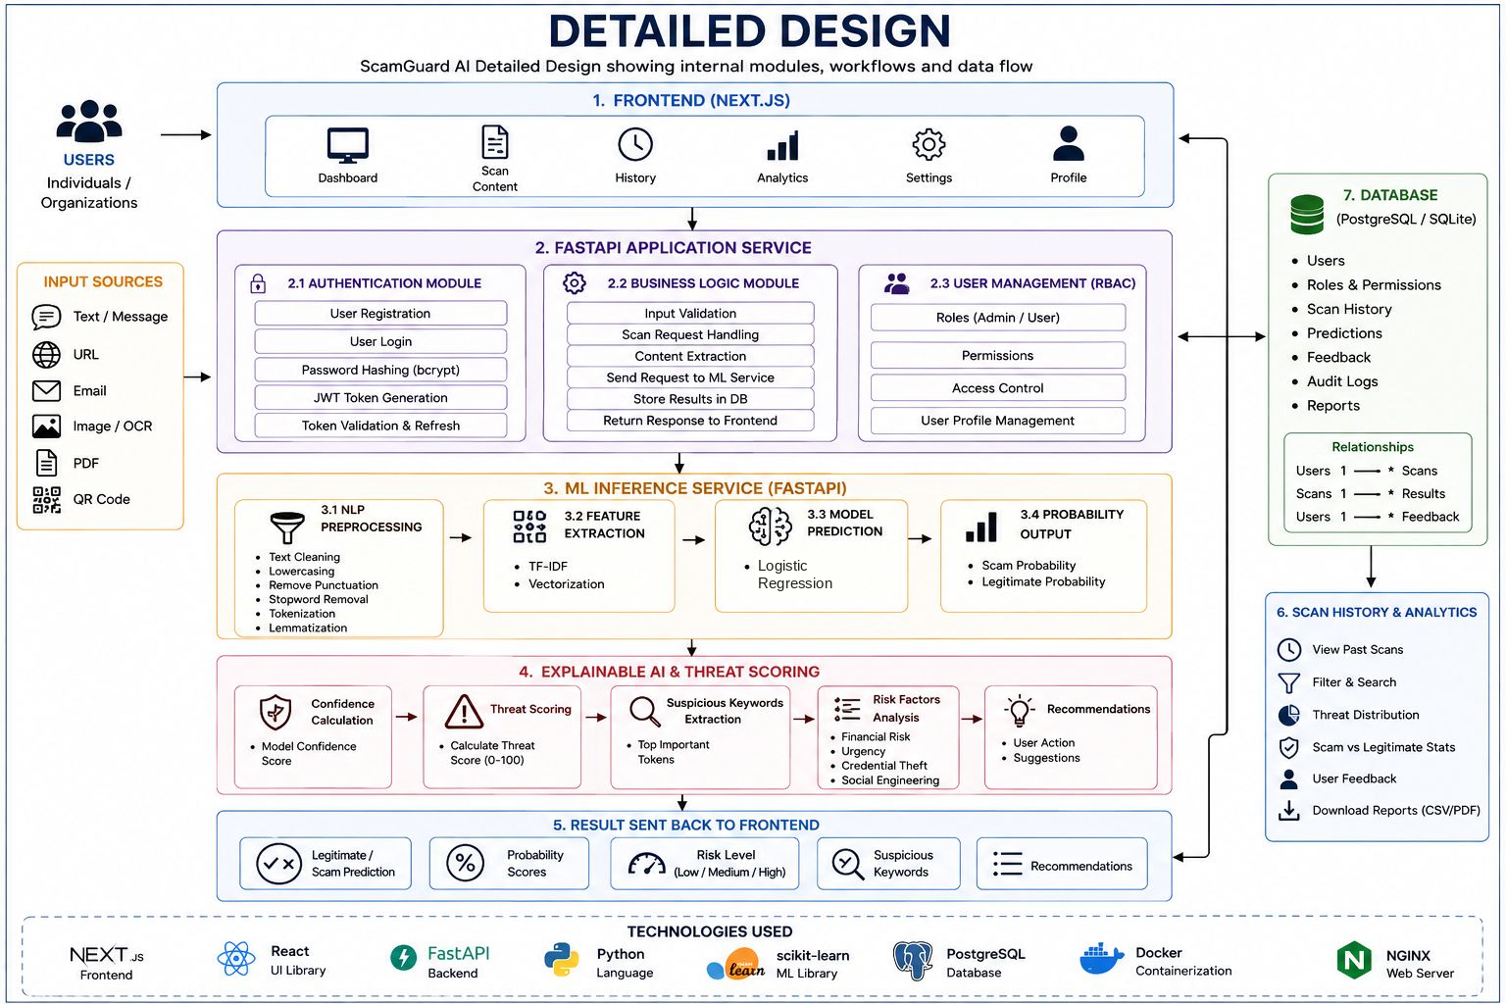
Detailed Design
Dataset and model pipeline: from source collection to the registered model
Collect: IMC 2025 India reports, India SMS collection, 2025-26 advisories, synthetic templates
Audit: every reported-message campaign confirmed by rule or read by hand; second pass on model disagreements
Split: MinHash near-duplicate campaigns; each campaign goes to only one of train, development or test

Slide 6
Detailed Design (contd.)
Preprocessing: replace e-mails, URLs (also bare links like bit.ly/x) and phone numbers with tokens; lowercase; keep Latin and Devanagari words; light stemming
Features: TF-IDF word 1-2-grams (30,000) + character 2-5-grams (60,000); 35,148 features after pruning; covers Hindi words and partial words; dotted or digit spellings (K.Y.C, bl0cked) are left to the intent rules
Classifier: logistic regression p(x) = σ(w·φ(x) + b), C = 16, balanced class weights
Intent layer: 31 patterns for 26 scam intents (OTP request, pay-to-receive, KYC deadline, remote-access app, legal threat) and 10 protective signals (do-not-share warning, 1909/1930, masked-account alert)
Fusion: s(x) = σ(clip(logit p, ±4) + 5(E⁺ − E⁻)); capped at 0.15 for genuine alerts; decoy rule for "never share your OTP ... share it"
Explanation: matched phrases grouped into hook, pressure, request and cash-out (Scam X-Ray, TrustLens)

Slide 7
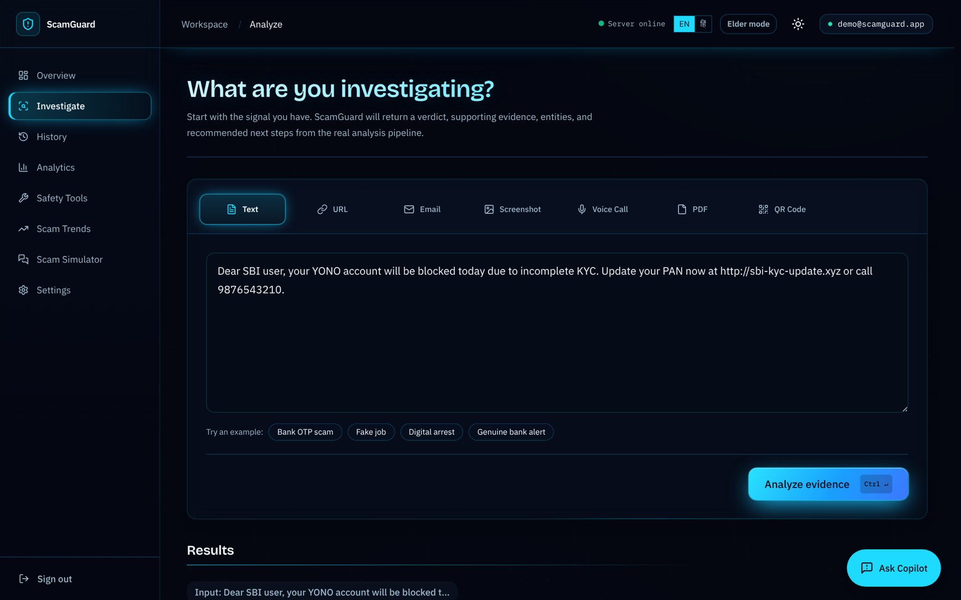
Implementation
Front end: Next.js 14, React 18, Tailwind CSS; English and Hindi
Back end: FastAPI, SQLAlchemy, PostgreSQL, JWT authentication, rate limiting
Machine learning: scikit-learn; versioned model registry; same preprocessing in training and serving
Data tools: datasketch (MinHash), pandas, NumPy, Matplotlib, Jupyter, Streamlit
Deployment: Vercel (front end), Render (back end), Neon PostgreSQL, GitHub Actions CI
Quality: 836 back-end and ML tests and 14 front-end tests in continuous integration
Full analysis screen

Slide 8
Implementation (contd.)
Module | What it does
Quick check | Verdict and reasons for a pasted message, without sign-in
Full analysis | Text, URL, e-mail, screenshot, PDF or QR input; risk score and evidence
Scam X-Ray and TrustLens | Risky phrases by stage, what a genuine message would do, next steps
AI copilot | Answers follow-up questions about a scan (Gemini, daily cap)
Safety tools | QR check, before-you-pay check, file check, chat timeline
History and analytics | Saved scans, search, export, verdict share and score trend
Cross-domain study | Baseline vs adapted model with probability and top words; Streamlit demo

Slide 9
Results: Dataset Used (ScamGuard-IN-2026)
Source | Genuine | Scam | Use
IMC 2025 reports, India subset (audited) | 963 | 3,987 | train / dev / test
India SMS collection (audited) | 1,694 | 6 | train / dev / test
2025-26 advisories and news | 1 | 11 | test only
Synthetic 2025-26 scam and genuine types | 2,950 | 1,787 | train only
Total | 5,608 | 5,791 | 11,399
Split | Messages
Train | 8,645
Development | 868
Test (real, unseen campaigns) | 1,874
2025-26 advisory test | 12
All 2,922 reported-message campaigns checked: 1,253 by rule, 1,669 by hand; 19.5% of retained reports were genuine
6,662 real messages form 4,085 near-duplicate campaigns (largest 128); test = 665 genuine + 1,209 scam
Attributes: text, label, source, subtype, is_synthetic, campaign, split

Slide 10
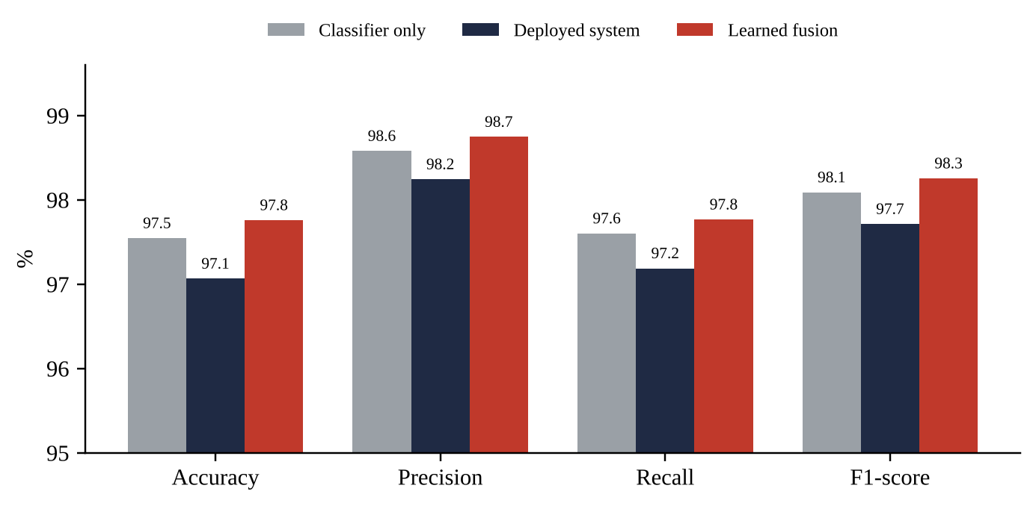
Results: Performance on the Real Test Set
System (1,874 messages) | Accuracy | Precision | Recall | F1 | False alarms
Classifier only | 97.5% | 98.6% | 97.6% | 98.1% | 2.6%
Deployed system | 97.1% | 98.2% | 97.2% | 97.7% | 3.2%
Learned fusion | 97.8% | 98.7% | 97.8% | 98.3% | 2.3%
Deployed system: accuracy 95% CI 96.3-97.8%; false alarms 95% CI 2.0-4.6%
ROC-AUC 0.995, average precision 0.997
Catches 1,175 of 1,209 scams; passes 644 of 665 genuine messages
2025-26 advisories: 10 of 11 scams caught, genuine notice passed

Slide 11
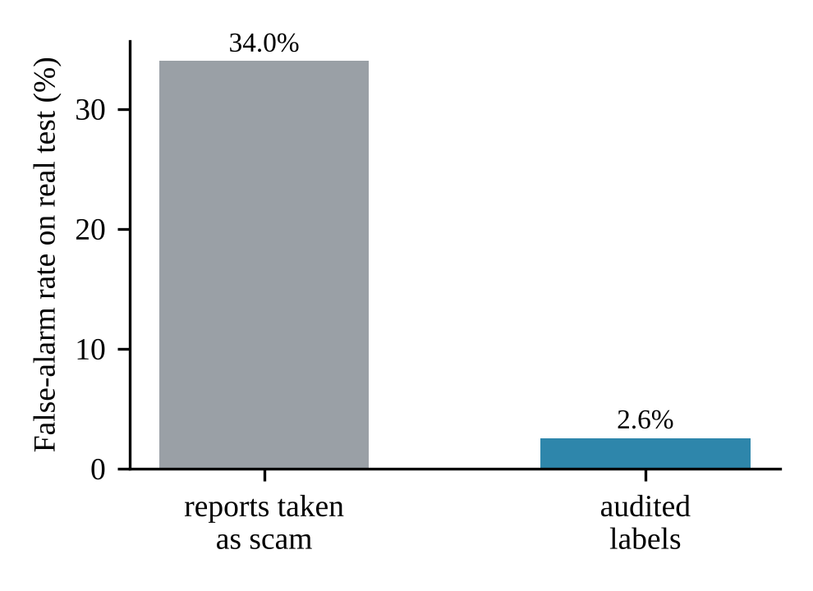
Results: Research Findings
Label audit: training on report labels gives 34.0% false alarms; audited labels give 2.6% (McNemar p < 10⁻³⁰)
Leakage: a random split shows 0.8% false alarms, the campaign split 1.4%; 793 test rows leaked under the random split
Synthetic data: recall on the team-written challenge set of 2025-26 scam types rises from 35.6% to 82.2%; real-data F1 stays at 98.1%
Intent rules: on unseen real data F1 98.1% → 97.7%; kept for phrase-level explanations

Slide 12
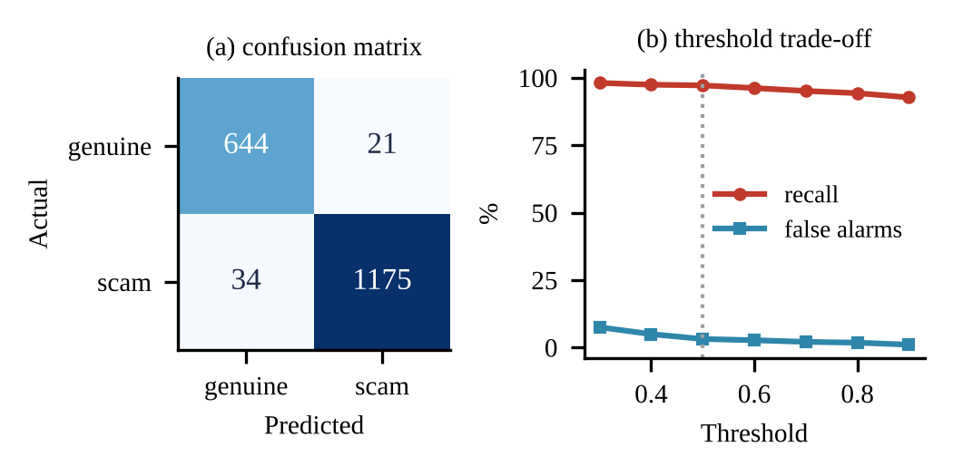
Results: Model Comparison and Errors
Word + char TF-IDF | F1 | False alarms
Naive Bayes | 95.5% | 6.5%
Logistic regression | 98.1% | 2.6%
Linear SVM | 98.2% | 3.9%
Random forest | 97.6% | 3.3%
Logistic regression selected: lowest false-alarm rate among the strong models, readable word weights
Deployed system: 34 scams missed, 21 genuine flagged; 15 of the 21 are reported-but-genuine bank messages
Threshold 0.9: false alarms 1.1% at 92.7% recall
Model 1.6 MB; about 4 ms per message with the rules
Deployed system: confusion matrix and threshold trade-off

Slide 13
Advancement: Cross-Domain Study
Question: does a spam filter trained on one SMS collection still work on messages from another region, and how much target data fixes it?
Source domain: UCI SMS Spam Collection, 5,574 messages, 5,158 after cleaning (duplicates and conflicts removed)
Target domain: India Spam SMS Classification, 2,267 messages, 2,050 after cleaning; never used for model selection
Models and features: Naive Bayes, Logistic Regression and Linear SVM on word 1-2-gram TF-IDF (20,000 features) and character 3-5-gram TF-IDF (char_wb); settings tuned by 5-fold cross-validation on UCI training data only
Adaptation: UCI split 80/20; India split 70/30 into a pool and a fixed 615-message test set; add 10%, 20% or 40% of the pool (143, 287, 574 messages) to the UCI training data and retrain
Rigour: three seeds (42, 123, 2026), mean ± SD, McNemar test, group-aware split check and manual error analysis
Objective: measure the accuracy lost under domain shift and show that a small labelled sample from the new domain recovers it, without changing the model type

Slide 14
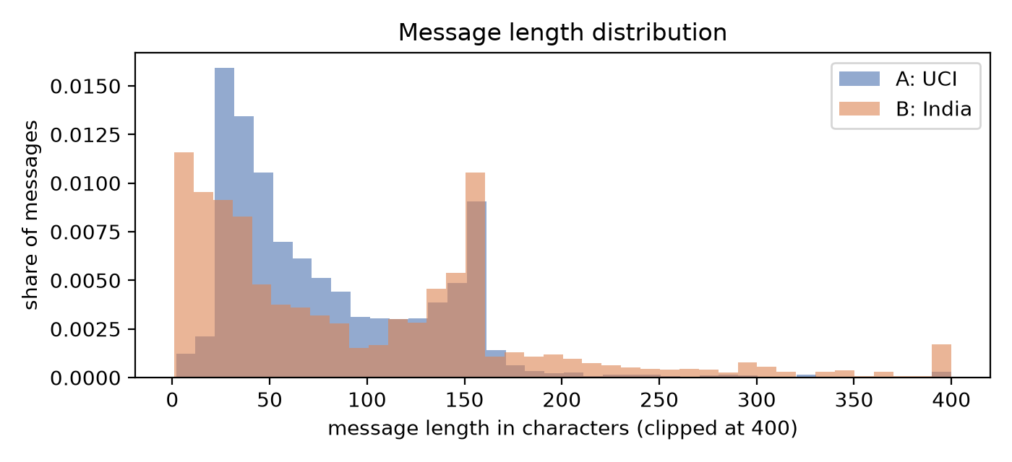
Results: Cross-Domain Generalization
Model (UCI-only) | Features | F1 UCI | F1 India
Naive Bayes | word | 0.906 | 0.551
Logistic Regression | word | 0.911 | 0.678
Linear SVM | word | 0.914 | 0.615
Naive Bayes | char | 0.948 | 0.684
Logistic Regression | char | 0.940 | 0.638
Linear SVM | char | 0.943 | 0.578
Drop: every UCI-trained model loses 0.23-0.36 F1 on Indian SMS; best transfer is Logistic Regression with words (0.911 → 0.678)
Why: precision stays high (0.88-0.96) but recall falls to 0.40-0.55: about half of Indian spam is missed
Domain gap: 20.7% of words in an Indian message are unseen in UCI training data (7.8% for UCI); 87% of Indian spam has a URL against 1.6% of UCI messages

Slide 15
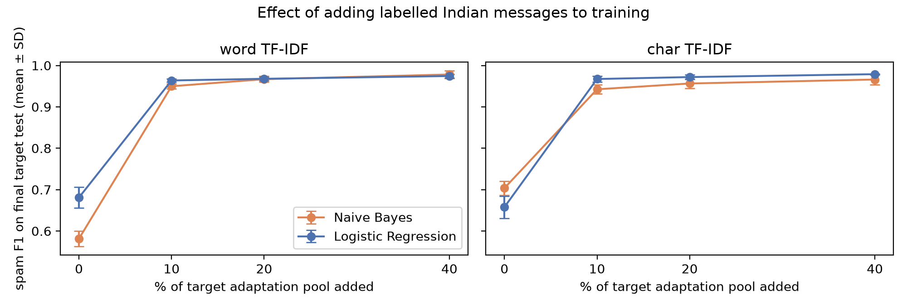
Results: Lightweight Domain Adaptation
Logistic Regression: F1 on Indian test set 0.681 → 0.964 (+143 messages) → 0.968 (+287) → 0.975 (+574)
Naive Bayes: 0.582 → 0.950 → 0.967 → 0.978; UCI F1 stays near 0.93 throughout
Significance: gain positive in all 3 seeds; McNemar p < 0.05 in all 36 comparisons; missed spam falls from 96 to 3 (LR, seed 42)

Slide 16
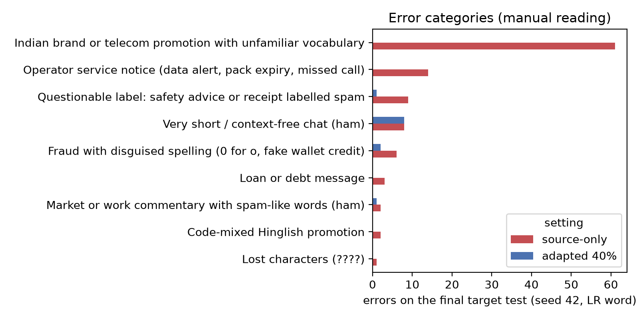
Results: Robustness and Error Analysis
Model | Added | Random split | Group-aware
Logistic Regression | 0% | 0.681 | 0.652
Logistic Regression | 10% | 0.964 | 0.952
Logistic Regression | 40% | 0.975 | 0.969
Naive Bayes | 0% | 0.582 | 0.551
Naive Bayes | 10% | 0.950 | 0.937
Naive Bayes | 40% | 0.978 | 0.960
Group-aware split: near-duplicate Indian messages kept on one side; adapted F1 drops by at most 0.02, so the gain is not caused by leakage
Errors read by hand: 106 errors (source-only LR) → 12 after adaptation; 61 were Indian brand or telecom promotions with unfamiliar words, all fixed
Remaining errors: very short chat messages (8) and disguised spellings such as "t0", "n0w" (2)

Slide 17
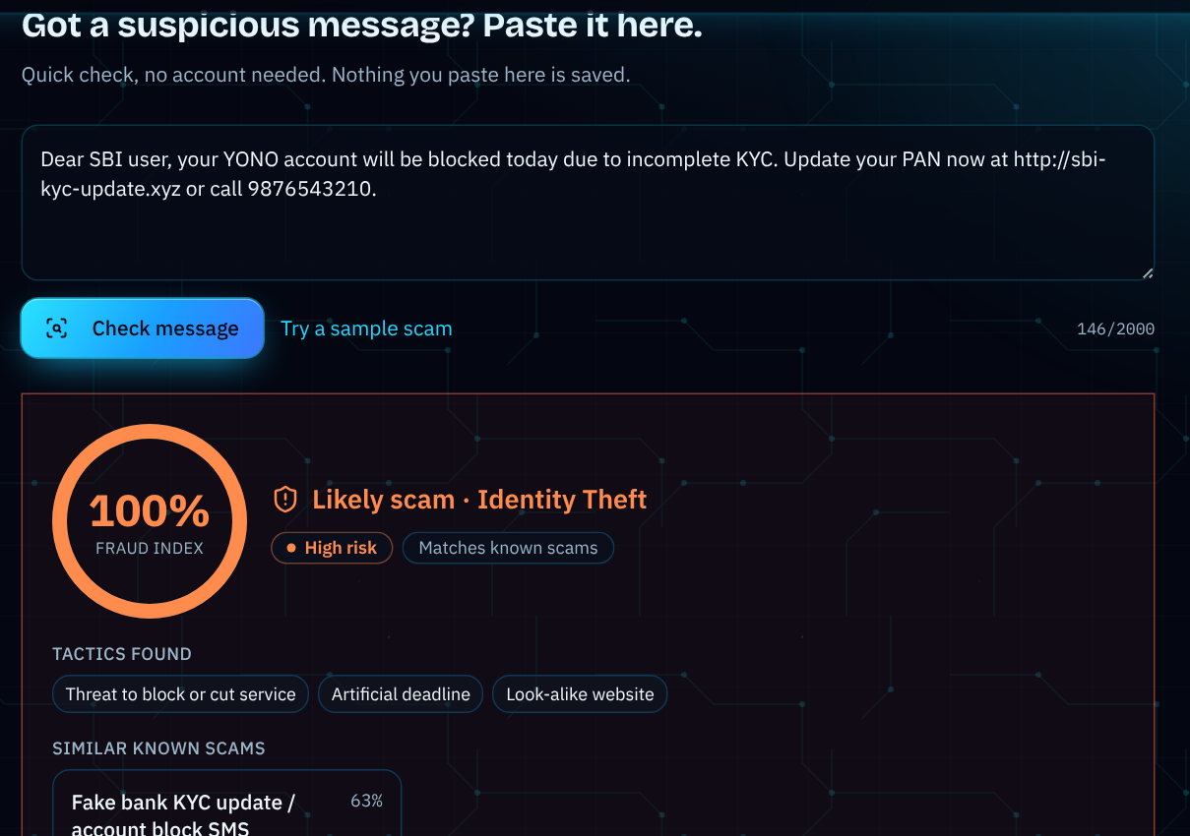
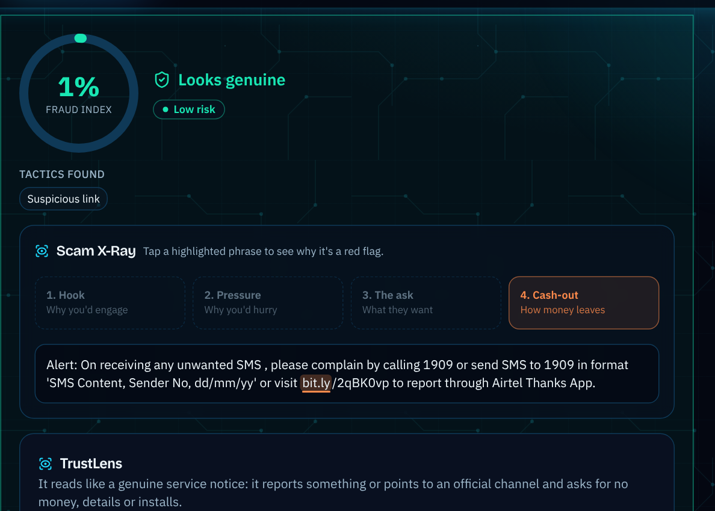
Results: Snapshots of the Output (1/5)
Quick check: fake KYC SMS flagged as scam
Quick check: operator 1909 notice looks genuine

Slide 18
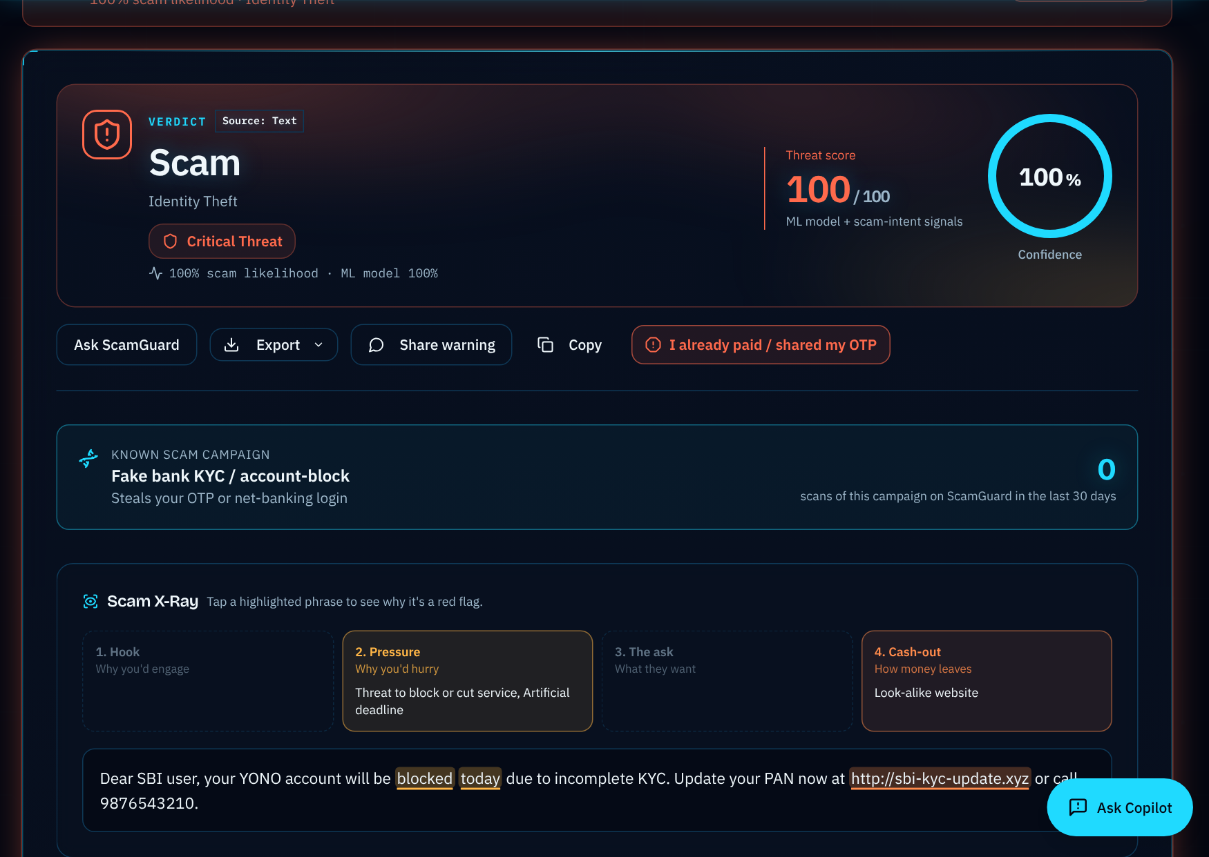
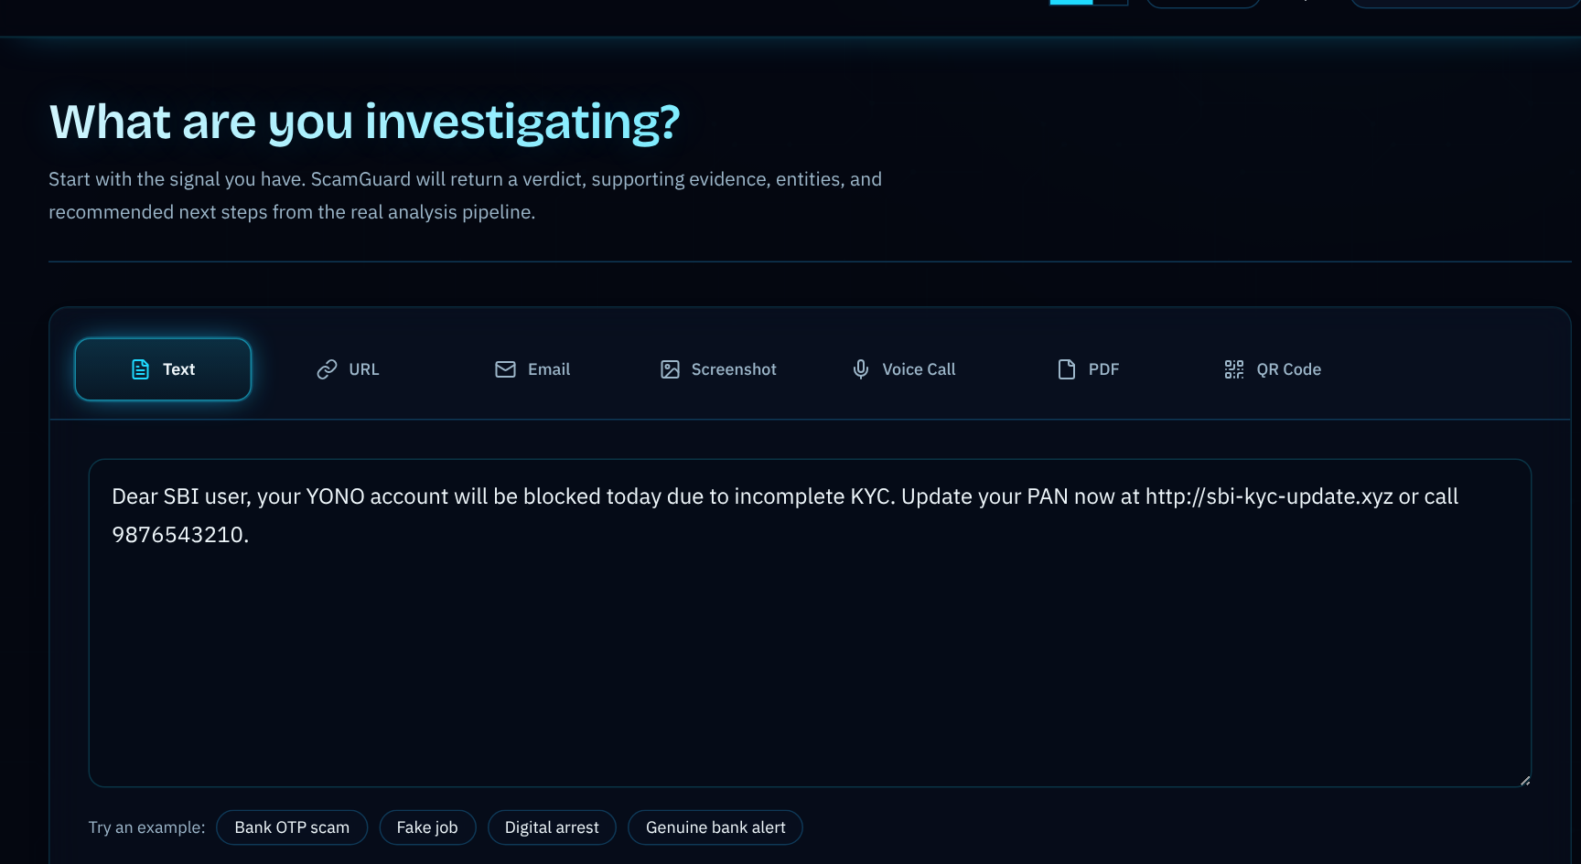
Results: Snapshots of the Output (2/5)
Full analysis of a scam message
Scam X-Ray: risky phrases by scam stage

Slide 19
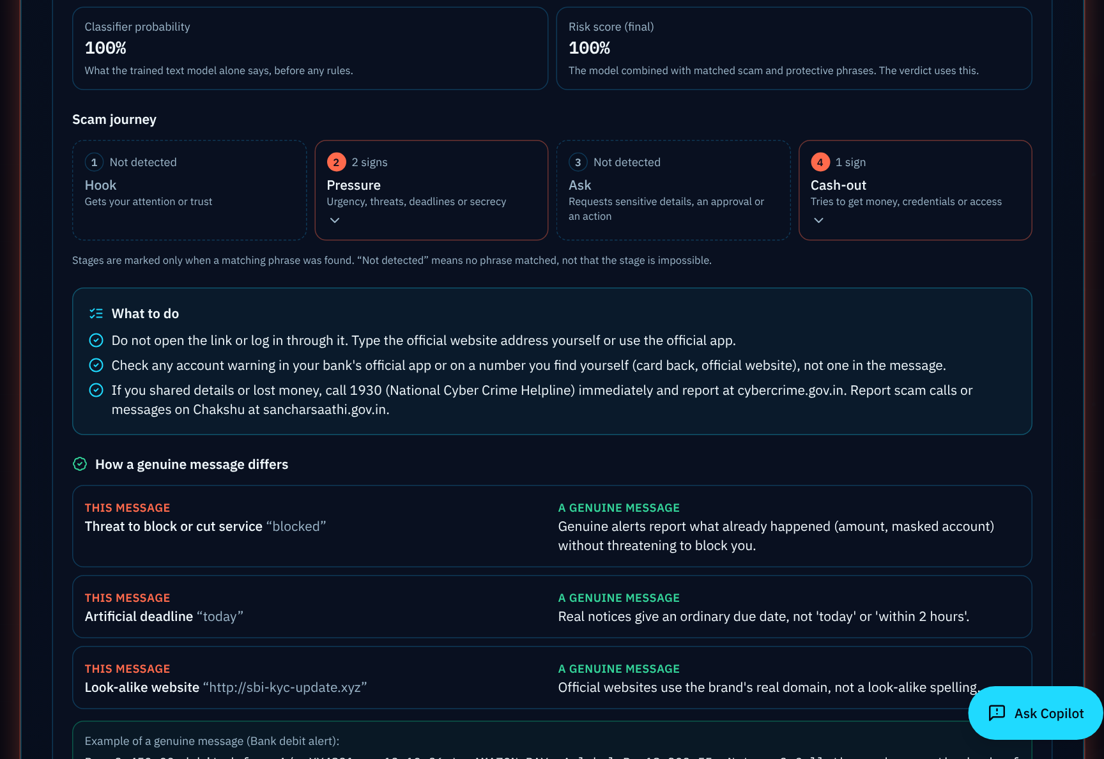
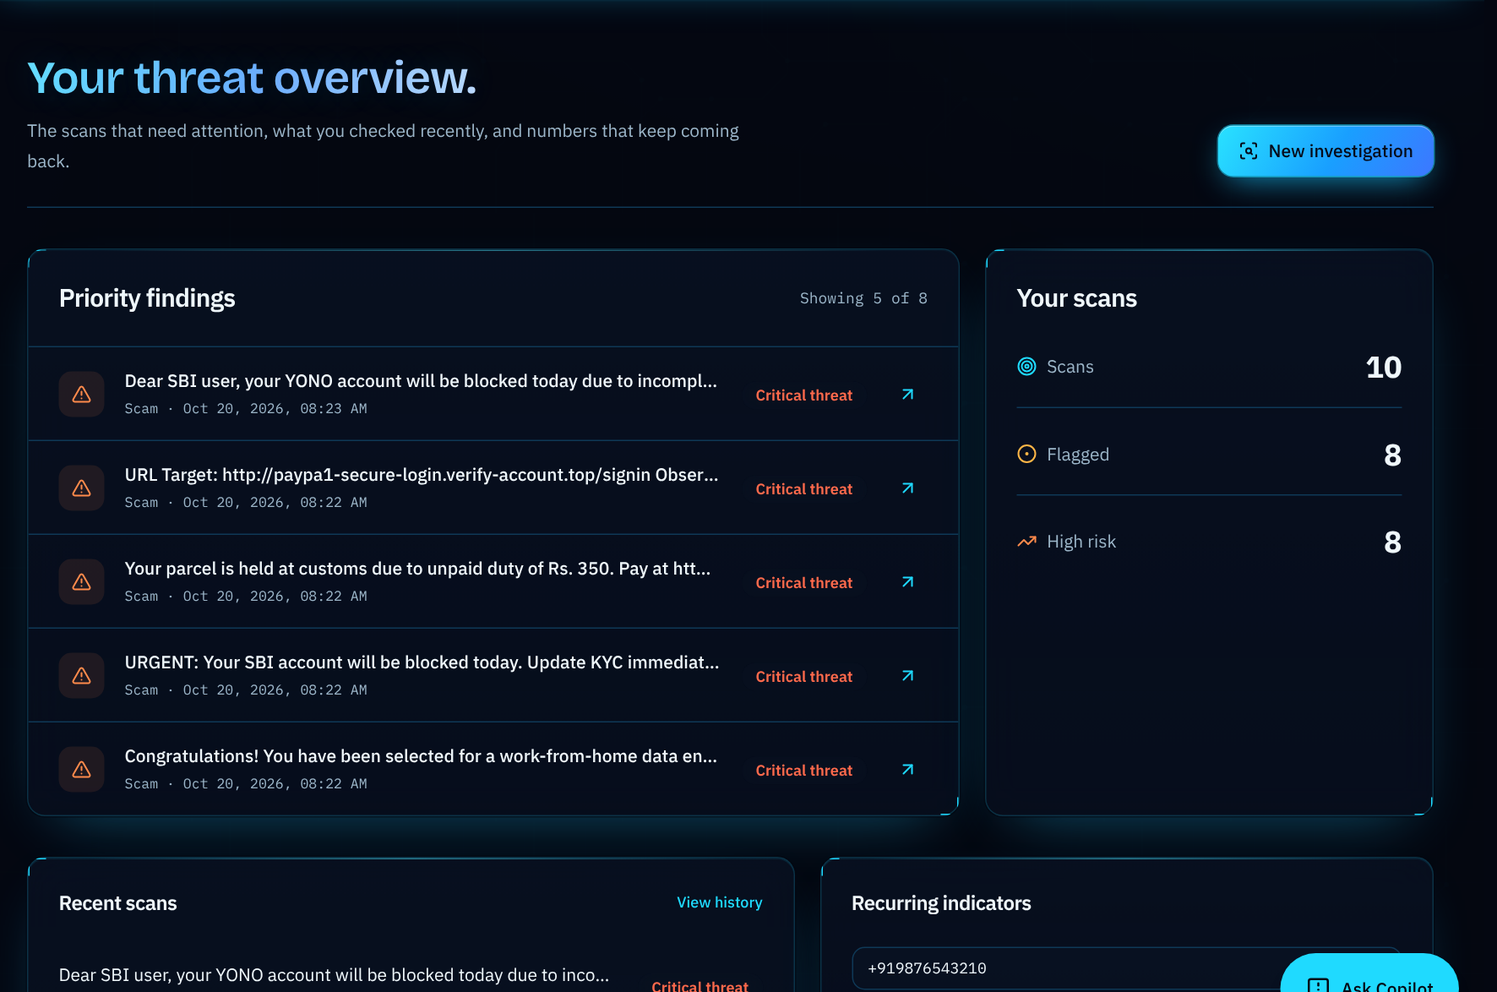
Results: Snapshots of the Output (3/5)
TrustLens: scam journey and next steps
Dashboard: priority findings and recent scans

Slide 20
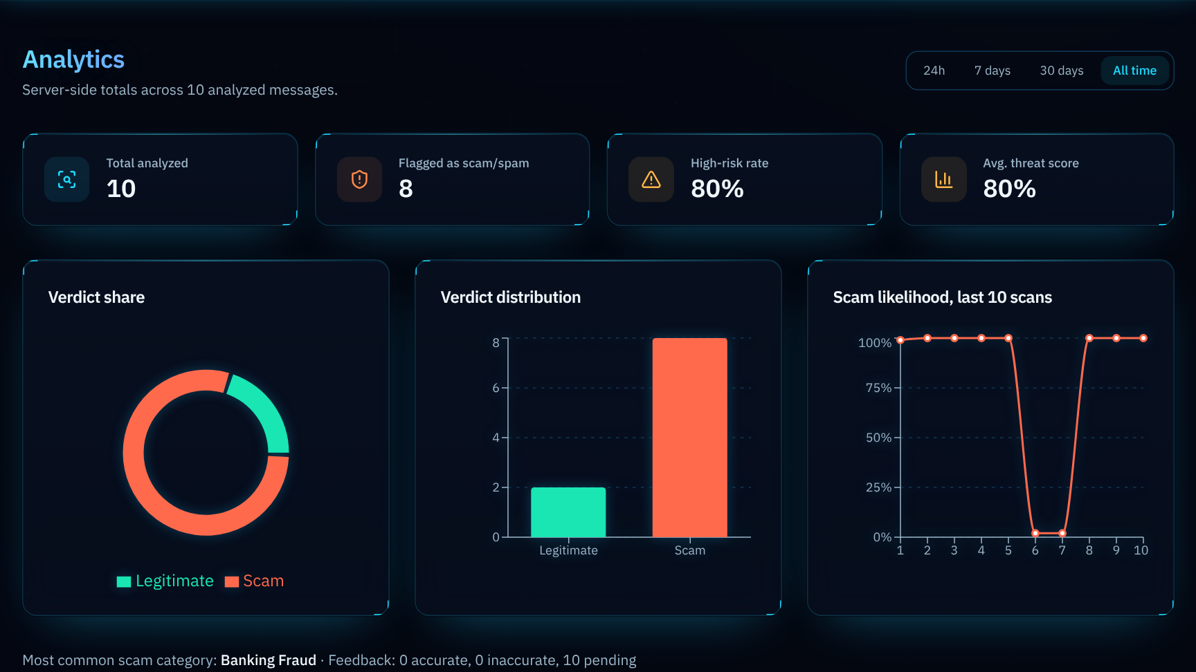
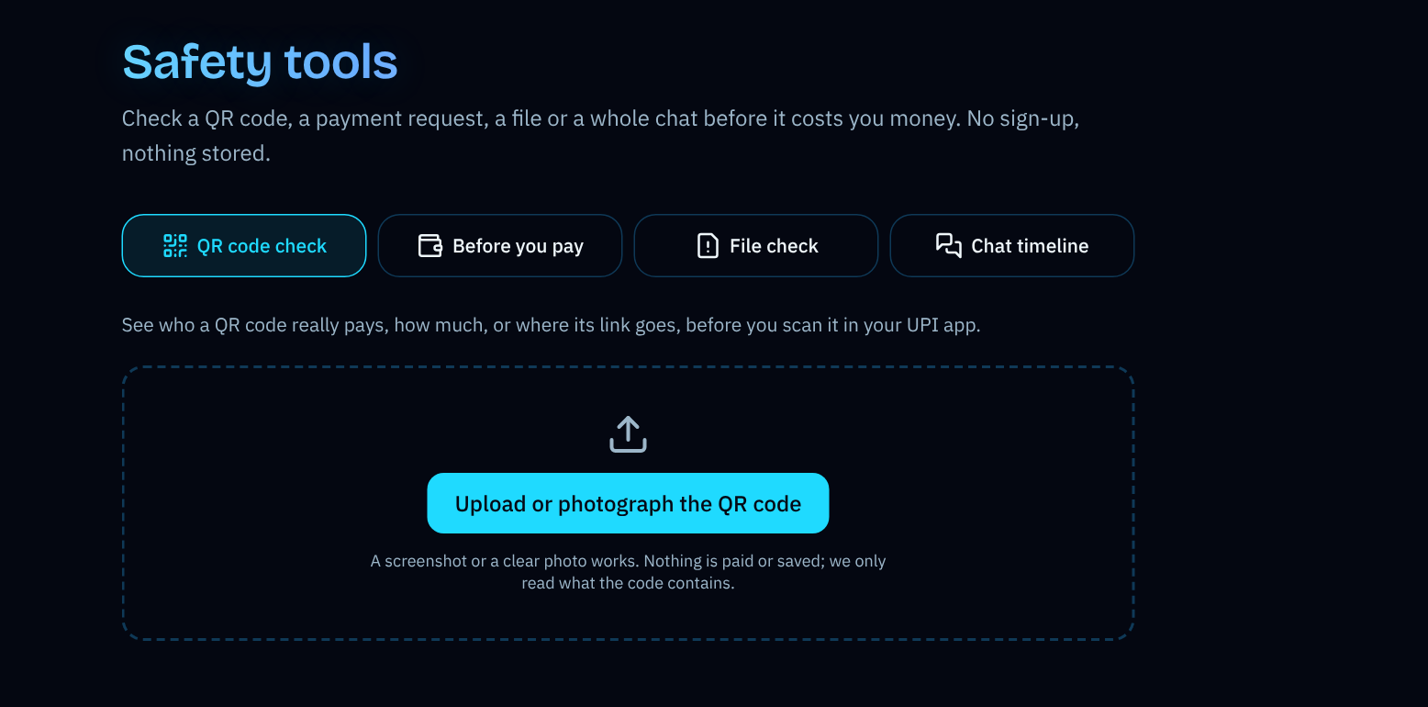
Results: Snapshots of the Output (4/5)
Analytics: verdict share and score trend
Safety tools: QR, before-you-pay, file check, chat

Slide 21
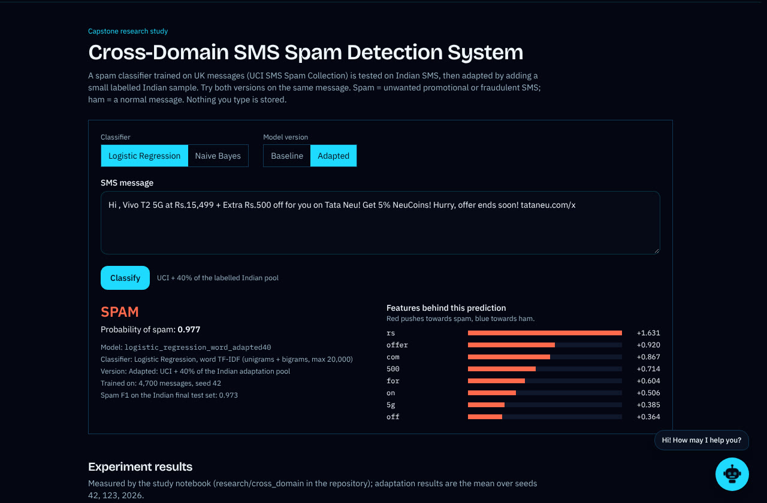
Results: Snapshots of the Output (5/5)
Cross-domain page: paste a message and compare the baseline (UCI-only) and adapted (UCI + 40% Indian) models
Choice: Naive Bayes or Logistic Regression
Output: label, spam probability, model version and the words behind the prediction
Also: the measured results of the study and a Streamlit app that loads the same saved models

Slide 22
Conclusion and Future Enhancements
Conclusion
Future Enhancements
ScamGuard-IN-2026: 11,399 Indian SMS, audited labels, campaign-aware split
Label quality matters most: report labels 34.0% false alarms, audited labels 2.6%
Deployed system on 1,874 unseen-campaign messages: 97.1% accuracy, 98.2% precision, 97.2% recall, 3.2% false alarms
Cross-domain study: UCI-trained LR falls from F1 0.911 to 0.678 on Indian SMS; 574 labelled Indian messages restore 0.975
Team-contributed 2026 SMS as a larger real test set
Second annotator and inter-annotator agreement
Kannada, Tamil, Telugu and other Indian languages
Small transformers; tests against LLM-paraphrased scams
Unsupervised adaptation and more target domains
Android share-to-check

Slide 23
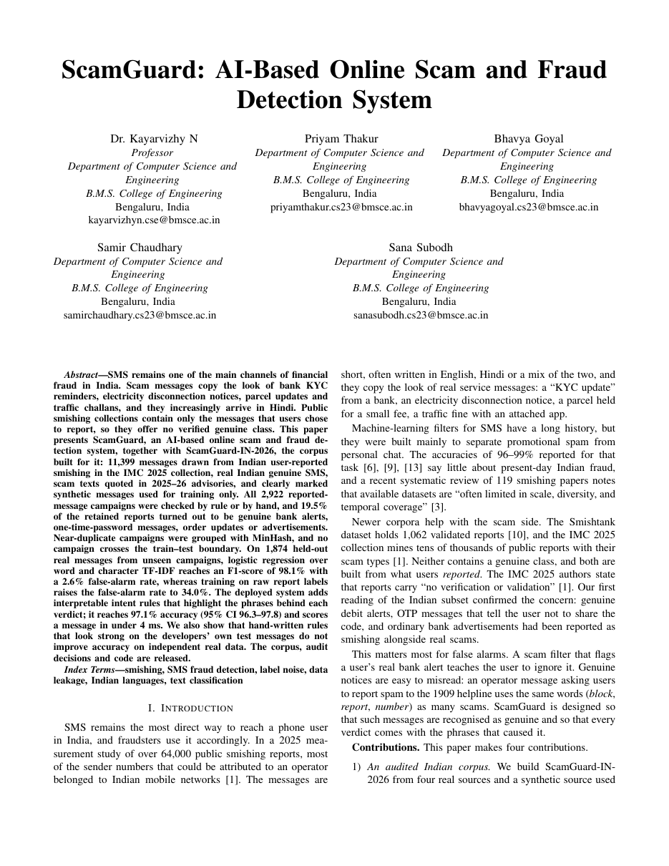
Research Papers
Title: (1) ScamGuard: AI-Based Online Scam and Fraud Detection System; (2) Cross-Domain Generalization and Lightweight Domain Adaptation for SMS Spam Detection
Authors: Dr. Kayarvizhy N, Priyam Thakur, Bhavya Goyal, Samir Chaudhary, Sana Subodh
Format: IEEE conference papers
Status: both manuscripts complete; to be submitted after the guide's approval
Contributions: (1) audited Indian SMS corpus, report-noise measurement, campaign-aware evaluation; (2) UCI-to-India transfer gap, adaptation with 143-574 labelled messages, error analysis

Slide 24
References
[1] S. Agarwal, A. Papasavva, G. Suarez-Tangil, and M. Vasek, "Fishing for smishing: Understanding SMS phishing infrastructure and strategies by mining public user reports," in Proc. ACM IMC, 2025, doi: 10.1145/3730567.3764431.
[2] S. Agarwal, G. Suarez-Tangil, and M. Vasek, "An overview of 7726 user reports: Uncovering SMS scams and scammer strategies," in Proc. NDSS Symp., 2026.
[3] M. M. A. Pritom et al., "Short message service (SMS) phishing attacks and defenses: A systematic review," arXiv:2604.11429, 2026.
[4] D. Timko and M. L. Rahman, "Smishing Dataset I: Phishing SMS dataset from Smishtank.com," in Proc. ACM CODASPY, 2024.
[5] D. Goel, H. Ahmad, A. K. Jain, and N. K. Goel, "Machine learning driven smishing detection framework for mobile security," arXiv:2412.09641, 2024.
[6] C. Northcutt, L. Jiang, and I. Chuang, "Confident learning: Estimating uncertainty in dataset labels," J. Artif. Intell. Res., vol. 70, pp. 1373-1411, 2021.
[7] K. Lee et al., "Deduplicating training data makes language models better," in Proc. ACL, 2022, pp. 8424-8445.
[8] S. Kapoor and A. Narayanan, "Leakage and the reproducibility crisis in machine-learning-based science," Patterns, 2023.
[9] A. Z. Broder, "On the resemblance and containment of documents," in Proc. Compression and Complexity of SEQUENCES, 1997.
[10] G. Salton and C. Buckley, "Term-weighting approaches in automatic text retrieval," Inf. Process. Manage., vol. 24, no. 5, pp. 513-523, 1988.

Slide 25
References (contd.)
[11] T. A. Almeida, J. M. Gómez Hidalgo, and A. Yamakami, "Contributions to the study of SMS spam filtering: New collection and results," in Proc. ACM DocEng, 2011, pp. 259-262.
[12] JuniorAlive, "India Spam SMS Classification," GitHub repository, 2024. https://github.com/junioralive/india-spam-sms-classification
[13] S. Ben-David, J. Blitzer, K. Crammer, A. Kulesza, F. Pereira, and J. W. Vaughan, "A theory of learning from different domains," Machine Learning, vol. 79, pp. 151-175, 2010.
[14] S. J. Pan and Q. Yang, "A survey on transfer learning," IEEE Trans. Knowl. Data Eng., vol. 22, no. 10, pp. 1345-1359, 2010.
[15] H. Daumé III, "Frustratingly easy domain adaptation," in Proc. ACL, 2007, pp. 256-263.
[16] Q. McNemar, "Note on the sampling error of the difference between correlated proportions or percentages," Psychometrika, vol. 12, no. 2, pp. 153-157, 1947.
[17] T. G. Dietterich, "Approximate statistical tests for comparing supervised classification learning algorithms," Neural Computation, vol. 10, no. 7, pp. 1895-1923, 1998.

Slide 26
Thank You

