Slide 1
Bikesharing_challenge_story
File created on: 1/27/2023 4:14:17 AM

Slide 2
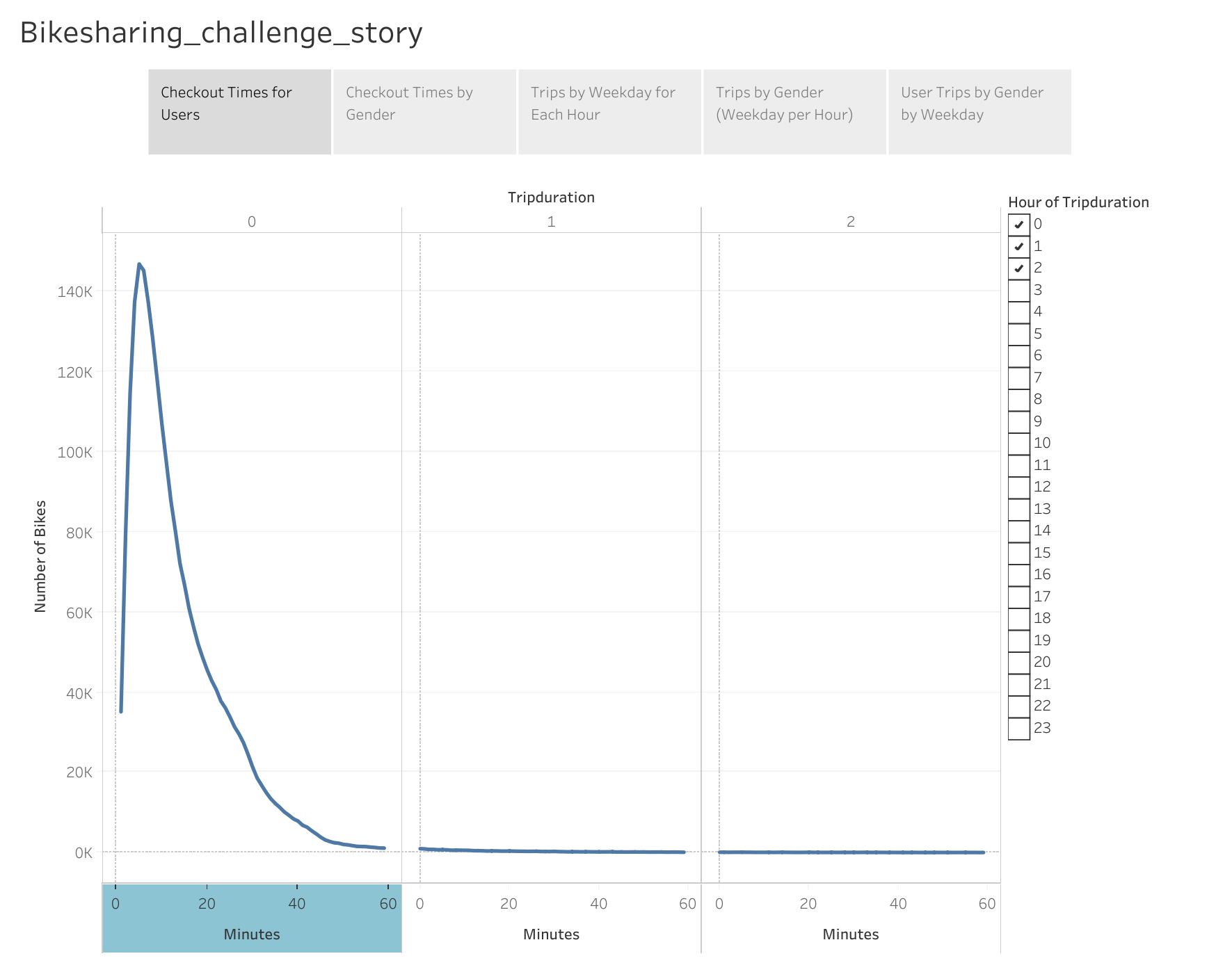

Slide 3
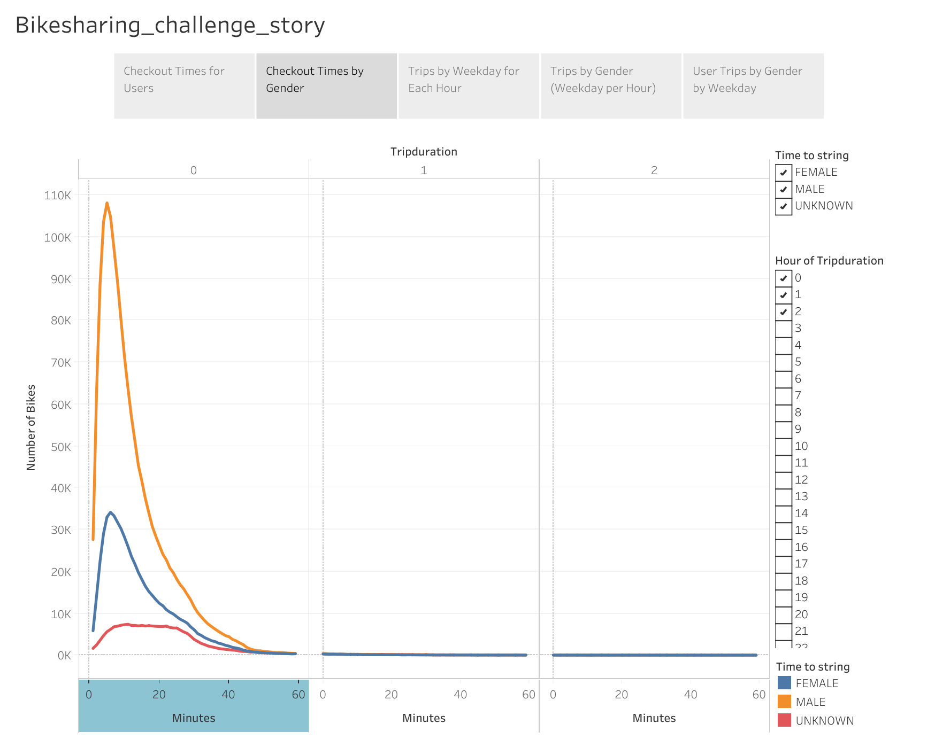

Slide 4
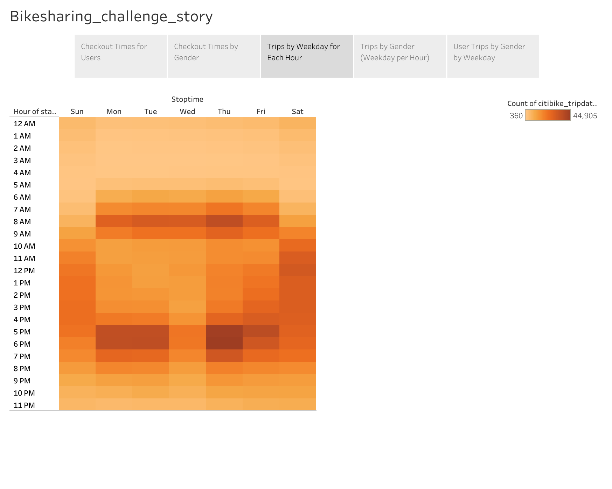

Slide 5
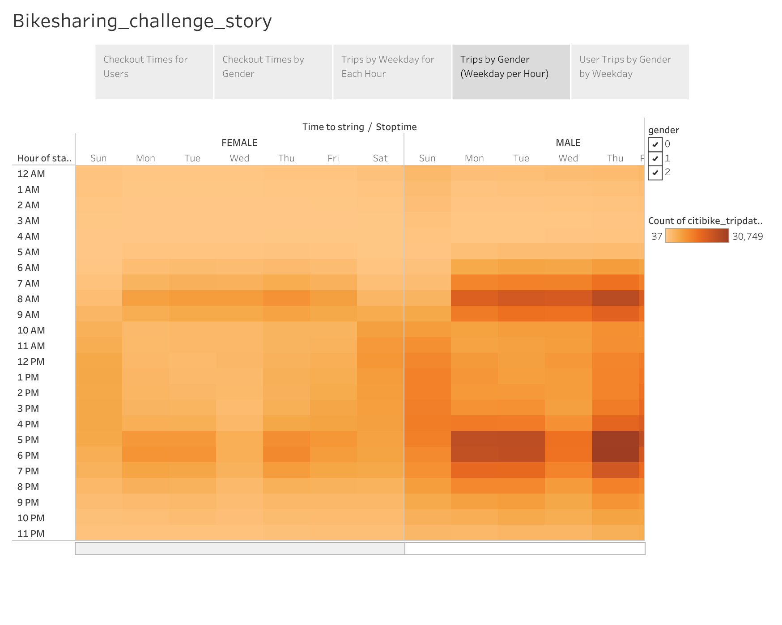

Slide 6
