Slide 1
IP ADDRESSING

Slide 2
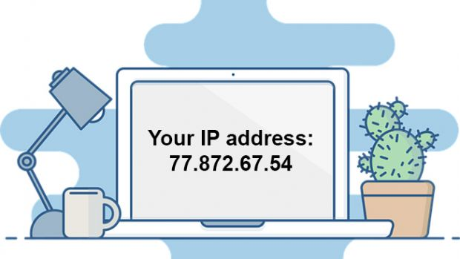
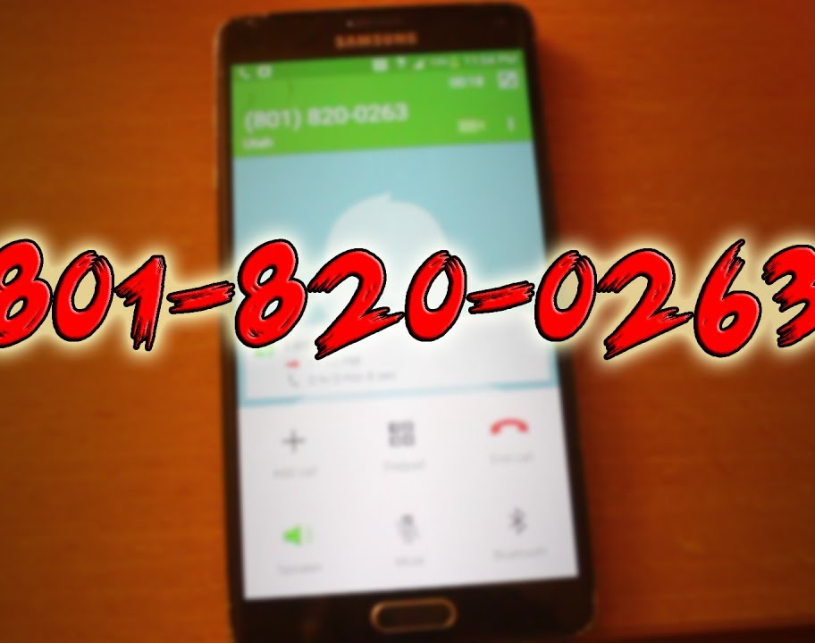
INTRODUCTION
What is IP address?
=
=

Slide 3
IP ADDRESS & EXAMPLE
IP address is nothing but a string of numbers .
Unique
All the computers in the world are individually addressed using IP address.

Slide 4

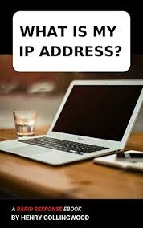


Slide 5

WHAT IS IP?
IP stands for Internet Protocol
It is a set of rules that makes Internet work

Slide 6
CLASSIFICATIONS
Dynamic IP address
Static IP address
DYNAMIC :
IP addresses are changeable
more secured
STATIC:
IP address never change
less secure than dynamic

Slide 7
VERSIONS
IPv4
sequence of 32 0’s and 1’s i.e., it a 32 bit IP address
2^32 = 4 billion devices can be addressed & connected to internet
Only 4,294,967,296 devices can be connected
We have more than 4 billion computers

Slide 8
IPv6
It is 128 bit IP address
It is a sequence of 128 0’s and 1’s
2^128 devices can be connected
This is more than enough for many future generation

