Slide 1
AI BLOGNEST
AI-Powered Blog Content Management System

Slide 2
Introduction
BlogNest is an AI-powered platform for creating and managing blog content.
It combines traditional blog management with AI-assisted content generation.
The project supports content creation, categories, tags, comments and user roles.
The source project describes AI blog generation and content summarization features.

Slide 3
Problem Statement
Difficulty managing multiple drafts, categories and tags.
Limited visibility into post performance and reader engagement.
Time-consuming content approval and comment moderation.
Need for different permission levels for administrators, editors, authors and readers.

Slide 4
Objectives
Create and organize blog posts in a centralized system.
Provide AI-assisted blog generation and summarization.
Support categories, tags and search.
Provide role-based access for different users.
Support comments and content moderation.

Slide 5
Main Features
Blog CRUD: Create, read, update and delete blog content.
Categories and tags for content organization.
Comments and moderation.
Role-based access: Admin, Editor, Author and Reader.
AI blog generation endpoint and AI summarization endpoint.
Search, scheduling and analytics concepts.

Slide 6
User Roles
Role | Responsibility
Admin | Manage users, roles, comments and system controls.
Editor | Review posts, publishing status and categories.
Author | Create and manage their own blog posts.
Reader | Read published posts and add comments.

Slide 7
Project Architecture
Interface / API layer receives requests.
Authentication and role middleware controls protected operations.
Granular services manage blog workflows and comments.
Database layer handles persistent blog and user data.
AI flow connects blog generation and summarization services.

Slide 8
AI Features
AI Blog Generation: creates structured blog content from a topic.
AI Summarization: produces concise summaries from longer content.
The source document identifies /api/ai/generate-blog and /api/ai/summarize.
The original backend specification uses Google Gemini AI.

Slide 9
Technology Used in the Original Project
Node.js - backend runtime
Express.js - REST API framework
MongoDB - database
Mongoose - MongoDB object modeling
JWT - authentication
bcrypt.js - password hashing
Google Gemini AI - AI-assisted content features

Slide 10
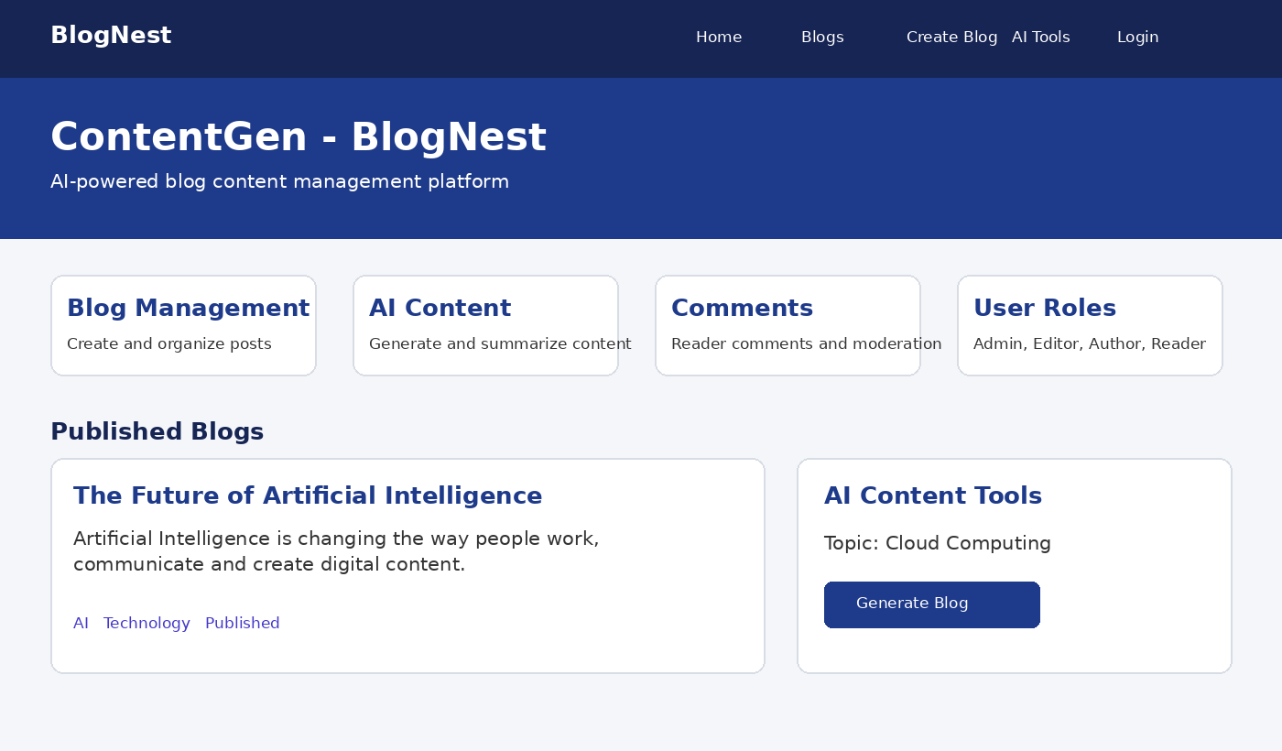
Sample Output

Slide 11
Advantages
Centralized blog content management.
Faster content creation using AI assistance.
Organized content using categories and tags.
Different permissions for different user roles.
Supports comments and moderation workflows.

Slide 12
Conclusion
BlogNest combines blogging and AI-assisted content creation.
It provides features for authors, editors, administrators and readers.
The project demonstrates how AI can support modern content management.
The HTML version provides a simple visual interface for demonstrating the project.

Slide 13
Thank You
Thank You
AI BlogNest - ContentGen

