Slide 1

Characterizing Consumer Questions for FAQ
TripleTen Hackathon December:
Arina Sitnikova
Anton Moiseev
Kseniya Gormash
Priyangka Roy
Aleksandr Arkhipov
Joshua Norfolk
Rami Awadallah

Slide 2

Initial Request
Given a dataset on consumer questions/complaints regarding financial services
Spans 2011-2023, only USA is included
“Consumer-Complaints-Database” from Consumer Financial Protection Bureau & Kaggle
Another team is creating a list of frequently asked questions (FAQ) for loans and money transfers
Our research question: What are the prevalent types of customer questions and complaints related to loans and money transfers in the banking system, and how can they be effectively categorized to optimize the creation of a targeted FAQ?
Notes:
The business task description: You’re working in the banking system. Your team has decided to help enhance support team processes in terms of dealing with customer complaints. You need to analyze what type of questions and complaints have been sent regarding loans and money transfers and categorize them so the support team will have a better understanding on what complaints types they can focus on in the first place to start creating their FAQ.
Thus, our main research question is: What are the prevalent types of customer questions and complaints related to loans and money transfers in the banking system, and how can they be effectively categorized to optimize the creation of a targeted FA
Q?

Slide 3
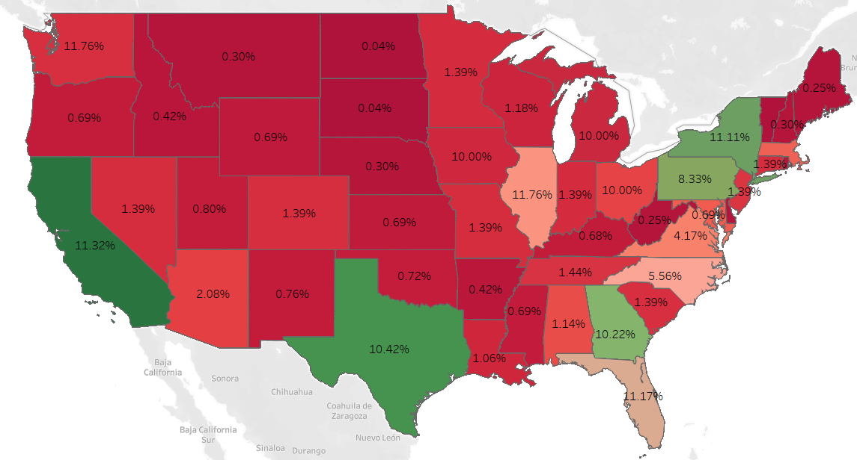
Feature Overview
Questions are divided first amongst products and sub-products
This allowed us to examine only data related to loans and money transfers
Then the data is divided into issues and sub-issues
This provides further precision on the customer’s specific issue
Company and geographic information also helps to narrow down potential FAQs for various companies and regions

Slide 4
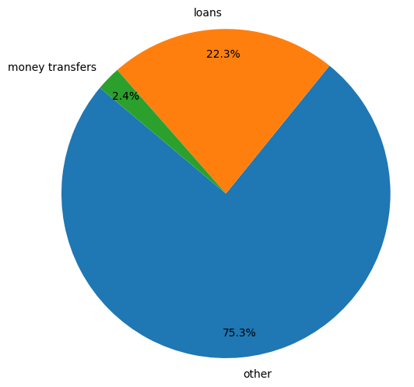
Data Cleaning & Preparation
Removed implicit duplicates to ensure data uniqueness.
Addressed missing values in sub-products and sub-issues.
Grouped products into three categories: Loans, Money Transfers and Others (Others are dropped).
Consolidated issues into 10 distinct categories for detailed analysis.
Removed data prior to 2018 to ensure market relevance and consistently-formatted data.
Notes:
0.29% of data were implicit duplicates
Addressed missing values in sub-areas by filling them with their primary product or issue
Combined similar categories together
A different structure of issues/products was introduced in 2017 to the database input interface. To build a contemporary FAQ, we need only the current structure, thus slicing the data for 2018-2023.
Example: only 2015-2017 record an issue “Account status”, while only in 2017-2023 we have an issue “Account status incorrect”. This is obviously one and the same issue. This happens a lot in the dataset.

Slide 5
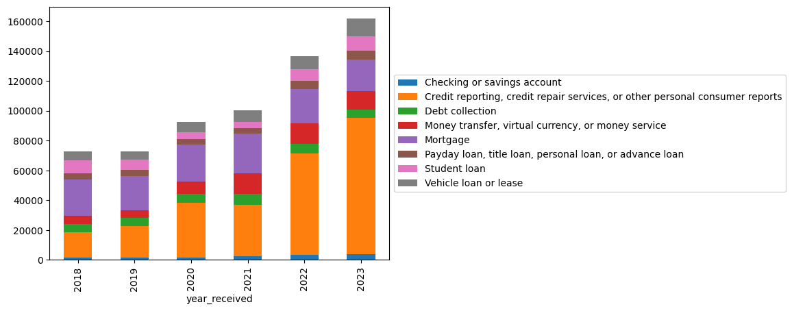
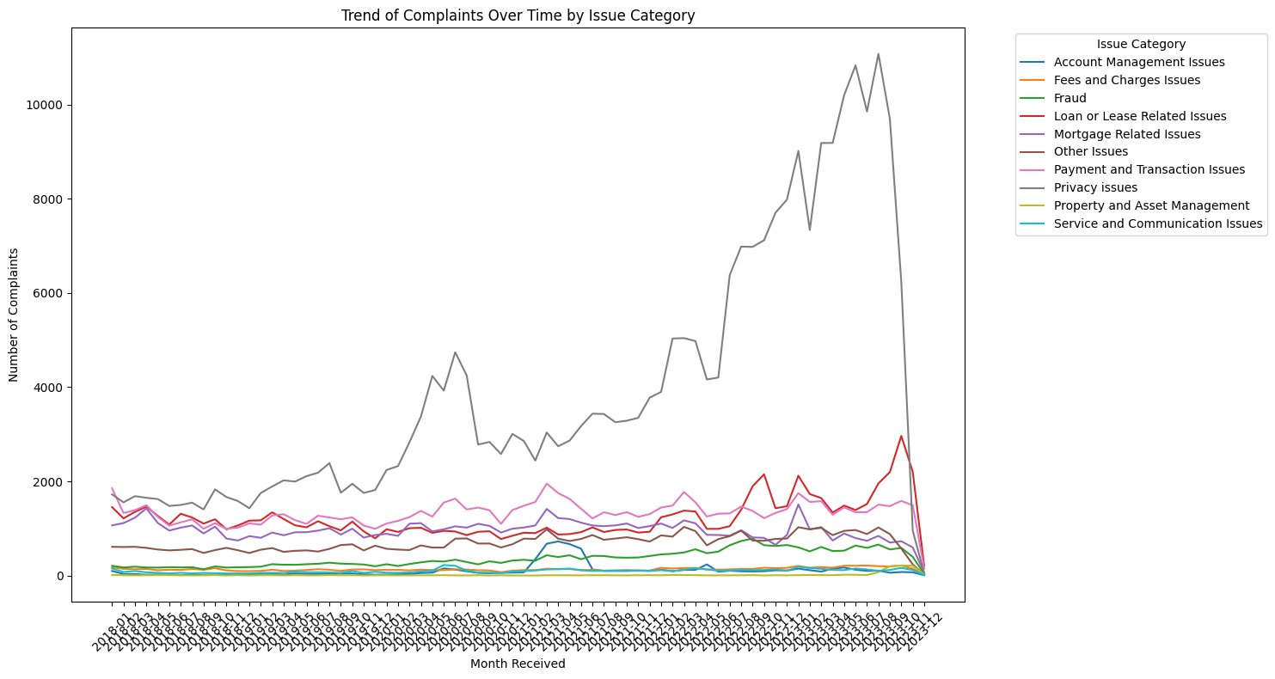
Two key features: Products and Issues
Product complaints annually
Issue complaints annually
Credit reporting complaints are on the rise. Money transfer complaints don’t grow starting from 2021
Privacy issues on the rise, others stable
Notes:
Based on connection to loans and money transfers:
Products trimmed to (8 of 21)
Issues trimmed to (60 of 177)
Mortgage complaints are decreasing in number.

Slide 6
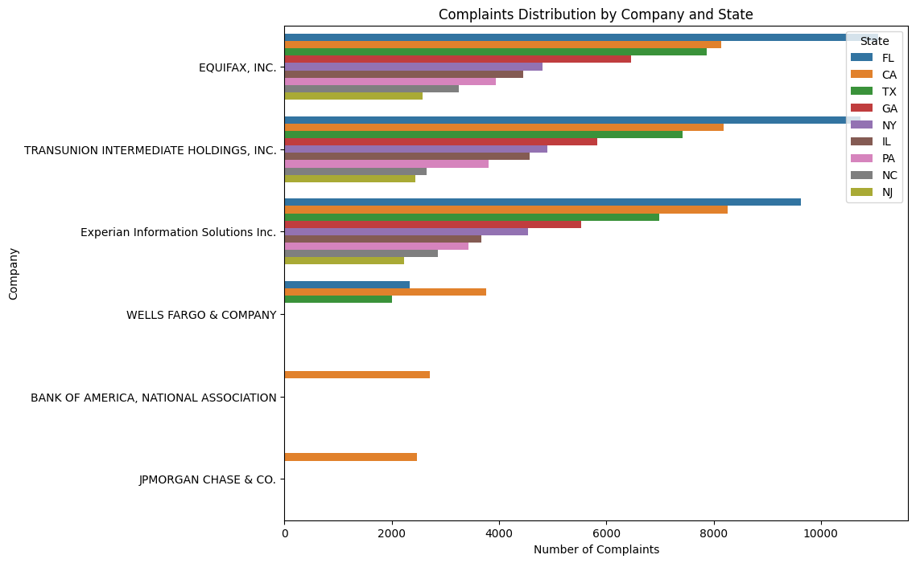
Analysis - geotargeting
Three leading credit reporting companies receive the most complaints.
Florida leads in complaints on credit reporting.
California leads in total number of complaints.
Notes:
Three leading credit reporting companies take all the head positions in the number of complaints.
Florida leads in complaints on credit reporting, while other analysis shows that California leads in total number of complaints.
Next three companies are large banks and they get most complaints from California.

Slide 7
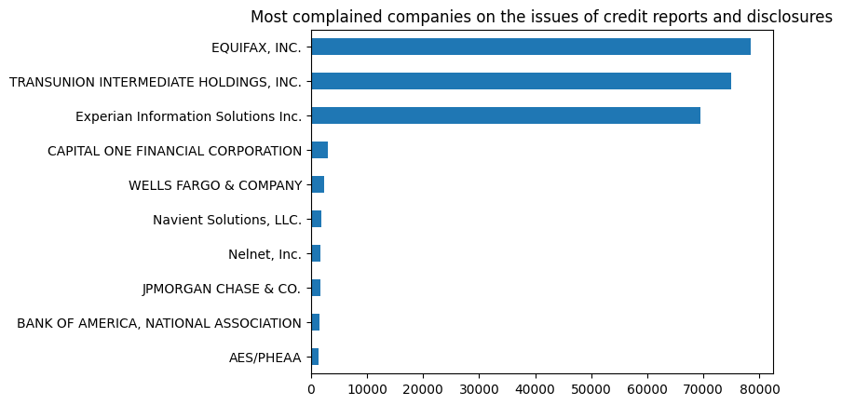
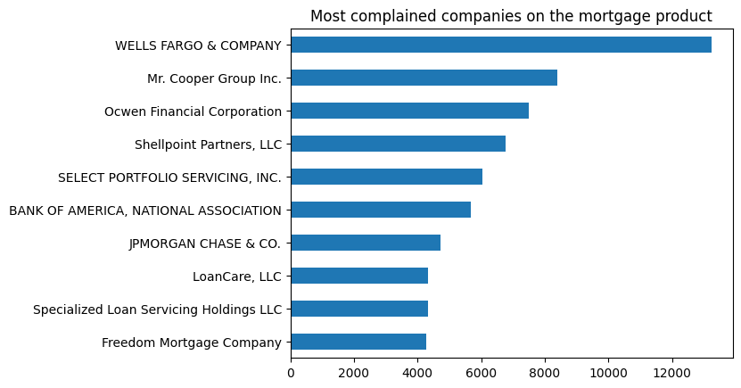
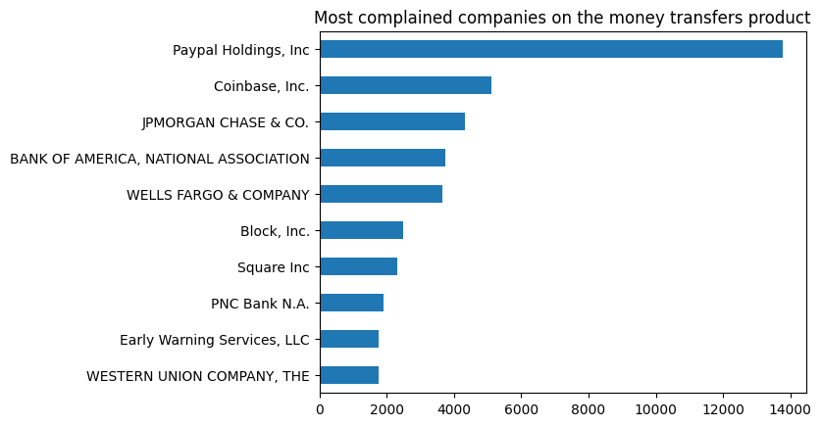
Analysis - targeting by company
It is possible to target consumers, especially clients of certain companies. Specific products/issues relate to specific companies.

Slide 8
Preparing Final Output
We characterize our consumer complaint categories first by product/issue combinations, and then by sub-product/sub-issue combinations
Insignificant combinations are removed -
Reducing initial products/issues to 29 options and to 93% of the dataset, and
Reducing deeper sub-products/sub-issues to 88 options and to 84% of the dataset.
Included are minor complaints from 2023, which are notable because they are novel
Notes:
For product/issue combinations the significance threshold is found best at 0.5% of total complaints. This reduces the number of substantial intersections to 29 (or 30, with New issues).
For subproduct/subissue combinations, it is currently at 1000 (0.15% of total) complaints, for the 2018-2023 period. This reduces the number of substantial intersections to 88 (+ New subissues). This is the number of proposed final FAQ entries.
New issues - issues/products introduced in 2023 only. They are low in number of complaints and could be filtered out by Threshold, but being new, should be included in the FAQ.

Slide 9
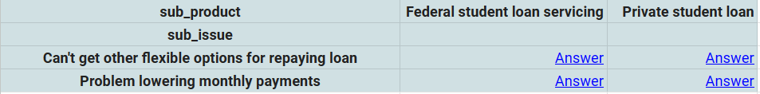
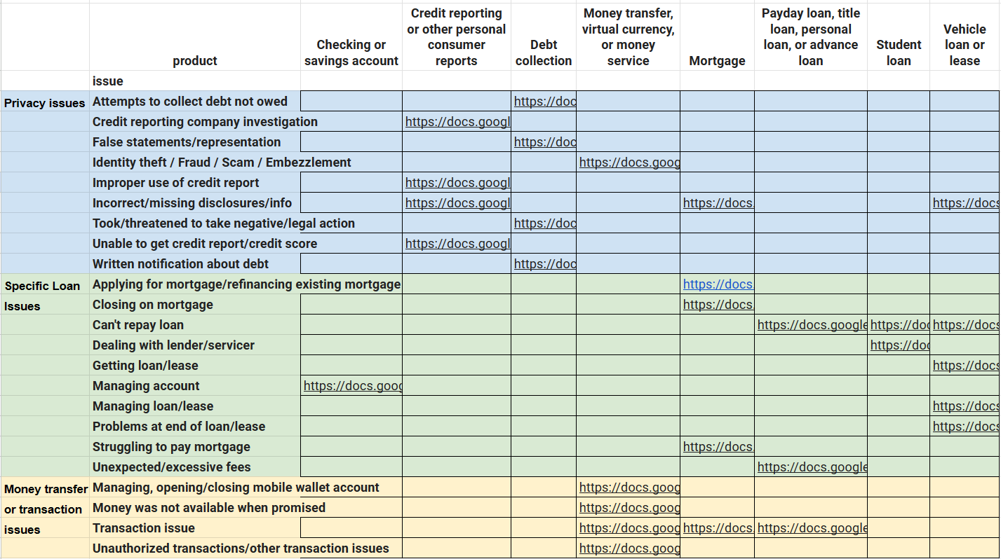

Final Output
88 links to answers
29 links to subtables
Dall-e image of a 3-D FAQ:
Notes:
The proposal for the FAQ is to have a table of issues cross-sectioned with products, with links to subsections. Each link would open a subtable with a list of most important sub issues cross-linked with most important sub products. It will be a sub-table, as the content of a cell in the initial table. This subtable will have links at the intersection of subissues and subproducts, leading to the answer.

Slide 10
Business Impact
Of Loans and Money transfers (637K complaints in total):
First (broad) level - comprise 93% of total complaints
Second (specific) level - comprise 84% of total complaints
Because only 91% of complaints are submitted online, we are left with 91% of the previous 84% of complaints.
A FAQ from this data can reduce the load of the complaint program by up to 76%.
Reducing the threshold will increase this number, but also increase the complexity of the FAQ and the demand for resources to build it.
Notes:
it's just 84% * 91%, or 84% reduced by 9% (we do not subtract, we multiply by 0.91 in this case). Got 76%.
The logic is here. If we make a general FAQ for 93% of cases, it won't cover many specific cases, so we'll still have complaints. If we cover 84% with specific answers, there will still be people who don't use web to complain, so they won't reach FAQ - and there are 9% of them.

Slide 11
Thank you for your attention!
You are now welcome to ask questions.

Slide 12
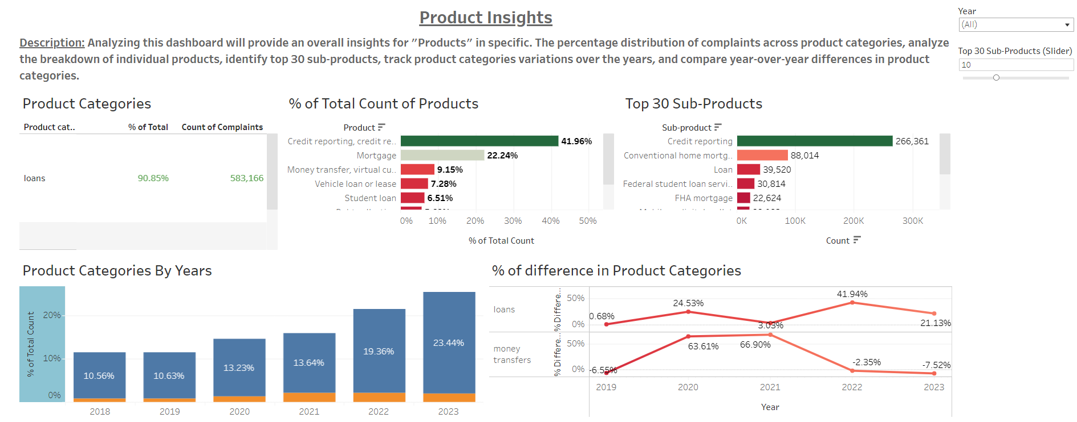
Appendix - Tableau Dashboard for Products

Slide 13
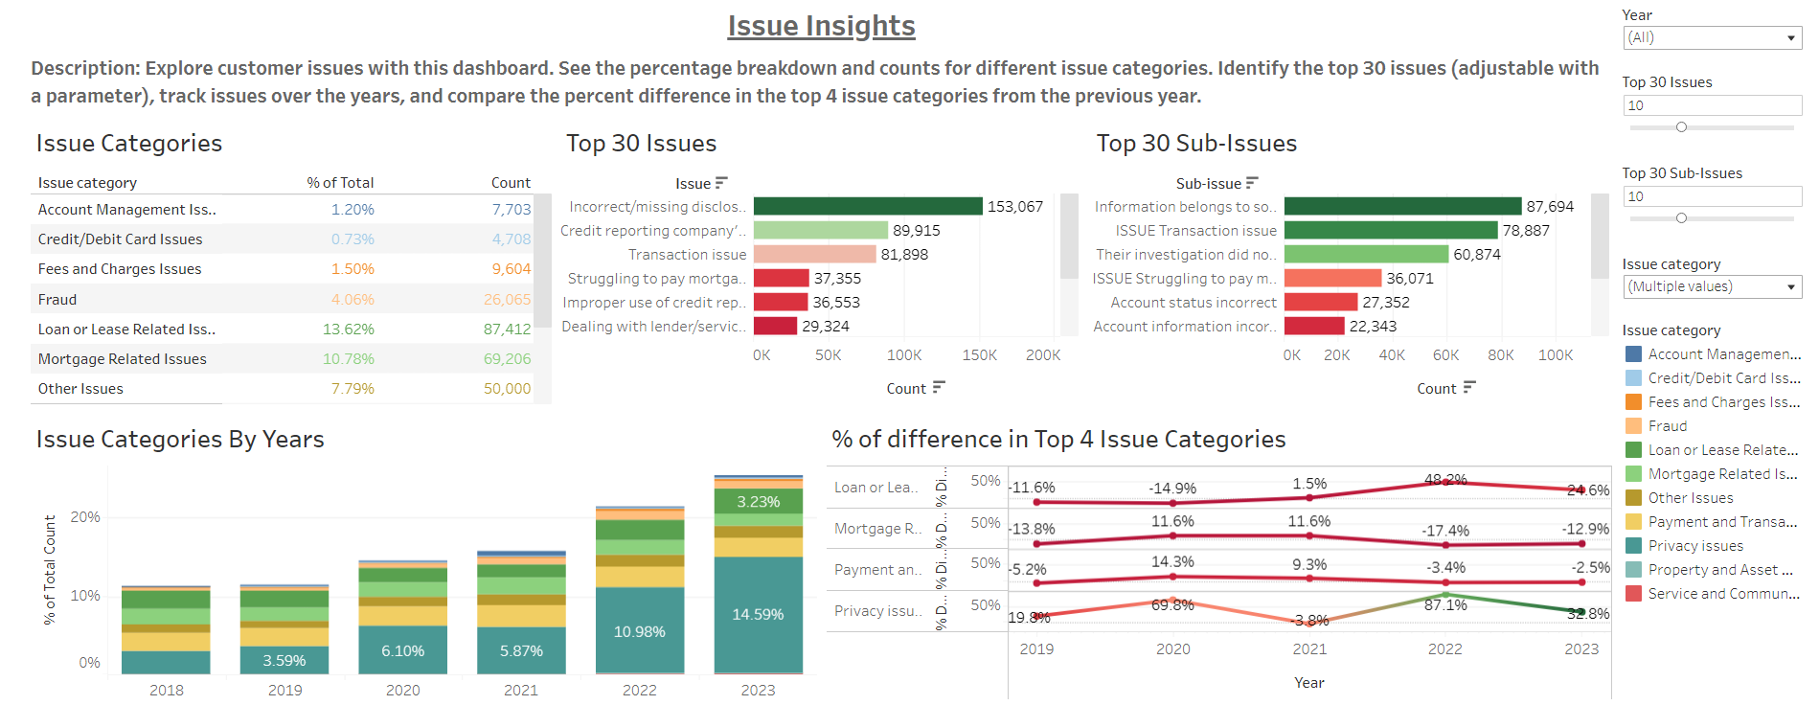
Appendix - Tableau Dashboard for Issues

Slide 14
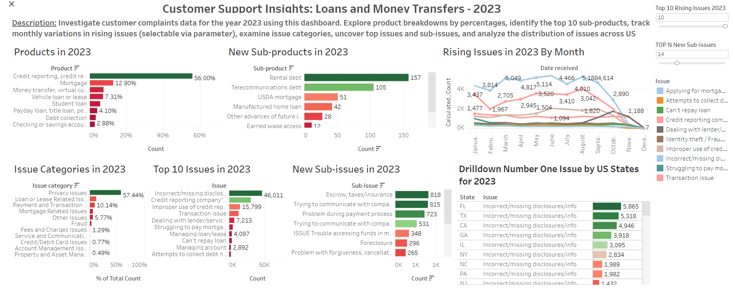
Appendix - Tableau Dashboard for 2023

