Slide 1

Concept to Launch

Slide 2


Outpacing the Competition: Generative AI for Next-Gen Procurement How The Technology will Transform procurement as we know it

Slide 3
Our Understanding of the Problem Statement
Procurement teams face challenges in selecting the best suppliers and pricing options due to limited benchmarking capabilities. This results in higher costs, operational delays, and missed savings opportunities.
Key Challenges Identified:
Issue | Impact
Lack of supplier performance comparison. | Leads to non-optimal sourcing and higher procurement costs.
Manual negotiation & PO generation. | Causes delays in procurement cycles.
No real-time price trend analysis. | Results in missed volume discounts and time-sensitive pricing deals.
Companies often buy slower and spend more because they can’t easily compare suppliers, prices, and timing — and don’t have automation helping them make faster, smarter decisions.

Slide 4
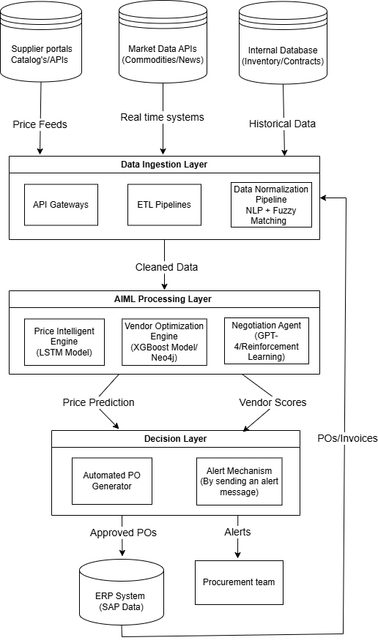
Gen-AI Enabled Procurement Automation Architecture

Slide 5
AI-solution components
Components | Description | Tools
Supplier Portals (Catalogs/APIs) | Provides product listings, pricing, and availability from suppliers. | Ariba, Jaggaer, Custom REST APIs
Market Data APIs | Real-time feeds on commodities, news, and pricing trends. | Bloomberg, Refinitiv, Quandl
Internal Database | Stores historical contract, inventory, and procurement-related data. | PostgreSQL, MongoDB, Oracle.
API Gateways | Entry point for securely connecting external systems, authenticating requests, and routing them to internal services. | AWS API Gateway, Apigee, Kong.
ETL Pipelines | Extracts, transforms, and loads structured and unstructured data. | Python/pandas.
Data Normalization Pipeline | Standardizes vendor names, units, fields using NLP + fuzzy logic. | SpaCy, FuzzyWuzzy, LangChain, sklearn

Slide 6
Components | Description | Tools
Price Intelligence Engine (LSTM) | Forecasts pricing trends using historical time-series data. | LSTM, Facebook Prophet, ARIMA.
Vendor Optimization Engine. | Ranks vendors using performance, pricing, and risk metrics. | XGBoost, Neo4j (graph DB).
Negotiation Agent (Gen-AI) | GPT-4 agent automating supplier negotiation, fine-tuned with RL. | GPT-4, OpenAI API, LangChain
Automated PO Generator. | Creates purchase orders based on AI insights and thresholds. | Python, OpenAI Function Calling (GPT-4)
Alert Mechanism | Sends procurement alerts and recommendations to team. | Slack API, Microsoft Teams API, Twilio.
ERP System | Final system of record for procurement actions (POs, invoices). | SAP, Oracle.
Procurement Team | Acts on alerts, reviews PO suggestions, interacts with negotiation agent | Slack/Teams dashboards, Web UI, Streamlit UI .

Slide 7
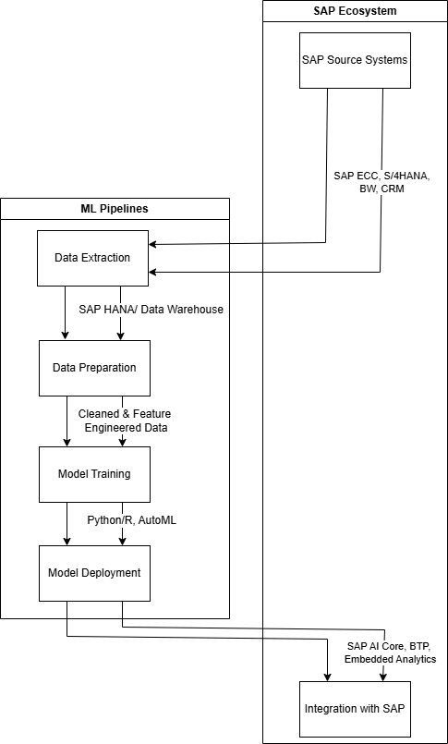
How to Train SAP Data for Procurement AI?

Slide 8
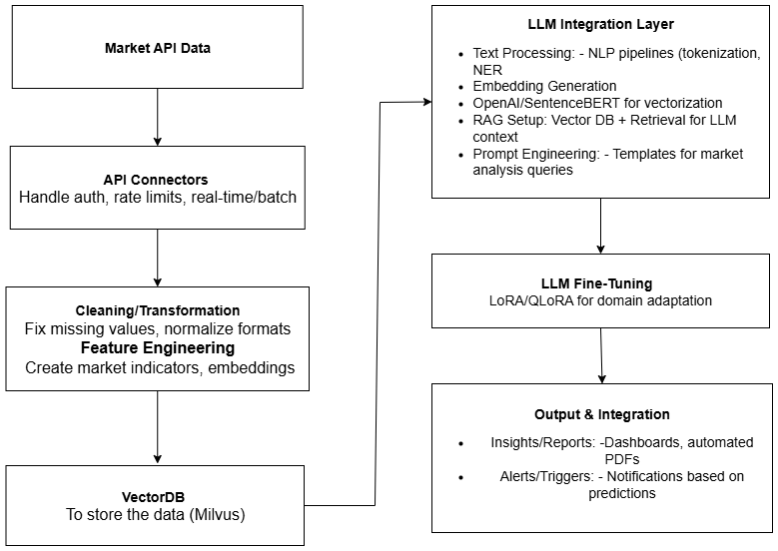
Market Benchmarking Data

Slide 9
Training SAP Data
This table outlines the SAP data integration process and key steps for implementing Generative AI into procurement.
Step | Description
Data Extraction | Extract raw procurement data from SAP tables (EKKO/EKPO, LFA1)
Processing | Process data with Generative AI for price benchmarking and risk analysis
Model Training | Train models using Machine Learning techniques
Visualization | Visualize insights with Power BI for informed procurement decisions

Slide 10
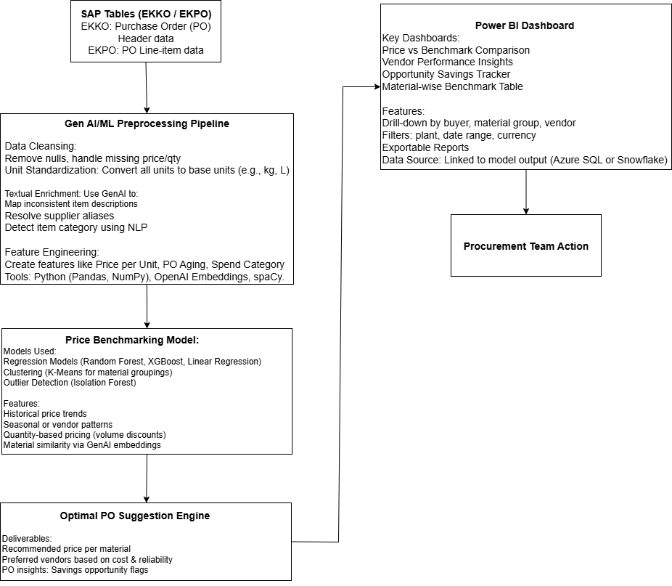
GenAI + SAP Integration Blueprint

Slide 11
SAP Tables (Data Source):
Raw procurement data is extracted from key SAP tables:
EKKO/EKPO: Purchase order headers/items.
LFA1: Vendor master data.
2. GenAI/ML Processing:
Data is processed using:
Generative AI: For price benchmarking, vendor risk analysis, and contract insights.
Machine Learning (SAP HANA PAL/Python): To train models on historical pricing, vendor performance, etc.
Price Benchmarking Model: Compares SAP prices with market benchmarks using ML (e.g., regression, clustering).
3. Outputs:
Structured recommendations (e.g., optimal prices, vendor scores, procurement alerts).
4. Power BI Dashboard (Frontend):
Visualizes insights via interactive reports:
Real-time price comparisons.
Vendor performance heatmaps.
Procurement KPIs aligned with BRD goals.
5.Procurement Team Actions:
Users take actions (e.g., approve POs, renegotiate contracts) based on Power BI insights.

Slide 12
Business Benefits & KPIs
This table summarizes the key business benefits and KPIs associated with implementing the AI-powered procurement system.
Cost Reduction | Enhancement of Supplier Negotiations
Management of Market Volatility | Improved Procurement Efficiency
Operational Efficiency | Higher Margin Gains

Slide 13
Estimated timelines for Design, Build, and Deployment
1. Month 1: Data Foundation (Critical Path)
Why 1 Month?
SAP data extraction (EKKO/EKPO, LFA1) requires:
IT approvals for OData/CDS access (1 week)
Cleansing vendor/pricing data (2 weeks)
Enrichment with market benchmarks (1 week)
2. Month 2: Price Benchmarking MVP
Why 1 Month?
SAP HANA PAL training (2 weeks):
Regression models need 3-4 iterations to hit 80% accuracy.
Power BI integration (2 weeks):
Real-time SAP HANA connectivity testing.
Stakeholder feedback on dashboard UX.
3. Month 3: GenAI POC + User Readiness
Why 1 Month?
Contract analysis (2 weeks):
Fine-tuning LLMs on procurement clauses.
Validation with legal team to avoid hallucinations.
Change management (2 weeks):
Procurement team training.
Process redesign for AI-assisted workflows.
4. Month 4: Pilot Launch
Why 1 Month?
Controlled rollout (raw materials category):
2-week parallel run (AI vs. manual decisions).
2-week KPI measurement:
Cost savings (target: 15-20%)
Cycle time reduction (target: 30%).

Slide 14

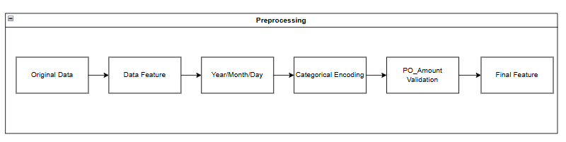
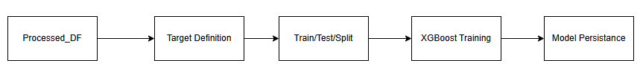
My small solution Demo
1. Data Ingestion & Initial Processing
2. Feature Engineering Pipeline
3. Machine Learning Pipeline

Slide 15
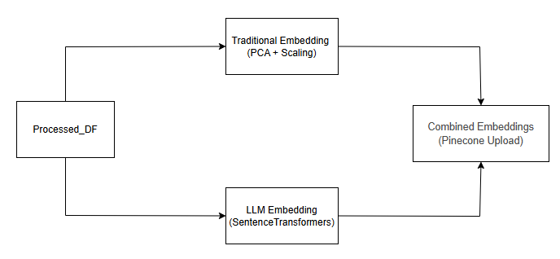
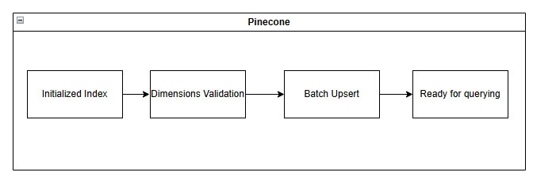
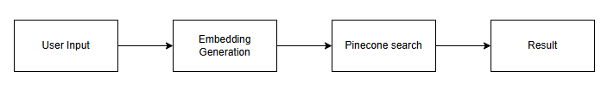
4. Embedding Generation
5. Vector Database Upload (Pinecone)
6. Query Processing Flow

