Slide 1

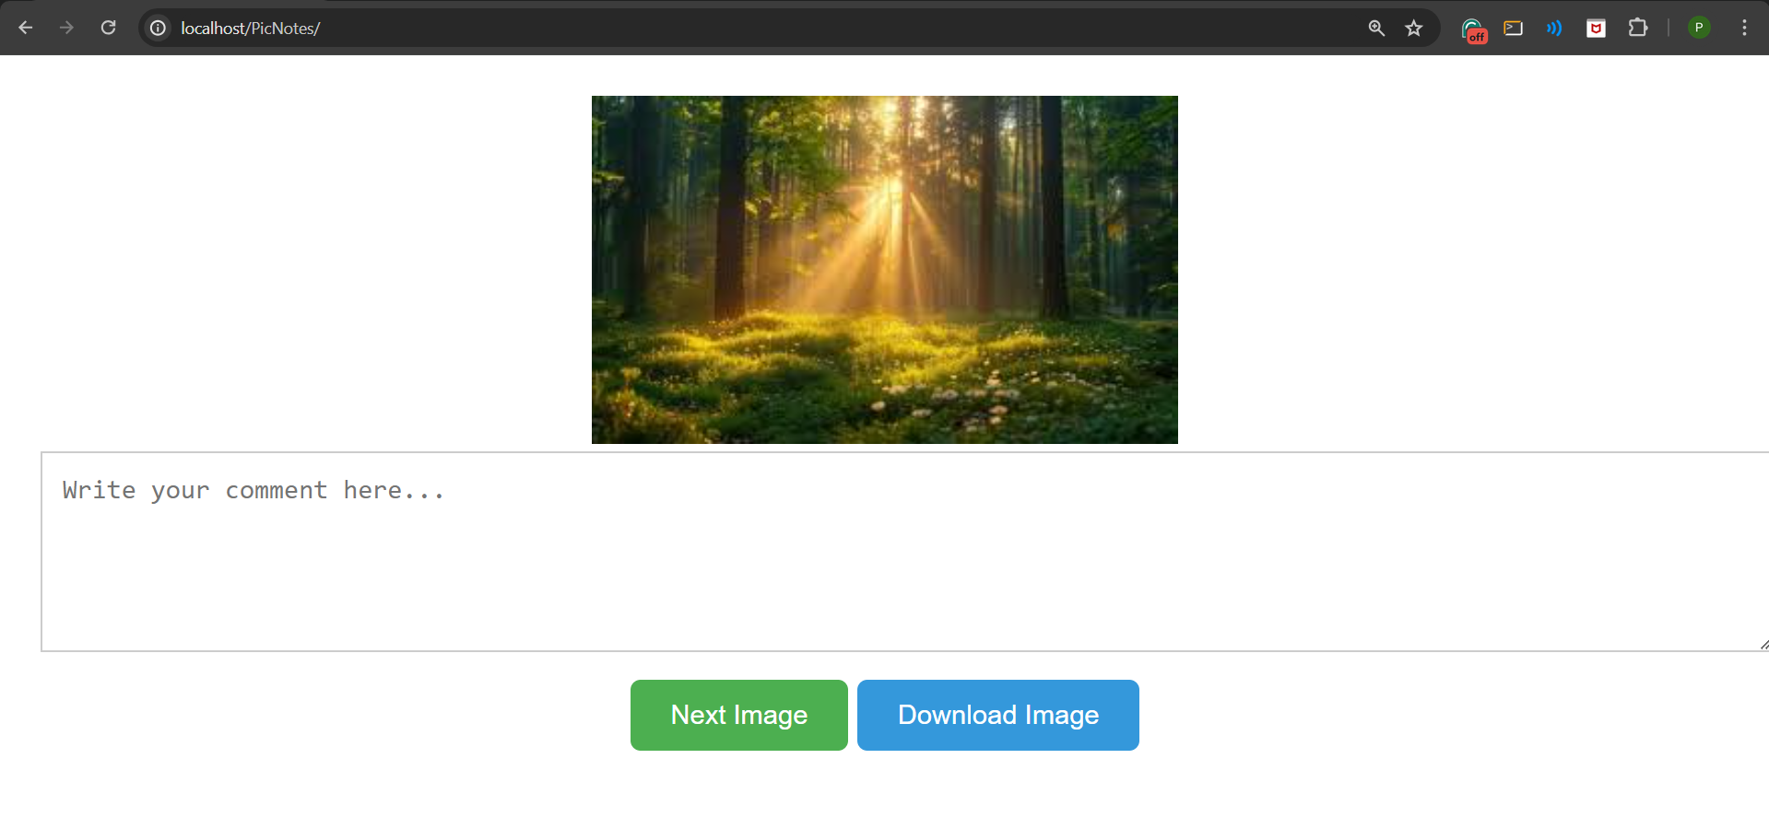
PicNotes
An Image Gallery with Comments

Slide 2
INTRODUCTION
This project aims to create a user-friendly image gallery where users can view images, leave comments, and engage with visual content.
The primary objective is to provide an interactive platform for sharing, discussing, and appreciating images within a community.
By incorporating a commenting feature, users can express their thoughts, provide feedback, and interact with other users' perspectives, fostering a sense of community and collaboration around visual content.

Slide 3
PROJECT COMPONENTS
HTML Structure :
‘Index.html’ defines the layout of the web page.
CSS Styling :
Visual presentation is managed by ‘style.css’.
JavaScript Functionality :
User interactions and dynamic content handling are implemented in ‘script.js’.
Server-Side Scripts :
fetch_images.php retrieves image data from the database.
save_comments.php saves user comments to the database for persistence.

Slide 4
FEATURES
Image display:
JavaScript fetches and displays images dynamically from the database.
Next Image Button:
Enables users to navigate through the gallery by displaying the next image.
Comment Section:
Users can write comments for each image, which are saved to the database.
Download Image Button :
Allows users to download the currently displayed image for offline viewing.

Slide 5
CONCLUSION
Recap of Project Objective:
Successfully developed a functional image gallery with an integrated commenting system that allows users to view images and leave comments.
Achieved seamless integration of front-end and back-end components to ensure smooth user experience and data management.
Future Enhancements:
Implementing user authentication to enhance security and personalize user experiences.
Adding image categorization features to organize and streamline the browsing experience.
Continuously updating and refining the commenting system to foster richer discussions and interactions among users.

Slide 6
Thank You

