Slide 1
Capstone Project
Loan Approval Prediction Capstone Project
Machine Learning and FastAPI
Github Link : https://github.com/priyank-rupera-13/Loan-Approval-Prediction-Capstone
Dataset : Loan-Approval-Prediction-Dataset
Created By : Priyank Rupera

Slide 2
Objective
Build a reliable system that predicts whether a loan application should be approved or rejected. The model uses key financial indicators (CIBIL score, annual income, loan amount, tenure in years, asset values, employment details).
To keep decisions realistic, enforce an affordability rule: the EMI at the chosen interest rate must be ≤ 50% of the applicant’s monthly income.
• Binary target: 1=Approve, 0=Reject (strict mapping).
• Tenure stored in years In dataset; converted to months for EMI.
• Final decision : Machine Learning prediction gated by EMI policy.

Slide 3
Approach to Solving the Problem
Followed a clear, reproducible ML workflow.
After cleaning column names and mapping the target to {0,1}, split the data with stratification to preserve class balance.
A shared ColumnTransformer imputes numeric values (median) and encodes categorical (one‑hot, handle_unknown='ignore'), ensuring identical preprocessing in training and inference.
• Baseline: RandomForest pipeline.
• Comparison: XGBoost pipeline with the same preprocessing.
• Evaluation: Accuracy, Precision, Recall, F1, ROC AUC; Confusion Matrix; ROC curves.
• Artifacts: joblib pipelines and feature_columns.json for API alignment.

Slide 4
Model Summary
Both models are wrapped in pipelines so that feature engineering and encoding are baked into the artifact.
RandomForest offers robustness and straightforward importance scores.
XGBoost is a powerful gradient boosting method that often excels on tabular data and can capture complex interactions.
Imbalance: consider class_weight (RF) / scale_pos_weight (XGB) if classes are skewed.
Interpretability: feature_importances_ and permutation importance; optional SHAP & PDPs.
• Reproducibility: fixed random_state and consistent preprocessing.

Slide 5
Results — Test Metrics
The following metrics summarize performance on the hold‑out set. Compared RandomForest and XGBoost using the same test data to ensure a fair, unbiased evaluation.
Accuracy | 0.9824
Precision | 0.985
Recall | 0.9868
F1-score | 0.9859
ROC AUC | 0.9984
Classification Report
 | Precision | Recall | F1-Score | Support
Reject | 0.98 | 0.98 | 0.98 | 323
Approve | 0.98 | 0.99 | 0.99 | 531
Accuracy |  |  | 0.98 | 854
Macro Avg | 0.98 | 0.98 | 0.98 | 854
Weighted Avg | 0.98 | 0.98 | 0.98 | 854

Slide 6
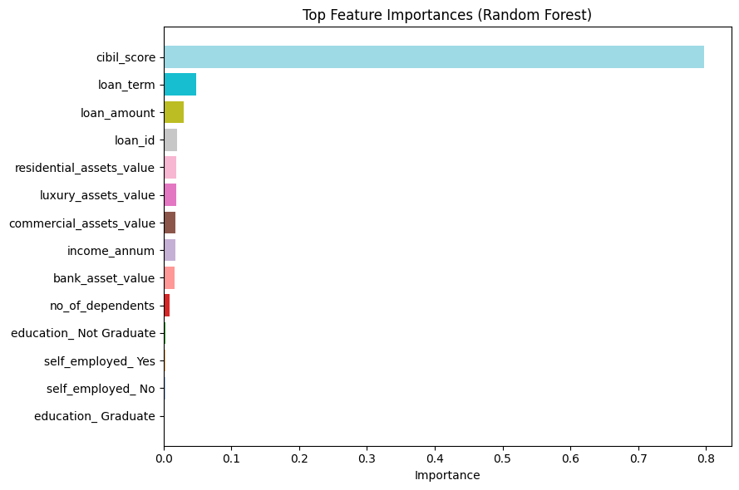
Feature Importance (Top Drivers)
Feature importance helps identify which inputs most influence the prediction. In our case, variables like CIBIL score, loan term, and loan amount typically rank highly, aligning with lending intuition.

Slide 7
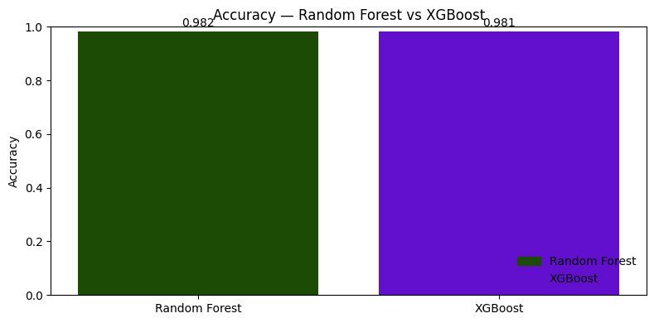

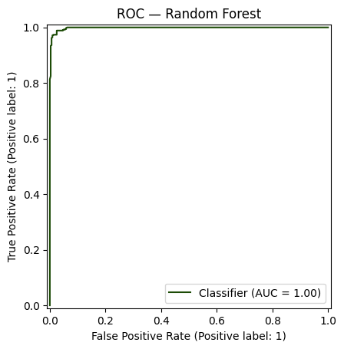
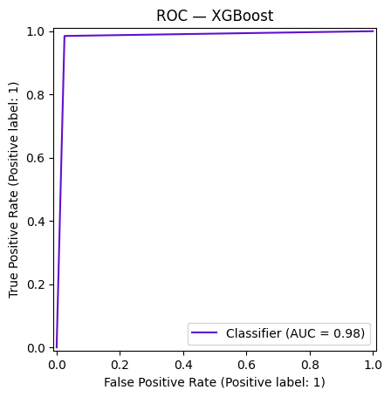
ROC Curves — RF vs XGB

Slide 8
Comparison table and Confusion Matrix
 | Accuracy | Precision | Recall | F1 | ROC_AUC
Random Forest | 0.9824 | 0.9850 | 0.9868 | 0.9859 | 0.9984
XGBoost | 0.9813 | 0.9849 | 0.9849 | 0.9849 | 0.9978
Random Forest Matrix
 | Pred Reject | Pred Approve
Actual Reject | 315 | 8
Actual Approve | 7 | 524
XGBoost Confusion Matrix
 | Pred Reject | Pred Approve
Actual Reject | 315 | 8
Actual Approve | 8 | 523

Slide 9
Inference (What We Learned)
Both models generalize well on unseen data.
The most influential features align with domain knowledge: credit quality and repayment capacity.
To avoid over‑optimistic approvals, we enforce an EMI affordability gate so that monthly payments remain manageable relative to income.
• Model score + EMI rule = safer, more transparent decisions.
• Reports include EMI, monthly income, threshold, and a human‑readable reason.

Slide 10
FastAPI Overview
The API loads the saved pipeline and the exact training feature list, aligns incoming JSON to training columns, computes a probability, and applies the EMI rule before returning the final decision.
Interest rate can be passed as 8.2 (percent) or 0.082 (fraction); tenure is provided in years and converted to months for EMI.
• Endpoints: /ping, /expected_features, /predict, /predict_batch.
• Outputs: model_pred, final_pred, prob_approve, EMI, monthly_income, threshold, reason.

Slide 11
Other Comments — Fine‑tuning & Next Steps
To push performance and trust further, consider tuning hyperparameters, calibrating probabilities if thresholds matter, and adding model‑agnostic explainability such as permutation importance and SHAP values.
In production, monitor approval rates and drift, and retrain on fresh data as needed.
• RandomizedSearchCV / GridSearchCV for RF & XGB.
• Cross‑validation and probability calibration (e.g., Platt/Isotonic).
• SHAP/PDPs for interpretability; cost‑sensitive thresholding.
• Monitoring: data/label drift, approval rate shifts; scheduled retraining.

Slide 12
References
• Scikit‑learn — https://scikit-learn.org/
• XGBoost — https://xgboost.readthedocs.io/
• FastAPI — https://fastapi.tiangolo.com/
• Kaggle — Loan Prediction dataset

Slide 13
Thank you !

