Slide 1

AUTOMOBILE PRICE PREDICTION
REGRESSION ANALYSIS
BY: 1)PRIYANK DUBEY
2)ATUL KUMAR

Slide 2
DATASET DETAILS
Our data set is collected from UCI repository which has been gathered in 1985
In our data set attributes of hundreds of cars are given including engine-size ,its type , maker of the car,it’s price and many other features as well.
Price is our Target variable.
Rest 25 features are our independent features.

Slide 3
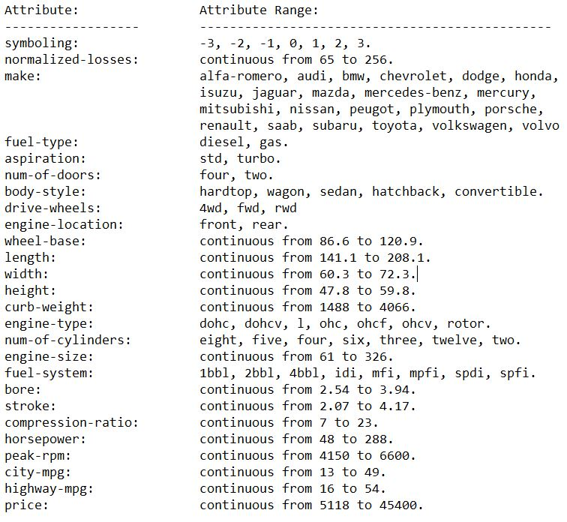
DATASET SUMMARY

Slide 4

OBJECTIVE
In The Project We Are To Build A Model That Must Predict The Price Of The Automobile On The Basis Of The Features .
And the user will input features on the application.
To deploy the model on cloud platform.

Slide 5


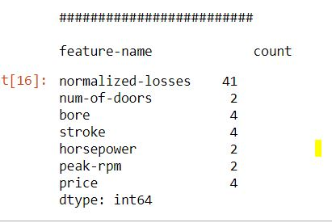
DATA MISSING VALUES
In Our Data Set, Missing Values Are In The Form Of ”?” .
No. Of Count Of Missing Values In Each Feature.

Slide 6
HANDLING MISSING VALUES
MISSING VALUES IMPUTATION
STRATEGY =‘MEDIAN’ ,’MEAN’
STRATEGY = MOST FREQUENT
FOR NUMERICAL COLUMN
FOR CATEGORY COLUMN
FOR TARGET VALUES
DROP THOSE RECORDS

Slide 7
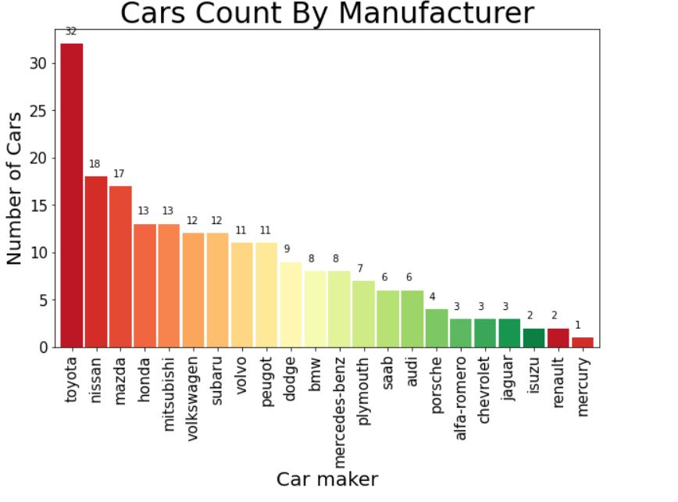
EDA
IN OUR DATA ON PEROFORMING THE EDA PART WE CAME TO KNOW ABOUT MANY POINTS:
DATA VISUALIZATION
1)TOYOTA ,nissan and mazda has the highest number of cars in the data
2)mercury isuzu and renault has the minimum number of
cars very less i.e 1,2,2
3)Japaneese cars has most share in the data i.e toyota ,nissan

Slide 8
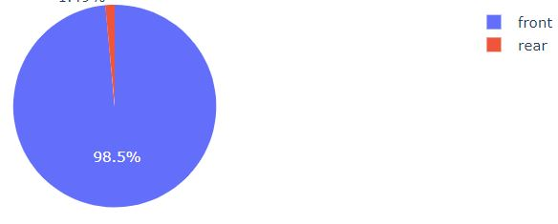
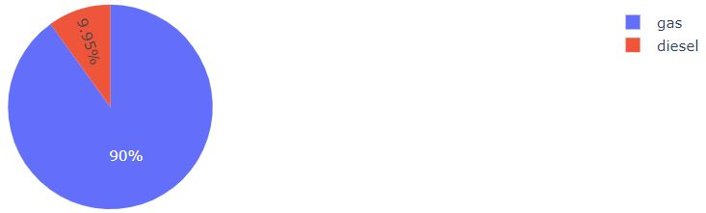
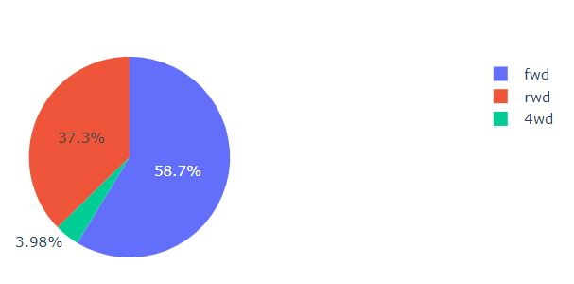
CONTINUE…….
Engine locations
Fuel Types
Drive wheels

Slide 9
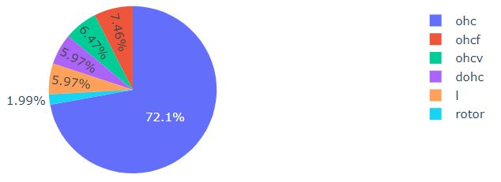
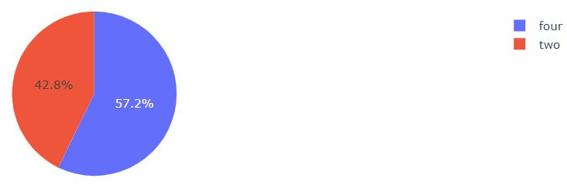
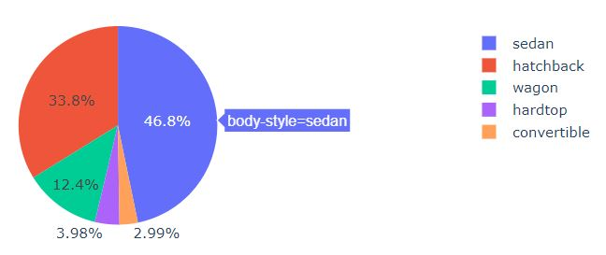
ENGINE
LOCATION
NUM OF CYLINDERS USED
Body styles

Slide 10

INSIGHTS FROM THESE GRAPHS
1) Most Cars Has The Fwd Types Of Drive-wheels Which Has 58.27% Share
2)most Of The Cars Has Four Doors Approx 57.2% Cars Has 4 Doors
3)Aspiration Of Maximum Cars Is Standard Beacuse It Is Very Outdated Data When Turbo Aspirated Cars Were Not Used More
4) body-syle Of Maximum Cars Is Sedan And Hatchback
5 )engine Location Is Mostly Preferred To Frontrather Than Rear
6 )engine Types Is Ohc Mostly Preferrred 72%
7) Maximum No Of Cars Has The Fuel Used As Gas And Very Less Uses Diesel

Slide 11
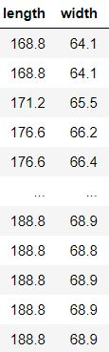
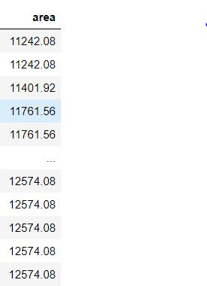
FEATURE ENGINEERING
In this part we have removed outliers from the data , removed some features and also added some more features

Slide 12
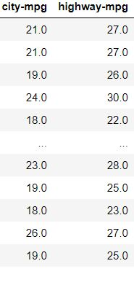

CONTINUE…

Slide 13
FEATURE ENGINEERING
FEATURE SCALING
In this we have scaled all the numerical columns to the same range to make our model more accurate
We have used MinMaxscaler

Slide 14
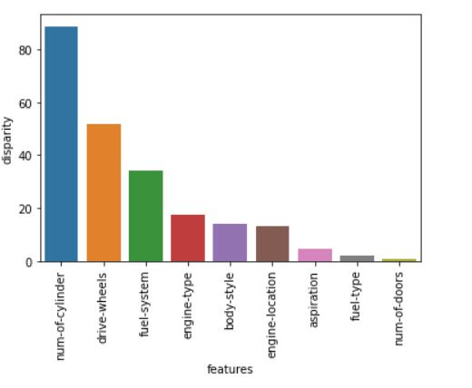
FEATURE SELECTION
WE HAVE SELECTED THE MOST SIGNIFICANT FEATURES USED TO MODEL BUILDING USING ANOVA TEST
1)FOR CATEGORICAL COLUMNS:
Here we have selected :
1)NUM –OF-COYLINDERS
2) DRIVE-WHEELS

Slide 15
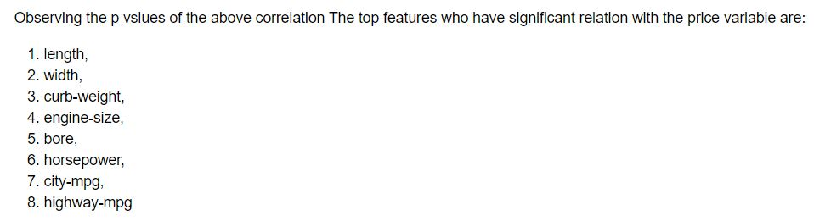
2)FOR NUMERICAL COLUMNS
USING CORREALTION WE HAVE SELECTED THE TOP FEATURES FOR MODEL BUILDING

Slide 16
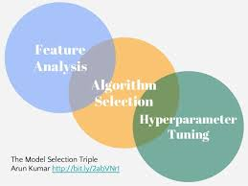
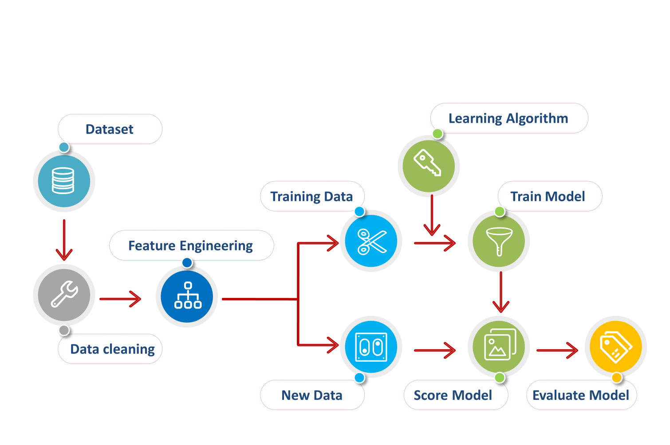
MODEL BUILDING
NOW WE HAVE CAME ON THE STAGE OF MODEL BUILDING ,FOR MODEL WE HAVE USED TWO ALGORITHMS :
1) XGBOOST REGRESSOR
2) RANDOMFORESTREGRESSOR

Slide 17
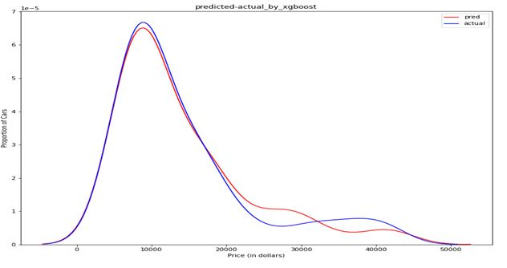
1) USING XGBOOST REGRESSOR
We have firstly applied the xgboost regressor for model and it shows nice results,,,
MODEL REPORT
Here we can see that the actual points of the test data and the preedicted are closely located so it shows that our model is a good predictor
For test set

Slide 18
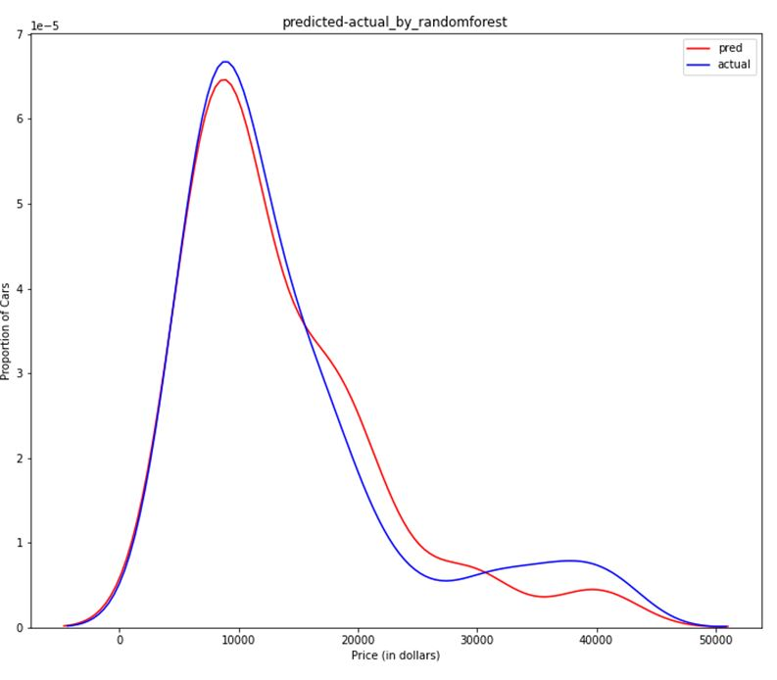
2) USING RANDOMFOREST REGRESSOR
Next we have also applied randomforest regressor and it’s results are as follows
MODEL REPORT
In random forest there is slightly far results from the actual so xgboost proves to be better
FOR TEST SET

Slide 19
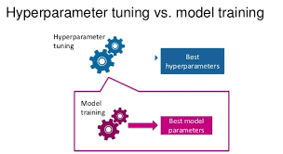
HYPERPARAMETER TUNING
In Machine Learning, Hyperparameter Optimization Or Tuning Is The Problem Of Choosing A Set Of Optimal Hyperparameters For A Learning Algorithm. A Hyperparameter Is A Parameter Whose Value Is Used To Control The Learning Process.

Slide 20
HYPERPARAMETER TECHNIQUES
1) Here we have used GRID SEARCH CV on xgboost regressor
2) And then we have used RANDOMIZED CV on random forest regressor . Randomized search is much faster than grid search but as per accuracy both are good.

Slide 21
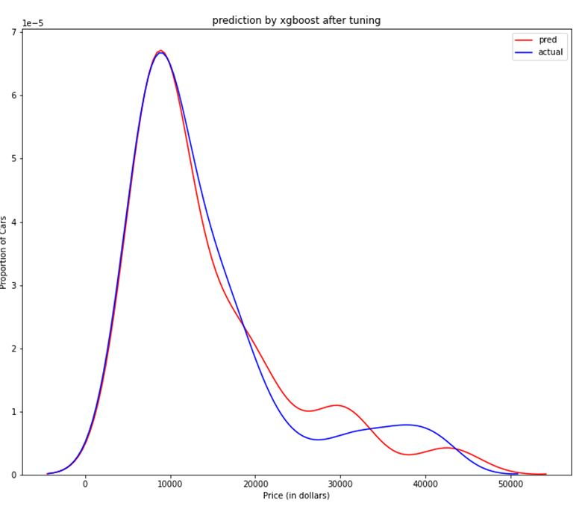
WE HAVE PERFORMED HUPERPARAMTERE TUNING IN BOTH THE MODELS WE HAVE APPLIED BEFORE:
1) GRIDSEARCH CV ON XGBOOST REGRESSOR
MODEL REPORT
For test set

Slide 22
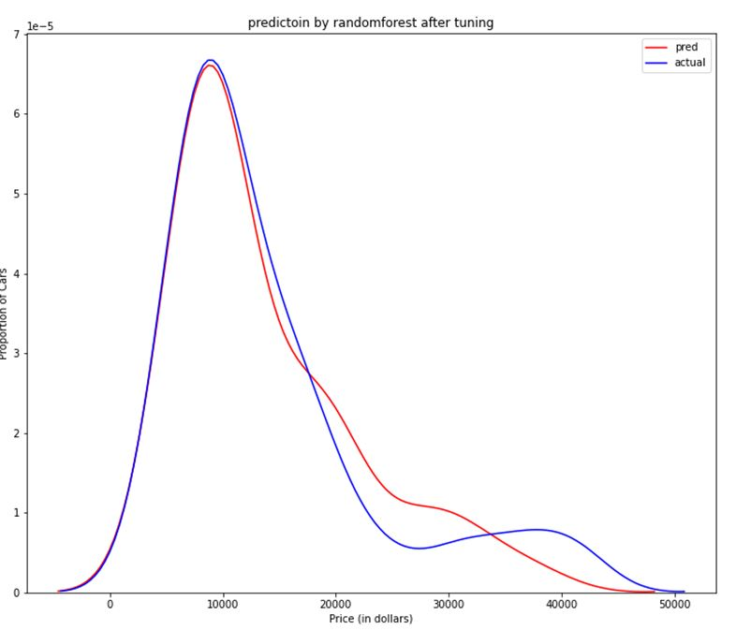
2) RANDOMIZED SEARCH CV ON RANDOM FOREST REGRESSOR
MODEL REPORT
For test set

Slide 23
MODEL SELECTION
METRICS BEFORE HYPERPARAMETER TUNING

Slide 24
MODEL SELECTION
METRICS AFTER HYPERPARAMETER TUNING

Slide 25
BEST MODEL
From the model metrics visualization we can see that after tuning the models we have got a slightly better results on both the models
But we have got good results on xgboost regressor as compared to randomforest so we wilol choose this model for prediction

Slide 26
UI DEVELOPMENT
FLASK LIBRARY HAS BEEN USED FOR UI DEVELOPMENT , A USER FRIENDLY APPLICATION WHERE HE CAN ENTER FEATURES AND GET THE CORRECT PREDICTION
HTML IS USED FOR FRONT END DEVELOMENT
Link for our deployement on cloud is below:
http://ec2-3-129-6-117.us-east-2.compute.amazonaws.com:8080/

Slide 27
PROJECT OUTCOME
FROM THE PROJECT I CAME TO KNOIW THAT THE FEATURES THA ARE IMPORTANT FOR CAR PRICE VARIATION ARE :
HORSEPOWER
NO OF CYLINDERS
AREA
ENGINE SIZE
SO FOR A CAR TO BE HIGHLY COSTLY THESE FEATURES CONTRIBUTE THE MOST

