Slide 1
MLB Pitcher Injury Risk Prediction
Syed Amaan Ahad
Viraj Sheth
Priyankkumar Patel
Mohammad Shahid Mahmood
DS 5110 · Essentials Of Data Science· Spring 2026

Slide 2
Motivation:
Our Approach:
Despite workload Guidelines, Baseball pitcher injuries keep rising
Injuries occur in shoulders, elbows and forearm
Injuries are costly for teams
No model to predict injuries in real time
Predicts injury risk to player on a game level
make a binary prediction on whether a pitcher gets injured in the next 21 days
Check on velocity trends; is the pitcher throwing slower than usual over recent outings?
What's the pitcher workload like; how many pitches/innings has he thrown in the past few weeks?
Models: Logistic Regression, Random Forest, XGBoost
Prior work:
Similar work on pitcher injury done by Kusminsky et al., 2024
Project predicted season level injuries

Slide 3
Data Processing:
10 Seasons
Two Primary Data Sources
Statcast (pybaseball) for velocity, spin rate, extension and movement of the pitch
MLB Stats API for Injury records
Datasets merged on player ID and date
Data Cleaning
Imputed spin rate & extension (347 rows) - pitcher season median
Removed pitch_count < 10 (1,729 early exits)
Removed days_rest > 30 (cross-season gaps)
Final cleaned dataset: 49,792 rows
256
Pitchers
49,792
Pitcher-games
21 days
Prediction Window

Slide 4
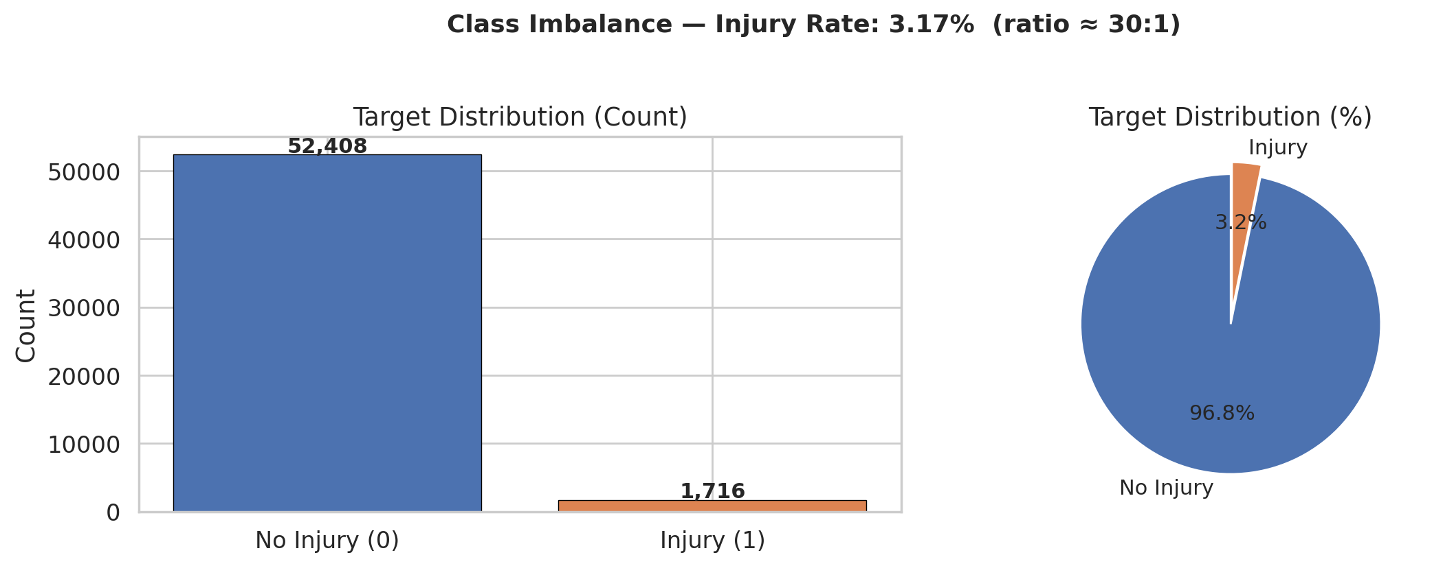
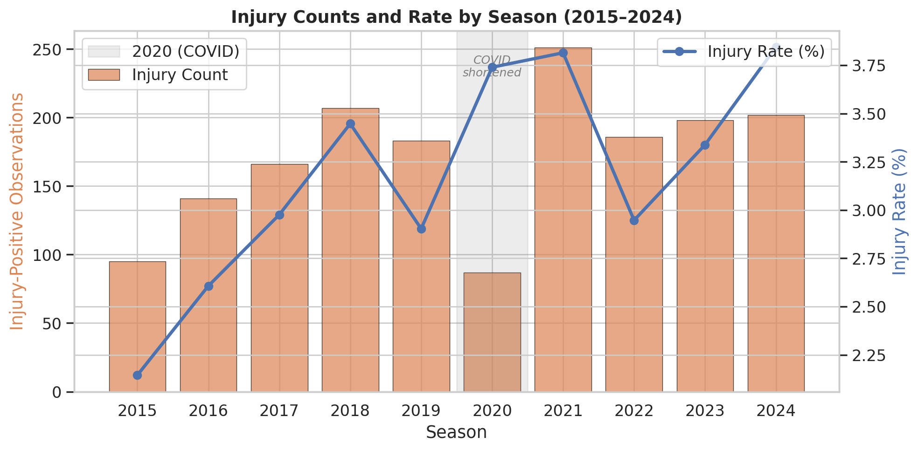
EDA

Slide 5
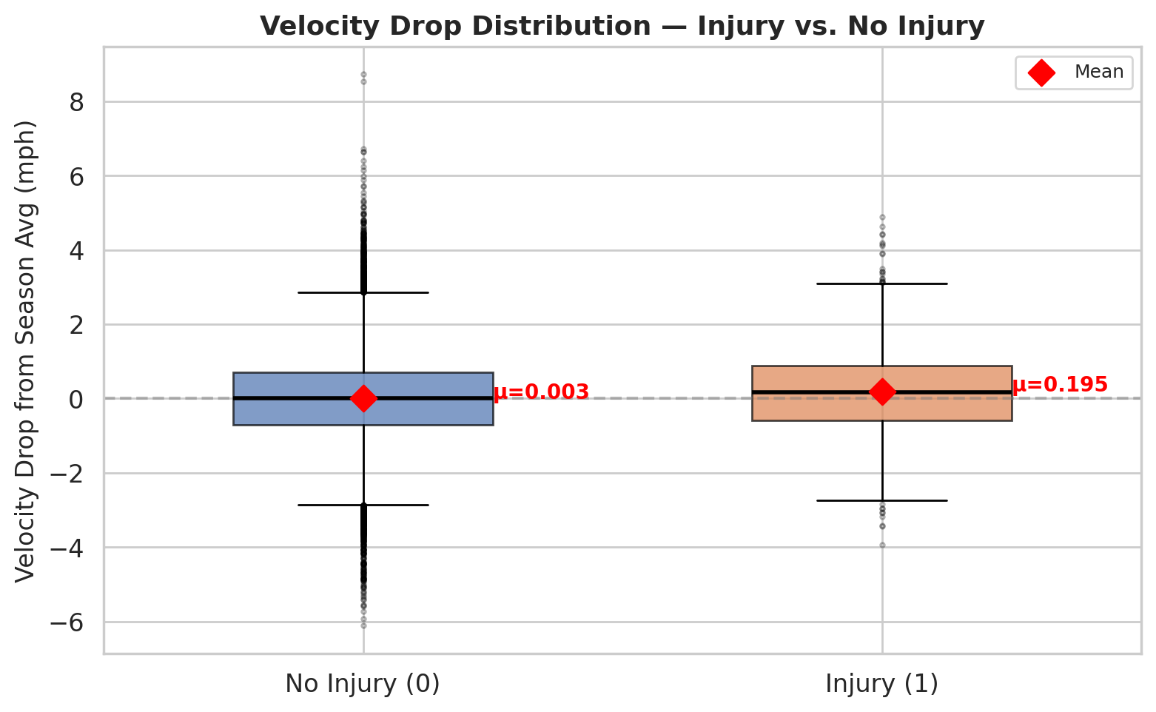
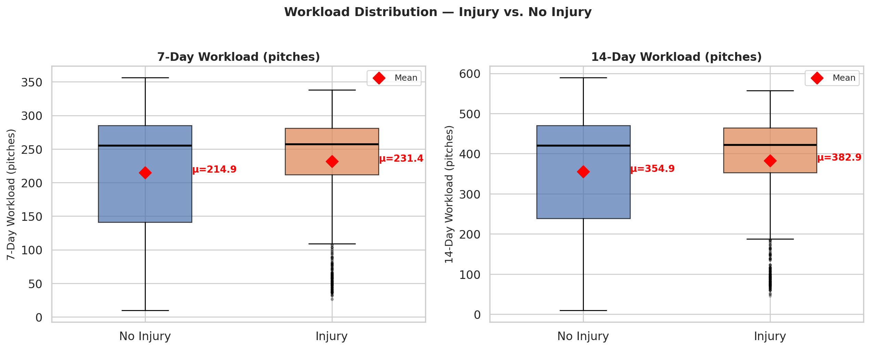

Slide 6
Modeling
Each row is a single pitcher start, with a binary target predicting whether an arm injury occurs within the next 21 days.
Data split temporally, trained on 2015–2021, tested on 2022–2024, to prevent future injury patterns from leaking into training.
With only 3.2% of starts resulting in injury, class weights were applied to all models, and the decision threshold was lowered to 0.3 to prioritize catching real injuries over minimizing false alarms.
Three models were trained: Logistic Regression as an interpretable baseline, Random Forest to capture non-linear interactions, and XGBoost for its gradient boosting approach and built-in class weighting via scale_pos_weight.
ROC-AUC was reported but not used as the primary metric because at a 3.2% positive rate it is slightly optimistic. PR-AUC and MCC were used instead as they better reflect performance on imbalanced data

Slide 7
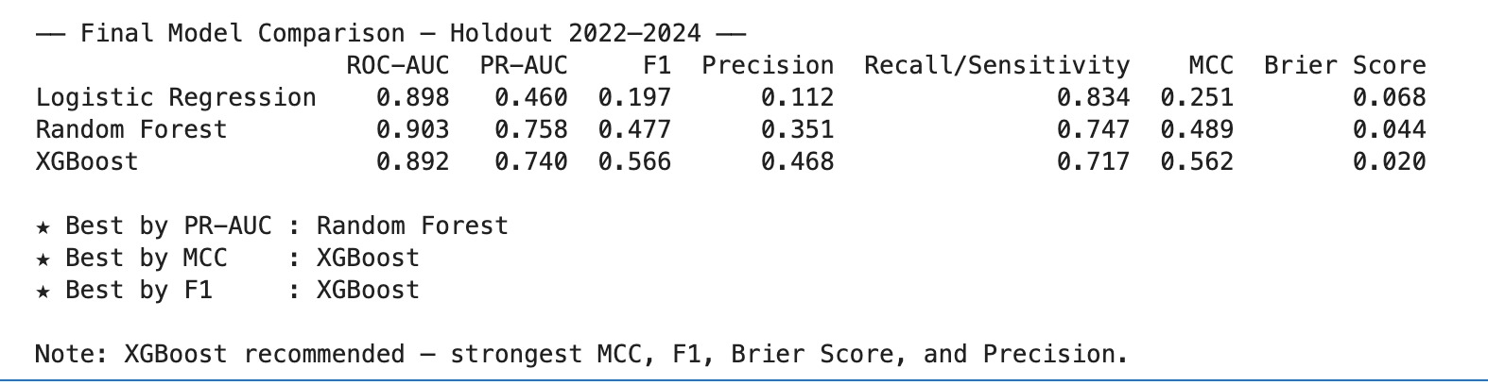
 | Logistic Regression | Random Forest | XGBoost
Type | Linear Baseline | Ensemble (bagging) | Ensemble (Boosting)
Why chosen? | Interpretable coefficients, establishes linear benchmark. | Captures non-linear interactions between features. | Gradient boosting with scale_pos_weight for class imbalance — strongest overall across F1, MCC and Brier Score
Handles Imbalance | Class weighting | Class weighting | Positive class scaling
XGBoost is the recommended model — it catches 72% of real injuries while generating 41% fewer false alarms than Random Forest, making it more operationally viable for decisions.

Slide 8
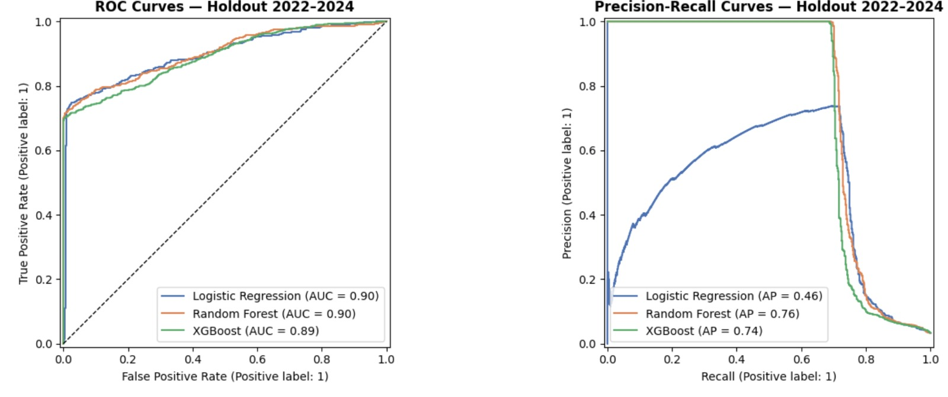
ROC and Precision-Recall Curves
ROC-AUC alone is misleading. All three models cluster at 0.90 making them look equal.
PR curve tells us the real story, showing that RF and XGBoost dominate LR, maintaining a high precision up to 65% recall, confirming non-linear injury patterns that a linear model cannot capture.

Slide 9
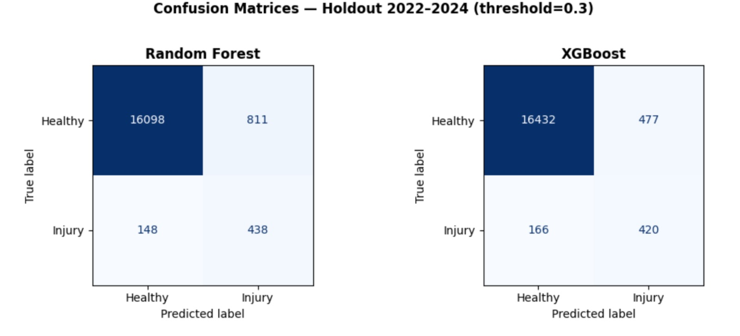
Model Performance
Default threshold of 0.5 missed too many real injuries, lowered to 0.3 to prioritize recall, as not flagging an injury carries a far higher cost than a false alarm.
XGBoost and Random Forest catch a similar number of true injuries (420 vs 438), but XGBoost generates 41% fewer false alarms, meaning fewer healthy pitchers are unnecessarily flagged.
In a real roster context, false alarms have a direct cost — resting a healthy pitcher affects game outcomes, making XGBoost the more operationally practical choice.

Slide 10
Injury history predicts arm injury far better than pitch mechanics
XGBoost is the recommended model — strongest F1 (0.566), MCC (0.562), and Brier Score (0.020) on the 2022–2024 holdout
Prior injury history dominates as the strongest predictor, suggesting that pitcher arm health is cumulative rather than game-by-game
Pitch-level fatigue signals like velocity drop added limited independent value, suggesting biomechanics data needs medical history context to be useful

Slide 11
Thank You!

Slide 12
References
1. Kusminsky, R., et al. (2024). Pitch-Tracking Metrics as a Predictor of Future Shoulder and Elbow Injuries in MLB Pitchers. American Journal of Sports Medicine / PMC.
2. Karnuta, J. M., et al. (2020). Machine Learning Outperforms Regression Analysis to Predict Next-Season MLB Player Injuries. Orthopaedic Journal of Sports Medicine.
3. MLB Advanced Media. (2015–2024). Baseball Savant: Statcast Search. https://baseballsavant.mlb.com/statcast_search
4. MLB Stats API — Official injury transaction records.

