Slide 1
Analysis of road accident Data Data Mining Project
Name - Priyank Prajapati
ID-201501138

Slide 2
Introduction:
There are a lot of vehicles driving on the roadway every day, and traffic accidents could happen at any time anywhere. As human being, we all want to avoid accident and stay safe.
To find out how to drive safer, data mining algorithms could be applied on the traffic accident dataset to find out some valuable information, thus give driving suggestion.

Slide 3
Introduction:
Road and traffic accidents are defined by a set of variables which are mostly of discrete nature. The major problem in the analysis of accident data is its heterogeneous nature.
Thus heterogeneity must be considered during analysis of the data otherwise, some relationship between the data may remain hidden.
There is no guarantee that this will lead to an optimal segmentation which consists of homogeneous groups of road accidents. Therefore, cluster analysis can assist the segmentation of road accidents.

Slide 4
Parts of Project
4 Parts of the Traffic Accident Data Analysis
Data Prepressing : Data Field Selection, Data Cleaning, Data Transformation
Clustering : Distance Measure and K Modes Clustering
Association Rules Mining: Apriori Algorithm on all clusters and dataset.
Data Analysis : Main dataset and Clusters analysis

Slide 5
Data preprocessing:
Data preprocessing mainly deals with removing noise, handle missing values, removing irrelevant attributes in order to make the data ready for the analysis.
The data set is taken from data.gov.uk website which contain records of 18,887 accidents occurs in U.K. during 2009 to 2015. I combined all files in one csv files using pandas library in python and perform data cleaning and data transformation on it. Some unimportant features are deleted from the dataset.
Features: Number Of vehicles, Season, Time, Surface of road, Light, Causality class, Gender, Weather, Casualty Severity, Age group, Type of Vehicle.

Slide 6
Some Transformation:
Season is decided from the Date. The format of the date in main data is dd-mm-yyyy. Month is extracted using split and then converted to appropriate season.
array=row[1].split("-") month=array[1]
Time is given in 0000 to 2400 types. It’s divided by 100 and converted to this form:
0 to 4 am => T1 4 to 8 am => T2 8 am to 12 pm => T3
12 to 4 pm => T4 4 to 8 pm => T5 8 to 12 pm => T6
Age group is transform as:
Age < 20 => CHD Age between 20 to 30 => YNU
Age between 30 to 60 => ADL Age > 60 => SNR

Slide 7
Clustering :
The objective of clustering algorithm is to divide the data into different clusters or groups such that the objects within a group are similar to each other whereas objects in other clusters are different from each other.
I used K-modes clustering which is an enhanced version of K means algorithm. K-modes clustering can be used for nominal data.
Initially select k random objects as cluster centers or modes. Find the distance between every object and the cluster center using distance measure.

Slide 8
Distance measure
Given a data set D, the distance between two objects X and Y, where X and Y are described by N categorical variables, can be computed as follows:
𝒅(𝒙,𝒚)=Σ𝛅( 𝐗𝐢,𝒀𝒊) Where δ(Xi, Yi) = 0 if Xi=Yi
=1 if Xi != Yi
So, Suppose cluster 1 has four nodes A=[1 1 0 0], B=[1 0 0 1],
c=[1 1 1 0], D=[0 1 0 0] after first round, then the cluster head moves
to [1 1 0 0].

Slide 9
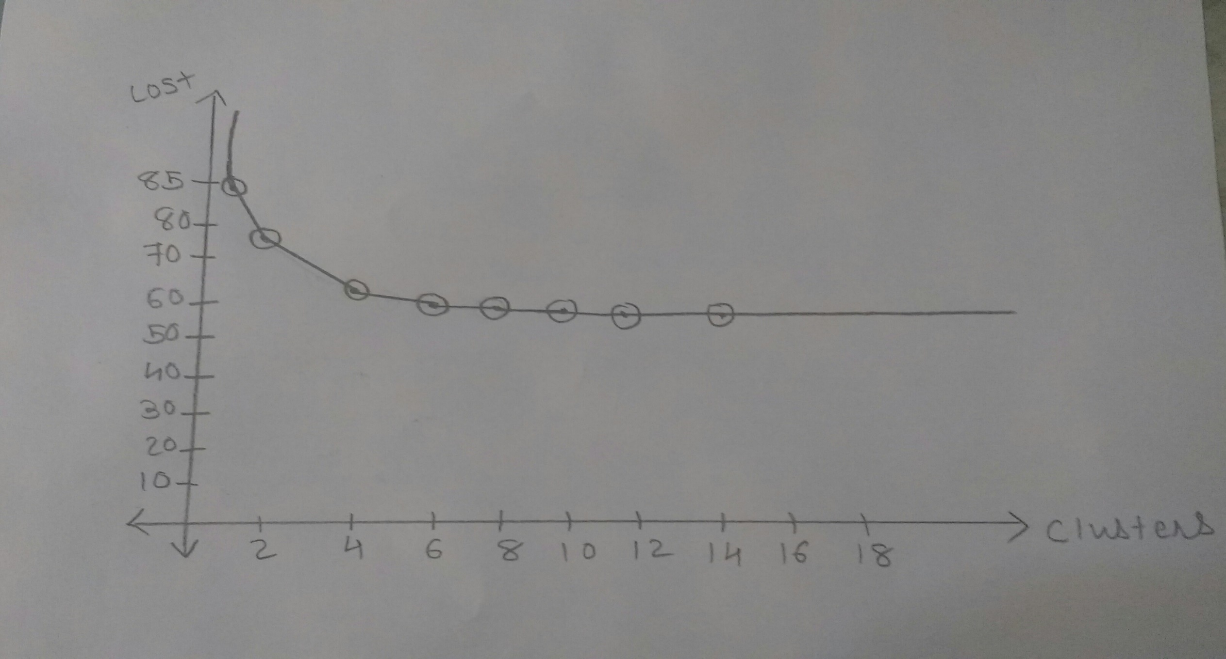
Selection of the numbers of clusters using cost
6 clusters are selected

Slide 10
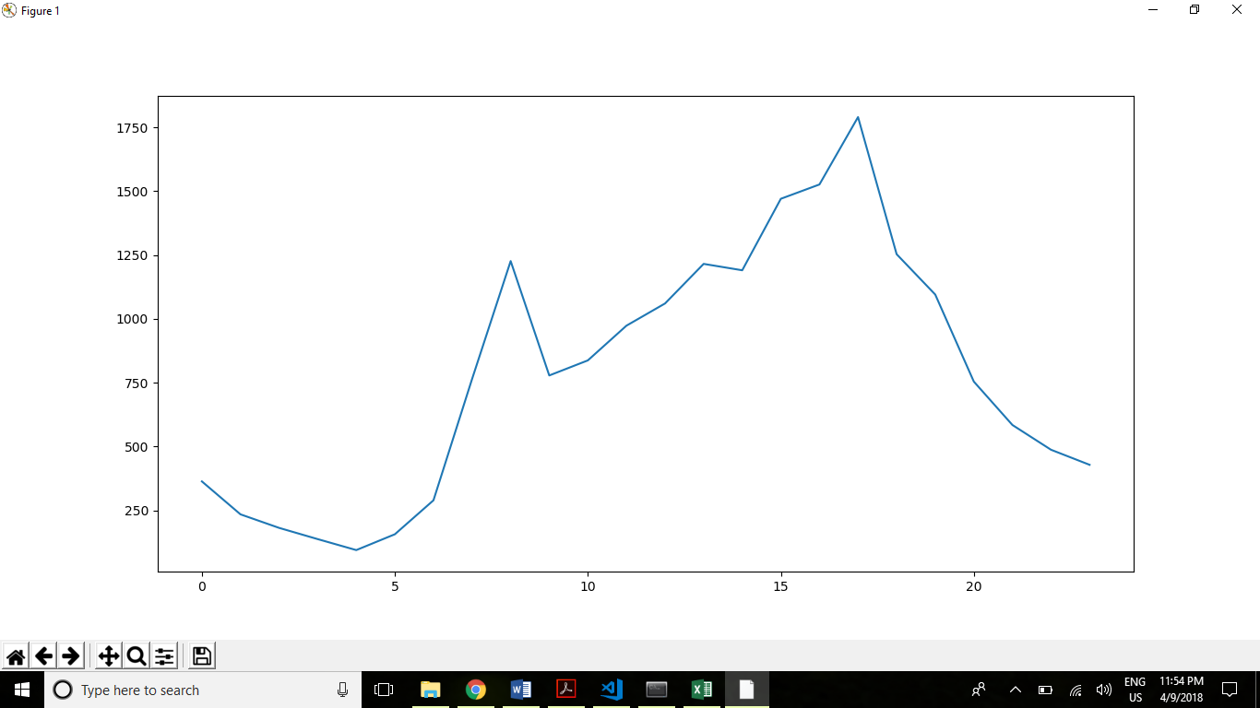
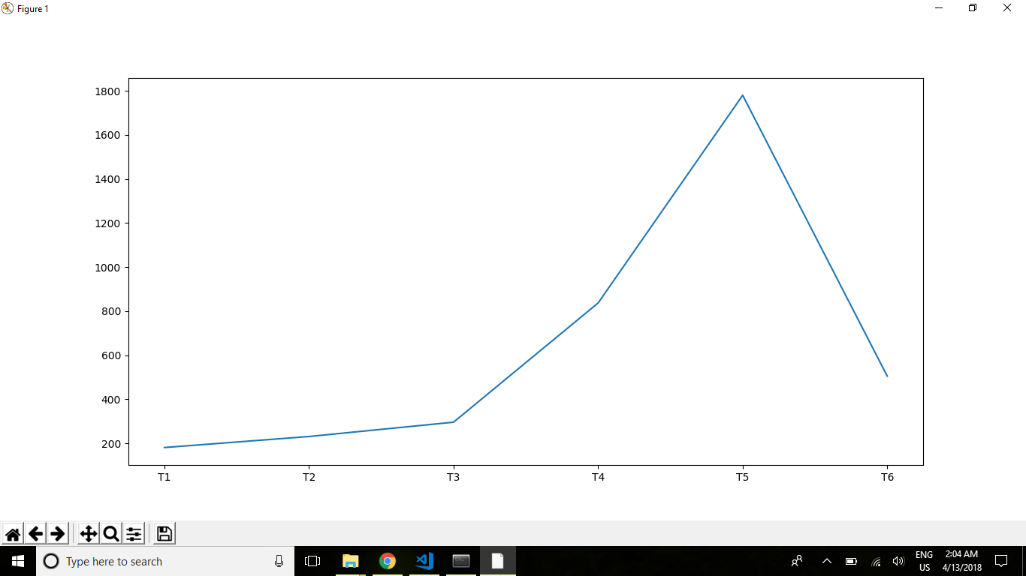
Time of accident chart of full dataset vs cluster 2

Slide 11
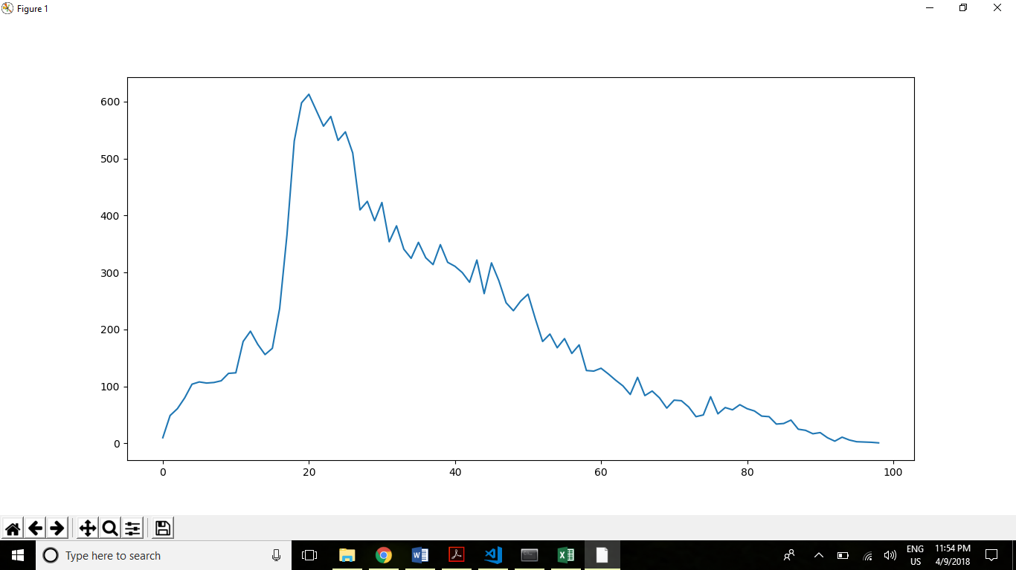
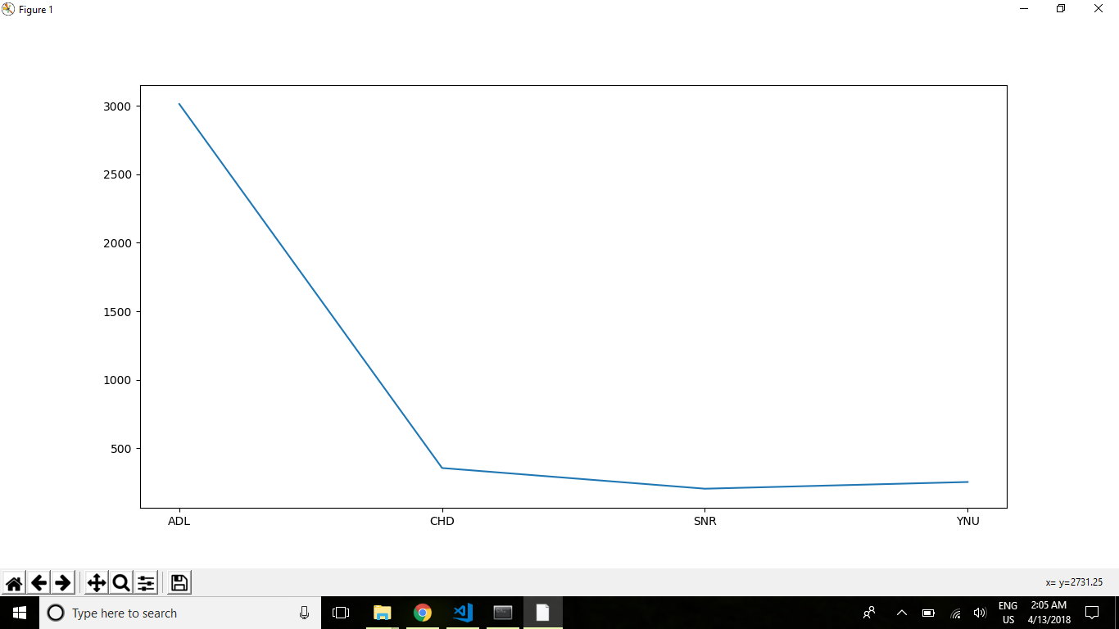
Age group chart of full dataset vs cluster 2

Slide 12
Association Rule Mining
Association rule mining is a very popular data mining technique that extracts interesting and hidden relations between various attributes in a large data set.
I used Apriori algorithm for analysis the association rules on each clusters. The output of the code will show frequent item sets, association rules, support, confidence and lift.
Strong rules with high lift values are taken for the analysis.

Slide 13
Analysis Of Cluster 1 and 2
It consists two wheeler accidents that occurred in summer season. In this cluster above 70% of accidents involved two vehicles and sex of causality of all people is male who are young and adult. The surface of the road is Dry. All accident are occur in daylight and between 12 pm to 8 pm. Around 25% of accident occur in rainy weather. The class of casualty is passenger.
It consists Car accidents that involved passenger as a class of causality. All the passenger as a class of causality are In this cluster. Above 80% of accidents involved two vehicles. All accident are occur in darkness when street light is present and between 4 pm to 8 pm in rainy weather.

Slide 14
Conclusion:
An association rule for Entire Dataset does not reveal enough information that can be important to identify factors affecting road accidents. The rules only show that accidents are scattered at every type of road conditions and does not identify any critical accidents.
Our results show that performing cluster analysis as a preliminary task can identify more important findings which can remain hidden if only entire data set is analyzed.
Only two wheeler accidents are identified in Entire Dataset that satisfies minimum support of 60 %, other accident type remain hidden.

Slide 15
Conclusion:
Forming cluster before rule generation gives various rules that are mainly associated with that cluster, but rules for Entire Dataset only shows a common association for each accident type which is not interesting.
A majority of unknown road feature is there in Dataset rules but after cluster analysis it seems that its impact is associated with few clusters.

