Slide 1

Department of Electronics and Electrical Communication Engineering
IIT KHARAGPUR
BANKING FRAUD DETECTION USING GRAPH NEURAL NETWORK
M. Tech Project Presentation
Supervisor : Prof. Pabitra Mitra
Co-Supervisor : Prof. Arijit De
By : Priyank Mundra
Roll No : 20EC39024
1
Notes:
Good morning, everyone, Firstly My name is Priyank Mundra, a final year student in the department of Electronics and Electrical communication Engineering pursuing my master in Vision and Intelligence Systems.
I want thanks my both of the supervisor, Professor Pabitra Mitra and Professor Arijit De for giving me this opportunity to work under them. My topic for my MTP is Bank Fraud detection using Graph Neural Networks

Slide 2

INTRODUCTION
Rise of Digital Transactions: Modern fraud schemes are becoming increasingly sophisticated, often involving multiple accounts, intermediaries, and hidden transactional patterns.
Objective
Motivation
As financial fraud becomes increasingly structured and relational in nature, conventional methods often fail to capture the underlying transaction dynamics. GNNs provide a principled approach to exploit the graph-structured nature of financial data, motivating their use for more refined and accurate fraud detection.
Develop a robust fraud detection system using Graph Neural Networks (GNNs) to model transaction networks, focusing on identifying suspicious patterns through relational and temporal analysis.
2
Notes:
My objective for this project is predict the node (transaction) in given transaction Heterogeneous graph as Fraud or Not Fraud and in homogeneous Graph node is the user so need to predict whether the user is involved in Fraud or not , basically it is an anomaly detection problem but is a graph. But why we need to do this, there are model which can do the Bank Fraud detection in very effective ways? The reason behind this is existing Techniques only focus on transaction which are from one account to another i.e., This sample only include only two account in it one is sender and one is receiver. Fraudster have found ways which can bypass this type of model very easily, some of these technique include using multiple accounts.
They increase the number of transaction to make it more complex to detect or they move the large amount of the money from one account to another account to not get detect due to large amount of transaction. This is why we made a graph of transaction which will help to include the information of all the connected transactions not just one.

Slide 3
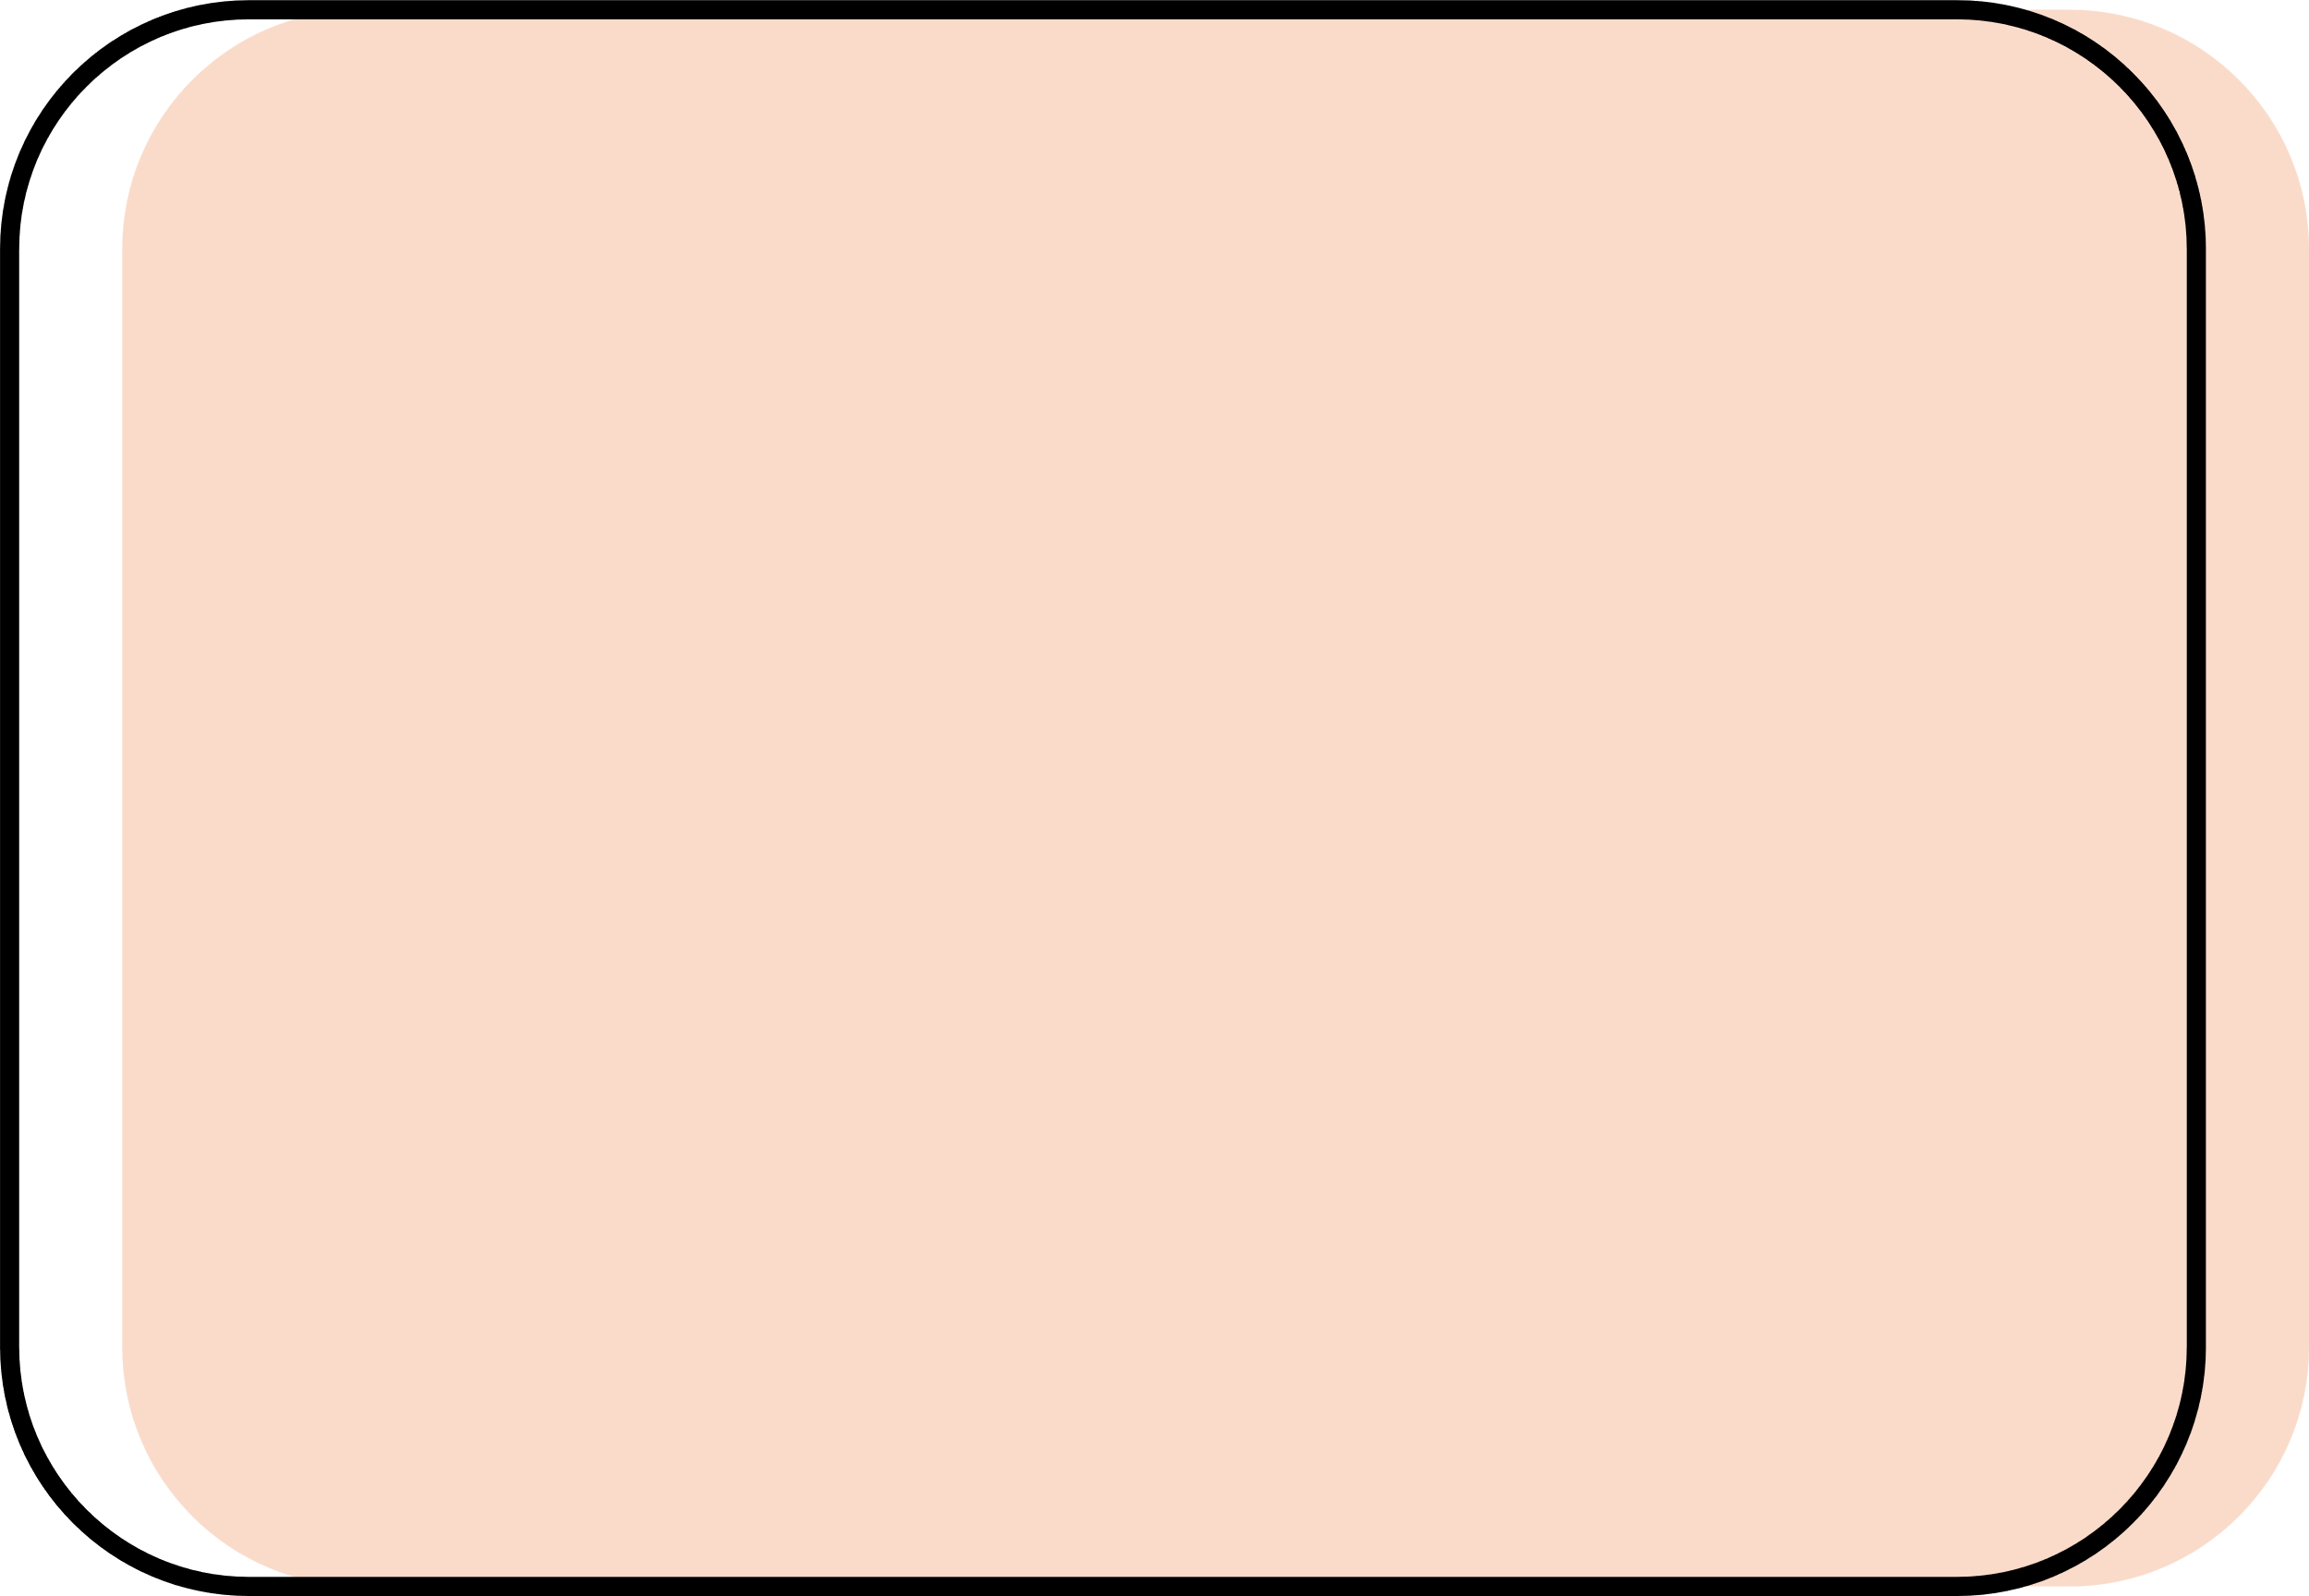
HOW DO WE USE GNN?
How can Graph Neural Networks (GNNs), specifically Graph Attention Networks (GATs) and Spatial-Temporal Aware Graph Transformer (STAGT), improve fraud detection in banking transaction networks?
Project Contribution
Developed a novel framework by modeling financial transactions as graphs, with accounts as nodes and transactions as edges in Homogeneous Graph, to capture complex relational dynamics in banking networks.
Investigated the potential of incorporating temporal dynamics and heterogeneous graph structures to improve the detection of suspicious patterns across diverse transaction scenarios.
Explored the application of GATs and STAGTs to address challenges like class imbalance and feature heterogeneity, focusing on dynamic weighting of transaction relationships through attention mechanisms.
4
Notes:
So we have decided to make a graph, in which node will the users and edge will consist of transaction features, we also have to explore Heterogeneous Graph and how we can include Temporal information in the transaction features since time also play an important role in the Fraud detection, we have used two model one is GAT and second one is STAGT, which is Spatial Temporal Aware Graph Transformer. Here in STAGT we will use GraphSAGE to tackle imbalance behaviors and use attention to weight the edges

Slide 4
DATASET OVERVIEW
Dataset Composition
Contains over 9.5 million banking transactions, labeled as fraud or non-fraud.
Distribution: 9,873 fraud samples (0.1%) and 9,494,979 non-fraud samples (99.9%)
Key Features
Time and date of transactions.
Sender and receiver account identifiers(number).
Transaction amount, payment currency, and received currency.
Sender and receiver bank locations.
Payment type (e.g., cash deposit, online transfer).
Fraud label (binary: 1 for fraud, 0 for non-fraud).
Dataset Utilization
Subset Creation: A smaller, representative subset was created using stratified sampling to address class imbalance and computational constraints, allowing focused model training and evaluation.
Full Dataset: The complete dataset of over 9.5 million transactions was also utilized to validate model scalability and performance in real-world scenarios.
5
Source
Notes:
Lets move to the Dataset overview, I didn’t find any existing Graphical dataset on the internet, so I decided to make it, after doing some research I found a dataset on Kaggle, which have 9.5 million+ transaction rows and it have 0.1% of fraud sample, I also checked whether it is able to make a graphical structure or not, and there exist at least 5000 chain of Transaction which have at least 20 accounts in it.
Since I check it take almost 14 to 15 hrs to create a complete Graph for this much big dataset and it will be also harder for me to run the model every time on this large dataset so I decided to make the dataset smaller since I don’t have that much computational power.

Slide 5
SAMPLING DATASET
Objective: Create a small, representative dataset that supports graph-based analysis for fraud detection.
Focus: Ensure that the dataset captures important connections, particularly for accounts involved in fraudulent activities.
Solution: Carefully select non-fraud samples to maintain representativeness and ensure meaningful graph construction
Original Dataset (9,504,852 samples)
Fraud (9873 samples)
Not Fraud(9,494,979 samples)
Taking all the sample of Frauds (9873 samples)
First Part (Non-Fraud Transaction from Fraud-Associated accounts)
Accounts involved in fraud (either sender or receiver) are included.
Second Part (Non-Fraud Transaction from clean accounts)
Non-fraud transactions from accounts with no prior involvement in fraudulent activities
Taking 40% of size of final dataset i.e., 59238 samples
Taking 60% of size of final dataset i.e., 88857 samples
Final Dataset (9873 Fraud + 148095 (15 times) not fraud samples )
6
Notes:
Our objective is to create a smaller dataset but we cannot randomly select the sample since it should result in making a connected graph, if the graph is not nicely connected then there is no point of using GNN. So, we decided to select all the Fraud sample and get 15 times more Not Fraud sample but we have to select Not Fraud sample carefully….Now explain the flowchart.

Slide 6
GRAPH CONSTRUCTION - Homogeneous Graph
Nodes and Edges
Nodes: Represent accounts (sender or receiver) in the transaction network. Each node captures unique account information for analysis.
Edges: Represent transactions, directed from sender to receiver, illustrating the flow of money between accounts.
Homogeneous Graph (for GAT): All nodes and edges are of the same type, focusing on account-to-account transactions with features like location, currency, and transaction frequency.
User4
Transaction
Node Features:
Account Number: Unique Id for every node
Location: Most frequent sender/receiver location
Currency Type: Most frequent type used (Received/Payment Currency)
Transaction Frequency: Out-degree (transactions sent) and in-degree (transactions received).
Edge Features:
Amount: Transaction size (continuous feature).
Payment Type: Identify Transaction method (Credit, Debit, Cheque)
Date: Date encoded as a continuous feature as a numeric format.
User1
User2
User3
Transaction
Transaction
7
Notes:
We now have a dataset which we can use to make a graph here Node will represent an Account and edge will represent the Transaction between those two account.
Each node has its own feature like: Location, Currency type, Transaction Frequency, : here Location and currency will be multiple so we decided to take the most Frequent one and as for the Transaction Frequency will be the in-degree (Received money) and out-degree (send money) count. In Homogenous Graph user = nodes and edge = transaction
After construction Homogenous Graph construction node have total 6 features with them and edges have 3 feature with them. As for heterogenous Graph there were two type of nodes and edges, node = user-type, taransaction-type , edge = Send-type, Received-type
Here User have

Slide 7
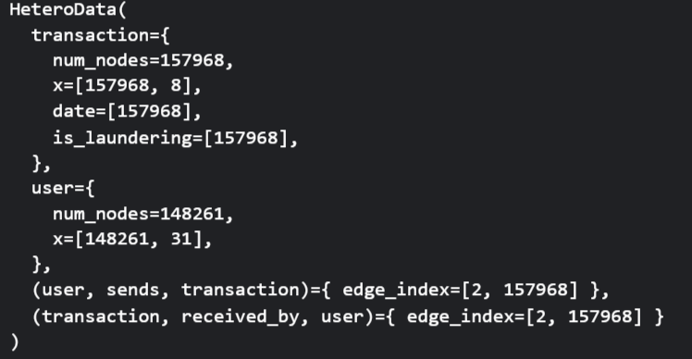
GRAPH CONSTRUCTION - Heterogeneous Graph
Nodes and Edges
This type of Graph have multiple node types i.e., user (Sender and Receiver) and Transaction and edge types (sends, received by), capturing diverse relationships and temporal dynamics.
Heterogeneous Graph (for STAGT): Here the Graph connection is not account to account like in homogeneous, it will be like user (sender) node to transaction node to user node (receiver)
Transaction3
Received By
User3
Sends
User1
Transaction1
Transaction4
Sends
Received By
User2
Sends
Received By
User4
7
Notes:
We now have a dataset which we can use to make a graph here Node will represent an Account and edge will represent the Transaction between those two account.
Each node has its own feature like: Location, Currency type, Transaction Frequency, : here Location and currency will be multiple so we decided to take the most Frequent one and as for the Transaction Frequency will be the in-degree (Received money) and out-degree (send money) count. In Homogenous Graph user = nodes and edge = transaction
After construction Homogenous Graph construction node have total 6 features with them and edges have 3 feature with them. As for heterogenous Graph there were two type of nodes and edges, node = user-type, taransaction-type , edge = Send-type, Received-type
Here User have

Slide 8
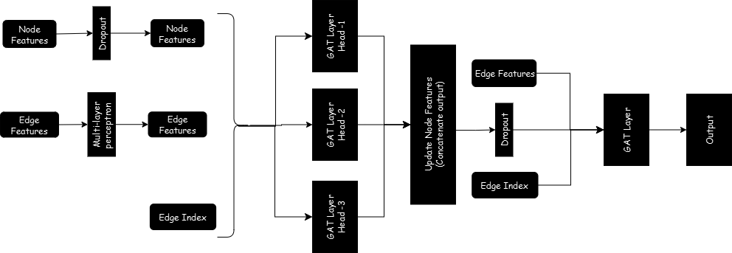
MODEL ARCHITECTURE
Graph Attention Network (GAT):
Comprises two GATConv layers to process node and edge features.
Input: 6 channels (node features like location, currency); Hidden: 16 channels; Output: 2 channels (binary classification).
Uses 3 attention heads per layer to weigh neighboring nodes dynamically, focusing on suspicious transaction patterns.
8

Slide 9
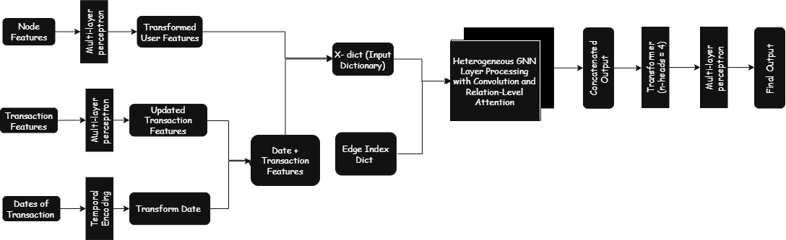
MODEL ARCHITECTURE
Spatial Temporal Aware Graph Transformer (STAGT):
Designed for heterogeneous graphs with user and transaction nodes.
Features temporal encoding for transaction timestamps, initial feature embedding, and multi-layer GNN with relation-level attention.
Incorporates inter-layer fusion and transformer encoder (4 attention heads) for spatial-temporal pattern capture, followed by an MLP for classification.
Key Advantage:
Both models leverage attention mechanisms to prioritize relevant connections, with STGAT excelling in temporal and relational dynamics for fraud detection.
9

Slide 10

METHODOLOGY
Stratified Sampling of Dataset
Preprocessing of
Original Dataset
Graph Construction for both types (Transaction Trials)
Data Cleaning
Feature Extraction
Normalization
Full Dataset
Homogenous
Heterogenous
Training on the train split dataset
Selecting the GNN Models
Time based split of dataset into train(70%) and test(30%)
Full Dataset
Stratified Dataset
GAT
STAGT
Recall
Accuracy
Area under the ROC curve
Confusion Matrix
Harmonic Mean (HM) Score (only for STAGT)
Prediction on test split
Evaluation
10
Notes:
So, this is the whole process of the project After preprocess the dataset such as normalize them remove empty rows, change categorical feature to numerical features, manage the dates of transaction. Since I don’t have much computational power so I decided to make a smaller dataset so I created a small dataset, then Go through the Graph construction while change the feature in such a way that it will help in making Graph, the I decided to use GAT and STGAT model. I have split the dataset into 7:3 ratio. Since The dataset is too much imbalance, I have weight for calculation of loss in this way Fraud sample will have high weightage then Not Fraud sample, without using this weights all node was classified as Not Fraud. I have calculated normal recall, AUC and Accuracy, Also a HM of Accuracy and recall for STGAT model because correct Fraud sample will able to contribute more to recall, and it may effect non-Fraud sample and affect accuracy

Slide 11
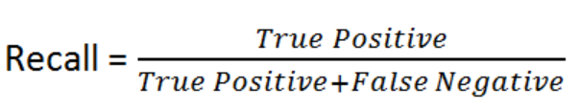
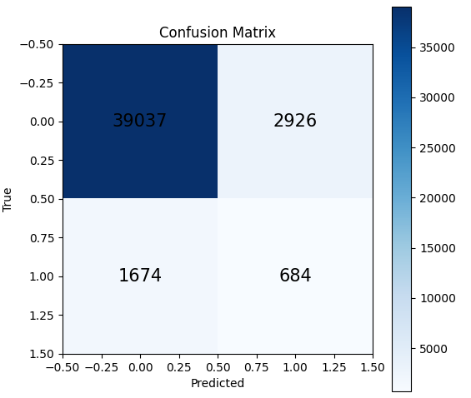
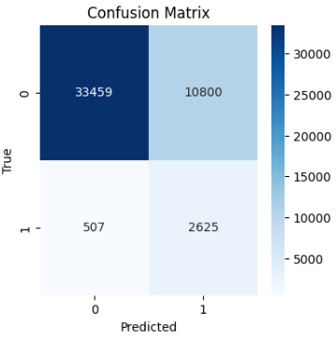
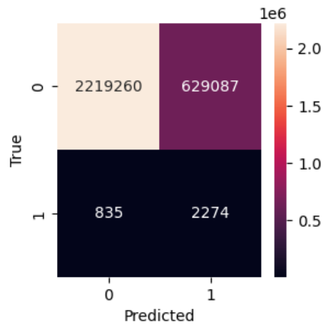
RESULTS
GAT
STAGT
Sampled Dataset
Sampled Dataset
Full Dataset
Recall: 0.29
Recall: 0.8381
Recall: 0.7314
11

Slide 12
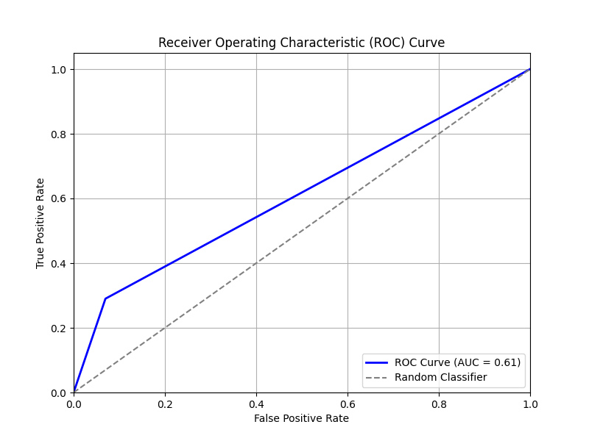
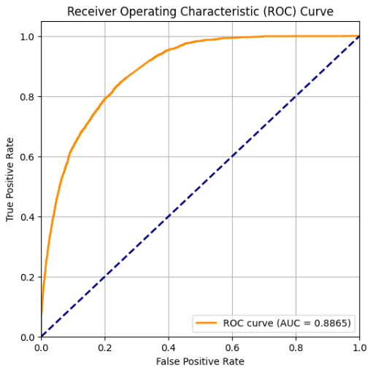
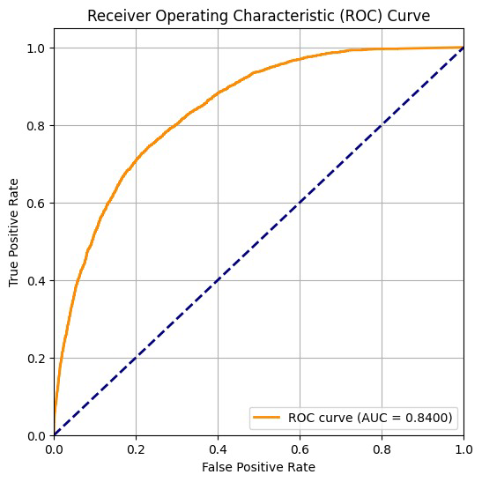
ROC CURVE
GAT
STAGT
Sampled Dataset
Sampled Dataset
Full Dataset
AUC = 0.61
AUC = 0.8865
AUC = 0.8400
12

Slide 13
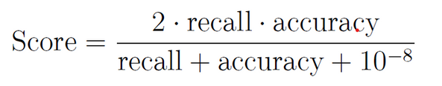
RESULT COMPARISON
Model | Recall | Accuracy | AUC | Harmonic Mean
GAT(Sampled Dataset) | 0.2901 | 0.8962 | 0.61 | 0.4384
STAGT(Sampled Dataset) | 0.8381 | 0.7614 | 0.8865 | 0.7979
STAGT(Full Dataset) | 0.7314 | 0.7791 | 0.8400 | 0.7545
Harmonic Mean (HM):
Used to select the best model checkpoint for STAGT, balancing fraud detection and overall performance.
Incorporates both recall (ability to identify fraudulent transactions) and accuracy (overall correct classifications), ensuring a balanced metric critical for imbalanced datasets like financial fraud.
13

Slide 14

CONCLUSION
Key Findings
Spatial-Temporal Aware Graph Transformer (STAGTs) significantly outperforming Graph Attention Networks (GATs) in identifying fraudulent transactions.
Model Performance
STAGT achieved a high recall of 83.81% and an AUC of 0.8865 on a subset dataset, showcasing its strength in capturing temporal and heterogeneous patterns as critical for fraud detection.
Scalability
On the full dataset of over 9.5 million transactions, STAGT maintained robust performance with a recall of 73.14% and an AUC of 0.84, proving its applicability to real-world, large-scale scenarios.
Challenges
Despite strong fraud detection, STAGT's higher false positive rate highlights operational challenges, necessitating further refinement for practical deployment.
14

Slide 15
FUTURE WORK
Advanced Architectures
Explore sophisticated GNN models like Graph Isomorphism Networks (GINs) or ensemble methods combining GAT, GraphSAGE, and STAGT to enhance detection of diverse fraud patterns.
Subgraph Detection
Develop methods for subgraph-level classification to identify complex fraud trails and community-based schemes, using graph pooling to capture multi-account fraud patterns.
Real-Time Learning
Implement online learning and reinforcement techniques for adaptive, real-time fraud detection, enabling the system to evolve with emerging fraud strategies.
Generative Models
Investigate generative approaches like Graph Variational Autoencoders (GVAEs) to reconstruct incomplete transaction trails and predict potential fraud paths proactively.
15

Slide 16
Department of Electronics and Electrical Communication Engineering
IIT KHARAGPUR
THANK YOU
By : Priyank Mundra
16

