Slide 1





5 - Days Bootcamp on Digital Forensics
“Think before you click”
DefendX
Team Members:
Riddhi Goswami (Leader)
Priyanshi Sadhu
Lavanya Guhe
Maahi Desai
5-Day Bootcamp on Digital Forensics
Final Presentation | 20 February 2026
Gujarat Technological University

Slide 2
PROBLEM STATEMENT
Problem statement:
User frequently click on malicious or phishing links without analyzing the risk, leading to data theft, financial loss, and system compromise.
Existing security tools focus on blocking threats but do not intervene in human decision-making at the moment of click.
Problem Importance:
Phishing is one of the top cyber attack methods globally
Human error is the weakest link in cybersecurity
A single click can expose credentials and sensitive data
Traditional tools protect systems, not user behavior
Current challenges and gaps:
Reactive detection using blacklists
No real-time behavioral interruption
Lack of explainable AI warnings
No psychological awareness integration
Users are not trained at the moment of risk

Slide 3
DOMAIN & RELEVANCE
Domain:
Threat Intelligence
Sub-domain:
Phishing detection
Browser-based threat prevention
Real world relevance/use case:
Prevents phishing attacks on real timeProtects users from fake banking and login pages
Reduces credential theft and identity fraud
Can be deployed in schools, colleges, and corporate environments
Useful for organizations to reduce human-based cyber risks.
Who will Benefit:
Individual internet users
Students and beginners vulnerable to phishing
Corporate employees
IT security teams
Educational institutions
Organizations conducting security awareness training

Slide 4
PROPOSED SOLUTION OVERVIEW
Brief description:
“Think Before You Click” is an AI-powered browser extension that intercepts link clicks, analyzes the URL using a Python-based risk engine, and warns users in real time before they visit potentially malicious websites.
It generates a risk score, explains suspicious patterns, and provides psychological awareness messages to encourage safer decision-making.
Key Objectives:
Detect phishing and suspicious URLs in real time
Provide clear explanation of detected threats
Introduce a decision pause before navigation
Improve user awareness through psychology-based warnings
Reduce human-based cyber security risks
How It Addresses the Problem:
Intercepts link clicks before execution
Uses AI logic to analyze suspicious URL patterns
Identifies phishing indicators (IP usage, long URLs, login keywords, etc.)
Explains why the link is risky instead of just blocking it
Encourages users to think before proceeding

Slide 5
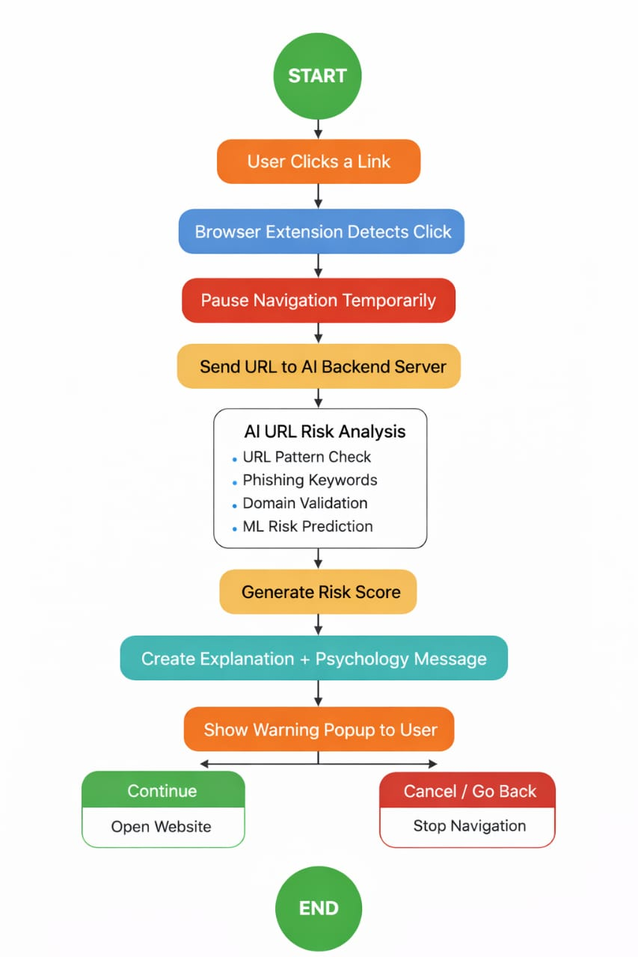
TECHNICAL ARCHITECTURE / WORKFLOW
Key Components
Browser Extension – Detects link clicks and shows warning
Backend API (Flask) – Receives URL and processes request
AI Risk Analyzer – Calculates risk score and explanation
Psychology Layer – Displays awareness message
Data Flow Overview
Click detected
URL sent to backend
AI analyzes URL
Risk score returned
Warning displayed to user

Slide 6
IMPLEMENTATION & TOOLS
Frontend (Extension)
HTML
CSS
JavaScript
Chrome Extension API
Backend
Python
Flask
Implementation Status:
Browser extension created
Link click interception implemented
Backend API developed using Flask
URL risk scoring logic implemented
Warning popup with explanation working

Slide 7
OUTCOME / DEMONSTRATION
Key Findings / Outputs
Real-time interception of link clicks is achievable
Simple URL features can effectively indicate phishing risk
Users are more cautious when shown explanation + awareness message
Behavioral pause increases security awareness

Slide 8
LIMITATIONS & FUTURE SCOPE
Current Limitations
Works mainly as a prototype (local backend server)
No centralized dashboard or logging system
Only browser-level protection
Future Enhancements
Integrate machine learning classifier trained on large phishing datasets
Add real-time domain reputation API integration
Create user risk history dashboard
Add adaptive learning based on user behaviour
Deploy as cloud-hosted backend
Multi-browser support (Chrome, Edge, Firefox)
Scope for Real-World Deployment
Can be deployed in corporate environments for employee protection
Useful in educational institutions for cyber awareness training
Can be integrated with enterprise security systems
Suitable for public cybersecurity awareness programs
Potential SaaS security product for individual users

Slide 9
CONCLUSION
“Think Before You Click” is an AI-powered browser extension that enhances cybersecurity by adding a real-time decision pause before risky link navigation.
It combines AI analysis and psychological awareness to reduce phishing attacks and promote safer online behavior.

