Slide 1

Hotel Management System in C
Efficient hotel operations management using C. Scalable and customizable for various hotel sizes.

Slide 2
Introduction to the HMS
Overview
Purpose
Key Features
Manages reservations, check-ins/check-outs, room service, billing, and guest information.
Automates hotel processes, improves efficiency, and enhances guest satisfaction.
Reservation Management
Guest Management
Room Management
Billing

Slide 3
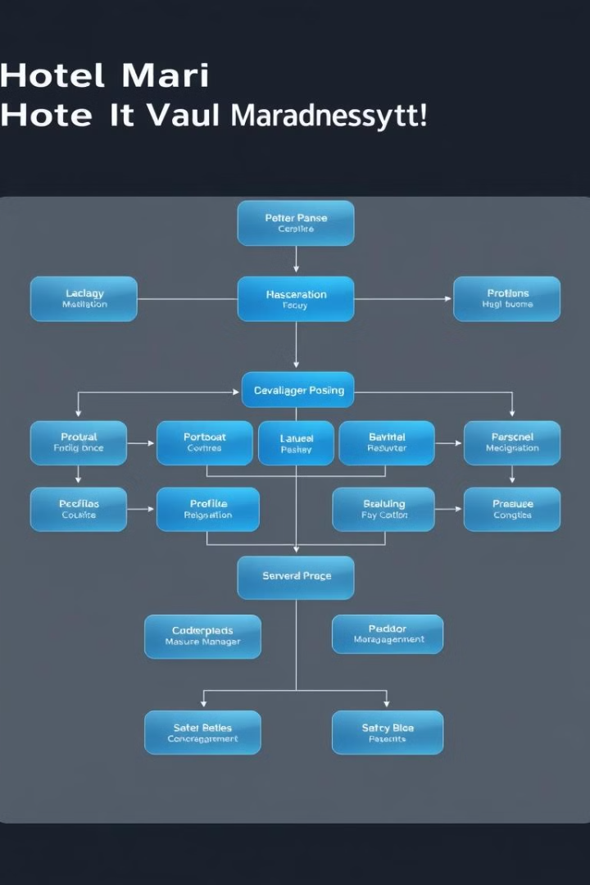
System Design & Implementation
Modular Architecture
Data Structures
Design is modular for easy maintenance and scalability. Includes reservation, guest, room status, and billing modules.
File-based storage, can be extended to databases. Efficient data management.
Key Algorithms
Includes search algorithms for reservation and guest lookup. Enhances operational speed.

Slide 4





Code Overview & Workflow
main()
Central control and menu display. Handles user input and directs operations.
bookRoom()
Handles reservation process. Manages room availability and booking details.
checkInGuest()
Manages guest check-in. Updates room status and guest information.
generateBill()
Calculates billing information. Displays charges and payment options.

