Slide 1
Credit Card Fraud Detection using Autoencoders
Priyanka Balamurugan

Slide 2
Problem Statement
Credit card fraud is a major issue in the financial sector.
Traditional rule-based or supervised methods are not effective when fraud patterns change.
Anomaly detection using deep learning can better identify unusual patterns.

Slide 3
Objective
1. Develop an unsupervised fraud detection system using Autoencoders.
2. Detect anomalies in credit card transactions.
3. Alert stakeholders in real-time when fraud is detected.
4. build a website to upload the transaction history to check if there is fraud.

Slide 4
What I Have Done
1. Collected and preprocessed dataset.
2. Applied robust scaling to features.
3. Built and trained Autoencoder model.
4. Set fraud detection threshold using reconstruction error.
5. Developed Flask web application.
6. Integrated email alert system.

Slide 5
What I Did – Detailed Explanation
1. Data Preprocessing
Loaded the credit card fraud dataset (CSV).
Dropped the Class column (fraud/legit) when preparing input for the autoencoder.
Ensured only numeric columns were used.
Applied RobustScaler to normalize the data (scales without being affected much by outliers).
Saved the list of features in features_list.joblib so that the model always expects the same input columns.

Slide 6
What I Did – Detailed Explanation
2. Model Architecture (Autoencoder)
Built a deep autoencoder neural network using TensorFlow/Keras. Structure:
Encoder: Compresses high-dimensional transaction data into a smaller latent space.
Decoder: Reconstructs the original input from the latent space.
The idea:
For normal transactions → the reconstruction error (difference between input & output) is low.
For fraudulent transactions → error is higher because the model fails to reconstruct unseen patterns

Slide 7
What I Did – Detailed Explanation
3. Training
Trained the model only on non-fraudulent transactions (Class = 0).
Loss Function: Mean Squared Error (MSE) → measures how well the model reconstructs.
Optimizer: Adam.
Saved the trained model as best_autoencoder.keras.

Slide 8
What I Did – Detailed Explanation
4. Fraud Detection Logic
For each new uploaded file:
Apply same feature engineering & scaling.
Feed into trained autoencoder → get reconstructed output.
Calculate reconstruction error (MSE) for each row.
Find threshold using the 95th percentile of errors → anything above it is flagged as fraud.
Added new columns:
recon_error → reconstruction error.
fraud_flag → 1 if fraud, 0 if normal.

Slide 9
What I Did – Detailed Explanation
5. Flask Web Application
Frontend:
index.html → upload CSV file.
results.html → displays results with fraud count, threshold, and full table.
Backend Routes:
/ → home page.
/upload → processes file, runs fraud detection, and shows output.

Slide 10
What I Did – Detailed Explanation
6. Email Alerts
If fraud is detected → triggers send_email_alert().
Sends an automated email notification using SMTP (via university email ID).
Subject: "Fraud Alert", Body: number of frauds detected.

Slide 11
Dataset Details
• Dataset: Kaggle Credit Card Fraud Detection Dataset.
• Records: 284,807 transactions.
• Features: 30 (anonymized + Time & Amount).
• Fraudulent Transactions: 492 (0.172%).

Slide 12
Output
• Web application to upload transactions CSV.
• Fraud detection based on reconstruction error.
• Results displayed with fraud count.
• Email alerts sent when fraud is detected.

Slide 13
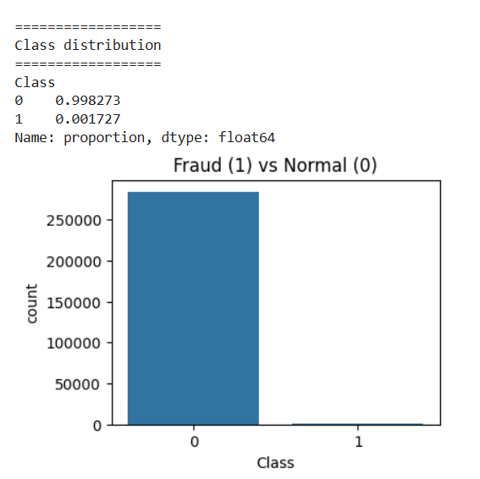
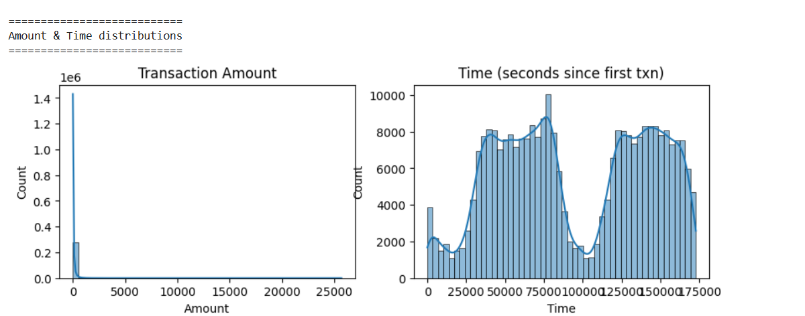
Output

Slide 14
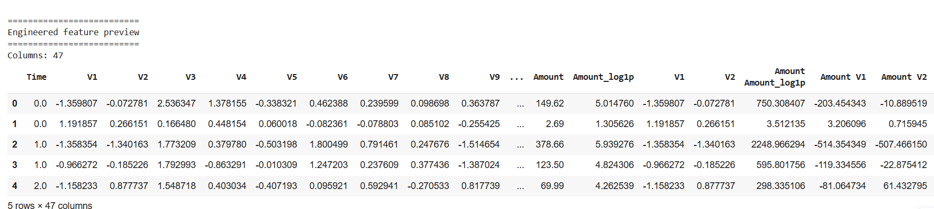
Output

Slide 15
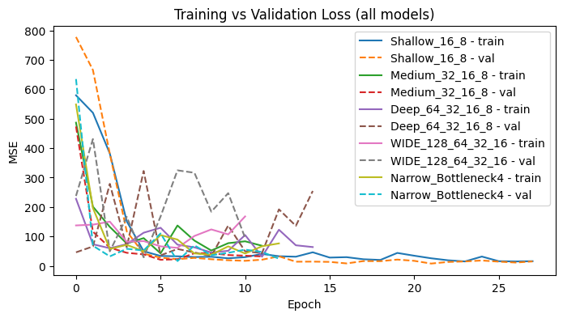
Output

Slide 16
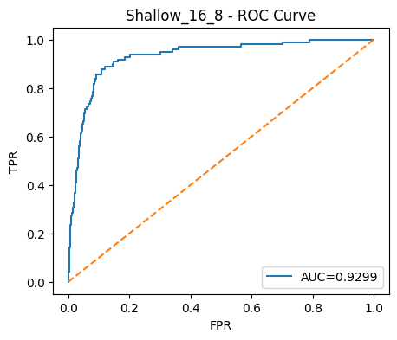
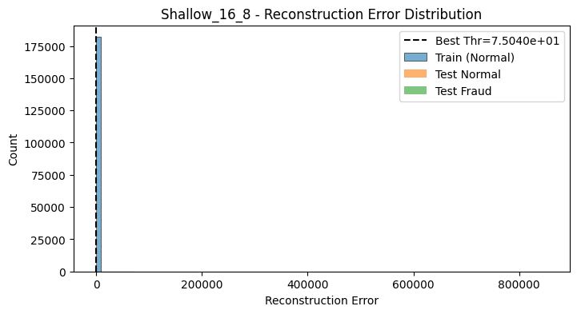
Output

Slide 17
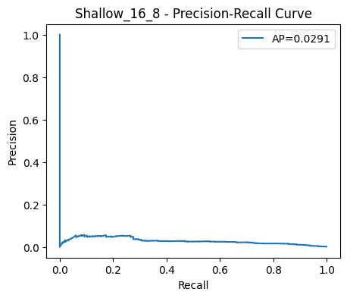
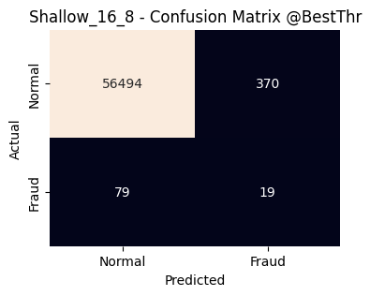
Output

Slide 18
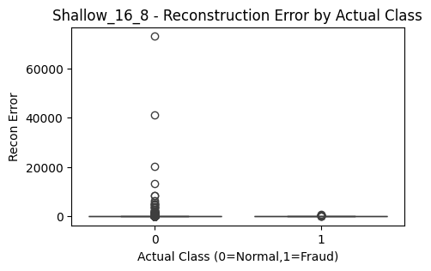
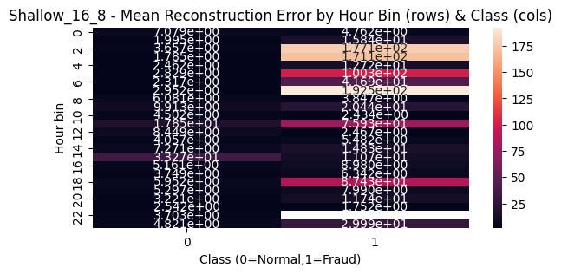
Output

Slide 19
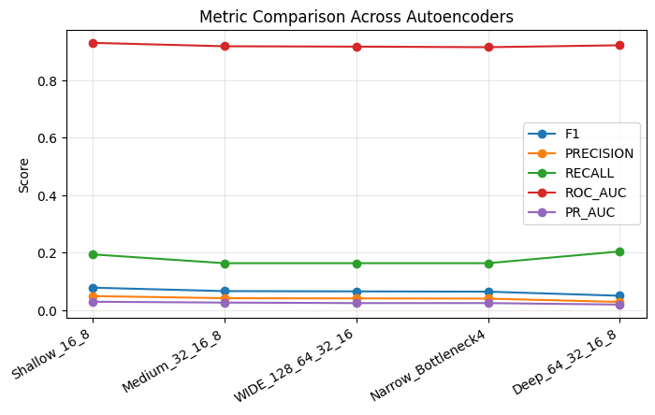
Output

Slide 20
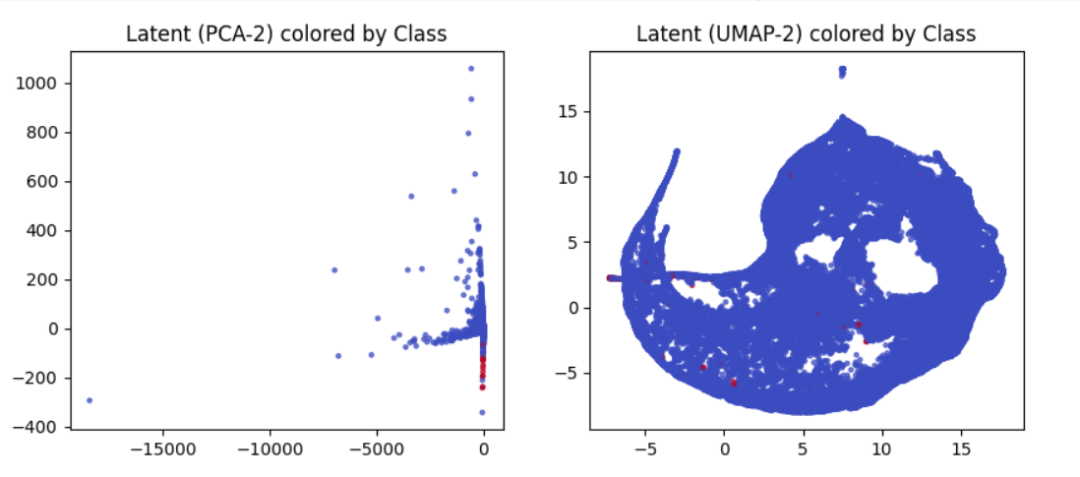
Output

Slide 21
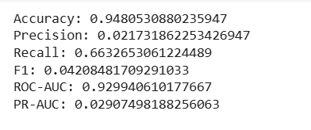
Output

Slide 22
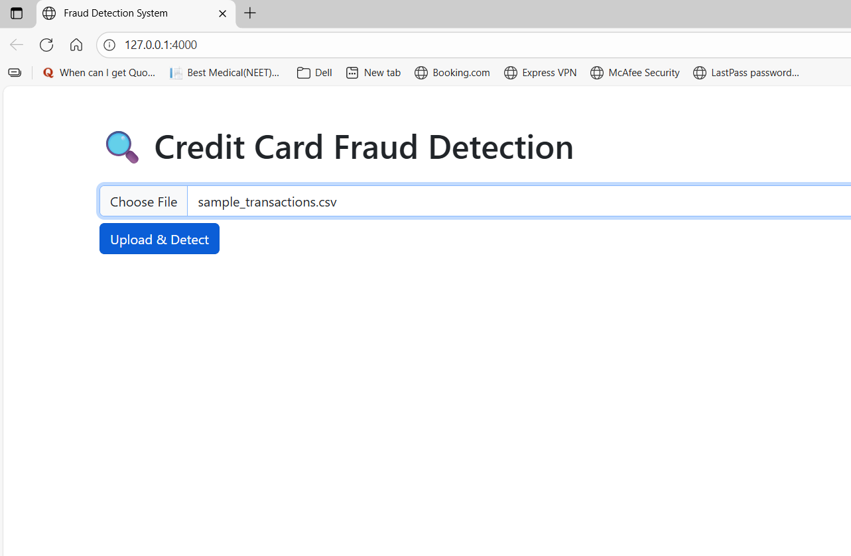
Output: Website

Slide 23
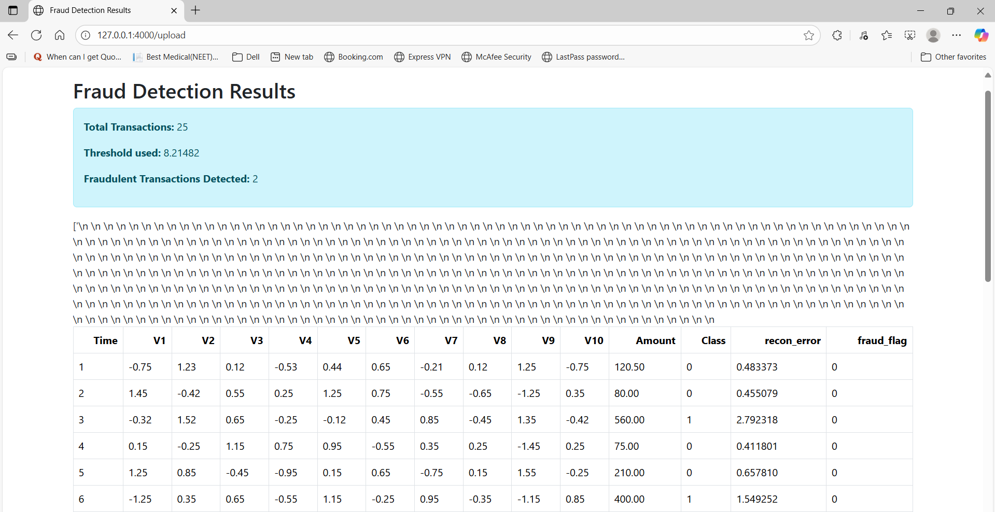
Output: Website

Slide 24
Drawbacks
1. High dependency on reconstruction error threshold.
2. Model performance decreases with unseen fraud types.
3. Limited interpretability of deep learning results.

Slide 25
Future Plans
1. Improve model with hybrid deep learning + supervised methods.
2. Deploy system on cloud for real-time fraud monitoring.
3. Incorporate explainable AI for interpretability.
4. Extend system to multi-bank fraud detection.

