Slide 1
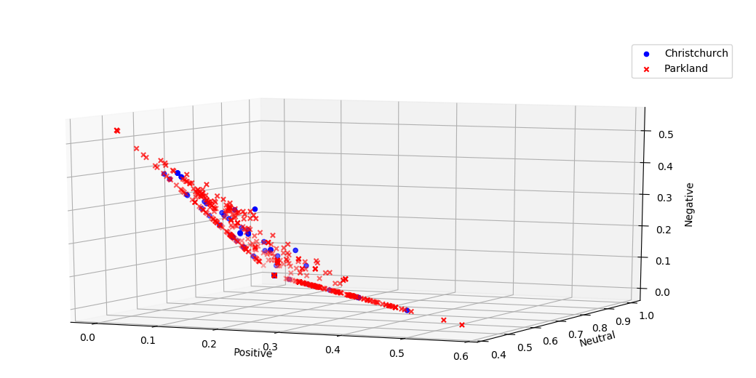
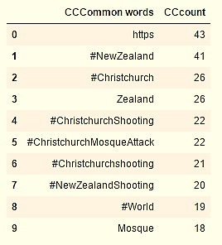
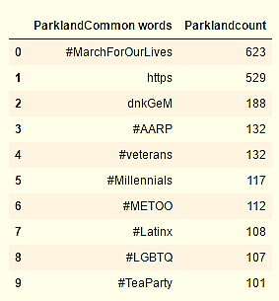
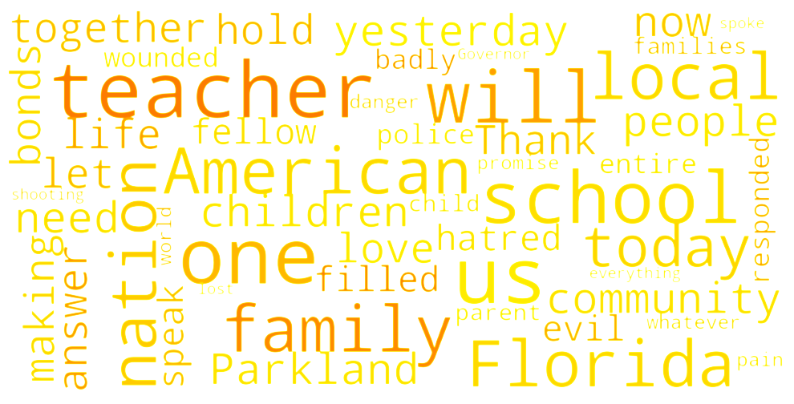
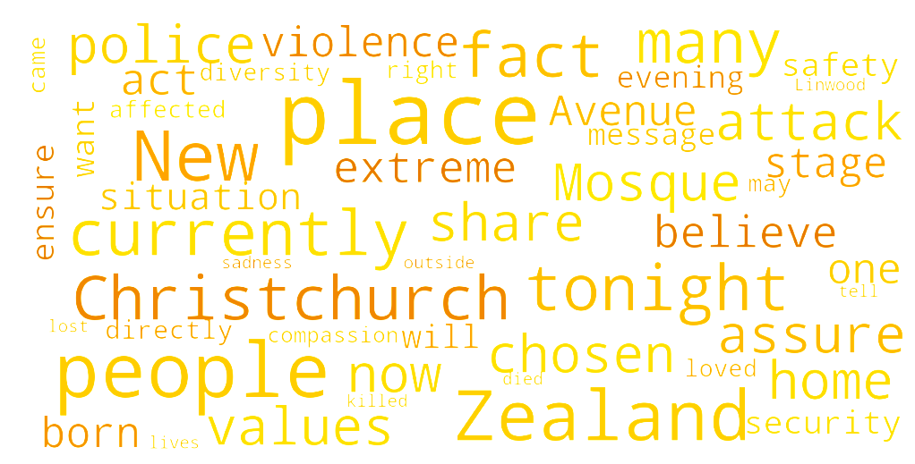
INTRODUCTION
The higher rate of gun violence has certainly raised a lot of questions on the issue of public safety around the world. Some question the gun control laws whereas some blame the mental health of the shooter. Some people have categorize these as an act of terrorism and some just think it is act of violence.
OBJECTIVE
The main objective of this project is analyze the how twitter reacted to two major gun violence incidents of current times: Parkland Shooting in US and Christchurch shooting in New Zealand. This project also analyzes the speeches of the leaders of these two countries addressing the matter.
Twitter Reacts: Gun Violence
By: PRIYANKA KHANAL
s524702@nwmissouri.edu
METHODS
10000 tweets each with hashtags “#parklandshooting” and “#christchurchshooting” was pickled to analyze.
Sentiment analysis was done and compared in those tweets.
Sentiment Analysis was performed on the collected and cleaned tweets.
“10 Most frequently used words” from the tweets was printed in a table
The speech given by leaders of both countries was converted into a text file and word cloud was generated.
CONCLUSION
Tweets related to both the incidents were mainly positive or neutral with the exception of few.
Hashtags used in parkland shooting were focused on other movements which was not related to the shooting but Christchurch shooting was focused on the incident.
Word cloud generated from the speech of two leaders shared very similar sentiment of grief and community
RESULTS
Result 1: Sentiment Analysis Result 2: Most commonly used words Result 3: What do the Leaders think
President of United States Donald J. Trump addressing the nation after Parkland Shooting
Prime Minister of New Zealand Jacinda Arden addressing the nation after Christchurch Shooting

