Slide 1
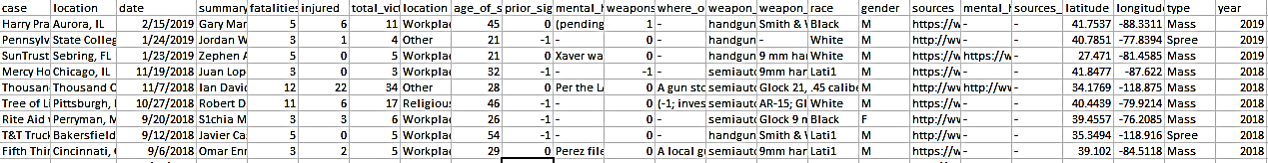
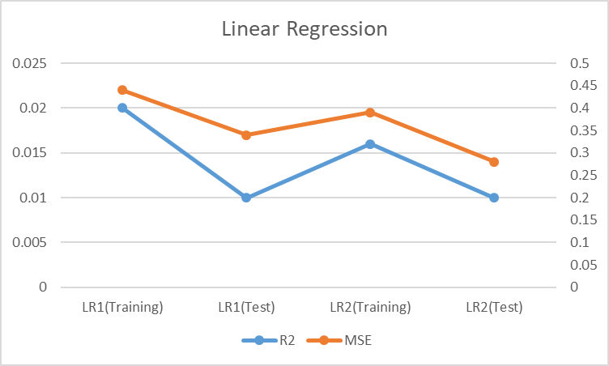
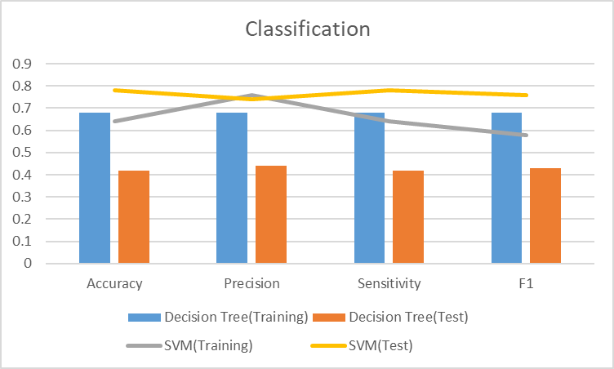
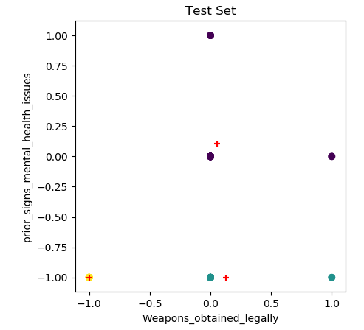
INTRODUCTION
Investigative Assistance for Violent Crimes Act of 2012 classifies an incident as mass shooting if the number of casualties is at least 3. In recent years the number of mass shooting has been rising significantly. According to the analysis of Mother Jones’ data, the rate of mass shooting has tripped since 2011. After every mass shooting incident, there is a discussion of mental health of the shooter and how was the gun obtained.
METHODS
Source: Mother Jones’ (mass shooting from 1982-2019)
Features: 24 columns(both numeric and categorical), 110 rows
6 columns were dropped and non of the rows had empty attributes
Data Split- 70% training and 30% test
X-feature: total victims; Y-feature: prior_signs_mental_health_issues
Machine learning algorithms : Support Vector Algorithms (SVM) and Decision Tree Classifier to calculate the metrics
Clustering of weapons_obtained_legally and prior_signs_mental_health_issues
OBJECTIVE
The main objective of this project is to see if we can find a correlation between number of casualties and mental health of the shooter and how obtaining the firearm legally affects the number of victims.
MASS SHOOTING AND
MENTAL HEALTH
By: PRIYANKA KHANAL
(s524702@nwmissouri.edu)
DRAWBACKS
The model is under fitted because of smaller dataset.
There were several undermined data points which may have played a role in the prediction.
The accuracy of the model can’t be fully trusted because of the possibility of under fitting.
RESULTS
Result 1: Linear Regression Result 2: :Classification Result 3: Clustering of Test Set
CONCLUSION
A smaller relation between total victims and prior history of mental health and the relationship even decreased when weapons obtained legally was added.
SVM classifier gives better result that Decision Tree in this model.
There is no relation between prior signs of mental health and obtaining weapon legally.
REFERENCES
https://www.gunviolencearchive.org/methodology
https://www.motherjones.com/politics/2012/12/mass-shootings-mother-jones-full-data/
https://www.cato.org/blog/are-mass-shootings-becoming-more-frequent

